Slide 1
RNA-Seq Basics: Generating and processing raw sequence data using Nanopore technology and CyVerse tools
Andrew D. L. Nelson
Research Scientist (UofA)/Assistant Professor (BTI)

Slide 2
Introduction and goals
I am a CyVerse “Power User”
My key words would be “plants, transcriptomics, comparative genomics, transcriptional regulation, stress biology, long non-coding RNAs”
Goals for today:
Briefly introduce Nanopore mRNA sequencing
Familiarize you with the tools for a basic workflow to analyze ONT sequencing data in CyVerse’s Discovery Environment
Preparing data for differential expression
Genome Browser visualization

Slide 3
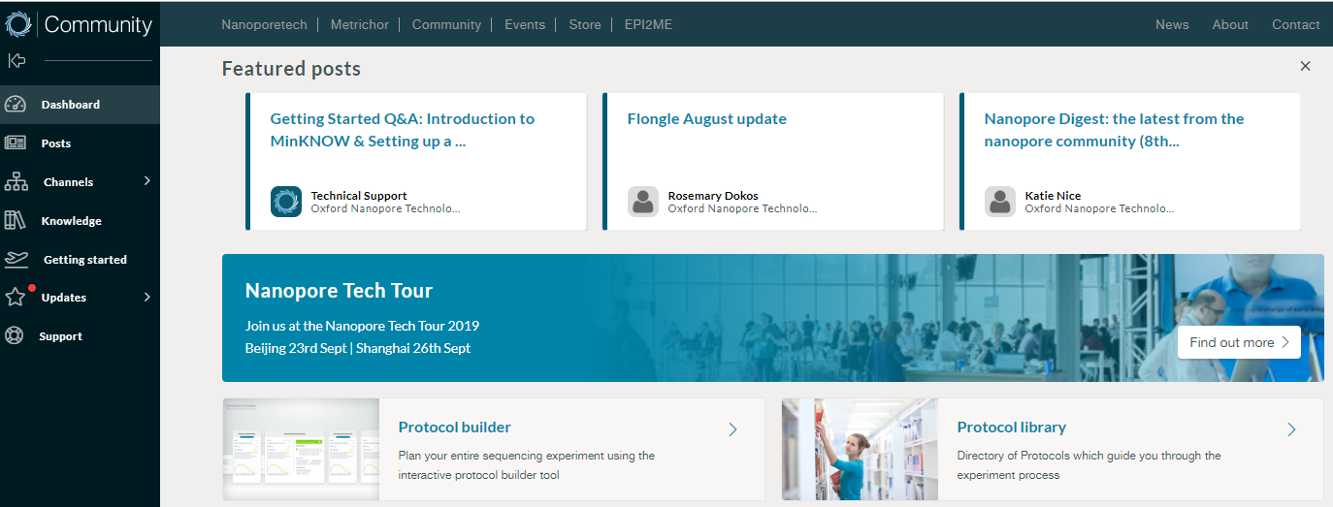
But before we begin - some resources:
https://community.nanoporetech.com/ (crucial)
Tips for preparing your Nanopore libraries and for analyzing data
My email: andrew.d.l.nelson@gmail.com
The Discovery Environment: https://de.cyverse.org/de/
RTD of today’s webinar:
https://cyverse-nanopore-rnaseq-workflow.readthedocs-hosted.com/en/latest/

Slide 4
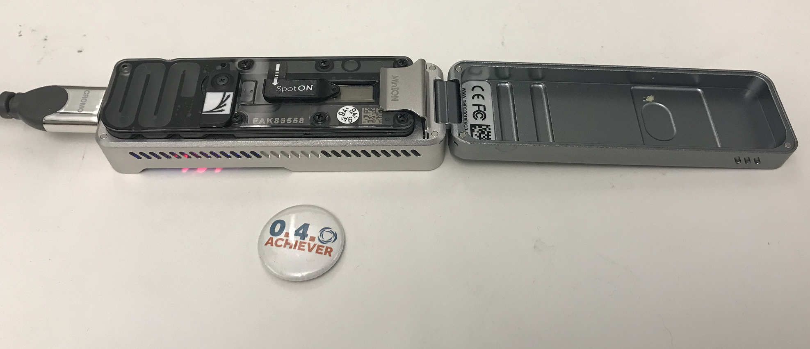
Welcome to Nanopore sequencing
???

Slide 5
Welcome to Nanopore sequencing
Oxford Nanopore Technologies mRNA sequencing provides the following advantages over traditional short read sequencing:
Full length, stranded sequencing
Better isoform resolution
Identification of antisense transcripts
Elucidation of RNA-base modifications
Identify post-transcriptional modifications without having to employ special antibodies or detection algorithms
Just like short read sequencing, ONT allows you to:
Perform differential expression
Identify novel genes without a genome
Importantly, ONT sequencing is fast and (relatively) easy
What do we do with all of this power?

Slide 6
General workflow: RNA to read counts
Steps to consider before you come to the Discovery Environment (DE):
RNA extraction
Library preps (we can talk about this after)
Sequencing
Basecalling (Guppy; we can talk about this after as well)
Data processing and analysis within the DE:
Generate a transcript file from genome annotation (gffread)
Map to a transcriptome (Graphmap/Minimap2)
Convert output SAM to sorted BAM (Samtools)
Count reads mapped to each transcript (Salmon)
Differential expression test using YFA (your favorite algorithm)
Visualization of your data in EPIC-CoGe

Slide 7
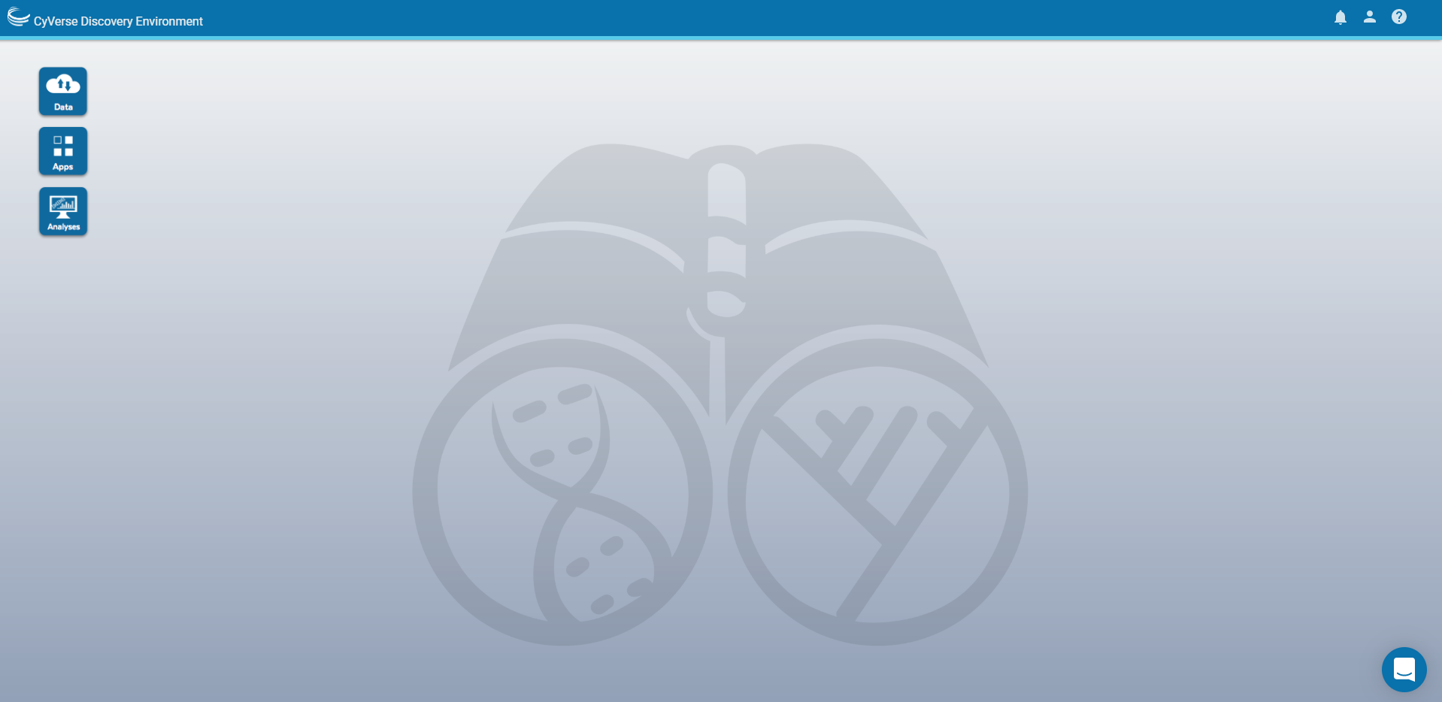
Workflow – from reads to DEx/visualization
3. Sort your mapped reads to a Salmon-readable format
4. Count the number of ONT reads mapped back to each gene
1. Generate a transcript only FASTA file
2. Map your ONT reads to known transcripts
5. Perform differential expression tests in Rstudio in the cloud
6. Visualize your mapped reads in EPIC-CoGe
SUCCESS/SCIENCE/NATURE/IGNOBLE PRIZE!1!
Also, thanks to the science analysts at CyVerse who implement these tools in the DE!

Slide 8
Let’s start analyzing our sequencing data! Consolidating the necessary files
Data required
Genome and genome annotation file (available in the DE for many species)
OR
Reference transcript file (FASTA)
Upload your sequencing data (and reference transcripts if necessary) to CyVerse’s Data Store
CyberDuck (https://wiki.cyverse.org/wiki/display/DS/Using+Cyberduck+for+Uploading+and+Downloading+to+the+Data+Store)
Direct upload from within Discovery Environment

Slide 9
Let’s start analyzing our sequencing data! Generating a reference transcriptome using the GFFread app
Many genomes are available in the DE at
/iplant/home/shared/iplantcollaborative/genomeservices/builds/1.0.0/24_77
http://cole-trapnell-lab.github.io/cufflinks/file_formats/#the-gffread-utility

Slide 10
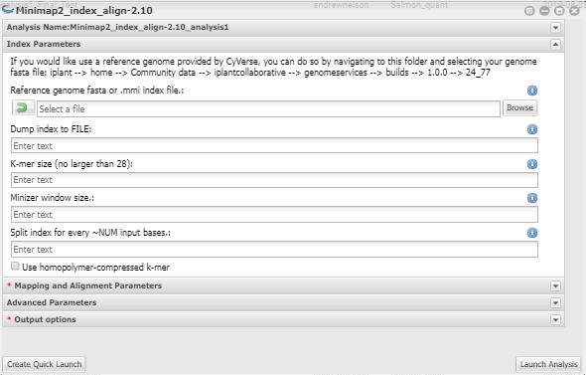
Mapping Nanopore reads to a transcriptome with the MiniMap2 App
Let’s launch two jobs –
one with the reference genome (for visualization)
Another with the reference transcriptome (for differential expression)
https://lh3.github.io/minimap2/minimap2.html
https://wiki.cyverse.org/wiki/display/DEapps/Minimap2_index_align-2.10

Slide 11
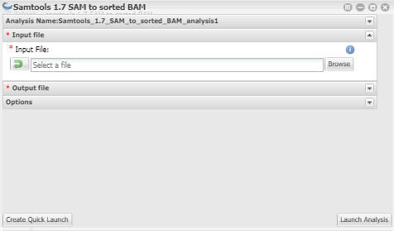
Converting MiniMap2 SAM output to sorted BAM with the Samtools app
http://www.htslib.org/doc/samtools-1.2.html

Slide 12
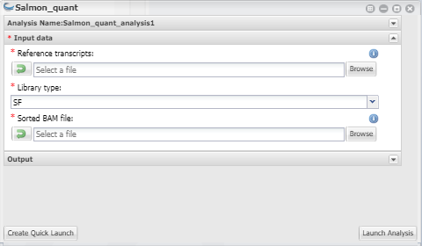
Counting reads with the Salmon_quant App
Salmon is a tool that counts the number of reads mapped to a particular locus.
In this case, we are asking Salmon to tell us how many reads in the sorted BAM file map back to our transcriptome we generated with gffread.
https://salmon.readthedocs.io/en/latest/salmon.html#quantifying-in-alignment-based-mode

Slide 13
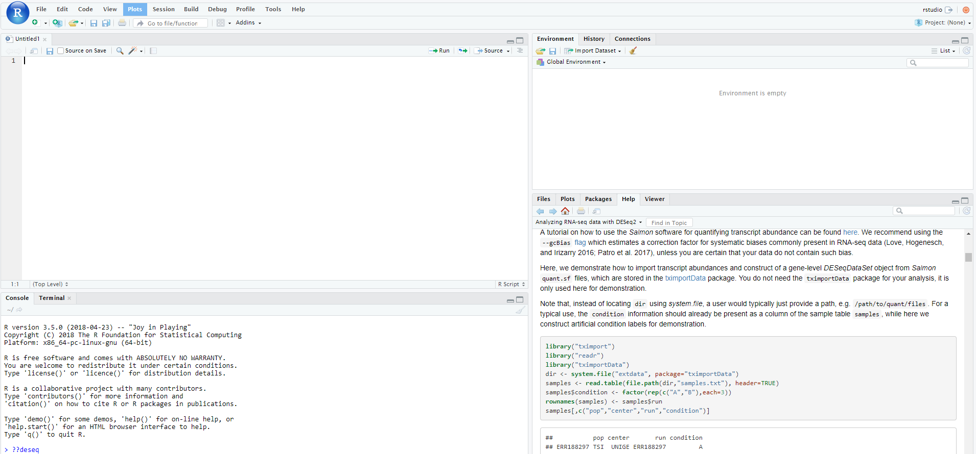
What’s next? Channeling VICE in the DE
VICE = Visual Interactive Computing Environment
VICE apps allow us to launch third party environments (Jupyter labs, Rstudio) from within the DE.
This allows you to perform standard R-based analyses on your data without local downloads (or installs).
https://learning.cyverse.org/projects/vice/en/latest/getting_started/about.html

Slide 14
Visualizing your Nanopore data in EPIC-CoGe
CoGe contains many useful tools for visualizing your data or performing comparative genomic analyses.
CoGe is directly linked to your data in CyVerse’s Data Store (you have a coge_data folder).
CoGe and CyVerse use the same user authentication system (one password/user ID for both).
You can upload the reads you mapped to the genome into CoGe for visualization
www.genomevolution.org

Slide 15
It’s as easy as that!
CyVerse is supported by the National Science Foundation under Grants No. DBI-0735191, DBI-1265383 and DBI-1743442.

Slide 16
Library preps: some tips for improving sequencing depth
The library prep protocols are going to take much longer than advertised (that’s okay, plan for it)
Any step that says to incubate on a Hula (rotator) mixer for 5 minutes:
Incubate for 20 minutes stationary at RT.
10 minutes on rotator.
Pelleting steps (AMPure XP beads) should be for 5 minutes.
Resuspension steps should be for 20 minutes (instead of 10) stationary, then 10 on rotator.
Adaptor concentration is critical (e.g., for the SQK-DCS109 kit).
Most of your mRNAs are not going to be 8 kb!
Use 0.2 pmoles of cDNA (calculated from qubit measurements)

Slide 17
An aside about basecalling with Guppy
Must be performed locally – not on the DE (and may already be performed for you).
CPU version available for all platforms.
GPU (much faster, 30-100x) version available for linux.
Useful when processing a lot of reads (transcriptome) or long reads (genome).
Not as crucial for mRNA sequencing.
If you go this route, use the Docker container system.
Docker v19.03 passes GPU information directly to your container.
A guppy container is available at https://hub.docker.com/r/andrewdlnelson/guppy_gpu
For more info about running Guppy, visit (Nanopore login required): https://community.nanoporetech.com/protocols/Guppy-protocol/v/gpb_2003_v1_revm_14dec2018/guppy-basecaller-and-guppy-basecaller-server
For more info on the GPU setup I use (thanks to Tyson Swetnam @ CyVerse:
https://wiki.cyverse.org/wiki/display/~tyson_swetnam/Workstation+Build

