Slide 1
The iPlant Collaborative
Community Cyberinfrastructure for Life Science
Tools and Services Workshop
Discovery Environment Overview

Slide 2
Welcome to the Discovery Environment
A Simple Interface to Hundreds of Bioinformatics Apps, Powerful Computing, and Data

Slide 3
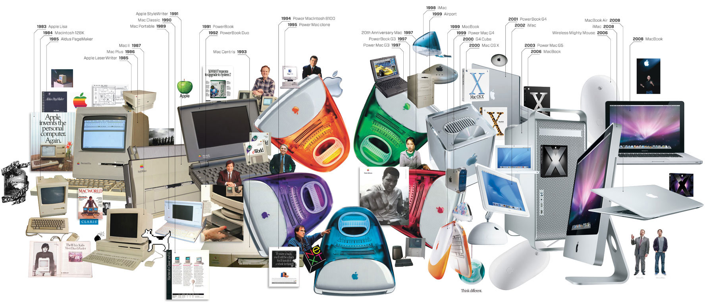
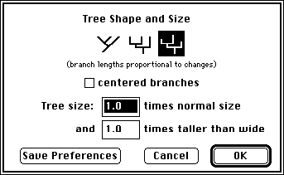
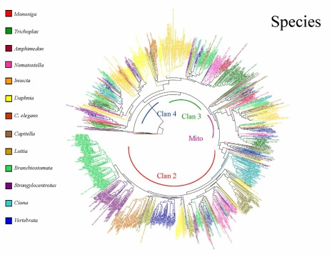
Discovery Environment Overview
A bench-biologist’s view on the evolution of computing
It can be difficult to keep up!
Investing in newer ‘better’ tools and resources is expensive.
?
Image From: http://www.wired.com/wired/archive/17.01/ff_mac_viewer.html

Slide 4
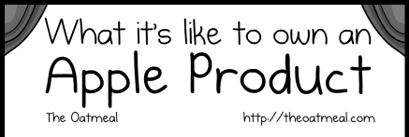
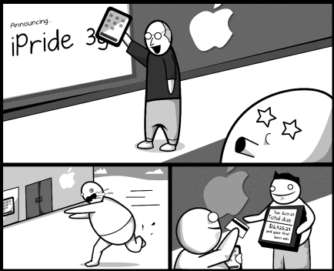
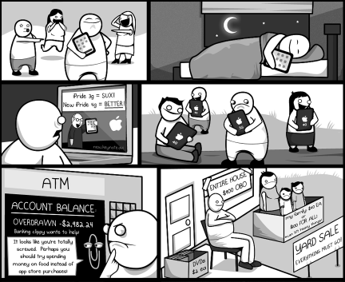
Discovery Environment Overview
The costs of keeping up with technology
Image From: http://theoatmeal.com/comics/apple

Slide 5
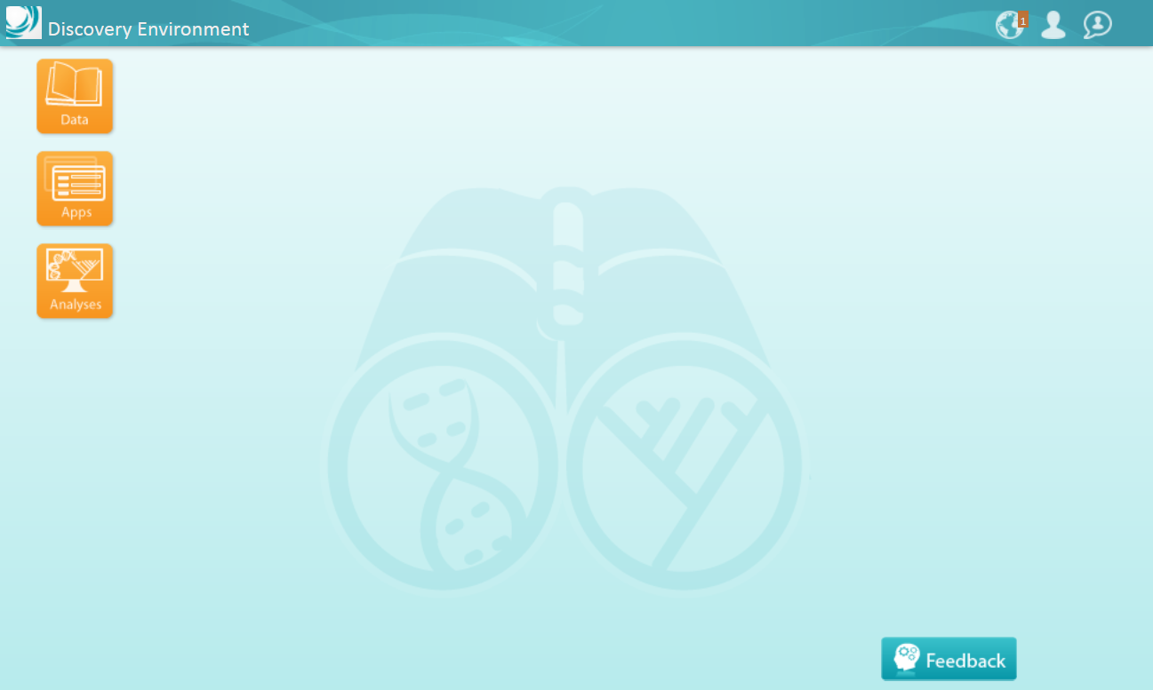
Discovery Environment Overview
Access your computational science through a single portal

Slide 6
Discovery Environment Overview
Manage data
Data
Upload / Download files and folders
Share files via URL (Public Links)
Share files/folders with other users

Slide 7
Discovery Environment Overview
Analyze data and customize Applications
Apps
Run hundreds of bioinformatics Apps
Build automated workflows
Modify Apps or integrate new ones

Slide 8
Discovery Environment Overview
View history, find results, reproduce analyses, optimize parameters
Analyses
Monitor job status and find results
Cancel jobs or re-launch jobs
Detailed job history

Slide 9
Discovery Environment Overview
Leverage dedicated support and training
Support
iPlant Ask forums
Tell iPlant about your needs

Slide 10
Discovery Environment Overview
Quick Tour 1 – Navigating the DE and running analyses

Slide 11
Discovery Environment Overview
Hands-on demo: Create a multiple alignment
By the end of this demo you will know how to:
Navigate the components of the DE
Access and manipulate data (upload, download, move, etc.)
Find and run analyses
Track analyses and view results

Slide 12
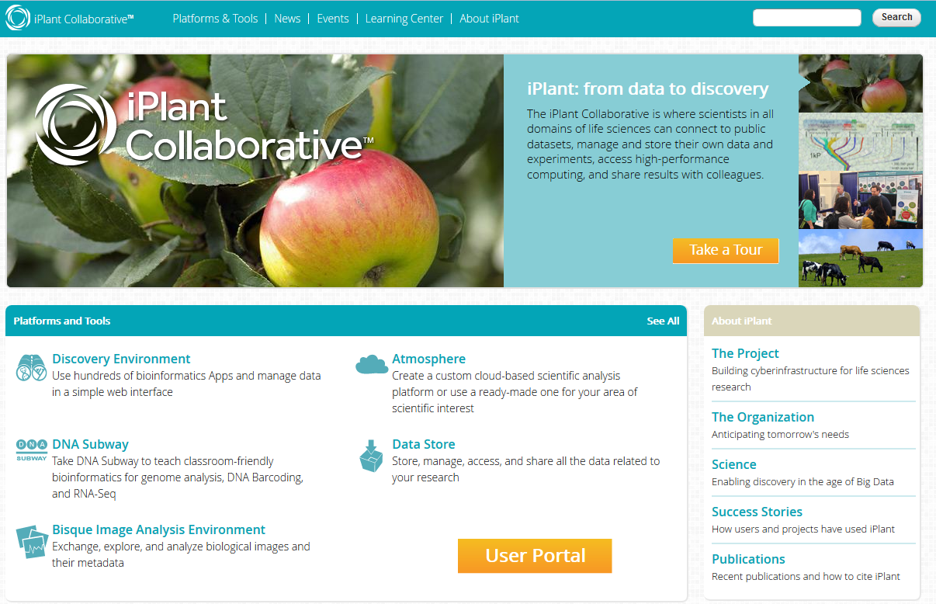
Discovery Environment Overview
Hands-on demo: Create a multiple alignment
Please login to the Discovery Environment.
Follow along with the instructor or with the handouts on your own

Slide 13
Discovery Environment Overview
Hands-on demo: Create a multiple alignment
Workshop packet page 16 – ‘Example Analysis in the Discovery Environment’
Demo Components
Locate a sequence file in the Data Store (Community Data folder)
Use an app to analyze sequences (MUSCLE sequence aligner app)
Monitor the analysis (job) status and export its parameters
View results
Access analysis history
Re-run analyses

Slide 14
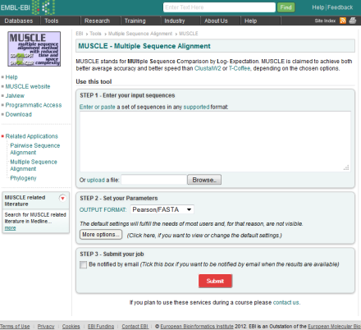
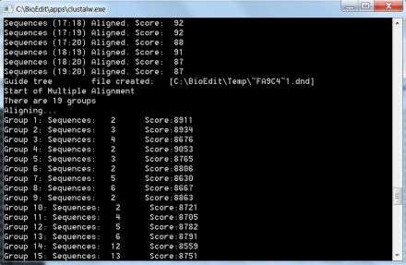
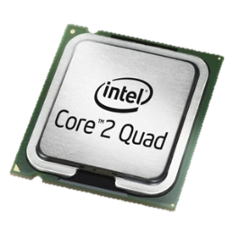
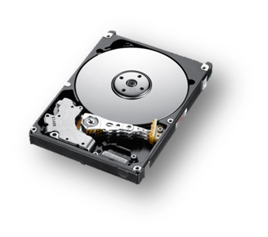
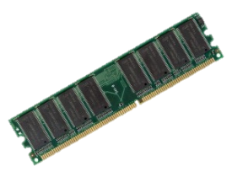
Discovery Environment Overview
Additional advantages: At a glance, options for data analysis may seem similar
Web services Local compute Discovery Environment

Slide 15
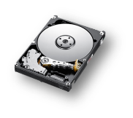
Discovery Environment Overview
Additional advantages: Limitations may not appear with ‘casual’ use
Little or none
Some: dependent on funding
or institutional resources
(and how much hardware
you are comfortable sitting on)
Scalable: From a single CPU job to >500K core machine – you don’t bear the pain and cost of scaling
✓
Scalability
?
$
Web services Local compute Discovery Environment

Slide 16
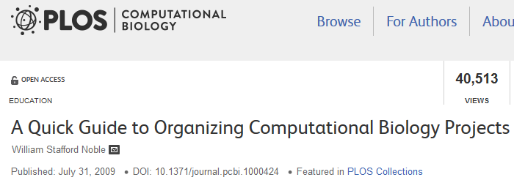
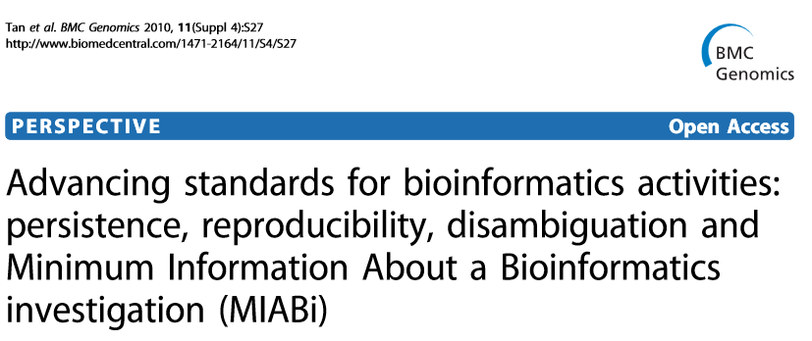
Discovery Environment Overview
Built for bioinformatics best practices: data stewardship, reproducibility, reliability
An extensible platform that scales with your science

Slide 17
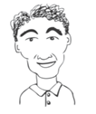
Discovery Environment Overview
User perspectives and possible applications
Does most of his data uploads/downloads/sharing here
He pushes results from his lab’s workflow into a common folder
Installed an HPC application here so that anyone can use it
Creates custom applications with default parameters exposed
Developed a workflow to QC and Filter reads for his users
Teaches about genome assembly with examples in the DE
Bench Scientist
Bioinformatician
Core Facilities
Images from personas based on: Bioinformatics Curriculum Guidelines: Toward a Definition of Core Competencies
PLOS Biology DOI: 10.1371/journal.pcbi.1003496

Slide 18
Tips
Apps are linked to iPlant wiki for documentation
Mark an App as a favorite and it will appear in your workspace
Use the Apps menu to:
Rate Apps to provide feedback
Click the info icon to see the user manual for an App
Re-launch a job with identical, or customized parameters by clicking on the App name in the Analyses tab

Slide 19
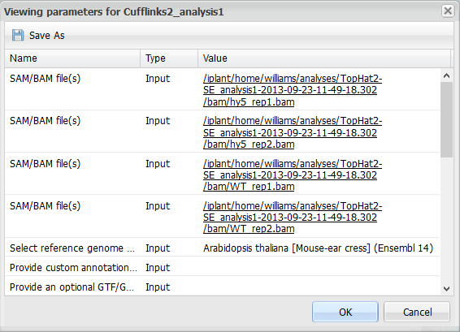
Tips
View a file containing metadata (settings, etc.) connected to your analysis. Select the a job and click View Parameters.

Slide 20
Tips
Can customize tools in the DE (simplifying here)
App installation / modification involves happens at two levels:
Apps (and dependencies) are installed on DE Cluster (done by iPlant support)
DE Interface (created by App integrator/user) and published to DE
Use the DE as a ‘ready to use’ interface for your open source software!

Slide 21
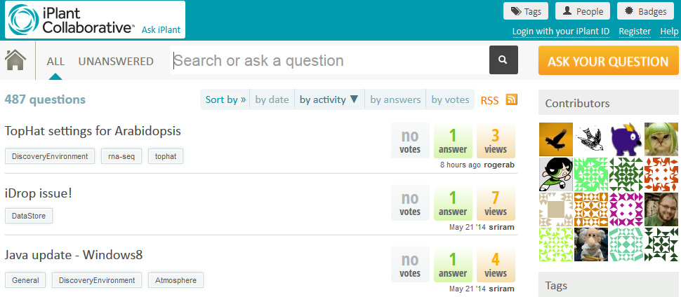
Detailed instructions with videos, manuals, documentation in
Learning Center
Keep asking: ask.iplantcollabortive.org

Slide 22
The iPlant Collaborative is funded by a grant from the National Science Foundation Plant Cyberinfrastructure Program (#DBI-0735191).

