Slide 1
iPlant Collaborative
Tools and Services Workshop
Overview of Atmosphere

Slide 2
Overview of Atmosphere
What is Cloud Computing?
Cloud computing refers to the delivery of computing and
storage capacity as a service to a heterogeneous community
of end-recipients. – Wikipedia
http://en.wikipedia.org/wiki/Cloud_computing
Image source: http://dilbert.com/strips/comic/2009-11-18/
Notes:
There is a difference between cloud computing and cloud computing that works.

Slide 3
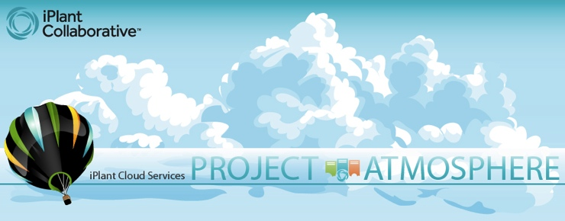
Overview of Atmosphere
Cloud Computing on Demand
On-demand computing resource built on a cloud infrastructure
Virtual Machine pre-configured with:
Software
Memory requirements
Processing power

Slide 4
Overview of Atmosphere
Cloud Computing on Demand
Fully integrated into iPlant authentication and storage and HPC capabilities
Enables users to build custom images/appliances and share with community
Cross-platform desktop access to GUI applications in the cloud (using VNC)
Provide easy web based access to resources

Slide 5
Overview of Atmosphere
Cloud Computing on Demand
API-compatible implementation of Amazon EC2/S3 interfaces
Virtualize the execution environment for applications and services
Up to 12 core / 48 GB instances
Access to Cloud Storage + EBS
>60 hosted applications in Atmosphere today, including users from USDA, Forest Service, database providers, etc.

Slide 6
Overview of Atmosphere
Multiple Use Cases
Standalone GUI-based applications are frequently required for analysis but not easy to transform into web apps
Need to handle complex software dependencies (e.g. specific bioperl version and R modules)
Users needing full control of their software stack (occasional sudo access)
Need to share desktop/applications for collaborative analysis (remote collaborators) Developers for application distribution
Prototyping/Testing new software/modules
Tailored software training setups (custom workshops/laboratory courses etc.)
Extend compute capabilities of existing applications i.e. utilize iPlant API

Slide 7
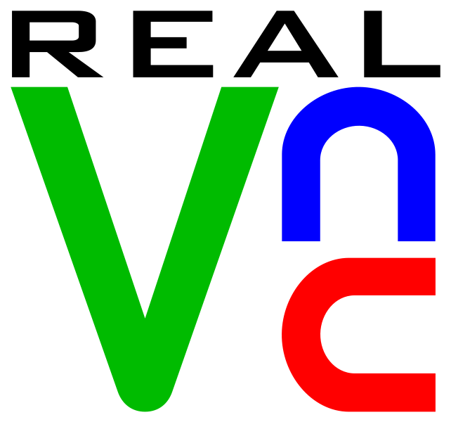
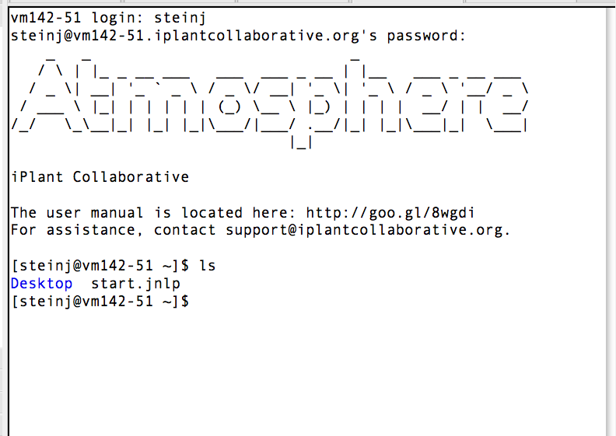
Overview of Atmosphere
Multiple Ways to Access
VNC client
Command line tools (e.g. SSH)

Slide 8
Atmosphere Hands-on Lab

Slide 9
Atmosphere Lab
By the end of this module you should be able to:
Launch an atmosphere app
Connect to an instance using VNC viewer
Import data into your Atmosphere instance from Data Store
Use an application on your instance
Share your instance with another user
Terminate your instance.

Slide 10
Atmosphere Lab
Goal: Use Atmosphere to examine illumina reads and share your desktop with another user
Task 1: Launch an Atmosphere instance and connect
Task 2: Import data into your instance
Task 3: Examine data with IVG viewer
Task 4: Share your data with another user

Slide 11
Atmosphere Lab
Work in teams of 3-4. Launch a single image to share

Slide 12
Atmosphere Lab
Summary
Launch a preconfigured instance in minutes
Import data from your data store
Visualize data in a stand-alone program
Share your instance with a collaborator

