Slide 1

iPlant Collaborative
Tools and Services Workshop
Overview of the iPlant Data Store
Notes:
Presenters Notes:
This power point is designed for a 25 minute presentation (5-minutes on the introduction; slides 2-6, and 20 minutes for the simple hands on lab; slides 7-X)

Slide 2

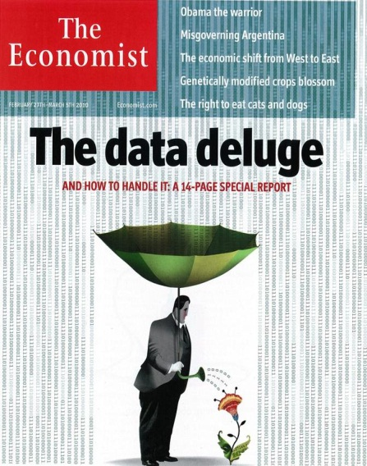
Overview of the iPlant Data Store
What is “Big Data”?
Big Data is a term applied to data sets whose size
is beyond the ability of commonly used software
tools to capture, manage, and process the data
within a tolerable elapsed time.
Big Data sizes are a constantly moving target
currently ranging from a few dozen terabytes
to many petabytes of data in a single data set.
Wikipedia
(http://en.wikipedia.org/wiki/Big_data)
Notes:
Wikipedia gives a nice definition
Its important to note, Big Data is not just a problem in
Biology, this means we can learn from other disciplines coping with the same problems.

Slide 3
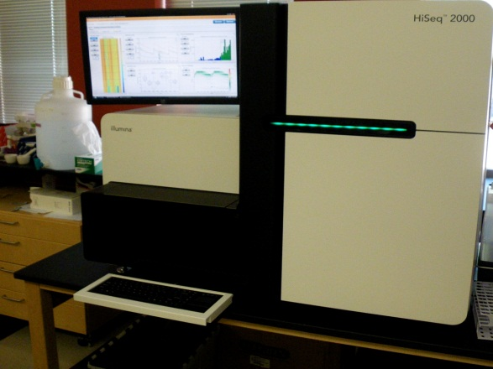
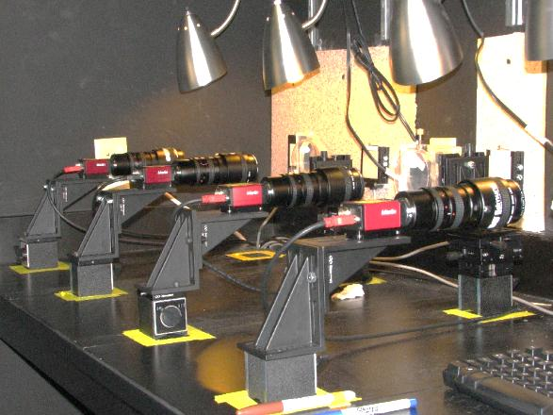
Overview of the iPlant Data Store
High-Throughput Biology (Not Just Sequence Data)
Genotype
Phenotype
In 11 Days
Generates 4TB of raw data
600,000,000,000 bases of DNA sequence (200 human genomes)
1 Day
30 camera sets
~200 movies of dynamic
root growth: 4GB a day
Notes:
HT data sources in biology are not limited to sequence data
Besides HT phenotyping, there are many other areas of biology (proteomics, metabolomics, etc.) that produce big data.

Slide 4

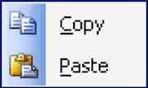
Overview of the iPlant Data Store
What makes Big Data different?
Why isn't saving/moving/copying
Big Data as simple as using the tools
we already have?

Slide 5
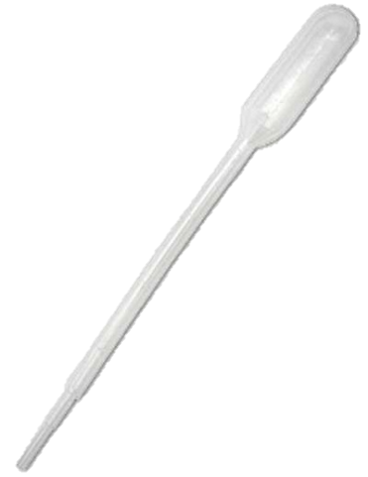
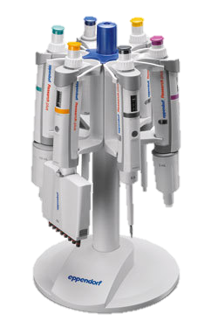

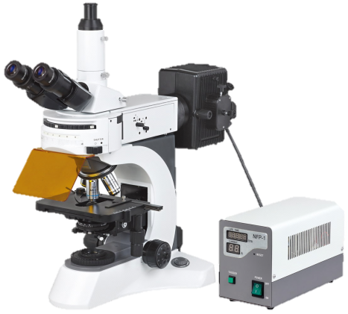
Overview of the iPlant Data Store
What makes Big Data different?
Changes in scale - quantitative
introduce qualitative differences
and complications?!
Notes:
We use various technologies in the context of our experimental designs.
While the principles are the same, as the scale we are operating on changes, we need to accommodate new complications introduced
e.g. now you need a light source, now you need to do calibrations, you need to spend a lot of money!

Slide 6
Overview of the iPlant Data Store
Some Complications of Big Data
Difficult/slow transfers
Expense for storage/backup
Difficult to share and publish
Metadata
Analysis

Slide 7
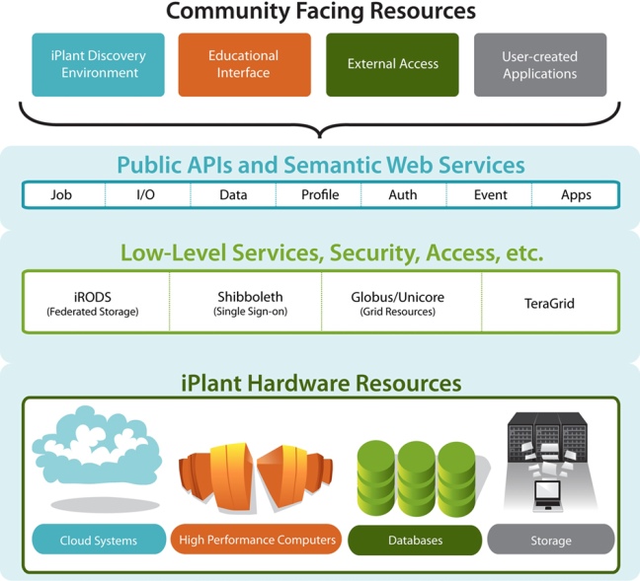
Overview of the iPlant Data Store
Scalable, Reliable, Redundant, High-performance
Access your data from multiple iPlant services
Automatic data backup (redundant between
University of Arizona and University of Texas)
Multiple way to share data with collaborators
Multi-threaded high speed transfers
Default 100GB allocation. >1TB allocations
available with justification
Teragrid
XSEDE

Slide 8

Overview of the iPlant Data Store
Scalable, Reliable, Redundant, High-performance
iRODS is an open-source data management system
iRODS supports many data intensive projects like NSF TeraGrid, Large Synoptic Survey telescope, etc.

Slide 9
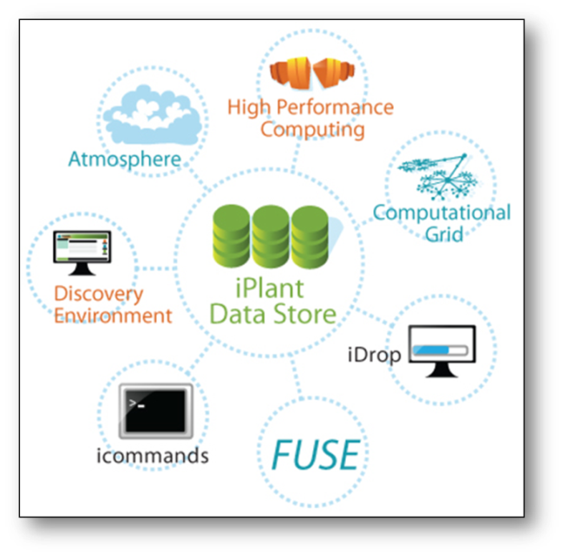
Overview of the iPlant Data Store
There are multiple ways to access the Data Store
Through the Discovery Environment
Davis Web interface (data.iplantcollaborative.org)
WebDAV
iDrop stand alone client
iCommands
iRODS FUSE (mounted volume in Linux environment)

Slide 10
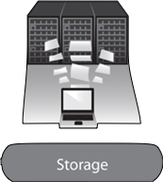
Overview of the iPlant Data Store
Some important items we won’t see in the demo
Replication
Arizona
Texas
Key component of your NSF data management
Worry Free!
Notes:
You won’t see these items because you shouldn't have to. They are working
For you in the background, but worth reviewing.
How the Data Store infrastructure is laid out:
1. replication between AZ and TX
2. connected to local computing resources (AZ-GriD, TX super)
3. Both connected to cloud computing resources
4. All transfers from outside go to AZ, replicated to TX.
5. TX is often busy with lots of file transfers due to their SC facility

Slide 11
Overview of the iPlant Data Store
Some important items we won’t see in the demo
Source | Destination | Copy Method | Time (seconds)
CD | My Computer | cp | 320
Berkeley Server | My Computer | scp | 150
External Drive | My Computer | cp | 36
USB2.0 Flash | My Computer | cp | 30
iDS | MyComputer | iget | 18
My Computer | My Computer | cp | 15
Close to optimum conditions; transfer between
Univ. of Arizona and UC Berkeley
100GB: 29m15s
1 GB / 17.5 seconds

Slide 12
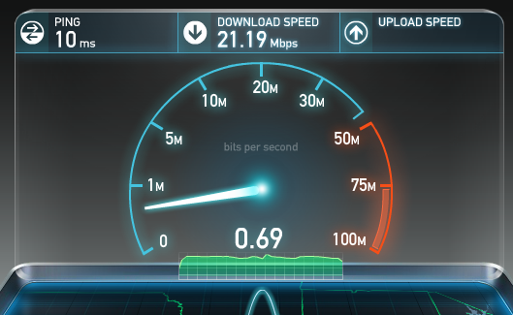


Overview of the iPlant Data Store
Some important items we won’t see in the demo
One of the complications of big data
transfers is that you will always be
limited by your local connection and
Institutional policies.
http://www.speedtest.net/

Slide 13
iPlant Data Store Hands-on Lab

Slide 14
iPlant Data Store Lab
By the end of this module you should be able to:
Upload “large” (3-4 GB) files into the DE
Import “large” (3-4 GB) files into the DE using a URL
Understand metadata and annotate a file using the AVU format
Share your data with another colleague/user
Get started with iCommands (* command line interface)

Slide 15
iPlant Data Store Lab
Goal: Import files into the data store, annotate them
with metadata and share them with a colleague.
Task 1: Import a file into the DE from a URL
Task 2: Import a “large” file using iDrop in the DE
Task 3: Markup your files with metadata
Task 4: Share your data with a colleague / other user

Slide 16
iPlant Data Store Lab
Please login to the Discovery Environment.
Follow along with the instructor
Or
Follow along with the handouts on your own
Notes:
Do the lab now!

Slide 17
iPlant Data Store Lab
Quick iCommands demo
Commands demonstrated:
iinit
ils
iget
iexit
Enter the host name (DNS) of the server to connect to: data.iplantcollaborative.org
Enter the port number: 1247
Enter your irods user name: <your iplant login name>
Enter your irods zone: iplant
Enter your current iRODS password: <your iplant password>
Learn more in the online documentation: http://www.iplantcollaborative.org/w_icmds
Notes:
I will be doing a demo using iCommands for windows. There are other options, but this particular
Part requires software installation.

Slide 18





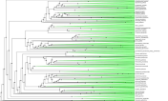
iPlant Data Store Lab
iPlant Supports the Life Cycle of Data
Markup
Search
Store
Transfer
Pre- Publication
Post- Publication
Share
Collaborate
Visualize
Analyze
Data Results A Results B
Algo1 Algo2
Notes:
You’ve seen an overview of how iPlant manages the life cycle of data.

