Slide 1
iPlant Collaborative
Foundation API Tutorial

Slide 2
What is an API?
APIs provide:
Utility
Abstraction
Interoperability
Documentation
iPlant APIs are of a class known as Web APIs
This doesn’t mean you only do web things with them
It means you interact with them via web actions

Slide 3
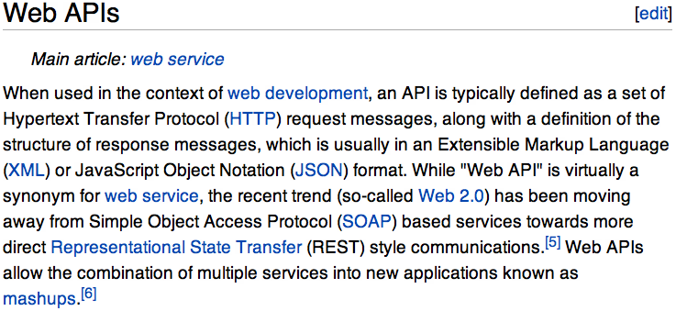
What is an API?
If the Discovery Environment is “User Interface,”
the Foundation API is “Machine Interface”

Slide 4
REST (REpresentational State Transfer)
REST uses URIs to refer to and to access resources.
REST is built on top of the stateless HTTP 1.1 protocol.
REST uses HTTP commands to define operations.
This last point is essential in REST architecture. HTTP commands have precise semantics:
GET lists or retrieves a resource at a given URI.
PUT replaces or updates a resource at a given URI.
POST creates a resources at a given URI.
DELETE removes the resources at a given URI.

Slide 5
A REST Example (1)
I’ve built a library database in which I store information about my books, DVDs, music, etc. and exposed it as a RESTful service
http://fonner.org/library
Sub-URLs of this /library endpoint represent types of media
http://fonner.org/library/books
http://fonner.org/library/dvds
http://fonner.org/library/music
I can add, update, remove, or fetch records from these via HTTP operations.

Slide 6
A REST Example (2)
Let’s go about storing information on a dvd that my 3 year old son loves:
{"title":"Mary Poppins",
"genre":"Family",
"release-date":"August, 1964",
"notes":"Carson will sing Chim Chim Cher-ee for a week after watching"}
I encode this data into an HTML form and POST it to
http://fonner.org/library/dvds
And then…

Slide 7
A REST Example (3)
I get back the following:
An HTTP status code of 200 OK, which means that the operation succeeded
A message body (in JSON format due to my preference)
{"id":101,
"date":"May 18, 2012",
"uri":"http://fonner.org/library/dvds/101"}
Now let’s say I want to retrieve that new record because I have a short memory and can’t recall what I just POSTed.

Slide 8
A REST Example (4)
I perform an HTTP GET operation on
http://fonner.org/library/dvds/101
I get back:
An HTTP status code of 200 OK, which means that the operation succeeded
A message body
{"id":101,
"date":"May 18, 2012",
"title":”Mary Poppins”,
"genre":"Family”, "release-date":"August, 1964”, "notes":"Carson will sing Chim Chim Cher-ee for a week after watching”}

Slide 9
A REST Example (5)
To update the record, say to change the notes to something less silly, I send an updated version of the original data object via HTTP PUT to http://fonner.org/library/dvds/101
To delete the record entirely, I perform an HTTP DELETE on http://fonner.org/library/dvds/101
That’s a nutshell example of a simple REST API
Importantly, the paradigm can be extended to accommodate more than just database records! We can move beyond documenting a children’s book collection to driving a national-scale cyberinfrastructure.

Slide 10
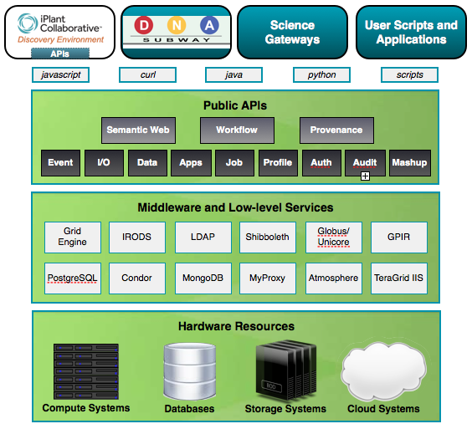
Language/OS-independent application development
Complexity is abstracted behind API layer
Reuse and integration of Open Source Middleware
National-scale physical resources

Slide 11
Foundation API Overview
Endpoint | Activities
IO | File data storage/retrieval/management. Database interoperability. File metadata management
DATA | Transparent file-format conversion
PROFILE | User information discovery and management
APPS | Registration and discovery of public or private HPC applications
JOBS | Submission and management of computing jobs on XSEDE systems
AUTH | Token-based highly secure authentication with proxy capability
SYSTEMS | Returns availability and other information about XSEDE JOB hosts
POSTIT | A URL –shortener and limited-used URL generator

Slide 12
Foundation API Overview
Endpoint | Activities
IO | File data storage/retrieval/management. Database interoperability. File metadata management
DATA | Transparent file-format conversion
PROFILE | User information discovery and management
APPS | Registration and discovery of public or private HPC applications
JOBS | Submission and management of computing jobs on XSEDE systems
AUTH | Token-based highly secure authentication with proxy capability
SYSTEMS | Returns availability and other information about XSEDE JOB hosts
POSTIT | A URL –shortener and limited-used URL generator
We’ll focus on using these four today.

Slide 13
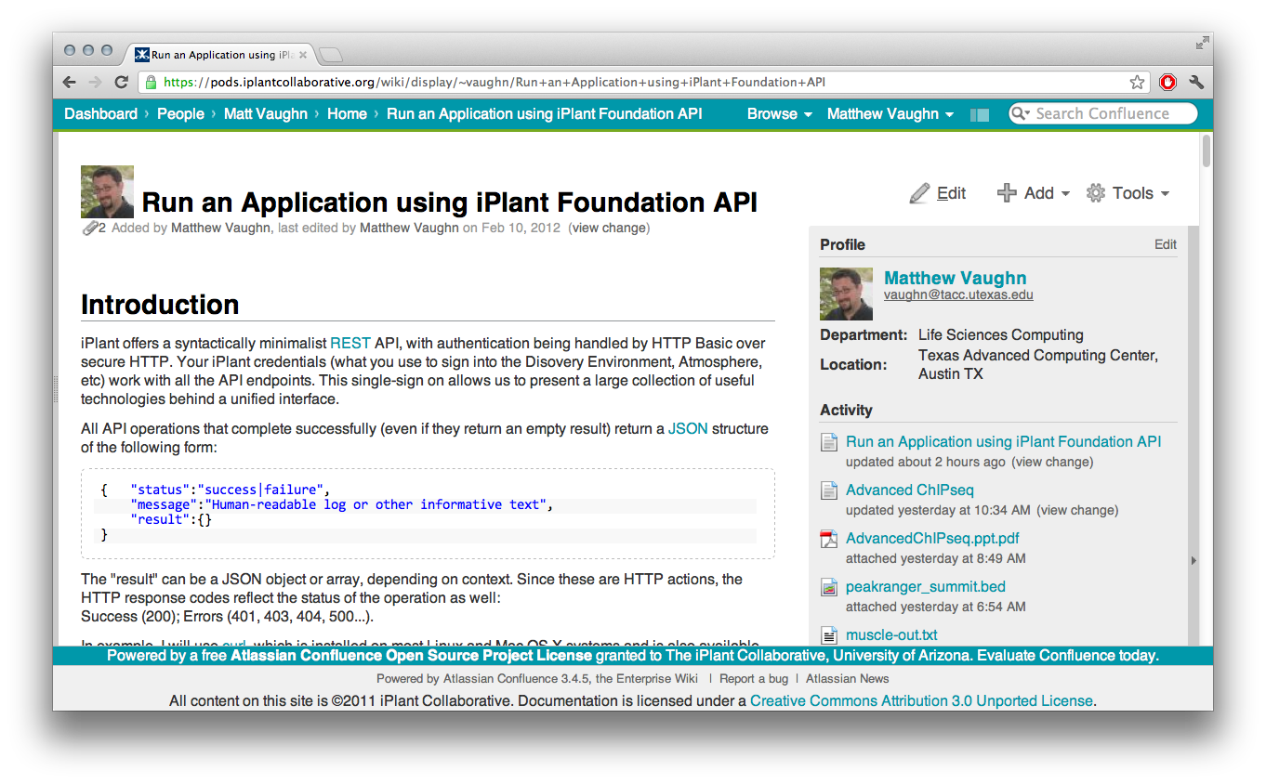
Real World Example: MUSCLE
https://pods.iplantcollaborative.org/wiki/x/EAm

Slide 14
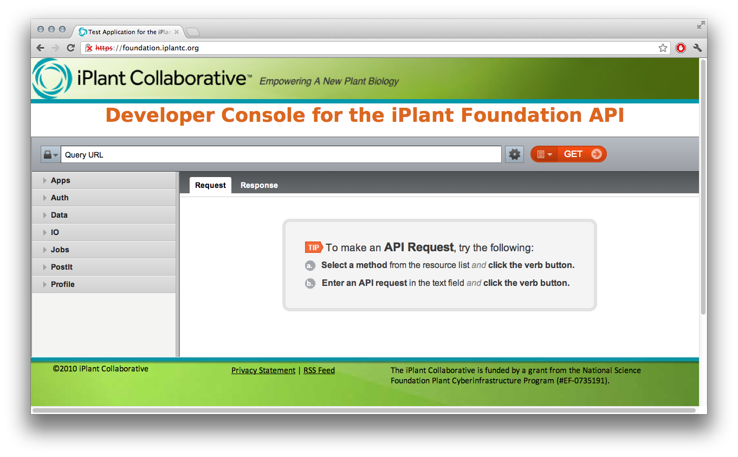
The apigee API console
Powered by

Slide 15
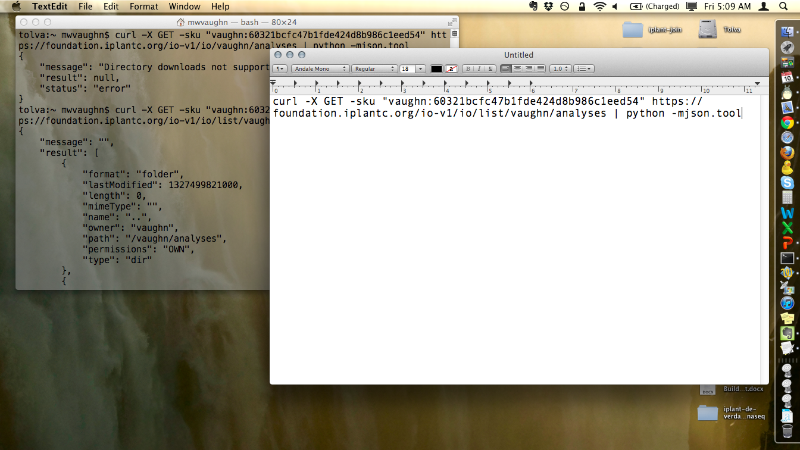
Working with cURL
Type up command line into a text editor, then copy and paste into the terminal emulator

Slide 16
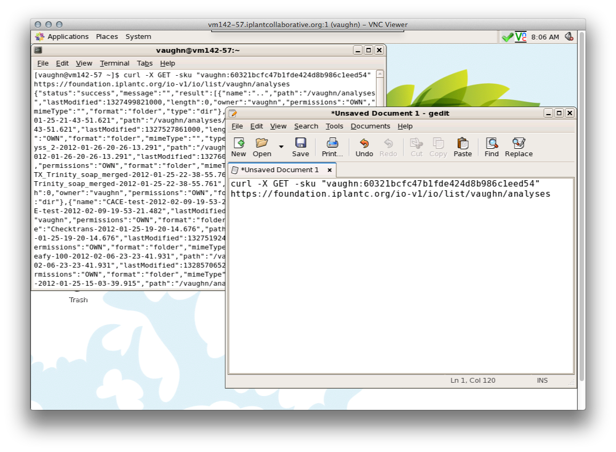
Working with cURL
This lets you document successful API operations and make notes!

Slide 17
Interactive Session
Notes:
Should take 1 hour (or less)

Slide 18
Additional topics
Querying and interpreting the APPS catalog
Callback URLs
Using POSTIT effectively
Deploying your own application in the APPS catalog
Writing a simple HTML/JS application to interact with the iPlant API

