Slide 1

iPlant Collaborative
Tools and Services Workshop
University of Wisconsin – Madison; August 20-21, 2012

Slide 2
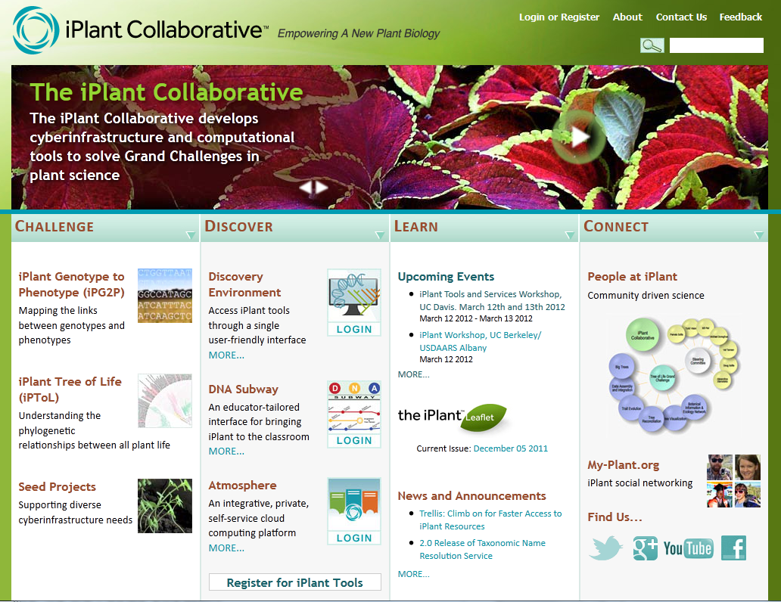
The iPlant Collaborative
Cyberinfrastructure for the Plant Sciences
Notes:
iPlant is by and for the plant science community.
We are developing a saleable extensible platform that delivers community scale solutions.

Slide 3

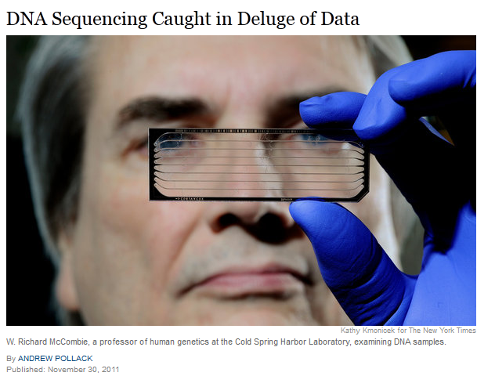
The Problem of Big Data in Biology
“BGI, based in China, is the world’s largest genomics research institute, with 167 DNA sequencers producing the equivalent of 2,000 human genomes a day.
BGI churns out so much data that it often cannot transmit its results to clients or collaborators over the Internet or other communications lines because that would take weeks. Instead, it sends computer disks containing the data, via FedEx.”

Slide 4
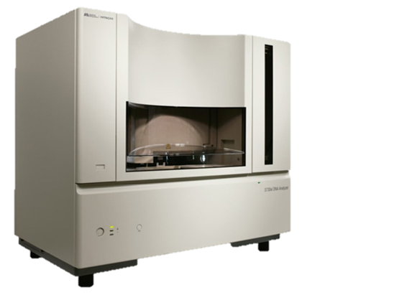
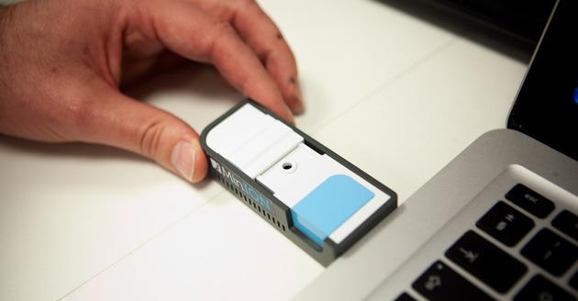
The Problem of Big Data in Biology
A decade’s progress
2003:
ABI 3730 Sequencer
2012:
Oxford Nanopore
MiniION
Human Genome:
$2.7 Billion, 13 Years
Human Genome:
$900, 6 Hours

Slide 5
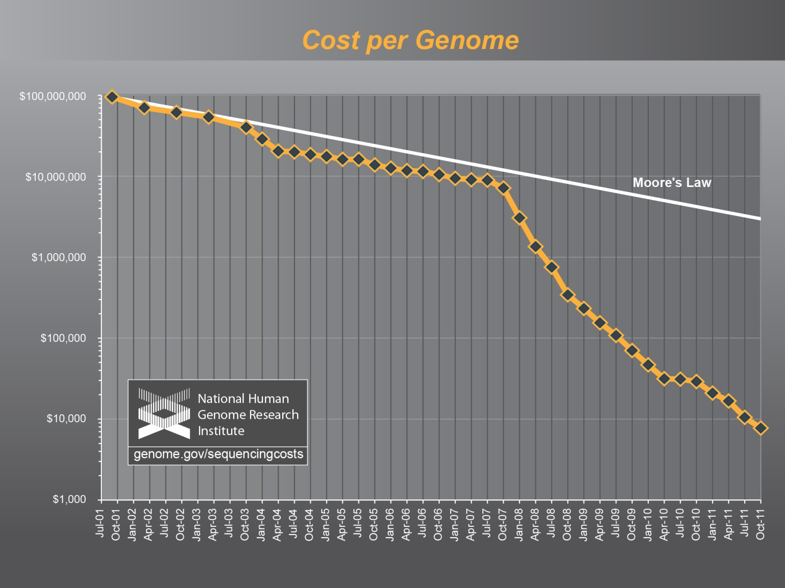
The Problem of Big Data in Biology
Notes:
This figure nicely contrasts the developing conflict between computational power (The domain of computer sciences)
With biological data (biologists).
The problems (and also promises!) of “Big Data” biology are only going to increase for the foreseeable future.

Slide 6
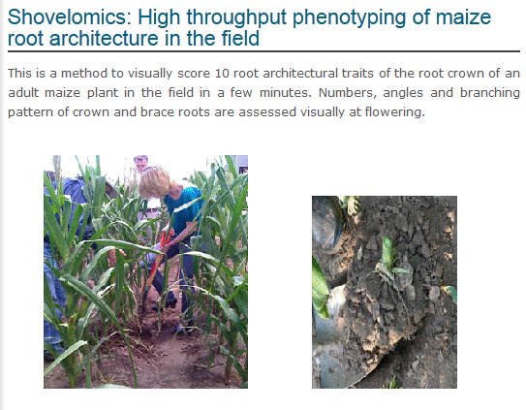
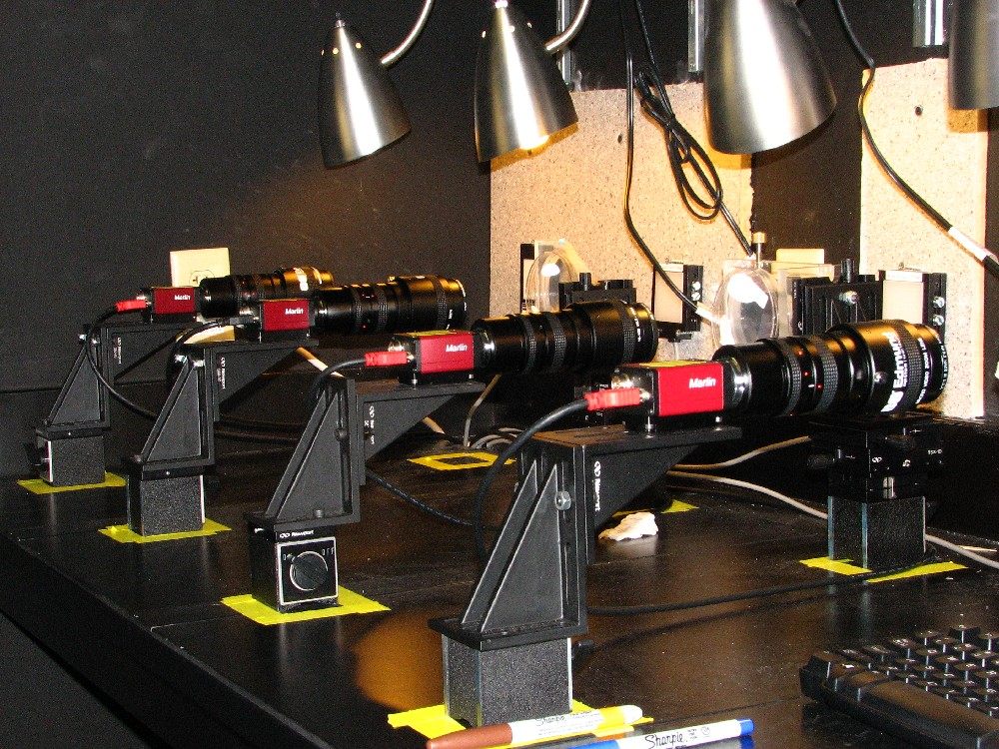
The Problem of Big Data in Biology
High Throughput Phenotyping
The large amount of sequence
based data need balancing
with equally powerful phenotypic
data.
Phytomorph Project (Univ. Wisconsin)
$70K for 30 cameras
200 movies of root growth
4GB/day of images for processing
http://roots.psu.edu/en/rootlab
Notes:
Work from Nate Miller (Edgar Spalding’s Group), Univ. Wisconsin
They use iPlant’s Atmosphere is scale their data processing solution so that
Several groups can now analyze and collaborate these data-intensive projects.
“Shovelomics (Lynch lab – Penn State University)

Slide 7

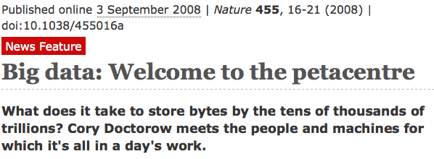
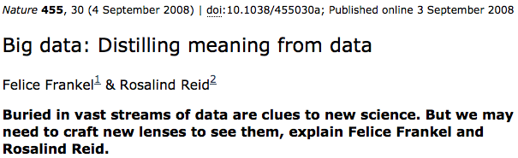
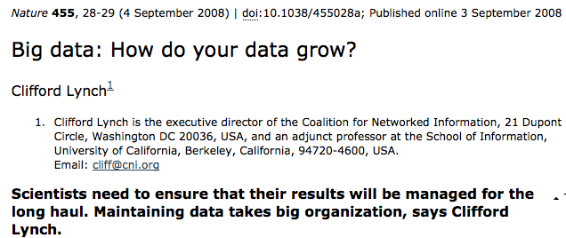
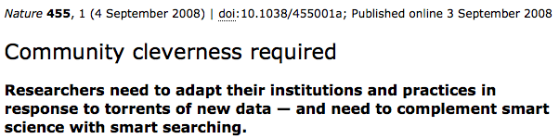
The Problem of Big Data in Biology

Slide 8
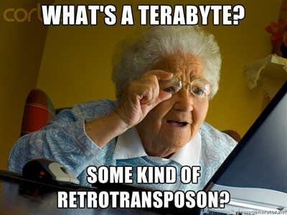
The Problem of Big Data in Biology
Data-intensive biology will mean getting biologists comfortable with
new technology…

Slide 9
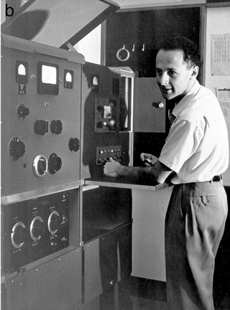
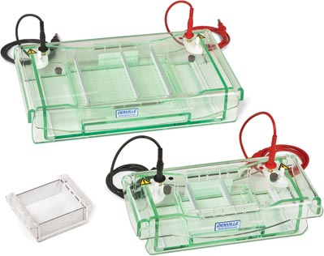
The Problem of Big Data in Biology
hopefully comfortable enough to minimize the technology
and focus on the biology.
1973
Sharp, Sambrook, Sugden
Gel Electrophoresis Chamber, $250
1958
Matt Meselson &
Ultracentrifuge, $500,000
Notes:
There was a time where a great deal of molecular biology was dependent on ultracentrifugation.
Much of the protocol was made obsolete by gel electrophoresis.
Democratizing access to and creation of knowledge accelerates progress.

Slide 10
The iPlant Collaborative
Cyberinfrastructure for the Plant Sciences
The iPlant CI is designed as infrastructure.
This means it is a platform upon which other projects can build.
Use of the iPlant infrastructure can take one of several forms:
    Storage
    Computation
    Hosting
    Web Services
    Scalability
Notes:
So what is iPlant’s contribution to the problems of Big Data?
iPlant is not “Take it or leave it” there are many component that you can customize for your own research.

Slide 11
The iPlant Collaborative
Cyberinfrastructure for the Plant Sciences
For a challenge as broad as “plant science,” focus on specific applications/tools is a moving target, and never enough.
Most important to build a *platform* that can support diverse and constantly evolving needs. “Cyberinfrastructure” is, in fact, infrastructure. The platform can lift all the apps, not select winners and losers.
“The useful lifetime of our analysis tool chains is now 6 months”
-Matthew Trunnel, Broad Institute
Notes:
This is why having this workshop is important. Learning how to use iPlant as a platform is knowledge that will exceed the lifetime of its component pieces.
Trunnel is IT director at Broad

Slide 12
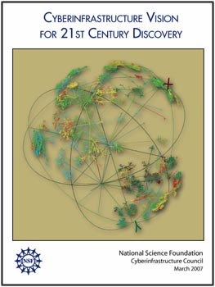
The iPlant Collaborative
Cyberinfrastructure Philosophy
We have designed iPlant to be consistent with the pillars of CIF21
  High Performance Computing
  Data and Data Analysis
  Virtual Organization
  Learning and Workforce

Slide 13
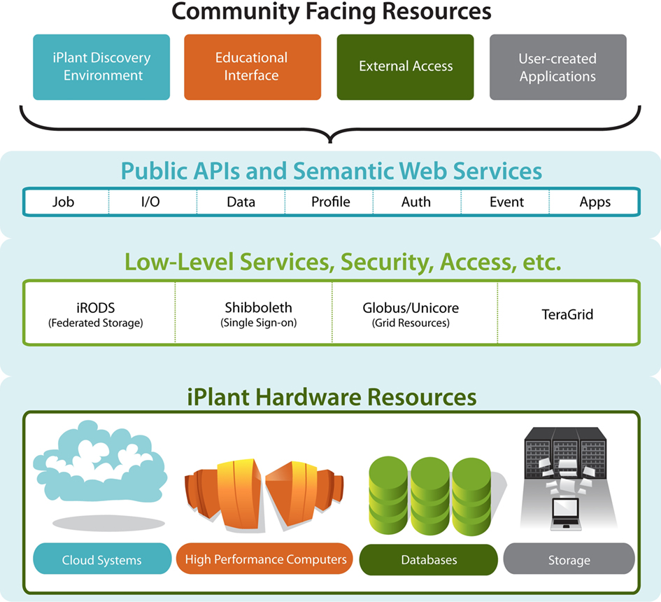

The iPlant Collaborative
Cyberinfrastructure for the Plant Sciences
End
Users
Teragrid
XSEDE
Computational
Users
Notes:
iPlant layer cake of resources and services.
Bottom->Up: Hardware->low-services/middleware->APIs

Slide 14
The iPlant Collaborative
Ways to access iPlant
Atmosphere: For virtual hosting of web apps, sites, databases.
iPlant Data Storage: All data large and small
The Discovery Environment: Integrated Web apps.
MyPlant: Social Networking.
DNASubway: Annotation and more
Standalone Apps: TNRS, TreeViewer, PhytoBisque, etc
The API: For programmers embedding iPlant CI capabilities
Command line for experts (thru TeraGrid/XSEDE)

Slide 15
The iPlant Collaborative
Practical Benefits
Powerful computational resources (Data analysis and storage)
Experimental verifiability, reproducibility, provenance
Interconnected resources / multiple levels of access
Facilitation of collaboration
Scalability/extensibility
Notes:
These are all good “selling points” but rather than discuss them in detail, we will demonstrate them throughout the workshop.

Slide 16
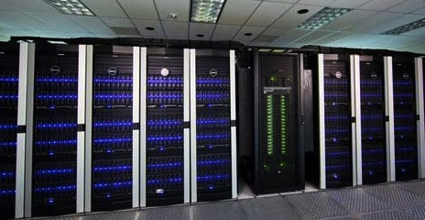
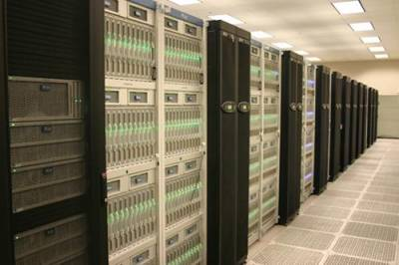
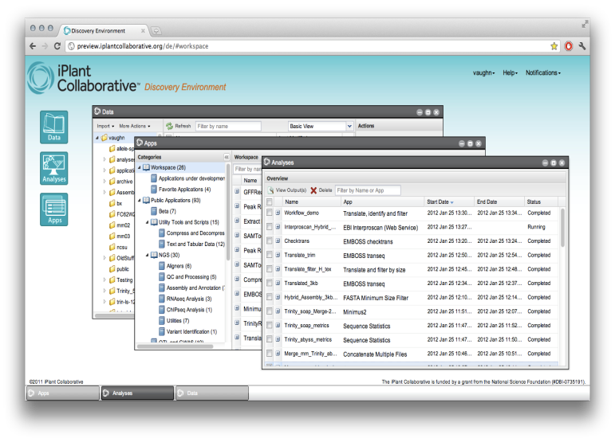
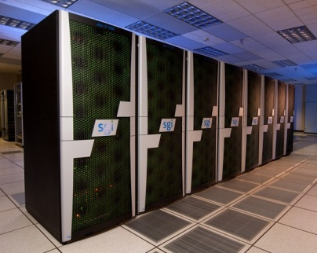
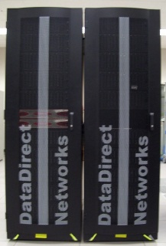
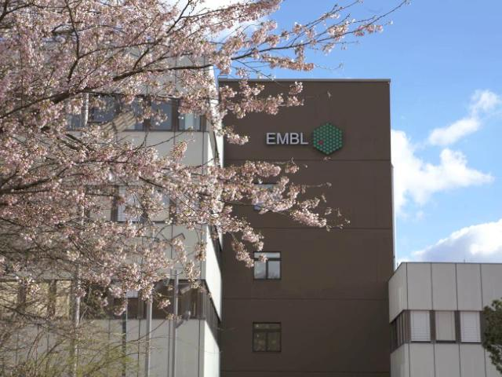
The iPlant Collaborative
Scalable Computation for High Throughput Inquiry
90,000 Compute Cores
Up to 1TB shared memory
Growing to ~500,000 cores by end of 2012
TACC Lonestar
TACC Ranger
PSC Blacklight
TACC Corral
EBI Web Services

Slide 17
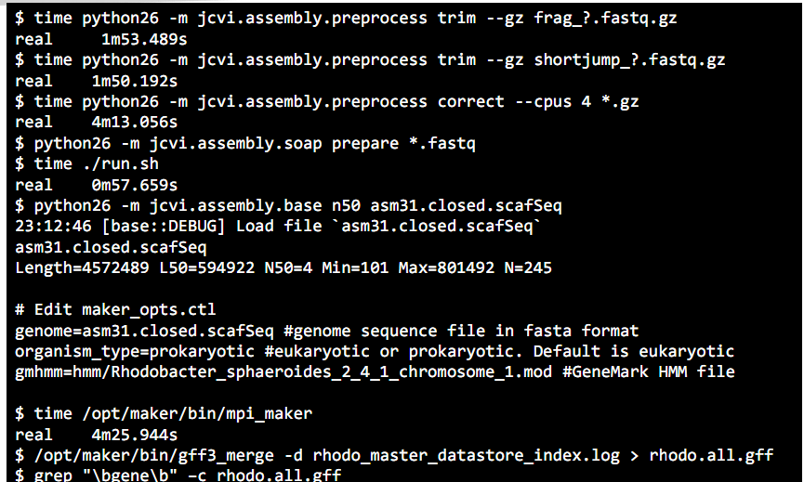
The iPlant Collaborative
Scalable Computation for High Throughput Inquiry
Chris Pires, U. of Missouri
  Assembly of Brassica Genomes on shared memory systems
Haibo Tang, JCVI
  “The resources available change your research landscape –the amounts and types of analyses that you do.”

Slide 18
The iPlant Collaborative
iPlant Discovery Environment
A rich web client
  Consistent interface to bioinformatics tools
  Portal for users who won’t want to interact with lower level infrastructure
An integrated, extensible system of applications and services
  Additional intelligence above low level APIs – Provenance, Collaboration, etc.

Slide 19
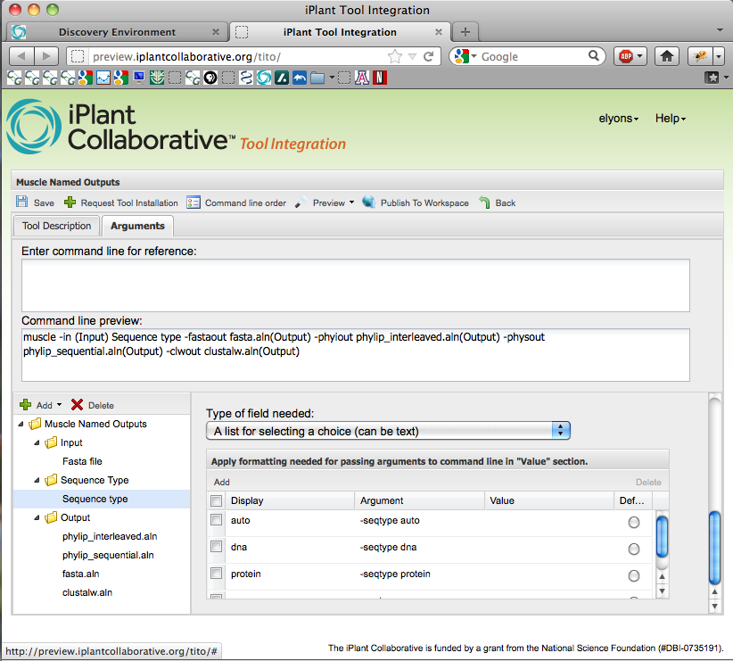
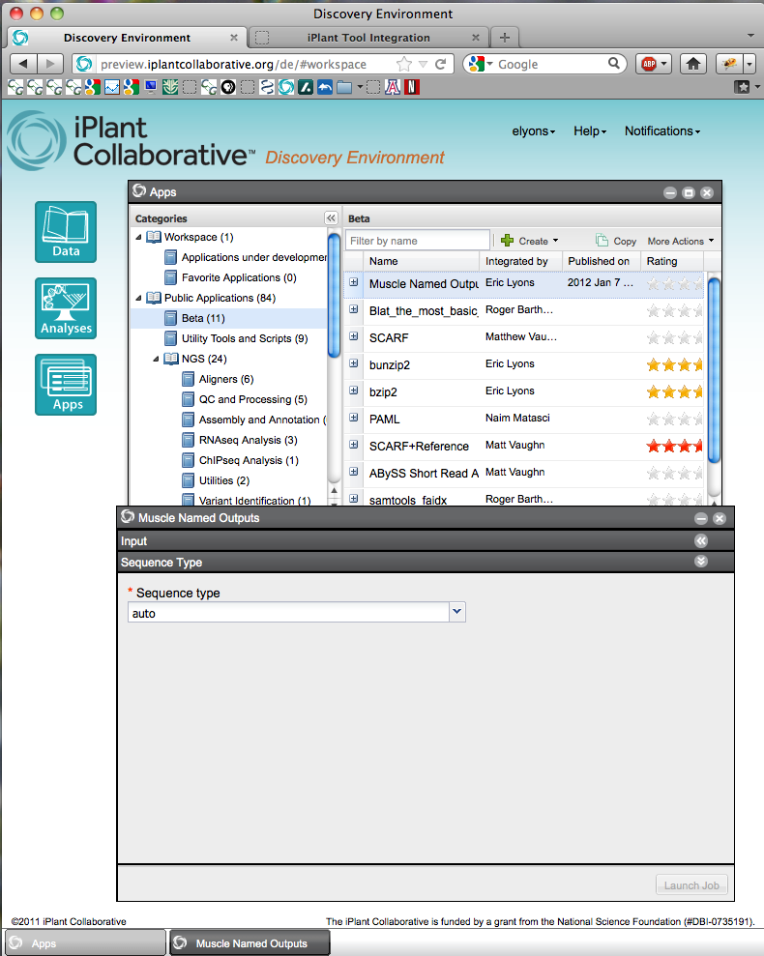

The iPlant Collaborative
iPlant Discovery Environment
Notes:
DE Tool integration; critical for reproducibility. Also key for evolving (democratizing) cmd line applications

Slide 20


The iPlant Collaborative
Project Atmosphere™: Custom Cloud Computing
API-compatible implementation of Amazon EC2/S3 interfaces
Virtualize the execution environment for applications and services
Up to 12 core / 48 GB instances
Access to Cloud Storage + EBS
Run servers, CloudBurst desktop use cases. Big data and the desktop are co-local again!
>60 hosted applications in Atmosphere today, including users from USDA, Forest Service, database providers, etc.
(30 more for postdocs and grad students for training classes)

Slide 21
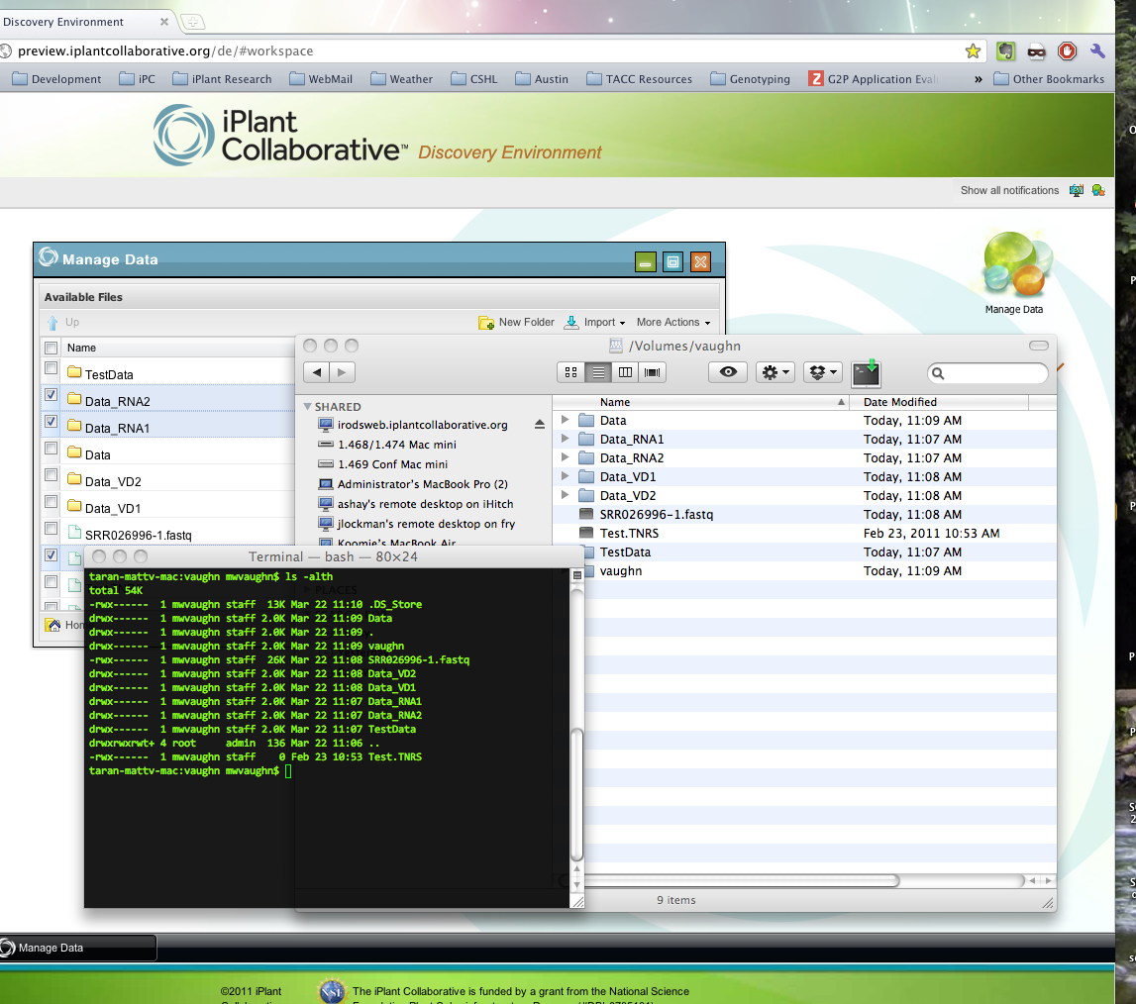
The iPlant Collaborative
Data Store
Fast data transfers via parallel, non-TCP file transfer
  Move large (>2 GB) files with ease
Multiple, consistent access modes
  iPlant API
  iPlant web apps
  Desktop mount (FUSE/DAV)
  Java applet (iDrop)
  Command line
Fine-grained ACL permissions
  Sharing made simple
Access and a storage allocation is automatic with your iPlant account
Notes:
~300 TB disk for now. Expanding to petascale storage ~ year’s end
Georeplicated. This is half your NSF data management plan!

Slide 22
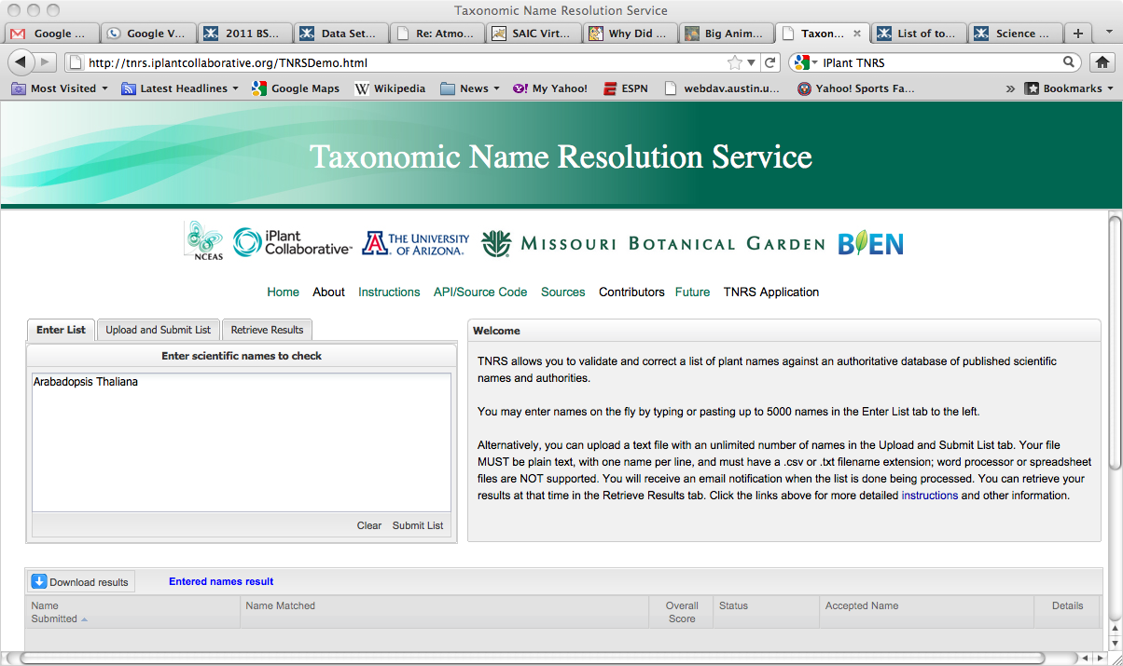
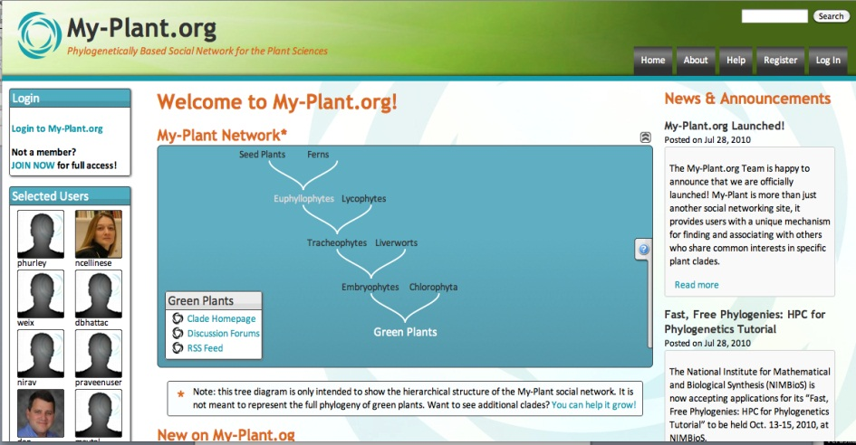
The iPlant Collaborative
A number of other applications are “Powered by iPlant” but developed by our team on top of the infrastructure.
In response to specific grand challenge team requests for things that needed their own web presence.
TNRS, My-Plant, and more.

Slide 23
The iPlant Collaborative
Other major projects are beginning to adopt the iPlant CI as their underlying infrastructure (some completely, some in limited ways):
  CoGe (auth service, hosting)
  BioExtract (web service platform)
  CiPRES (computation)
  Gates Integrated Breeding Platform (hosting, development)
  Galaxy (storage, for now)

Slide 24

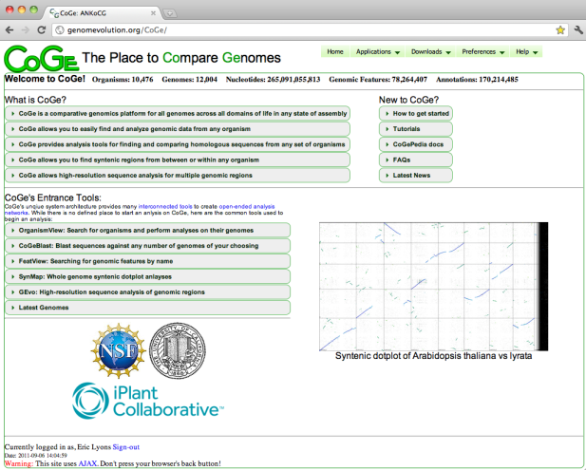
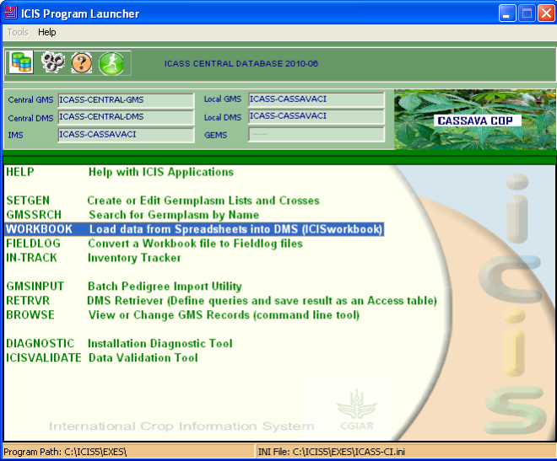
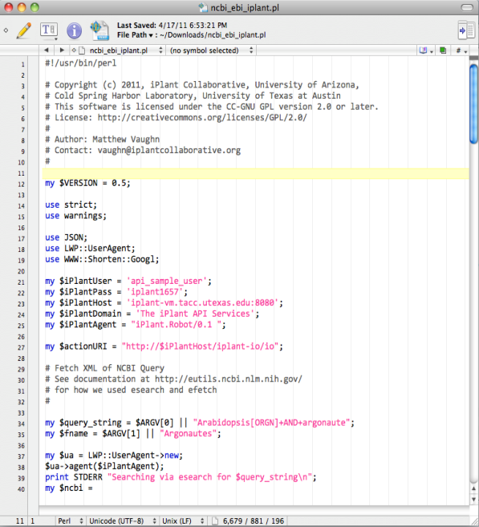
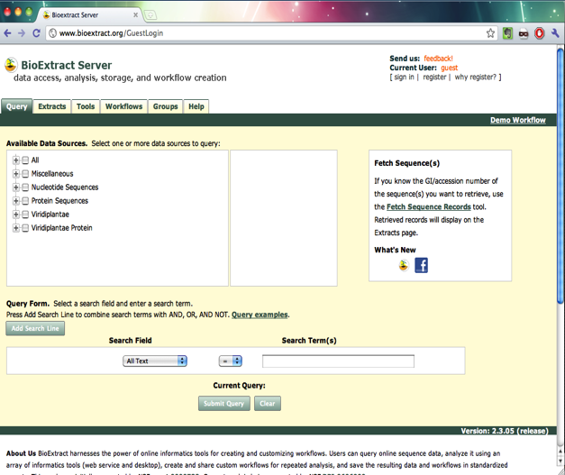
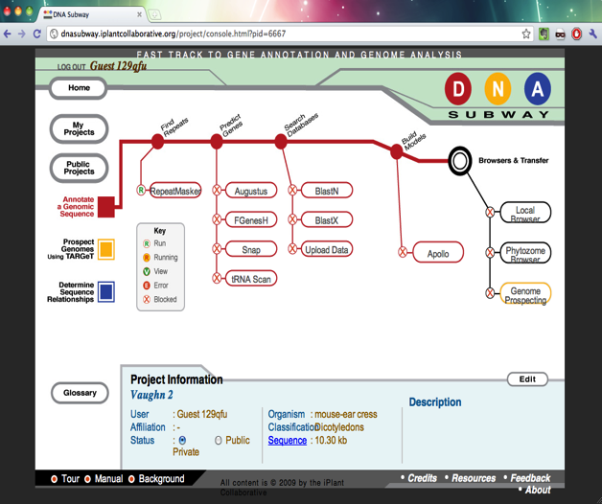
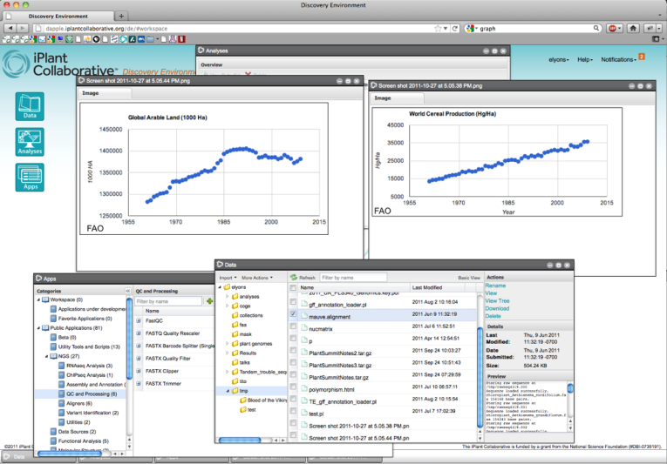
iPlant APIs
Resources
Notes:
powered by iPlant: building an ecosystem of platforms so that developers can focus on delivering scientific solutions and not maintaining hardware, data, and common services (authorization)

Slide 25
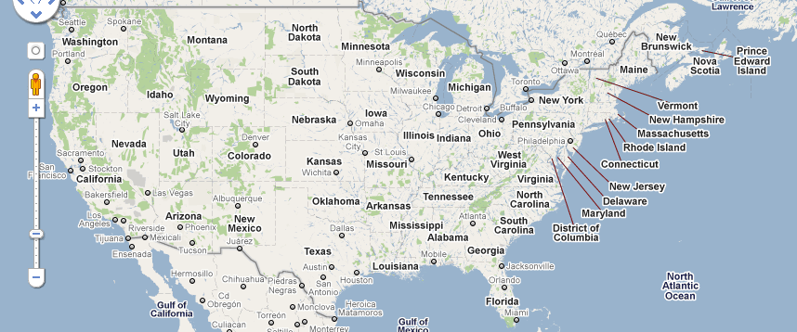
The iPlant Collaborative
A virtual organization
CSHL
UA
TACC

Slide 26
The iPlant Collaborative
Postdocs:
Barbara Banbury
Jamie Estill
Bindu Joseph
Christos Noutsos
Brad Ruhfel
Stephen A. Smith
Chunlao Tang
Lin Wang
Liya Wang
Norman Wickett
Students:
Peter Bailey
Jeremy Beaulieu
Devi Bhattacharya
Storme Briscoe
Ya-Di Chen
John Donoghue
Steven Gregory
Yekatarina Khartianova
Monica Lent
Amgad Madkour
Aniruddha Marathe
Kurt Michaels
Dhanesh Prasad
Andrew Predoehl
Jose Salcedo
Shalini Sasidharan
Gregory Striemer
Jason Vandeventer
Kuan Yang
Executive Team:
Steve Goff
Dan Stanzione
Metadata
Data
Tools
Workflows
Viz
Faculty Advisors & Collaborators:
Ali Akoglu
Greg Andrews
Kobus Barnard
Sue Brown
Thomas Brutnell
Michael Donoghue
Casey Dunn
Brian Enquist
Damian Gessler
Ruth Grene
John Hartman
Matthew Hudson
Dan Kliebenstein
Jim Leebens-Mack
David Lowenthal
Robert Martienssen
Staff:
Greg Abram
Sonali Aditya
Roger Barthelson
Brad Boyle
Todd Bryan
Gordon Burleigh
John Cazes
Mike Conway
Karen Cranston
Rion Doodey
Andy Edmonds
Dmitry Fedorov
Michael Gatto
Utkarsh Gaur
Cornel Ghiban
Michael Gonzales
Hariolf Häfele
Matthew Hanlon
Anthony Heath
Barbara Heath
Matthew Helmke
Natalie Henriques
Uwe Hilgert
Nicole Hopkins
Eun-Sook Jeong
Logan Johnson
Chris Jordan
B.D. Kim
Kathleen Kennedy
Mohammed Khalfan
Seung-jin Kim
Lars Koersterk
Sangeeta Kuchimanchi
Kristian Kvilekval
Aruna Lakshmanan
Sue Lauter
Tina Lee
Andrew Lenards
Zhenyuan Lu
Eric Lyons
Naim Matasci
Sheldon McKay
Robert McLay
Angel Mercer
Dave Micklos
Nathan Miller
Steve Mock
Martha Narro
Praveen Nuthulapati
Shannon Oliver
Shiran Pasternak
William Peil
Titus Purdin
J.A. Raygoza Garay
Dennis Roberts
Jerry Schneider
Bruce Schumaker
Sriramu Singaram
Edwin Skidmore
Brandon Smith
Mary Margaret Sprinkle
Sriram Srinivasan
Josh Stein
Lisa Stillwell
Kris Urie
Peter Van Buren
Hans Vasquez-Gross
Matthew Vaughn
Fusheng Wei
Jason Williams
John Wregglesworth
Weijia Xu
Jill Yarmchuk
B.S. Manjunath
Nirav Merchant
David Neale
Brian O’Meara
Sudha Ram
David Salt
Mark Schildhauer
Doug Soltis
Pam Soltis
Edgar Spalding
Alexis Stamatakis
Ann Stapleton
Lincoln Stein
Val Tannen
Todd Vision
Doreen Ware
Steve Welch
Mark Westneat

Slide 27
iPlant Collaborative
Tools and Services Workshop
Workshop Goals
Demonstrate some of the ways iPlant CI can advance your science
Familiarize you with iPlant tools and services
Helping you add your “voice” to the iPlant user community
Getting your feedback on the computation bottlenecks iPlant
should tackle next

