Slide 1
Genome Assembly using NanoDJ Notebooks in Cyverse
Presented by: Tamara Hernández-Beeftink
Hospital Nuestra Señora de Candelaria, Spain
September 13th, 2019

Slide 2
Outline of Today’s Focus Forum
Next generation sequencing steps
Oxford nanopore technology sequencing
Assembly process
NanoDJ bacteria genome assembly demo
*Due to time constraint and the complexity of the assembly process, we will not perform the assembly of a complete genome in real time.

Slide 3
Main steps of Next Generation Sequencing
xxxxxxxxxxxxxxxxxxxxxxxxxxxxxxxxxxxxxxxxxxxxxxxxxxxxxxxxxxxxxxxxxxxxxxxx
Fragmentation
xxxxxxxxxxxxxxxxx
xxxxxxxxxxxxx
xxxxxxxxxxxxxxxxxxx
xxxxxxxxxxxxxx xxxxxxxxxxxxxxxxxxxxx
xxxxxxxxxx
xxxxxxxxxxxxx
xxxxxxxxxx
xxxxxxxxxxxxxxxxxxxxxxxxxxx
Sequencing
AGCGATGA
AGCGATGAGCGTG
GTGACGAAGTNGATTTTTCAGTGA
AGCGATGAGCGTNACGAAGTTGA GTGAGCTAGACTCGA ACTCGAACCGCTC
CAGNGAGCTAG
GAACCGCTC
ACGAAGTTGA
GAGCGTG
Assembly
TTGACCAGGCAGTGA
Alignment
De Novo

Slide 4
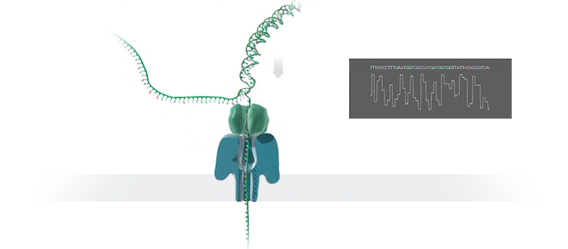
Nanopore sequencing

Slide 5
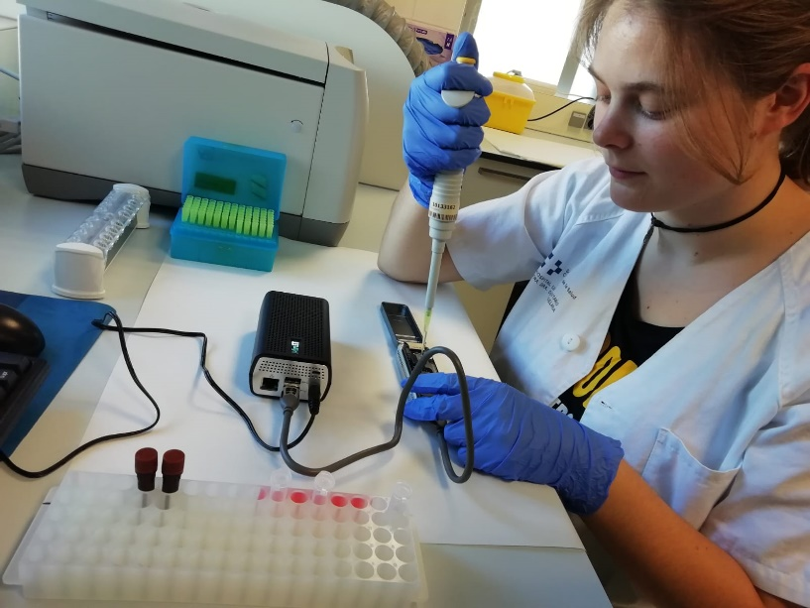
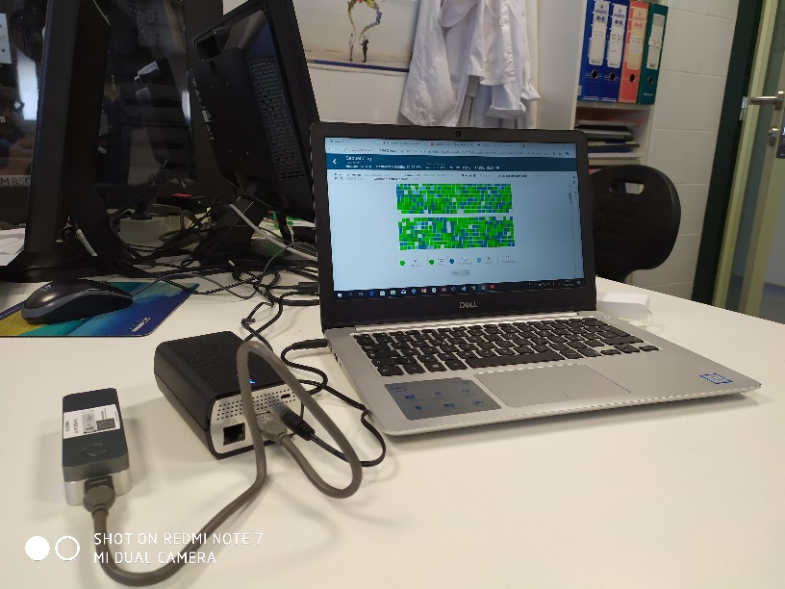
Nanopore sequencing
Portable
Long reads
Sequencing in real time
Assemble complex genome

Slide 6
File formats (FAST5 → FASTQ)

Slide 7
Some assemblers
Shorts reads: Velvet, SPAdes
Long reads: Canu, Flye, Miniasm
Short and long reads: Unicycler, MASurCa

Slide 8
Overlap Layout Consensus assembly (OLC)
De Bruijn graph (DBG)
AGCGATGAGCGTGACGAA
TCGG → CGGC → GGCA → GCAT
AGCGATGANCGTGACGAA
9X
ATGAGCGTGACGAAGTT
AGTC → GTCG
CATT → ATTA→ TTAC
GTGACGAAGTTGACCAG
AAGTTGACCNGGCA
CCAGGCAGTGAGC
TCGT → CGTC → GTCA → TCAT
CAGGCAGTGAGCT
1X
CAGTGAGCTAGAC
AGCTAGACTCGAC
AGCGATGAGCGTGACGAAGTTGACCAGGCAGTGAGCTAGACTCGAC

Slide 9
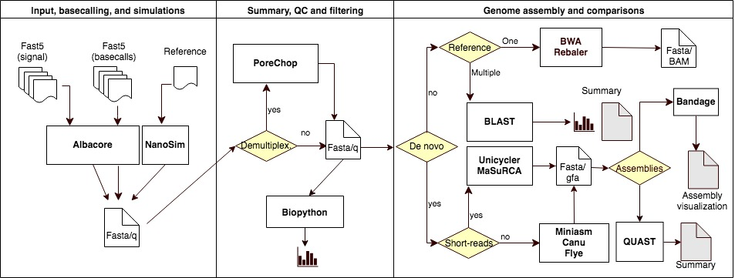
https://github.com/genomicsITER/NanoDJ

Slide 10
https://github.com/genomicsITER/NanoDJ

Slide 11
https://github.com/genomicsITER/NanoDJ

Slide 12
https://github.com/genomicsITER/NanoDJ
QualityControl.ipynb
AssemblyCompare.ipynb
Fastq
Quality control step (Biophyton)
FLYE
CANU
QUAST
Bandage
DeNovo_Canu+polish.ipynb
AssemblyGraph.ipynb
DeNovo_Flye.ipynb

Slide 13
Genome assembly demo

Slide 14
Things to keep in mind
The assembly depends on different factors such as the nature of the sequenced organism and the run perfomance.
The type of assembler depends on the objective of your study and the genome you want to assemble.
Assembly of larger genomes requires greater computational performance and longer execution time.
We are testing new tools to incorporate in NanoDJ.

Slide 15
Thank you for attending
CyVerse is supported by the National Science Foundation under Grants No. DBI-0735191, DBI-1265383 and DBI-1743442.
FI17/00177 PI17/00610 PI14/00844
RTC-2017-6471-1

