Slide 1
Atmosphere Overview
Intro Cloud Computing

Slide 2
Welcome to Atmosphere
Custom Cloud Computing for Life Sciences

Slide 3
What is Cloud Computing?
Yet another round of jargon

Slide 4
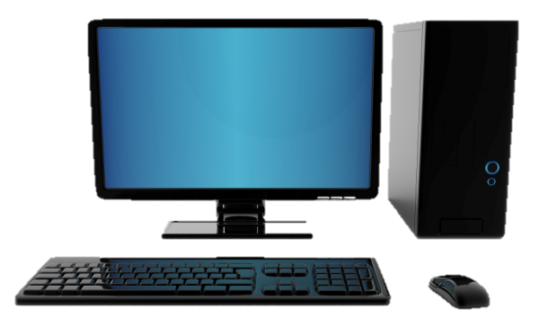
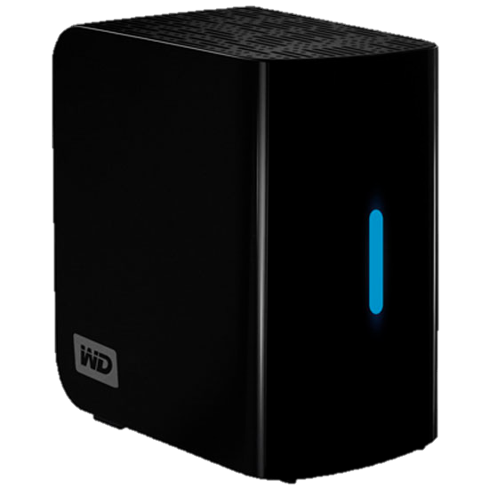
What is Cloud Computing?
Important concepts: Image
Image (file)
Complete clone (files/data)
Original system
Document(s) (file)
Copied Document(s) (file)

Slide 5
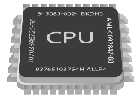
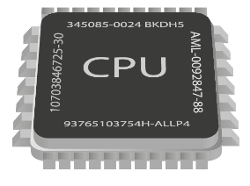
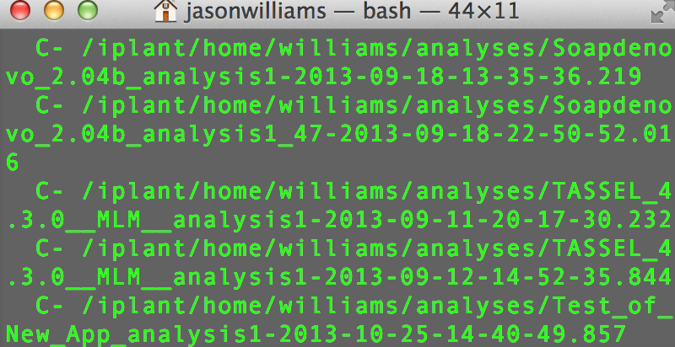
What is Cloud Computing?
Important concepts: Instance
+
(Disk + CPU + Memory) + (Image)
128.196.34.158
CyVerse Cloud
Atmosphere Instance (virtual machine)

Slide 6
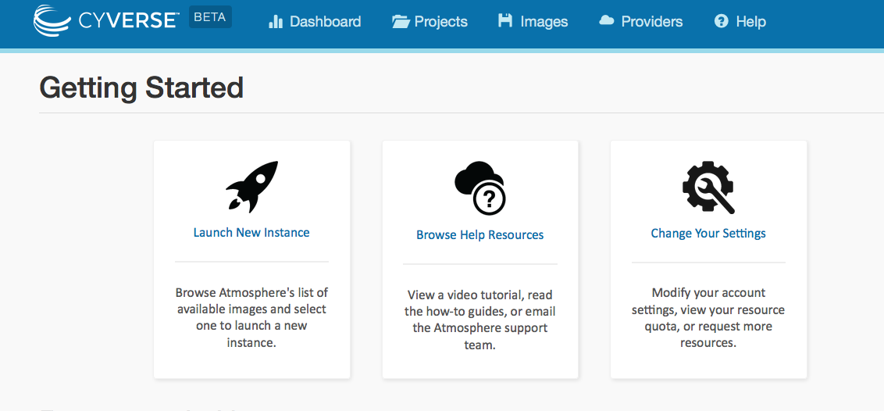
Atmosphere Overview
Largest, easiest to use cloud for Life Sciences
Choose an existing image or customize
Instances up to 16-Core / 128 GB RAM
Access via shell or VNC
Share you image with selected users, or make them public

Slide 7
Atmosphere Overview
Benefits
Get Science Done
Work in an on-demand Linux environment (most bioinformatics)
Collaborate with students and colleagues on the same instance
Make data, workflows, and analyses available in a public image
Access previous software version and images
Multicore high memory images to run multithreading applications
Move your analyses from your laptop to the cloud
Reproducibility
Productivity

Slide 8
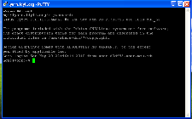
Atmosphere Overview
Connecting to your instance
Windows
Mac
Linux
VNC Viewer
VNC Viewer
VNC Viewer
PuTTY
Shell/terminal
Shell/terminal
VNC Viewer: www.realvnc.com/download/viewer
PuTTy: www.putty.org

Slide 9
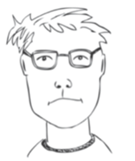
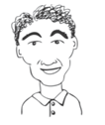
Atmosphere Overview
User perspectives and possible applications
Learned how to use the shell and how to work with Linux
Mastered using R to develop plots for his manuscript
Launches an image and has full SUDO access to customize
Developed a software with numerous R and Python library dependencies
She updates it regularly by making a new image
Linked several atmosphere instances with Apache Hadoop
Worked with CyVerse to import existing Amazon image
Bench Scientist
Bioinformatician
Core Facilities
Images from personas based on: Bioinformatics Curriculum Guidelines: Toward a Definition of Core Competencies
PLOS Biology DOI: 10.1371/journal.pcbi.1003496

Slide 10
Atmosphere Overview
Key things to remember when you try this yourself
Images do not have automatic access to your Data Store
Use Cyberduck to access the Data Store
Use iCommands
Users have monthly allocation limits
Terminate, or stop instances not in use
If a larger allocation is needed, contact support
All data on terminated instances will be destroyed
Use Cyberduck or iCommands to transfer data off the instance
You may also create an EBS Volume (see documentation)
Notes:
What is EBS?

Slide 11
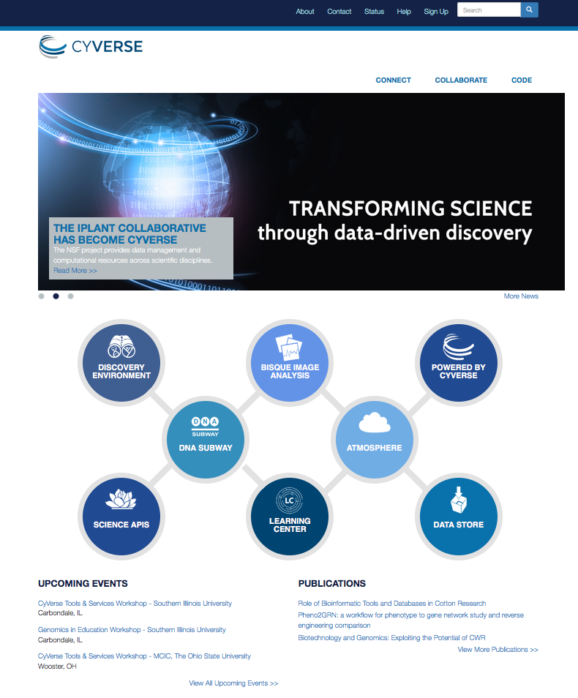
Where to go from here:
Learning Center
Get Started Guide
Tutorials and Videos
Documentation
Upcoming Events
Workshops
Webinars

Slide 12
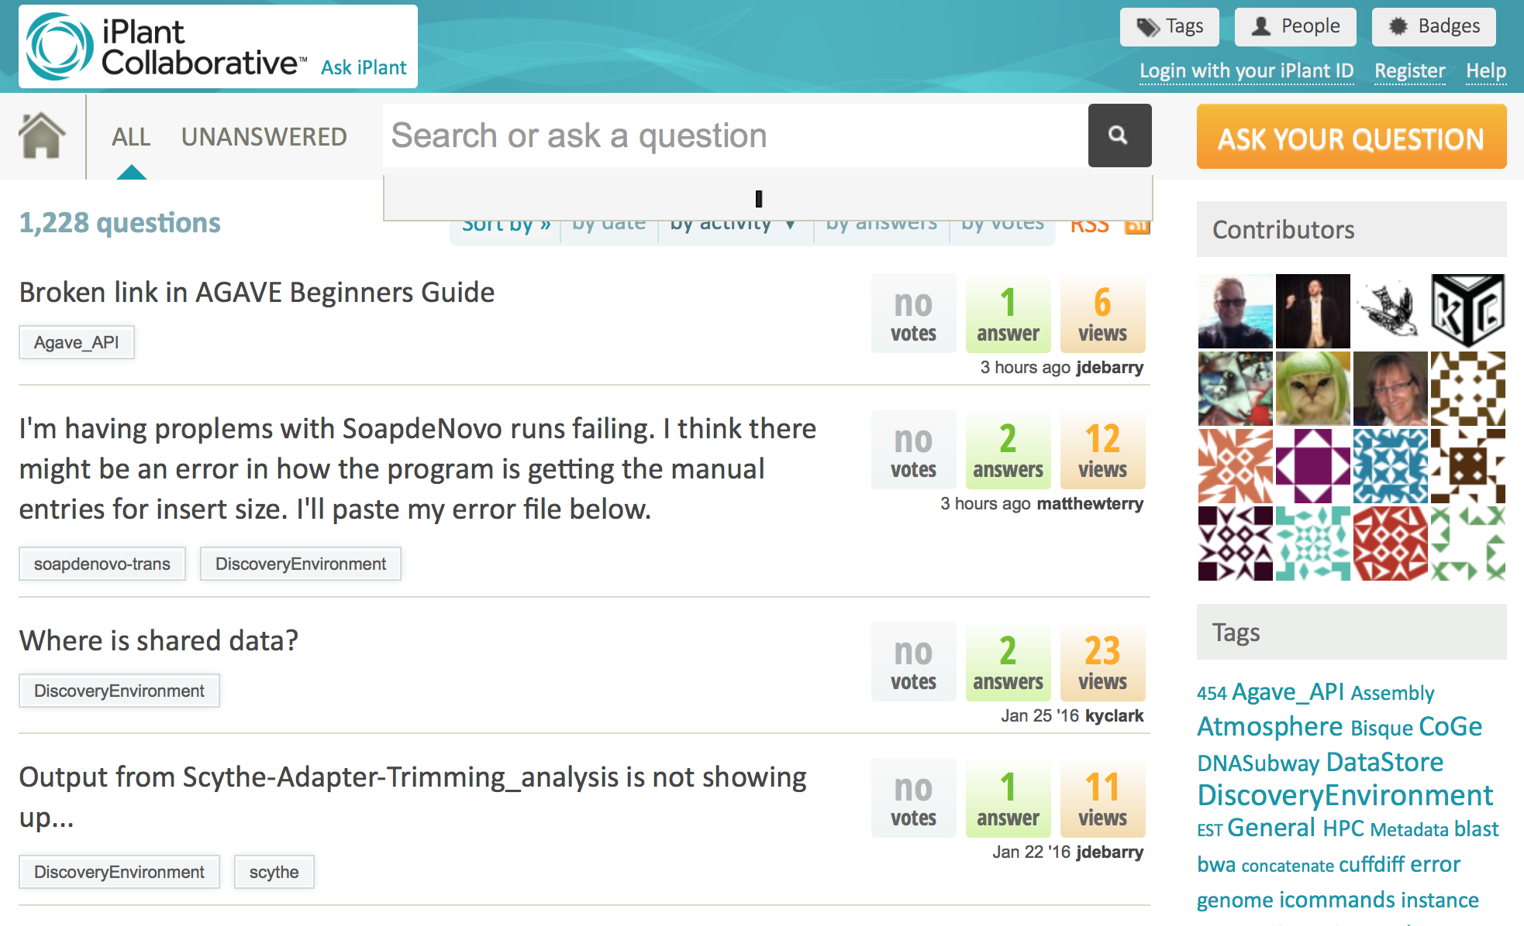
Keep asking: ask.iplantcollaborative.org
Detailed instructions with videos, manuals, documentation in Learning Center

