Slide 1
CyVerse Discovery Environment
Web-based bioinformatics and data

Slide 2
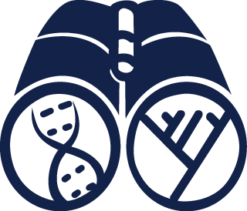
Welcome to the Discovery Environment
A Simple Interface to Hundreds of Bioinformatics Apps, Powerful Computing, and Data

Slide 3
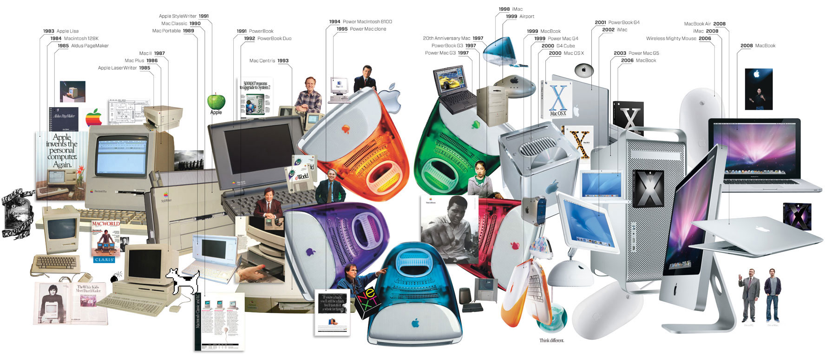
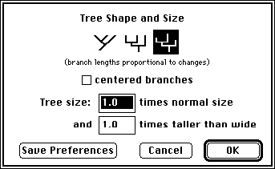
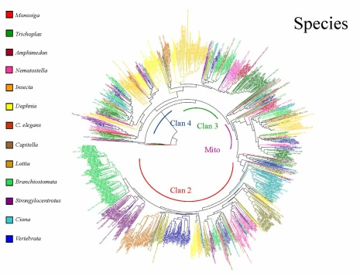
Discovery Environment Overview
A bench-biologist’s view on the evolution of computing
It can be difficult to keep up!
Investing in newer ‘better’ tools and resources is expensive.
?
Image From: http://www.wired.com/wired/archive/17.01/ff_mac_viewer.html

Slide 4
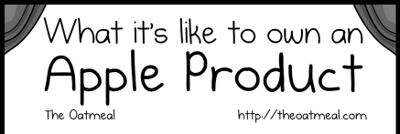
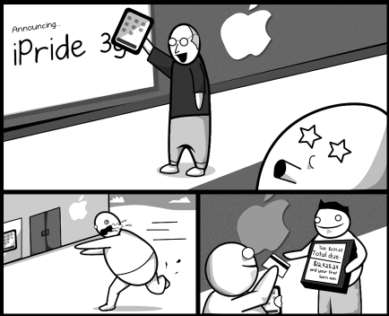
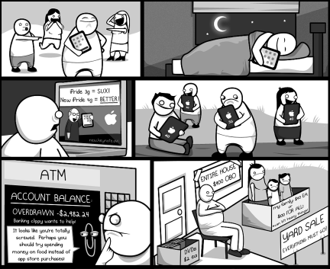
Discovery Environment Overview
The costs of keeping up with technology
Image From: http://theoatmeal.com/comics/apple

Slide 5
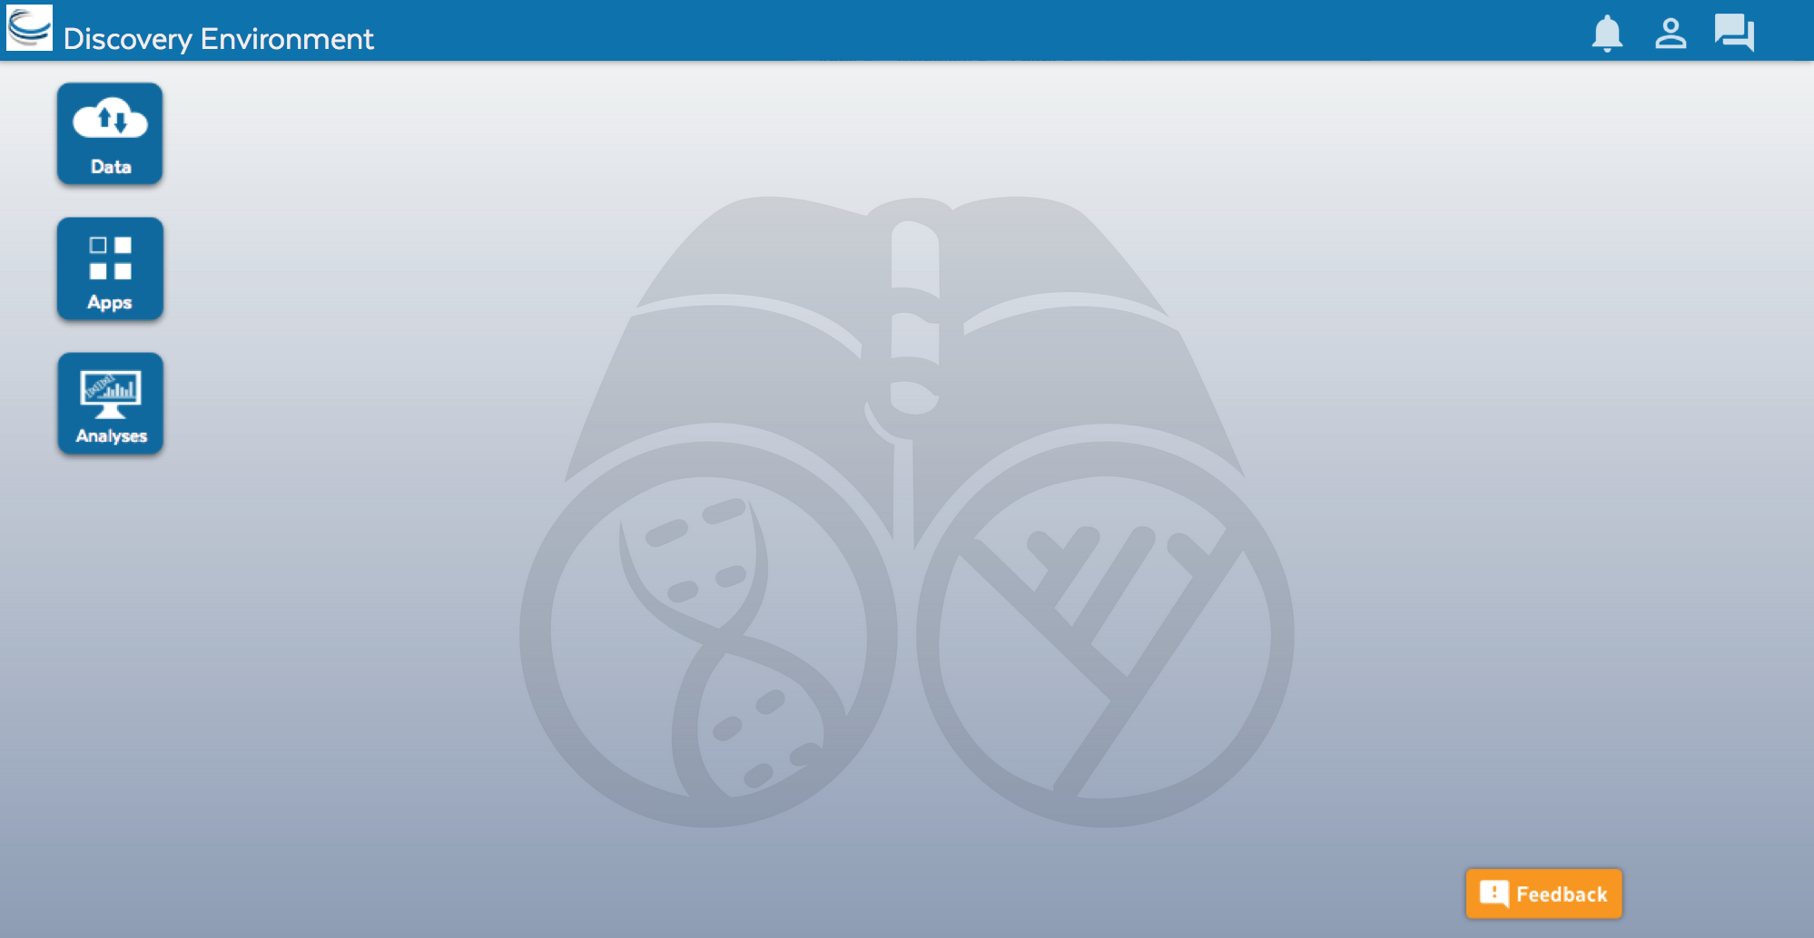
Discovery Environment Overview
Access your computational science through a single portal

Slide 6
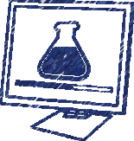
Discovery Environment Overview
Benefits
Get Science Done
Use hundreds of bioinformatics Apps without the command line
Add your own applications – an extensible, scalable platform
Create and publish Apps and workflows so anyone can use them
Analysis history and provenance – “avoid forensic bioinformatics”
High-performance computing – not dependent on your hardware
Manage a secure data repository and share data easily
Reproducibility
Productivity

Slide 7
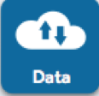
Discovery Environment Overview
Manage data
Data
Upload / Download files and folders
Share files via URL (Public Links)
Share files/folders with other users

Slide 8
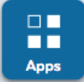
Discovery Environment Overview
Analyze data and customize Applications
Apps
Run hundreds of bioinformatics Apps
Build automated workflows
Modify Apps or integrate new ones

Slide 9
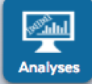
Discovery Environment Overview
View history, find results, reproduce analyses, optimize parameters
Analyses
Monitor job status and find results
Cancel jobs or re-launch jobs
Detailed job history

Slide 10
Discovery Environment Overview
Hands-on demo: Create a multiple alignment
By the end of this demo you should be able to:
Navigate the components of the DE
Access and manipulate data (upload, download, move, etc.)
Run an analysis
Track your analysis and see your results

Slide 11
Discovery Environment Overview
Hands-on demo: Create a multiple alignment
Find a file in the Community Data folder
Download a small file of unaligned DNA sequences
Upload a small file
Use the MUSCLE App to align the sequences
Monitor the job status and export its parameters
View results

Slide 12
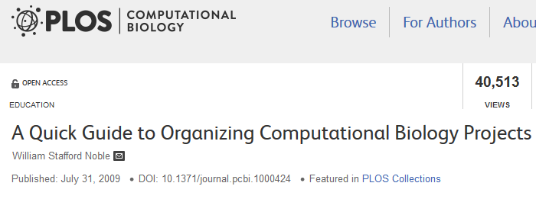
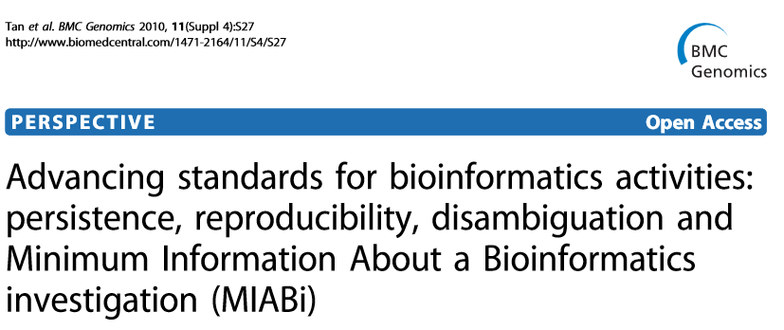
Discovery Environment Overview
Built for bioinformatics best practices: data stewardship, reproducibility, reliability
An extensible platform that scales with your science

Slide 13
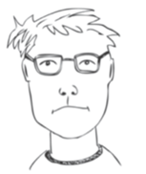
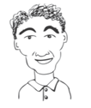
Discovery Environment Overview
User perspectives and possible applications
Does most of his data uploads/downloads/sharing here
He pushes results from his lab’s workflow into a common folder
Installed an HPC application here so that anyone can use it
Creates custom applications with default parameters exposed
Developed a workflow to QC and Filter reads for his users
Teaches about genome assembly with examples in the DE
Bench Scientist
Bioinformatician
Core Facilities
Images from personas based on: Bioinformatics Curriculum Guidelines: Toward a Definition of Core Competencies
PLOS Biology DOI: 10.1371/journal.pcbi.1003496

Slide 14
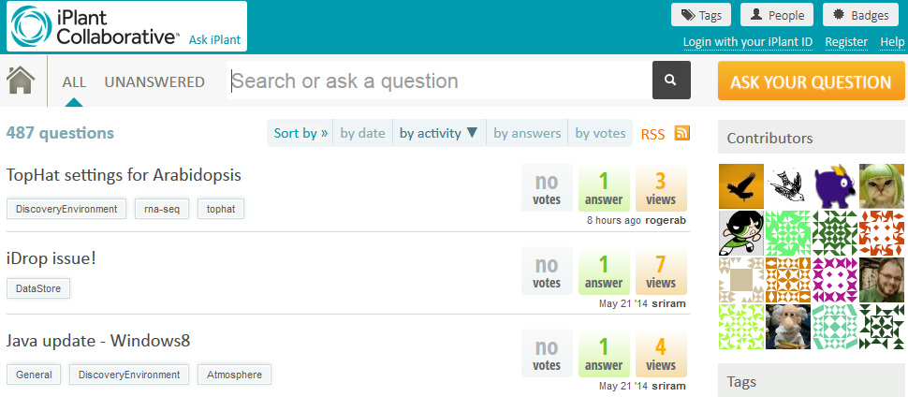
Detailed instructions with videos, manuals, documentation in
Keep asking: ask.iplantcollabortive.org

