Slide 1

CyVerse Workshop
Genome Annotation w/ MAKER

Slide 2

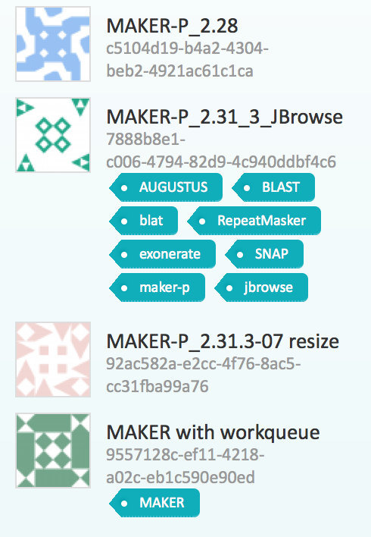

Available on Atmosphere and DE (Lonestar)

Slide 3
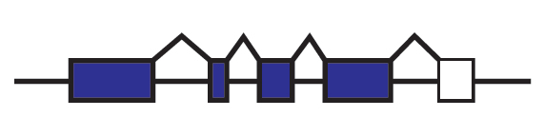
What Are Annotations?
Quick Review
Annotations are descriptions of features of the genome
  Structural: exons, introns, UTRs, splice forms etc.
  Coding & non-coding genes
  Expression, repeats, transposons
Annotations should include evidence trail
  Assists in quality control of genome annotations
Examples of evidence supporting a structural annotation:
  Ab initio gene predictions
  ESTs
  Protein homology

Slide 4
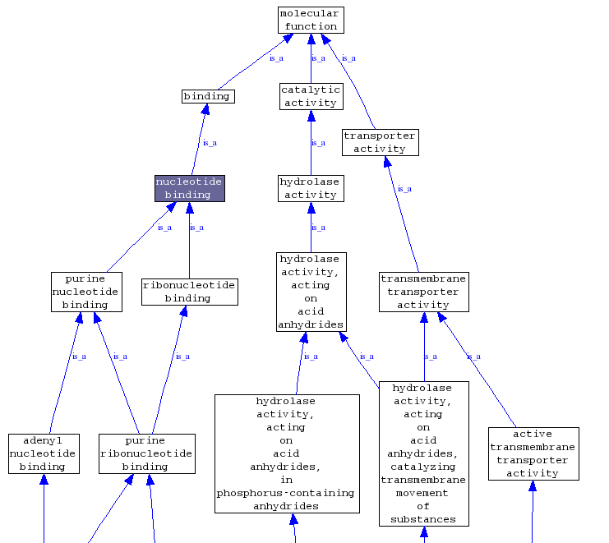
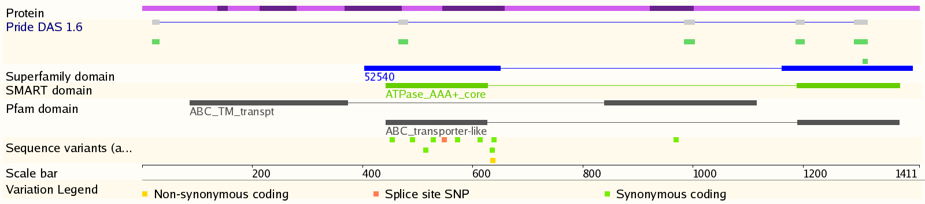
Secondary Annotations
Protein Domains
InterPro Scan: combines many HMM databases
GO and other ontologies
Pathway mapping
E.g. BioCyc Pathway tools

Slide 5
Challenges in Annotation
Particularly for plants…
Genomes are BIG
Highly repetitive
Many pseudogenes
Assembly contamination
Incomplete evidence
No method is 100% accurate

Slide 6
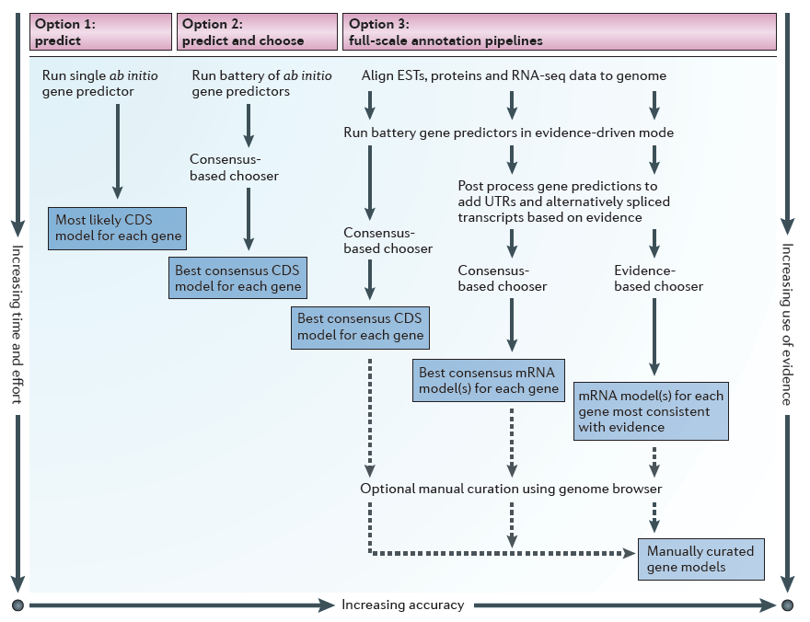
Options for Protein-coding Gene Annotation
Yandell & Ence. Nature Reviews Genetics 13, 329-342 (May 2012) | doi:10.1038/nrg3174

Slide 7
Typical Annotation Pipeline
Contamination screening
Repeat/TE masking
Ab initio prediction
Evidence alignment (cDNA, EST, RNA-seq, protein)
Evidence-driven prediction
Chooser/combiner
Evaluation/filtering
Manual curation

Slide 8
MAKER-P Automated Pipeline
MPI-enabled to allow parallel operation on large compute clusters
Repeat Library
Ab initio prediction
Evidence
Collaboration with Yandell Lab

Slide 9
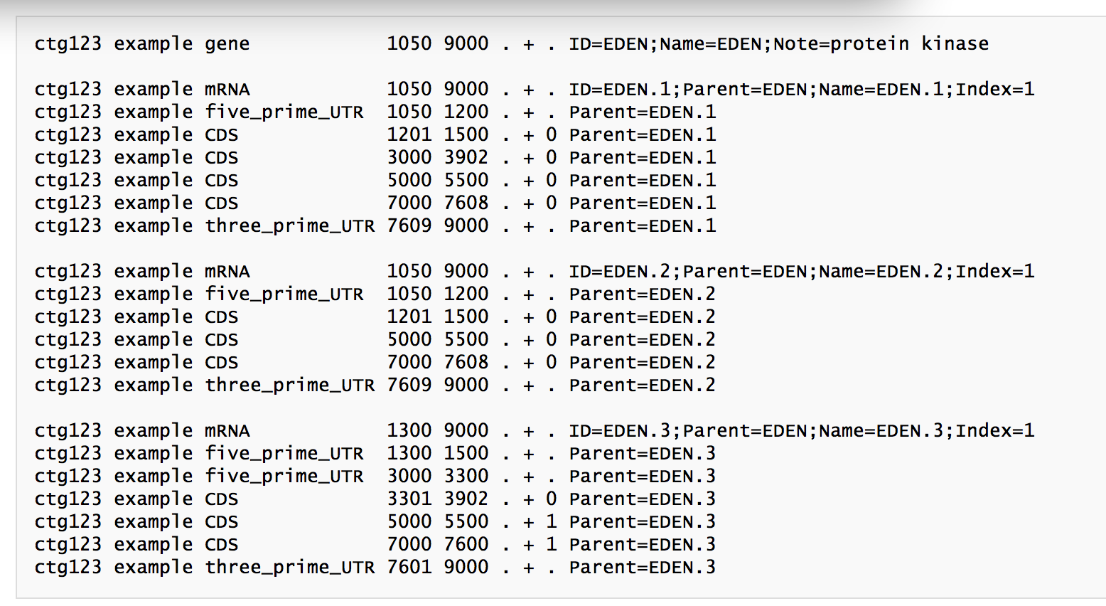
What is a GFF File?
Generic Feature Format

Slide 10
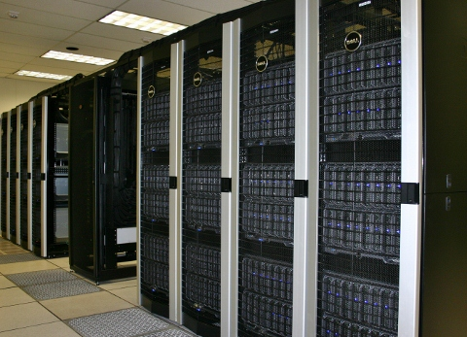


MAKER-P at iPlant
TACC Lonestar Supercomputer
22,656 CPU cores on1,888 nodes
Genome | Assembly | Size (Mb) | CPU | Run Time
Arabidopsis thaliana | TAIR10 | 120 | 600 | 2:44
Arabidopsis thaliana | TAIR10 | 120 | 1500 | 1:27
Zea mays | RefGen_v2 | 2067 | 2172 | 2:53
Campbell et al. Plant Physiology. December 4, 2013, DOI:10.1104/pp.113.230144
PAG 2014:
W559 - Annotation of the Lobolly Pine Megagenome—Jill Wegrzyn
  20.15 Gb assembly—split into 40 jobs—216 CPU/job (8640 CPU total)—17 hours
P157 - Disease Resistance Gene Analysis on Chromosome 11 Across Ten Oryza Species
  10 rice species (each w/12 chromosome pseudomolecules)
  96 CPU per chromosome (1152 CPU total) ~ 2hr per genome
Agave API

Slide 11

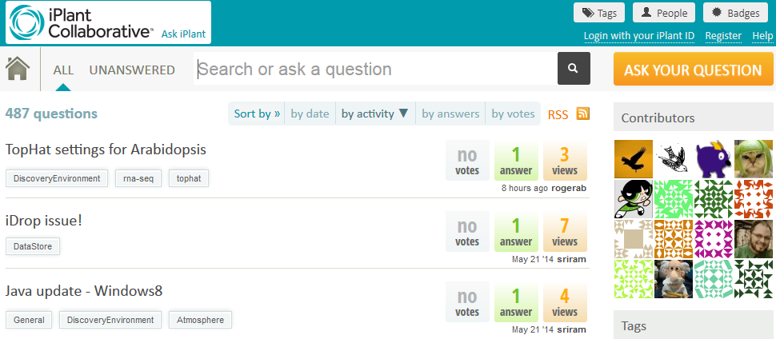
Keep asking: ask.iplantcollabortive.org

