Slide 1
Workshop Goals
Langebio, Cinvistav
Jason Williams – Lead, CyVerse – Education, Outreach, Training
John Fonner – Research Associate, TACC Life Sciences Computing Group
Cold Spring Harbor Laboratory
williams@cshl.edu [ @JasonWilliamsNY]
jfonner@tacc.utexas.edu [ @johnfonner]

Slide 2
Welcome to the workshop
Workshop Wiki: www.cyverse.org/langebio-wiki
Pre-Survey: www.iplantc.org/tswpre
Download Packet
Wifi:

Slide 3
Broad objectives we hope to enable
Be able to upload/download/share any dataset ( MB, GB, TB /100-1000’s files)
Run bioinformatics application with or without the command line
Be able to create simple workflows and integrate new tools
Get started with large data projects – RNA-Seq, Genome Assembly/annotation
Use cloud computing to operate in a powerful restriction free environment

Slide 4
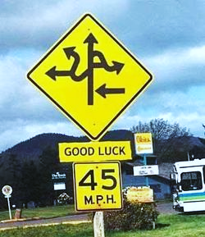
The limitations of any training workshop
“I had the feeling I have been exposed to many bioinformatics tools but I would be unable to use any of them on my own.”

Slide 5
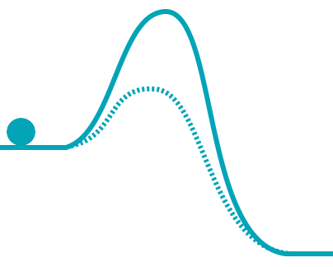
Some suggestions

Slide 6
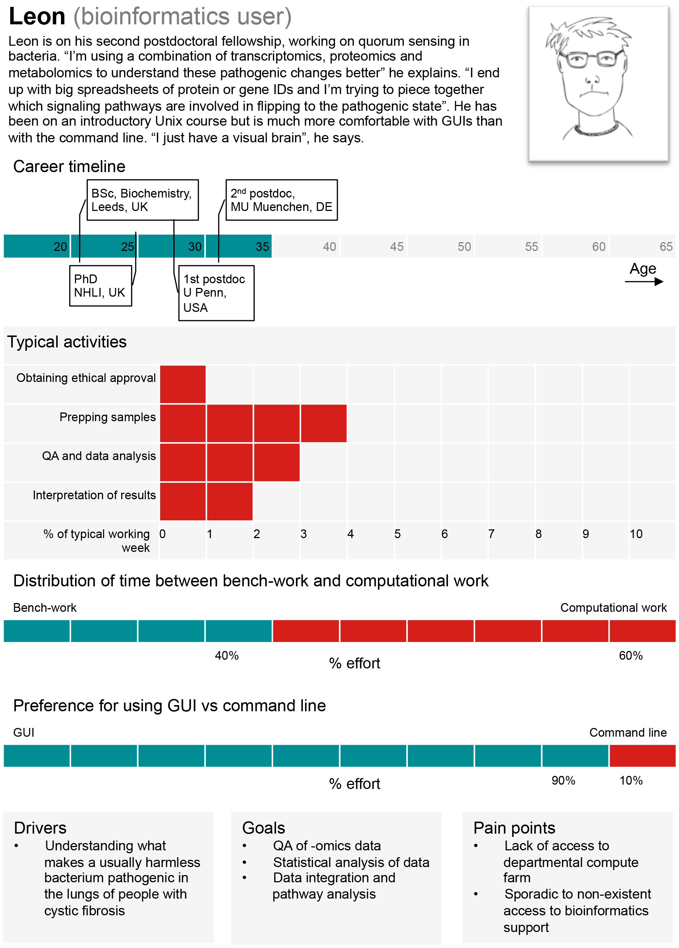
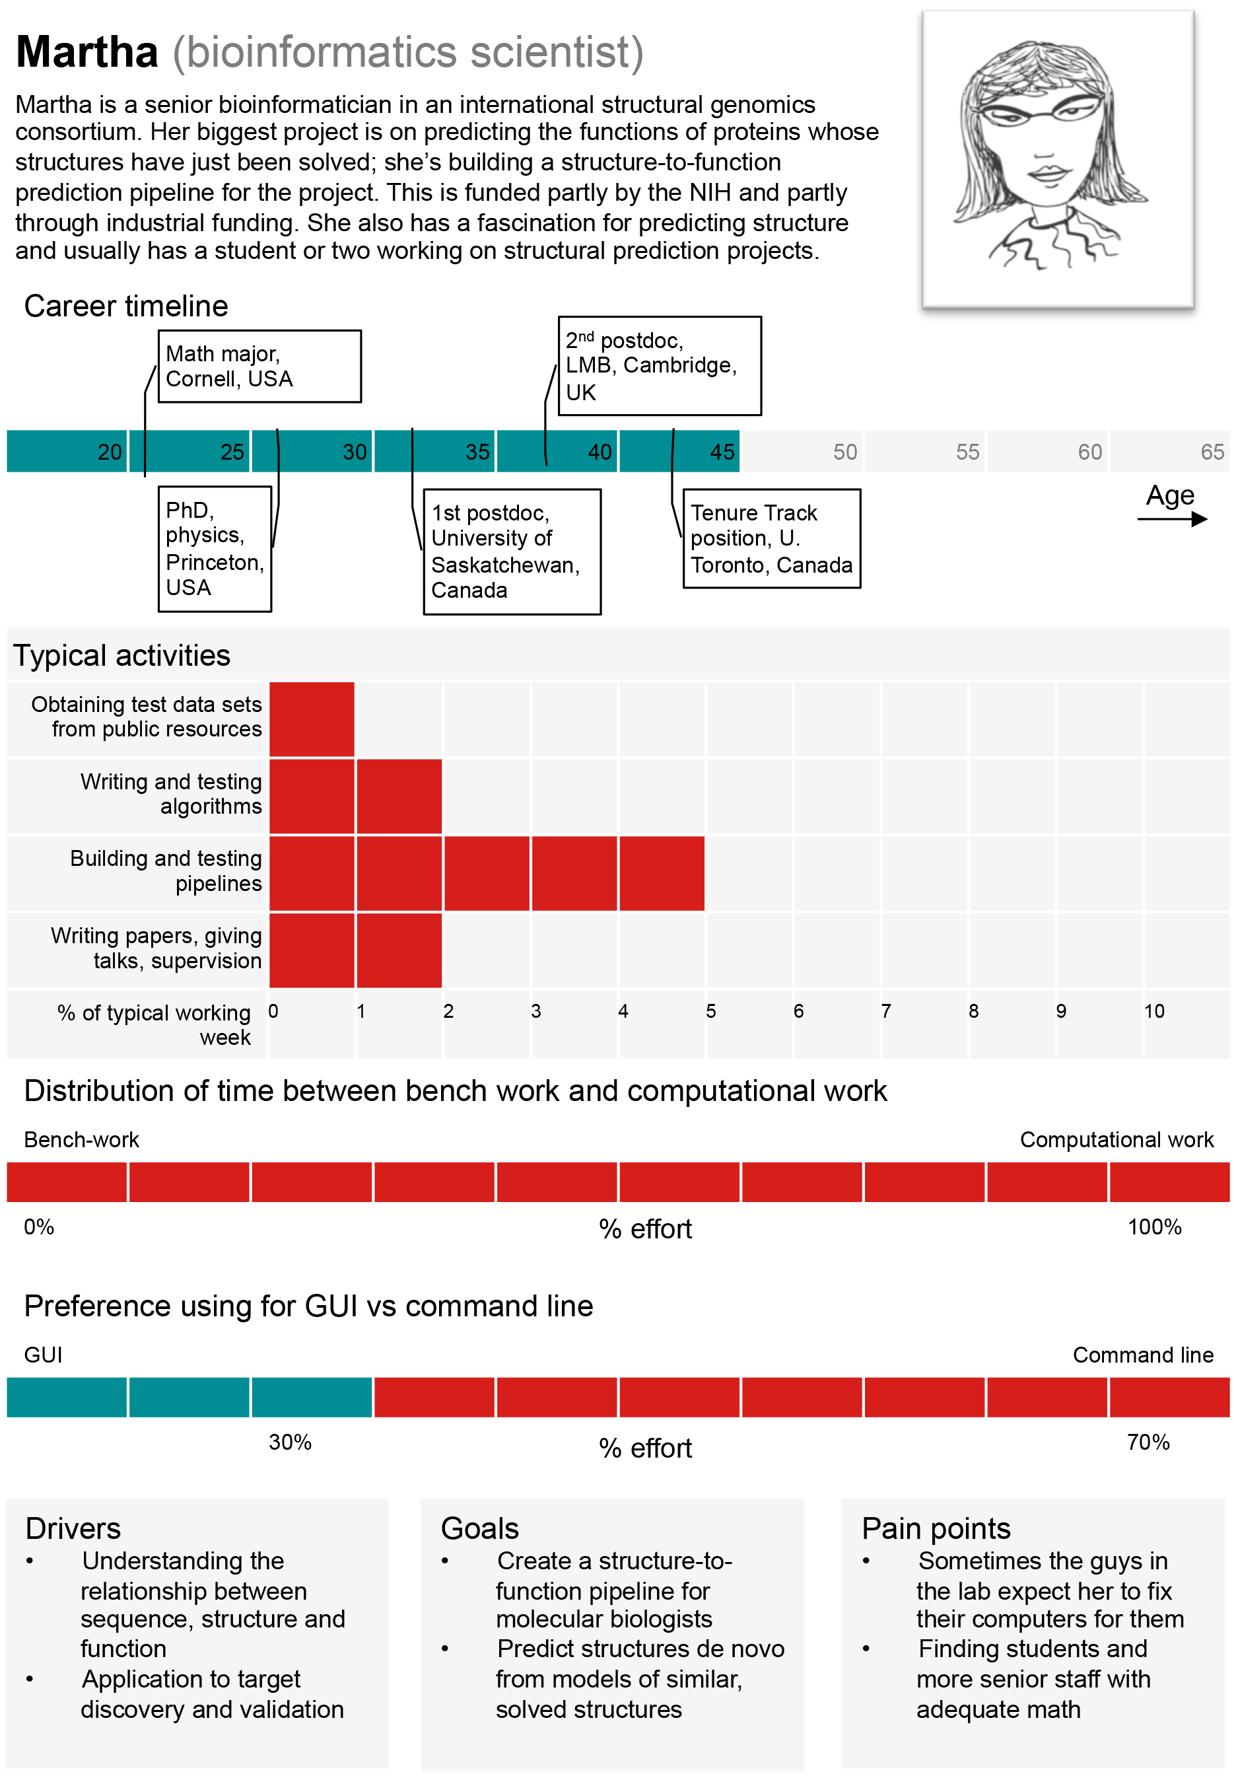
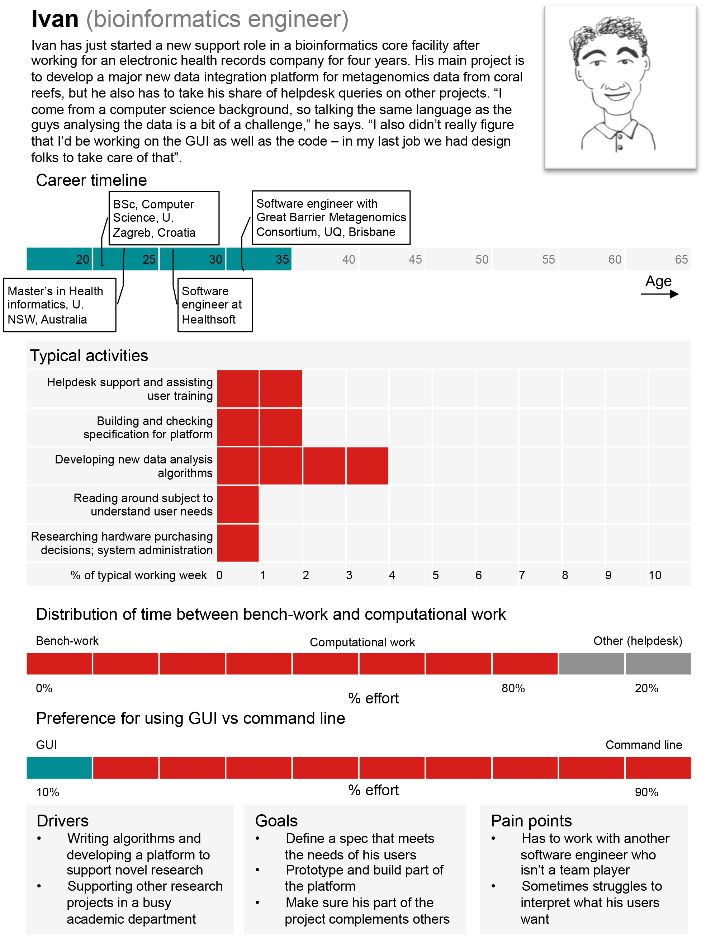
1. Know what type of user you are (or want to be)

Slide 7
2. Look for what’s important to your research
Get Science Done
Ability to access and manage data
Software to analyze data
Computing resources
Skills and help to use software and interpret results
Ensure Reproducibility
Metadata management
Ability to share data and workflows
Open source sustainable tools
Increase Productivity
High-performance and scalable computing
Ability automate and collaborate
Funding spent on science, not software or hardware

Slide 8
3. Keep asking questions
Don’t hesitate to ask
“Can CyVerse do this?”
If CyVerse can, we’ll help show you how…
If CyVerse can’t we’ll find the path that gets you what you need
Keep asking at ask.iplantcollabortive.org

