Slide 1
Scan and Visualize Genomes with PatMatch and Circos in VICE
Presented by: Wayne Decatur
May 17th, 2019

Slide 2
Outline of Today’s Focus Forum
Intro: beyond these tools
PatMatch Demo
Benefits of CyVerse VICE
Circos Intro
Circos Demo
(Visual Interactive Computing Environment)

Slide 3
No need for notes aside of this link
Links and everything covered
already listed right now at:
bit.ly/CyverseWayne
CyVerse will provide link to the video and more later.

Slide 4
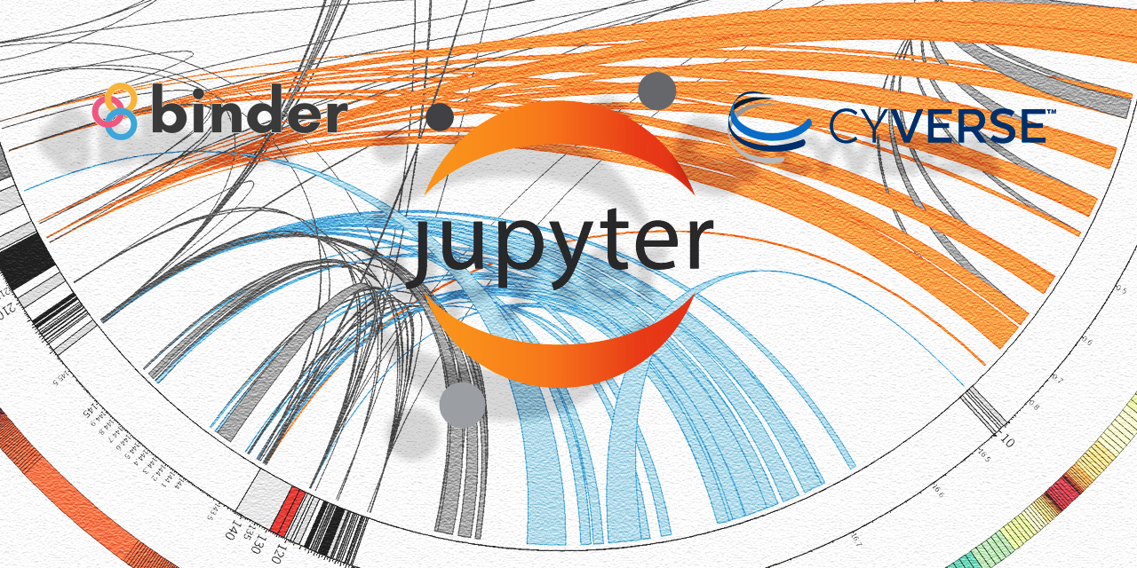
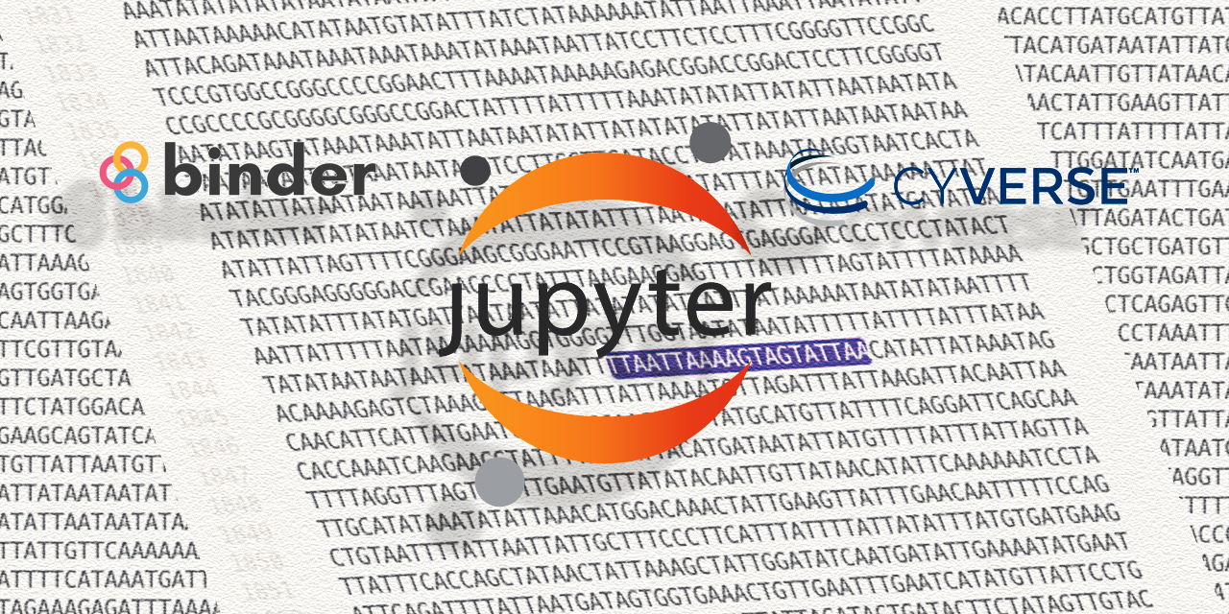
Ostensibly…
Circos
PatMatch
Circos

Slide 5
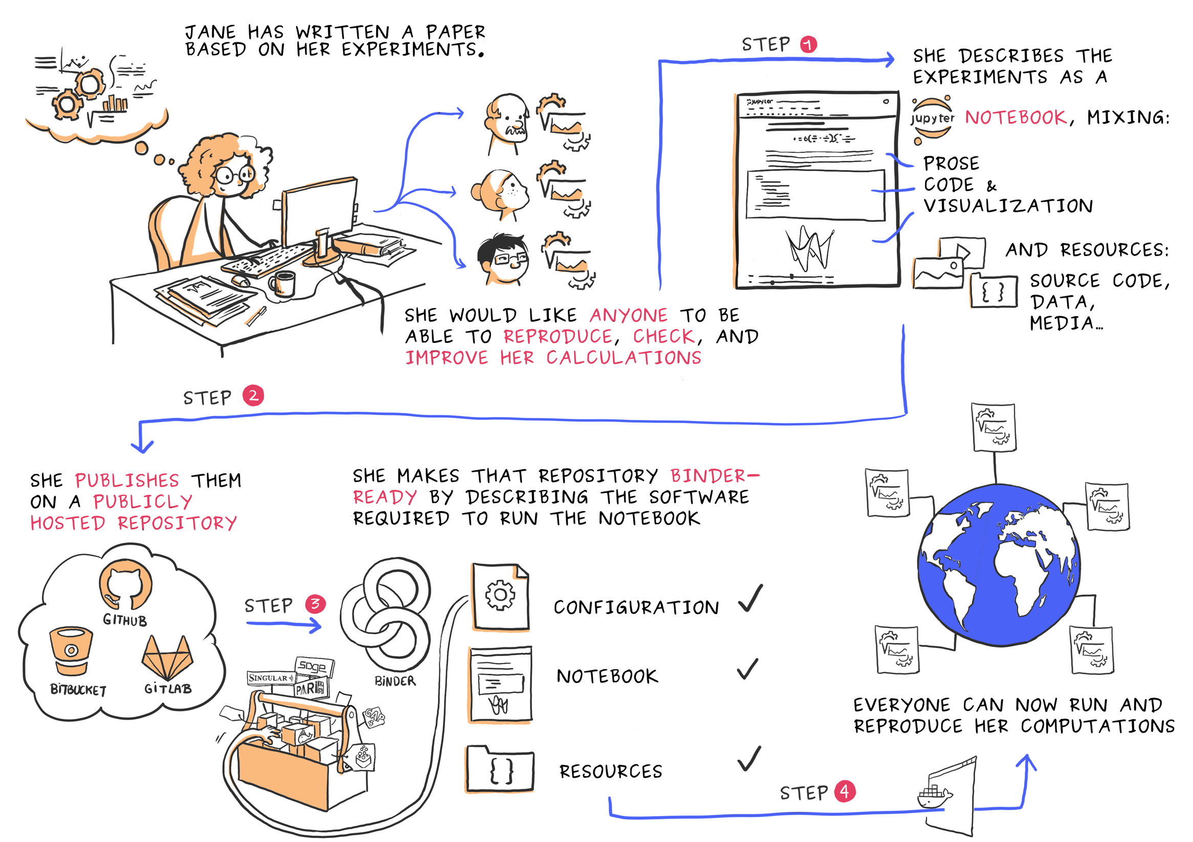
by
Juliette Taka
for OpenDreamKit

Slide 6
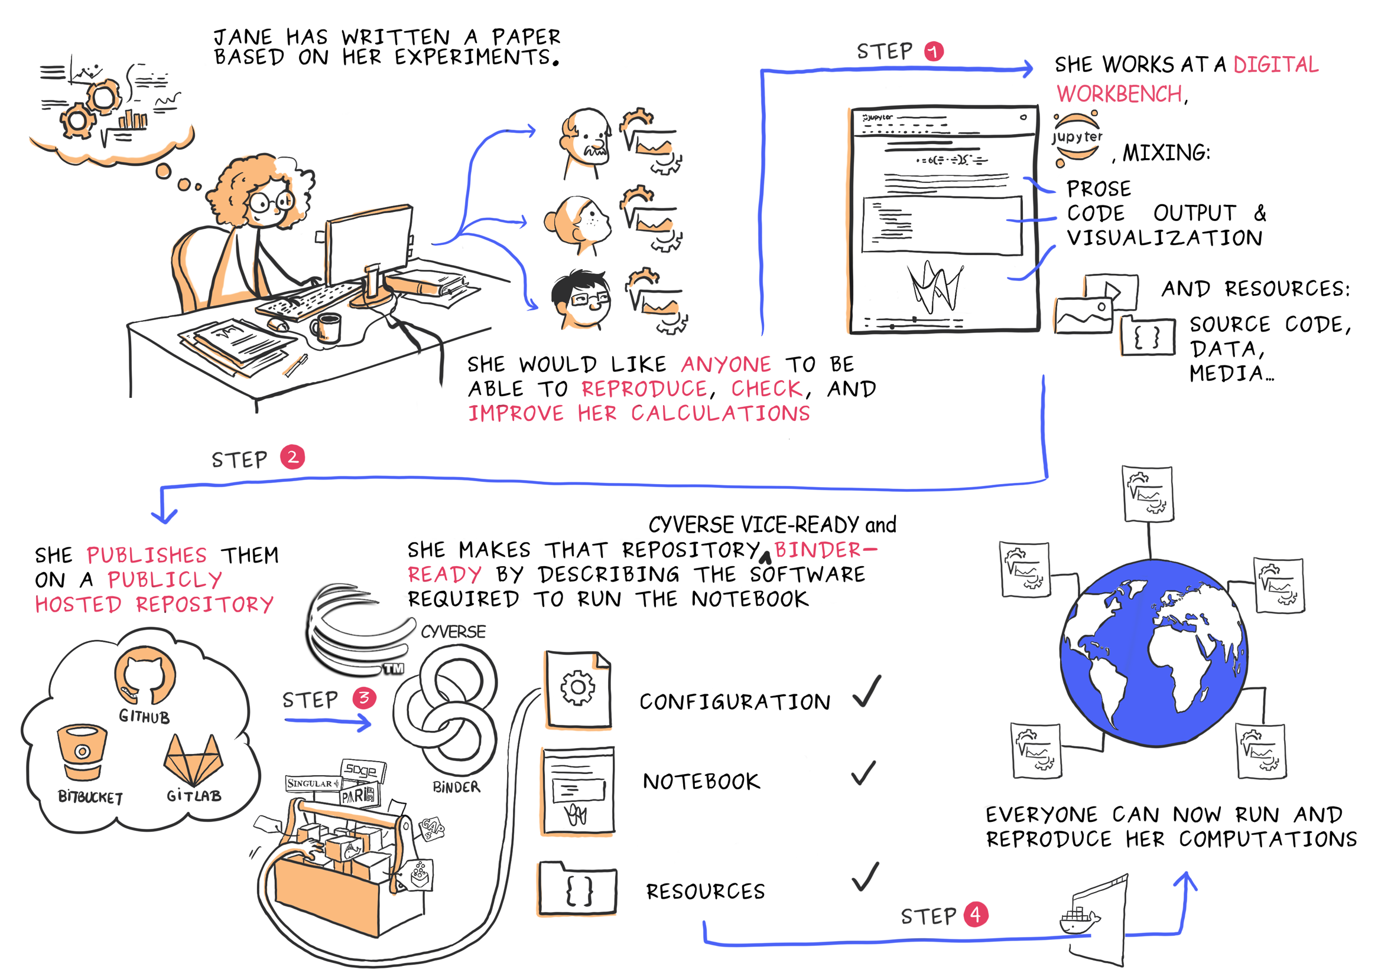
expanding on image by
Juliette Taka
for OpenDreamKit

Slide 7
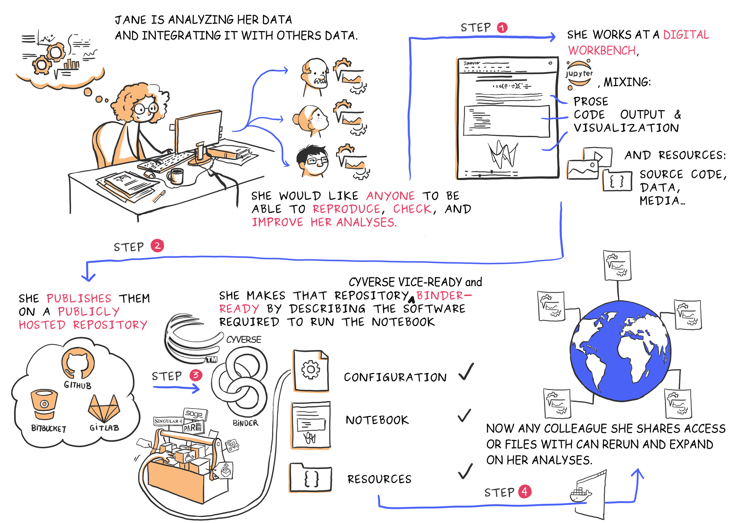
expanding on image by
Juliette Taka
for OpenDreamKit

Slide 8
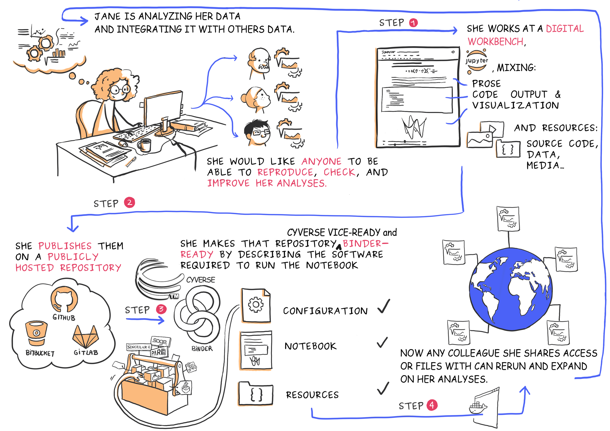
WITH WHOM IS JANE MOST
OFTEN COLLABORATING?
expanding on image by
Juliette Taka
for OpenDreamKit

Slide 9
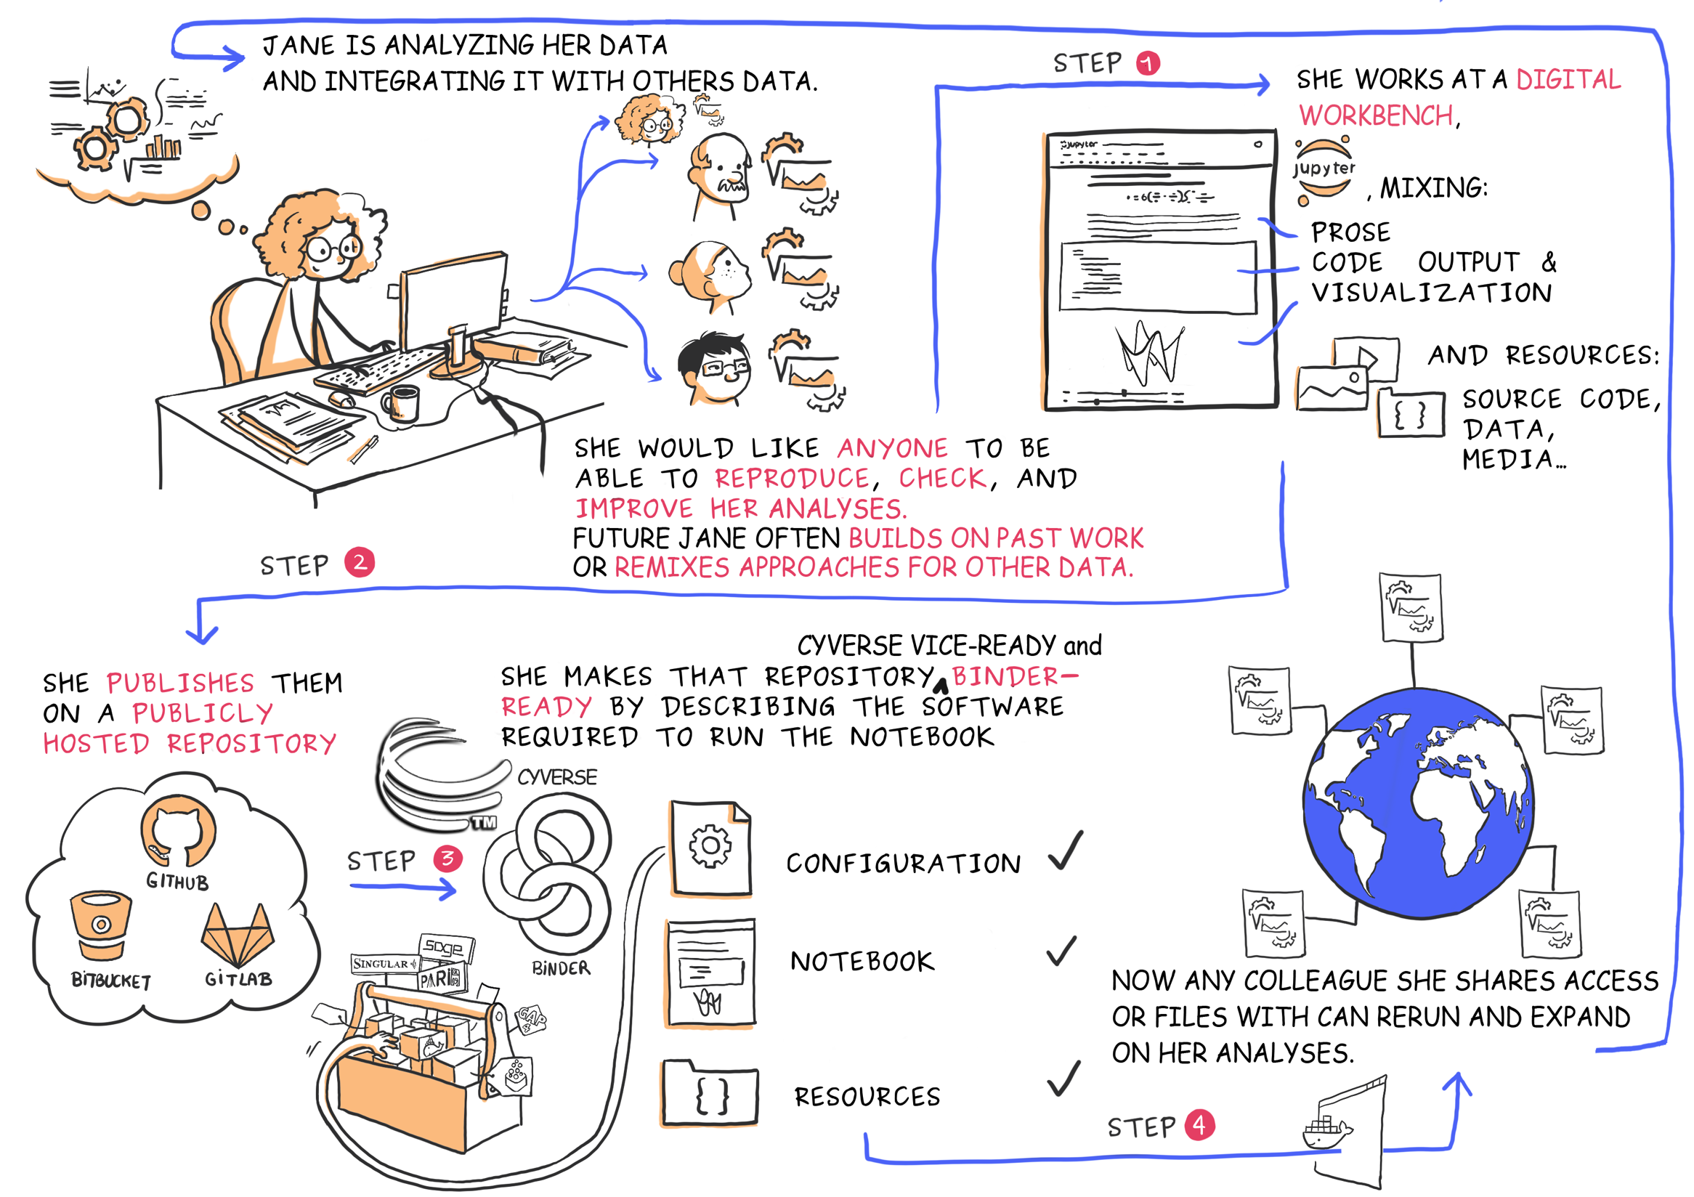
expanding on image by
Juliette Taka
for OpenDreamKit

Slide 10
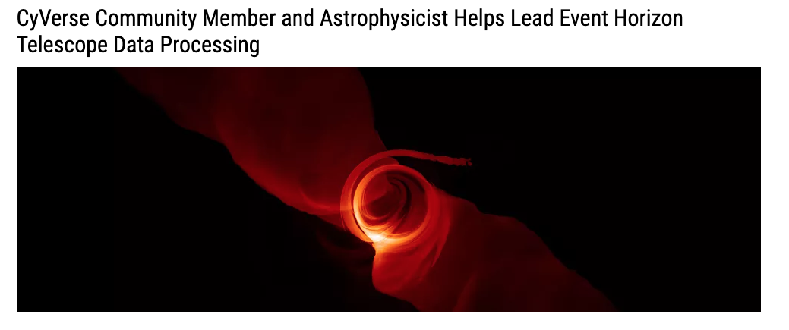
WORLD CLASS, OPEN SOURCE SOFTWARE
TODAY…
expanding on image by
Juliette Taka
for OpenDreamKit

Slide 11
What problems does PatMatch address?
Find sequence or sequence pattern in nucleic acids or polypeptides
Why better than find/replace or grep or regex?

Slide 12
What problems does PatMatch address?
Find sequence or sequence pattern in nucleic acids or polypeptides
Features domain specific abilities
Command line enables scalability and reproducibility
Why better than find/replace or grep or regex?
faster than GUI-find line breaks biological syntax

Slide 13
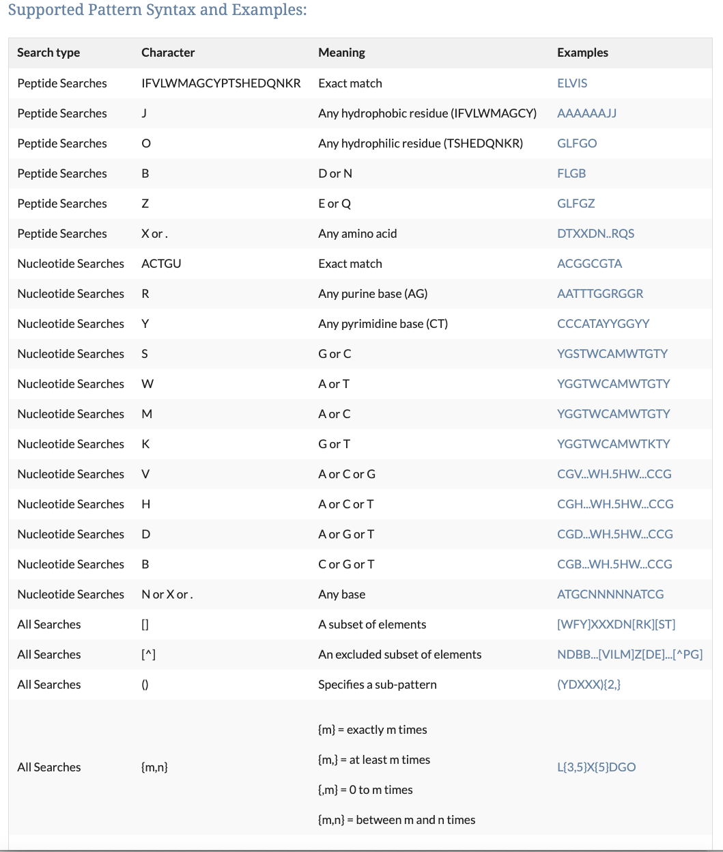
From
https://www.yeastgenome.org/nph-patmatch
Weak
not C
not A

Slide 14
From
https://www.yeastgenome.org/nph-patmatch

Slide 15
Launch at: https://github.com/fomightez/patmatch-binder

Slide 16
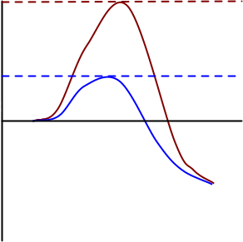
binder
VICE
Besides computability:
No installation
No impact on local systems
Portability

Slide 17
binder
VICE
Besides computability:
No installation
No impact on local systems
Reproducibility
Scalability
Connectability
Convertability
Shareability

Slide 18
VICE
Besides computability:
No installation
No impact on local systems
Reproducibility
Scalability
Connectability +
Convertability
Shareability +
Persistence+

Slide 19
What does Circos do?
Generates informative visualizations

Slide 20
http://circos.ca/guide/genomic/img/circos-conservation.png

Slide 21
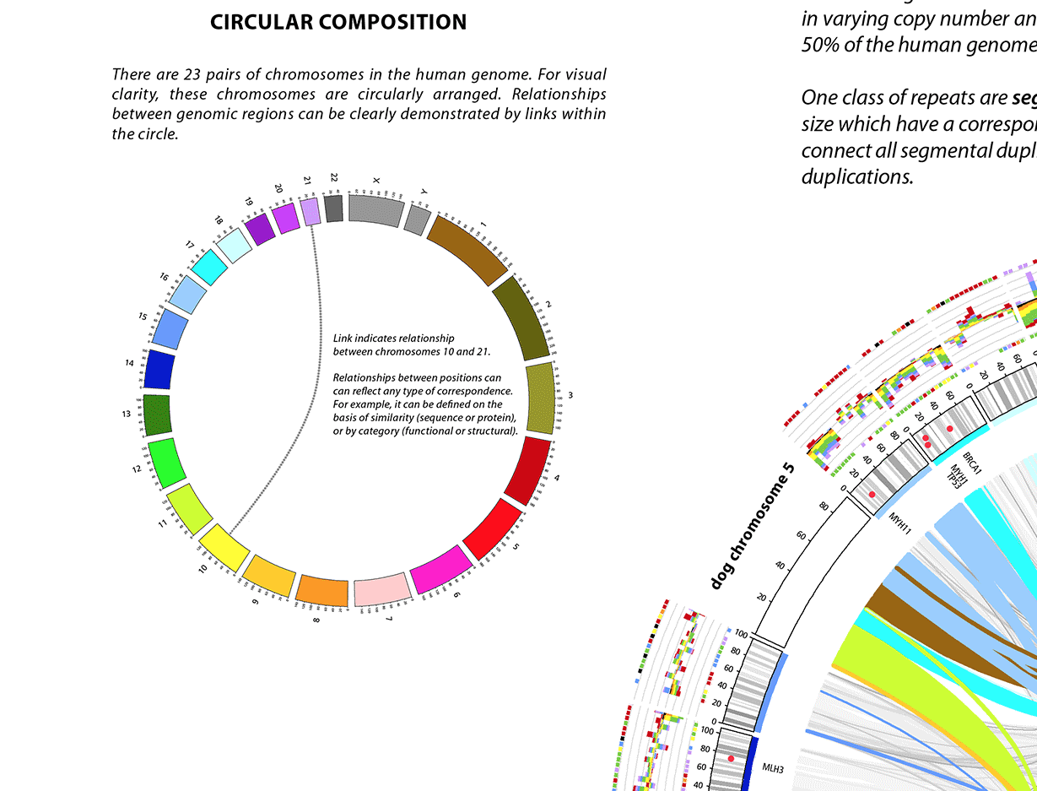

Slide 22
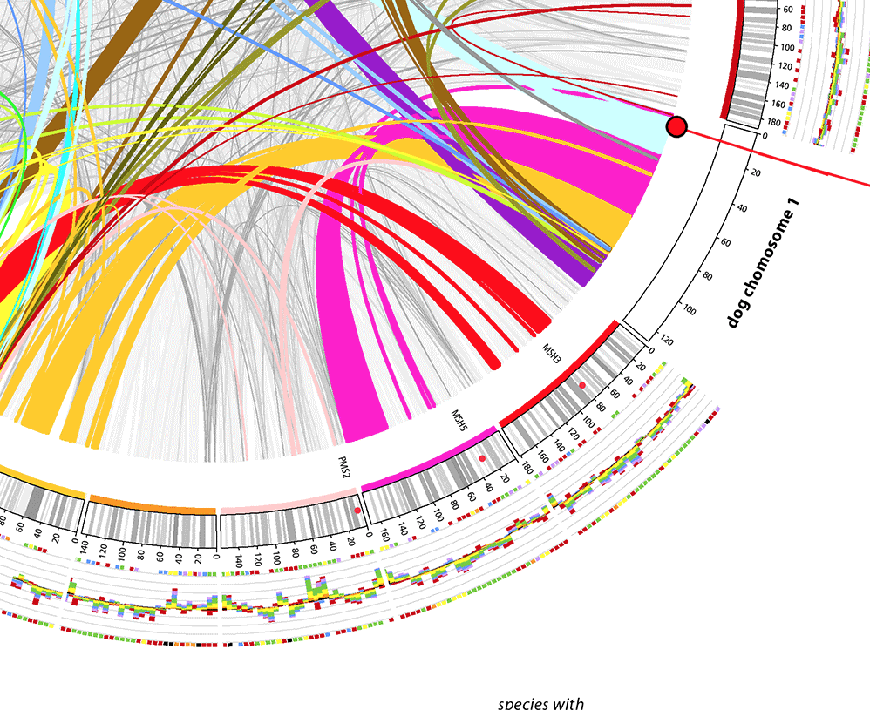

Slide 23
From Putnam et al., 2008 (PMID: 18563158)

Slide 24
What do you need for making a Circos plot?
Minimum required
karyotype
ideogram
name and size of chromosomes.
Banding, if available.
how to depict the chromosome or a region of it.
Boilerplate code can handle everything else (colors,fonts, image generating settings, etc.).

Slide 25
What do you need for making a Circos plot?
Typical plot enhancements
Links
Data Tracks
Ticks & Labels
Highlights

Slide 26
What do you need for making a Circos plot?
Typical plot enhancements
Links
Data Tracks*
Ticks & Labels
Highlights*
* potential sources of lots of data

Slide 27
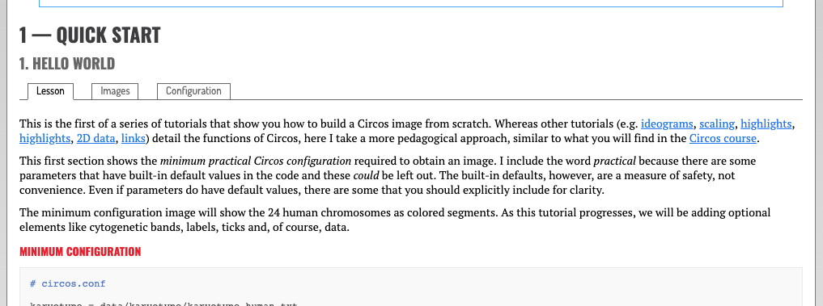
Segue to Demo: Actual minimum configuration file
From: http://circos.ca/documentation/tutorials/quick_start/hello_world/lesson

Slide 28
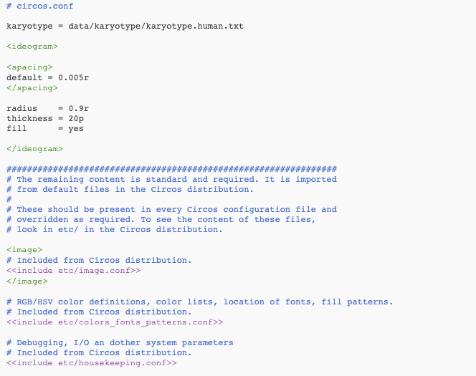

Slide 29
Segue to Demo: Basics of running tutorial code in your browser
_

Slide 30
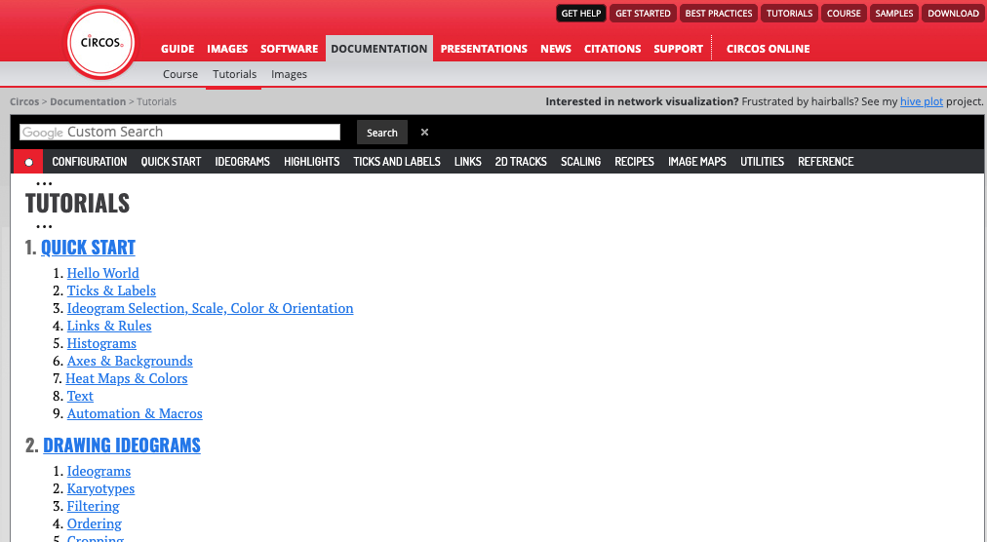
Segue to Demo: Basics of running tutorial code in your browser
_

Slide 31
Segue to Demo: Basics of running tutorial code in your browser
_

Slide 32
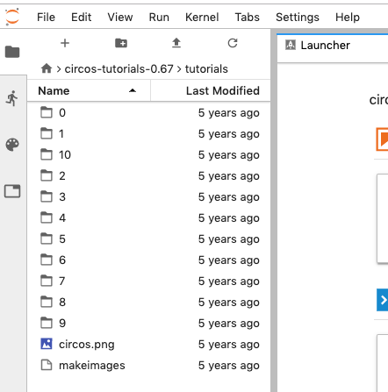
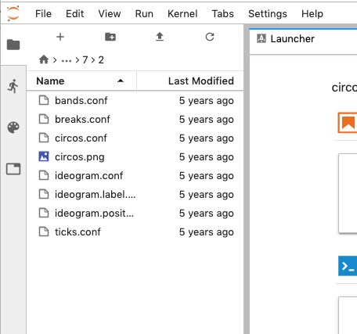
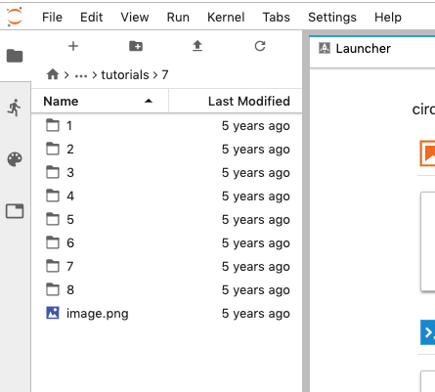
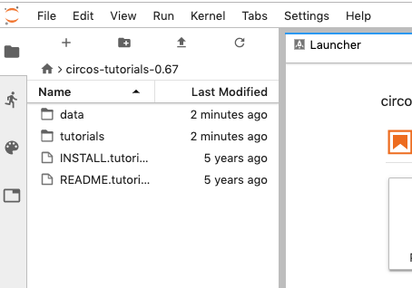
Segue to Demo: Basics of running tutorial code in your browser
_

Slide 33
Launch at: https://github.com/fomightez/circos-binder
Quick start: https://cyverse-circos-quickstart.readthedocs-hosted.com/en/latest/

Slide 34
Acknowledgements
Martin Krzywinski
T. Yan, D. Yoo, T.Z. Berardini, L.A. Mueller, D.C. Weems, S. Weng, J.M. Cherry, S.Y. Rhee
CyVerse Team
MyBinder Team
Biochem. & Mol. Biol. Dept.
see bit.ly/CyverseWayne

Slide 35
Needs/Suggestions/Ideas for Vice Apps
Discuss with CyVerse staff
(Upendra Devisetty)
upendra_35@cyverse.og @upendra_35
- or via the CyVerse intercom -

Slide 36
Useful references
bit.ly/CyverseWayne
decaturw@upstate.edu @fomightez fomightez

Slide 37
CyVerse is supported by the National Science Foundation under Grants No. DBI-0735191, DBI-1265383 and DBI-1743442.

Slide 38
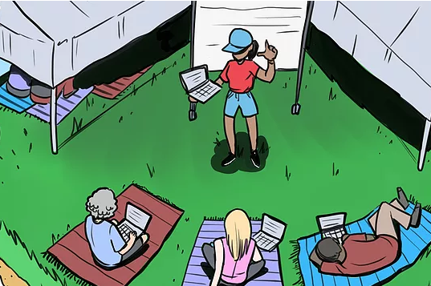
Help Future You & Your Colleagues
Keep in mind
Not just for large data handling
Start incorporating
Share with others
CyVerse’s
FOSS camp

Slide 39
CyVerse is supported by the National Science Foundation under Grants No. DBI-0735191, DBI-1265383 and DBI-1743442.

Slide 40
Useful references
bit.ly/CyverseWayne
decaturw@upstate.edu @fomightez fomightez

Slide 43
Picture placeholder

Slide 44
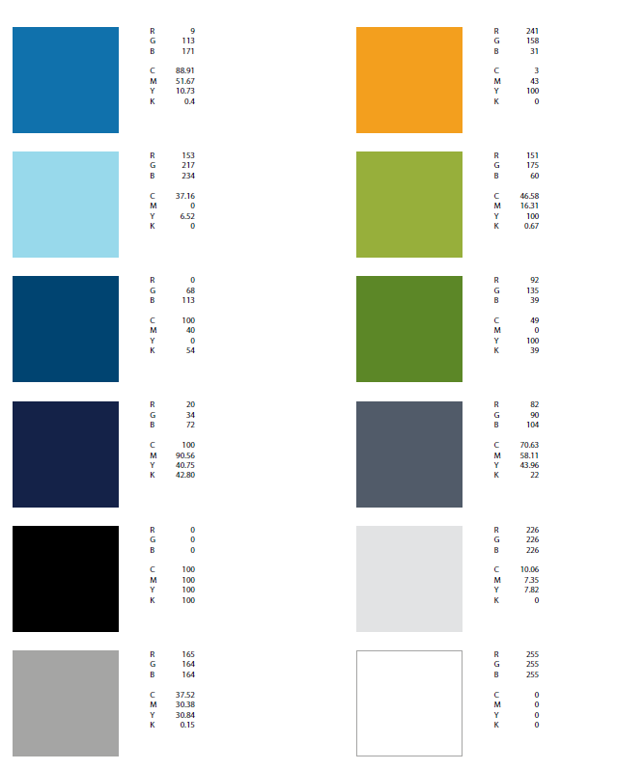
Logos, Fonts
Color palette
Text In Black
CyVerse Dark Blue
CyVerse Light Blue
CyVerse Green
CyVerse Orange

Slide 45
Other Icons
Subtitle
Get Science Done Productively Reproducibly Twitter

