Slide 1
iPlant Collaborative
Tools and Services Workshop
Overview of the iPlant Discovery Environment
Notes:
Presenters Notes:
This power point is designed for a 25 minute presentation (5-minutes on the introduction; slides 2-6, and 20 minutes for the simple hands on lab; slides 7-X)

Slide 2
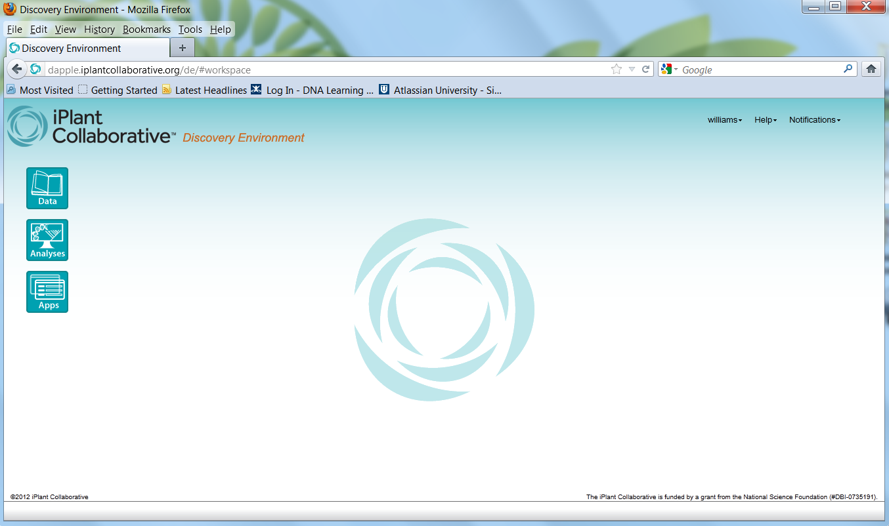
Overview of the iPlant Discovery Environment
Scalable platform for
powerful computing, data, and application resources

Slide 3
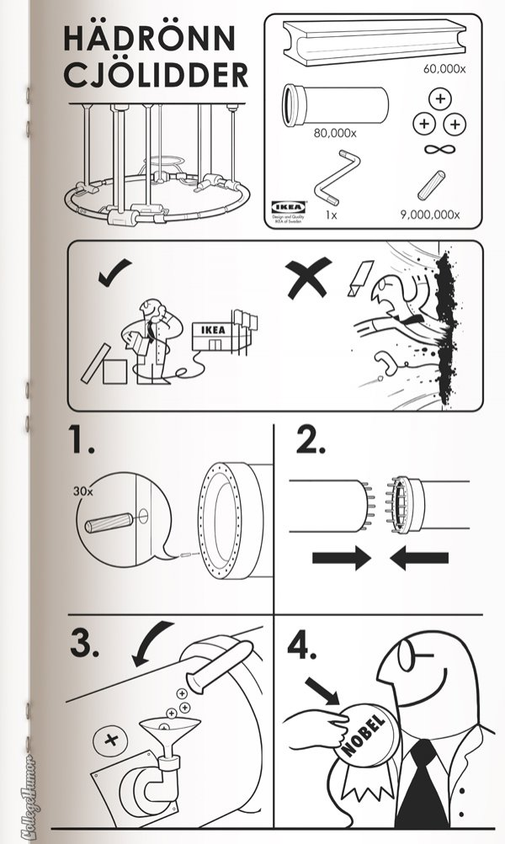
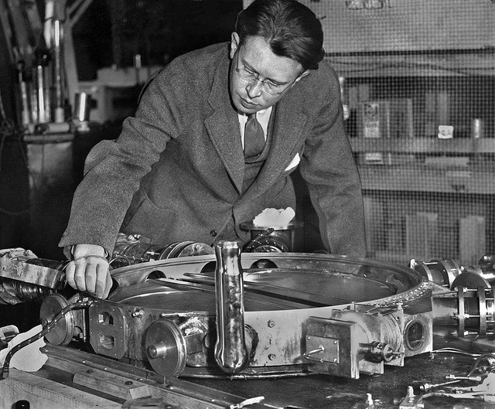
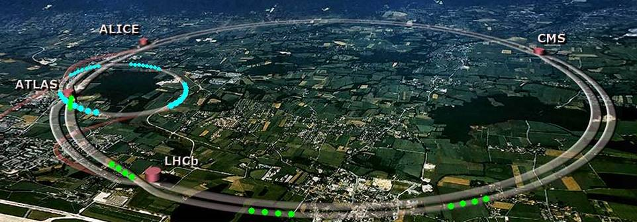
Overview of the iPlant Discovery Environment
Scalable Science: from table top to “mountain top”
Notes:
Physics has learned this lesson, and now that Biology is in the “front seat” we are learning how too!
In 1930, Ernest O. Lawrence, the father of particle accelerators, built the first hand-held cyclotron at Berkeley, California.
Particle physics depended on the scaling of their technology to drive discovery
Physics made the transition from single experimenters, single labs, to multiple investigators, multiple labs. This requires INFRASTRUCTURE

Slide 4
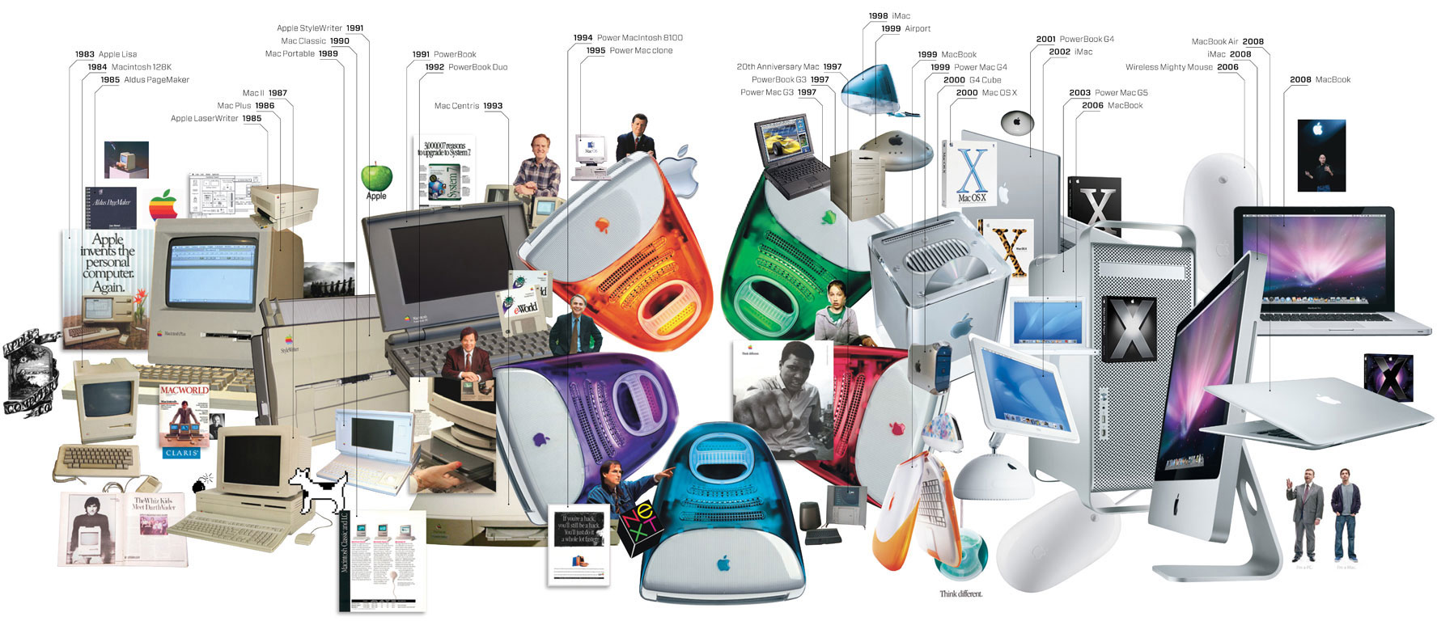
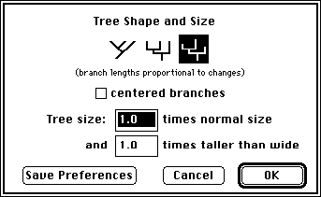
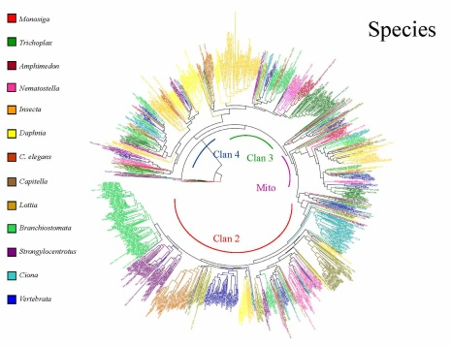
Overview of the iPlant Discovery Environment
The evolution of cyberinfrastructure, from the bench biologist’s point of view
?
Image From: http://www.wired.com/wired/archive/17.01/ff_mac_viewer.html
Notes:
Why do we need to have / what is a scalable platform for modern biology?
All science depends on technological advances that spur development. (e.g. Kuhn, Normal Science ….The term refers to the routine work of scientists experimenting within a paradigm, slowly accumulating detail in accord with established broad theory, … Kuhn identified this mode of science as being a form of "puzzle-solving.“ – wikipedia)
Periods of normal science are where technology aimed at a particular technique (e.g. NGS) gets more and more refined/advanced.
Computational power to advance biology could be looked at under a similar analogy
Computational power has advanced, but the technology has outpaced single lab, single institution scale (e.g. MacClade on an apple II was great, but when we want big trees, even though the new iMacs are purddy, they won’t cut it)

Slide 5
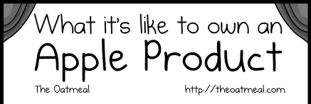
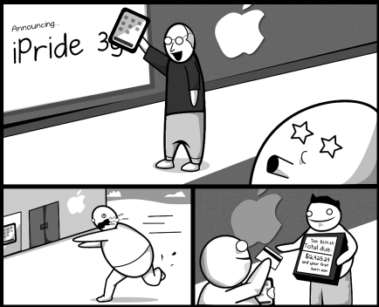
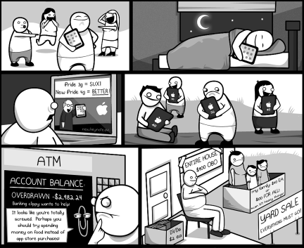
Overview of the iPlant Discovery Environment
Image From: http://theoatmeal.com/comics/apple
Notes:
Investing in rapid-turnover technologies – faster computing power, hard drive space, etc. Is not a saleable model for science.

Slide 6
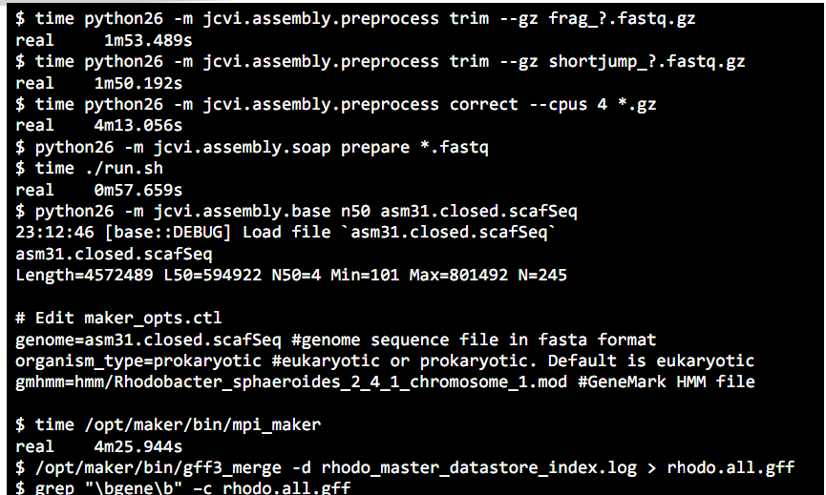
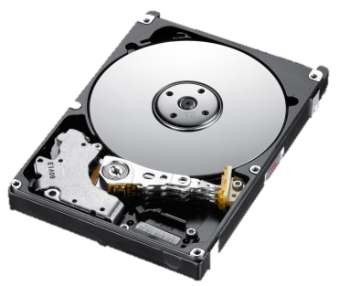
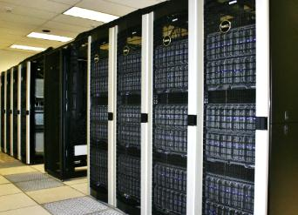
Overview of the iPlant Discovery Environment
Through the Discovery Environment you have:
High-powered computing
iPlant data store
Easy to use interface
Virtually limitless apps
Analysis history (provenance)
Notes:
The DE is part of iPlant’s answer to the scalability issue of bioinformatics.
By creating a platform, instead of a “tool,” the community can continue to scale and expand.
No need to worry about changing technologies and operating systems, its web-based and open source

Slide 7
Discovery Environment Hands-on Lab

Slide 8
Discovery Environment Lab
By the end of this module you should be able to:
Navigate the components of the DE
Access and manipulate data (upload, download, move, etc.)
Start and complete an analysis
Track your analysis and see your results

Slide 9
Discovery Environment Lab
Goal: Create a multiple sequence alignment.
Task 1: Download a file from the community data folder.
Task 2: Upload the file to your personal data store.
Task 3: Find and select the multiple sequence aligner MUSCLE
and run the app.
Task 4: Monitor the progress of your analysis and save parameters.
Task 5: View your results.
Create multiple Alignment with MUSCLE
Download an input FASTA
Monitor analysis progress
Upload FASTA to data store
Locate and view results

Slide 10
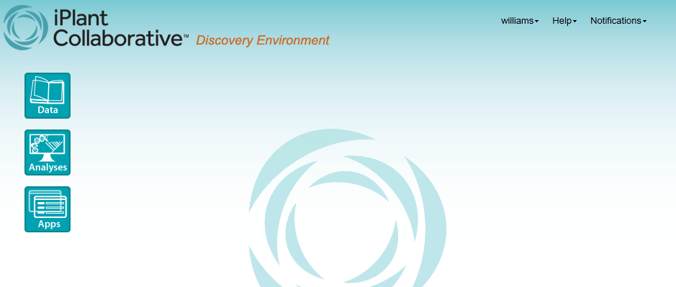
Discovery Environment Lab
1
2
3
4
Access to help, notifications, login/out
Access to data (files, results, etc.)
Analysis history
Bioinformatics apps (directory and integration)
Notes:
Rather than have a bunch of slides on the DE, the presenter will walk you through the DE overview as you preform you analysis.
There are more detailed screenshots in the handouts!

Slide 11
Discovery Environment Lab
Please login to the Discovery Environment.
Follow along with the instructor
Or
Follow along with the handouts on your own
Notes:
Do the lab now!

Slide 12
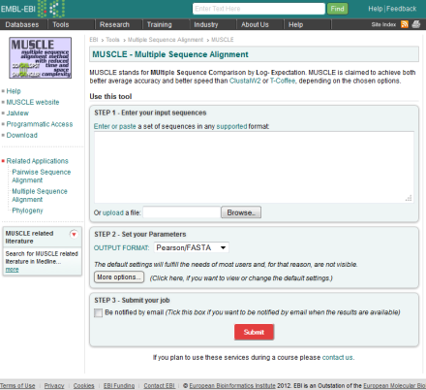
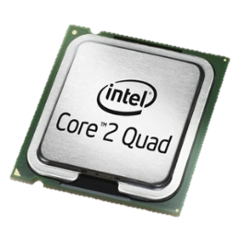
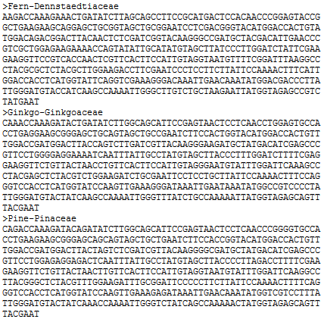
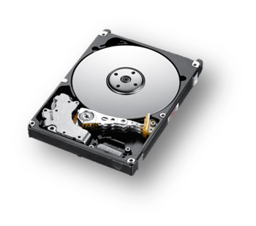
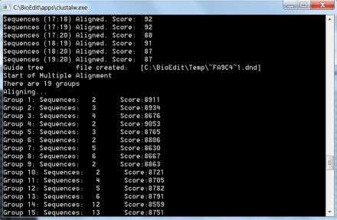
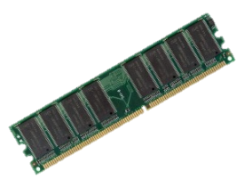
Discovery Environment Lab
Summary
Single task webserver
Desktop command line
Discovery Environment
Notes:
So what have you just done, and what’s so special?
You have familiarized yourself with the DE in about 20 minutes. It does not get fantastically more complicated than what you just covered.
You have run completed a very simple workflow, that you could have done many different ways. So why is the DE special

Slide 13
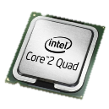
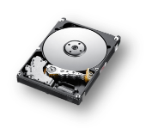
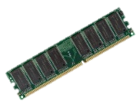
Discovery Environment Lab
What happens when we need more power (RNA-seq) ?
?
?
?
Limited/ no scalability
Limited / costly scalability
Painless scalability
Notes:
The DE shines when we move to larger demanding workflows that require it’s scalability!
Of course the DE is not unlimited, but it scales to the majority of use cases.
Scalability of the DE is done without burdening the user with the details.

Slide 14
Discovery Environment Lab
What happens when we need more tools (RNA-seq) ?
Unitasker
Do you know what you are doing?
Notes:
Single tool web portals have limited functionality
Even if you have local computing resources, do you have expertise to get things started?

Slide 15
Discovery Environment Lab
What happens when we need more?
Rich platform for bioinformatics
186 293 apps (and counting)
Data co-localized with analysis
Easy to use interface, with access
to support
More than just RNA-seq (phylogenetics
GWAS, QTLs, and more
Easy to integrate and customize your own
tools

Slide 16
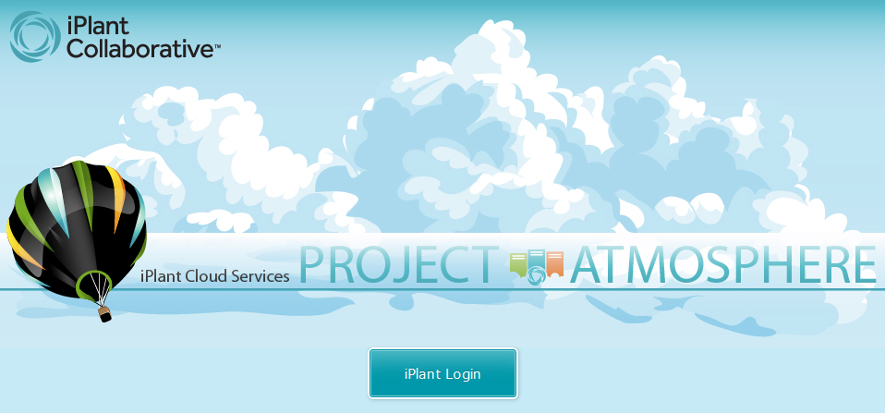
Launch Your Atmosphere Images
Follow your instructors’ instructions and
work in teams for the Atmosphere demo

