Slide 1
Using CyVerse Cyberinfrastructure to Enable Data Intensive Research, Collaboration, and Education
Joslynn Lee – Data Science Educator
Jason Williams – Education, Outreach, Training Lead
Cold Spring Harbor Laboratory
williams@cshl.edu [ @JasonWilliamsNY]
jolee@cshl.edu [ @theoreticalfun]

Slide 2
TAGC Session Agenda
Download slides / View tutorials
http://www.cyverse.org/tagc2016
Overview of CyVerse
CyVerse Data Store - Managing "Big Data”
Overview of the CyVerse Discovery Environment (DE)
Overview of Cloud Computing Atmosphere
Overview of BisQue
DNA Subway
Notes:
ACTION: reword

Slide 3
CyVerse Evolution
iPlant 2008
Empowering a New Plant Biology
iPlant 2013
Cyberinfrastructure for Life Science
CyVerse 2016
Transforming Science Through Data-Driven Discovery
http://www.cyverse.org/tagc2016

Slide 4
CyVerse Evolution
We are funded by the National Science Foundation
We are your colleagues and collaborators!
$100 Million in investment
Freely available to the community
Spur national/international collaboration
Cite CyVerse:
CyVerse.org/acknowledge-cite-cyverse
DBI-0735191 and DBI-1265383
http://www.cyverse.org/tagc2016

Slide 5
CyVerse Evolution
Vision:
Transforming science through data-driven discovery
Mission:
Design, develop, deploy, and expand a national cyberinfrastructure for life science research, and train scientists in its use
More than 40K users, PB of data, and hundreds of publications, courses, and discoveries
CyVerse 2016
Transforming Science Through Data-Driven Discovery
http://www.cyverse.org/tagc2016

Slide 6
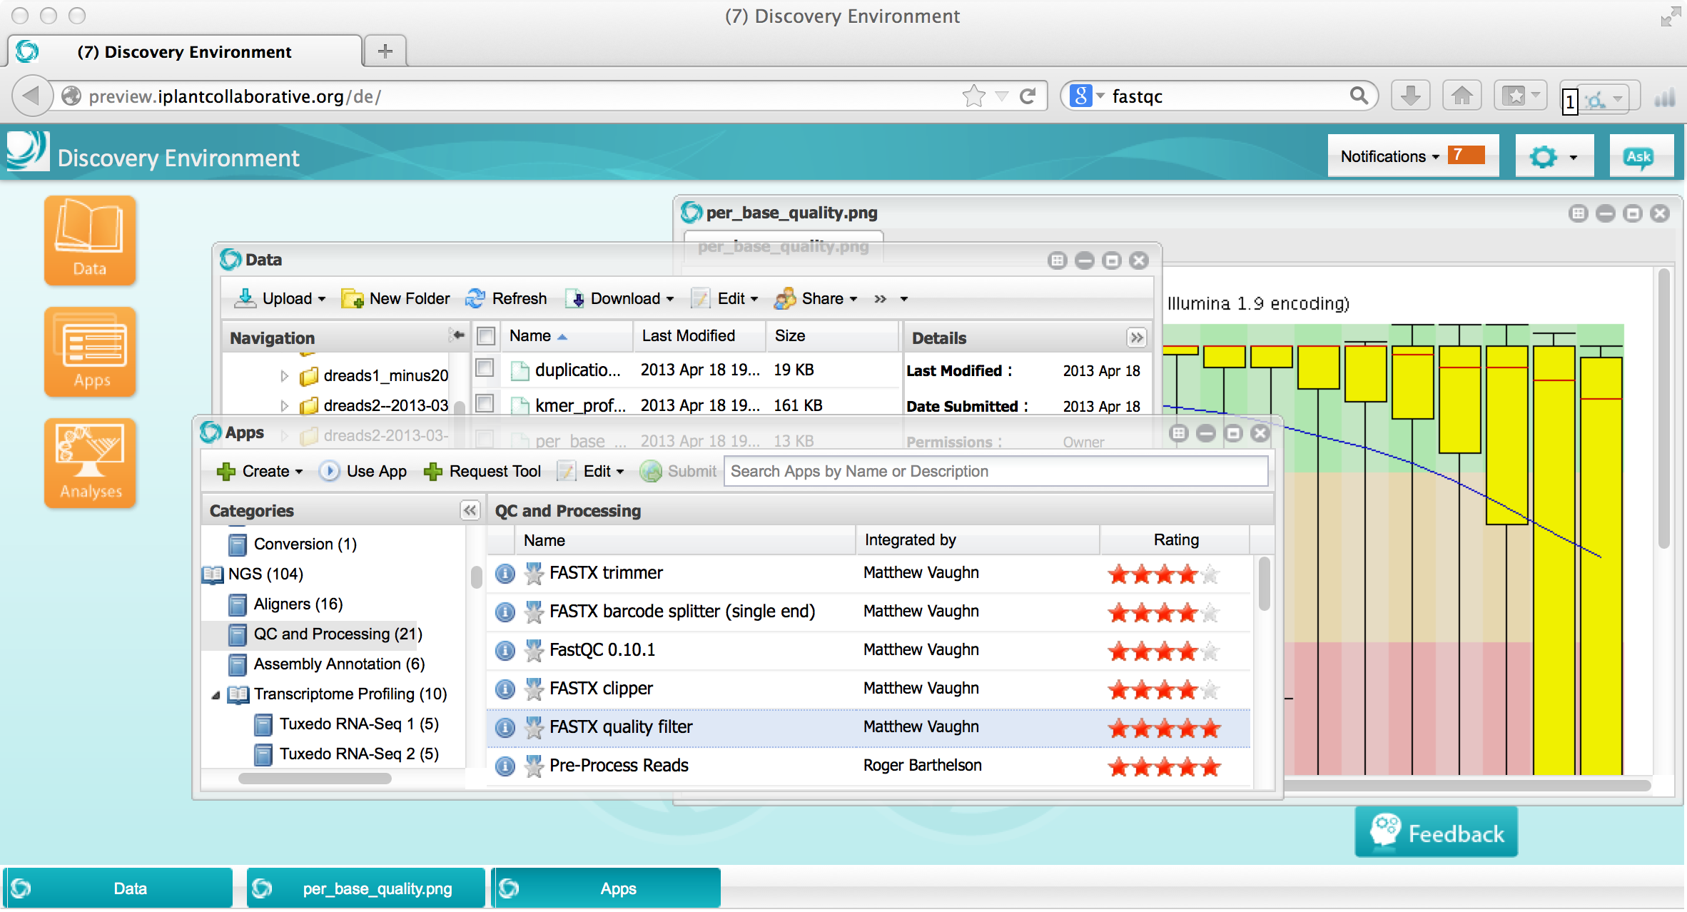
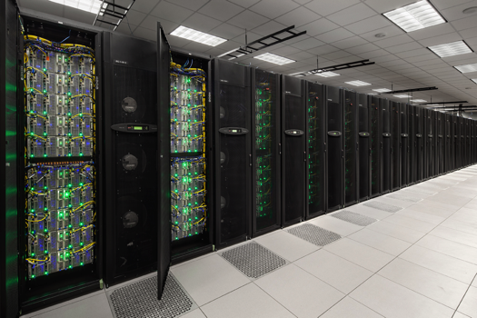
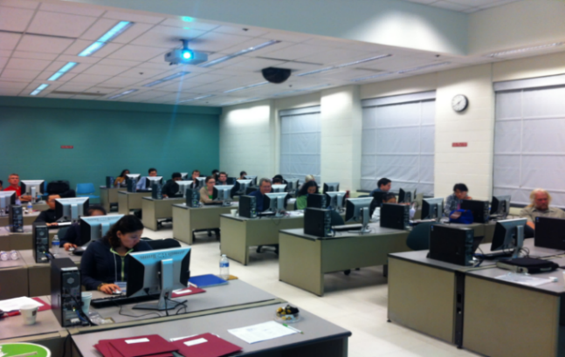
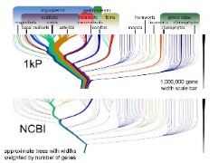
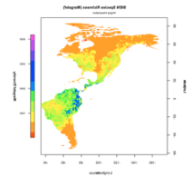
What is cyberinfrastructure?
CI provides solutions to the challenges of large-scale computational science were unapproachable because the computational requirements were too large, too complex, or simply unknown.
Platforms, tools, datasets Storage and compute Training and support
HPC People

Slide 7
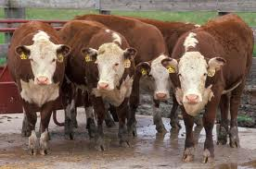
CyVerse supports all domains of life science
Plant / Microbial Animal Biomedical Ecological/Climate
CyVerse is built for data

Slide 8
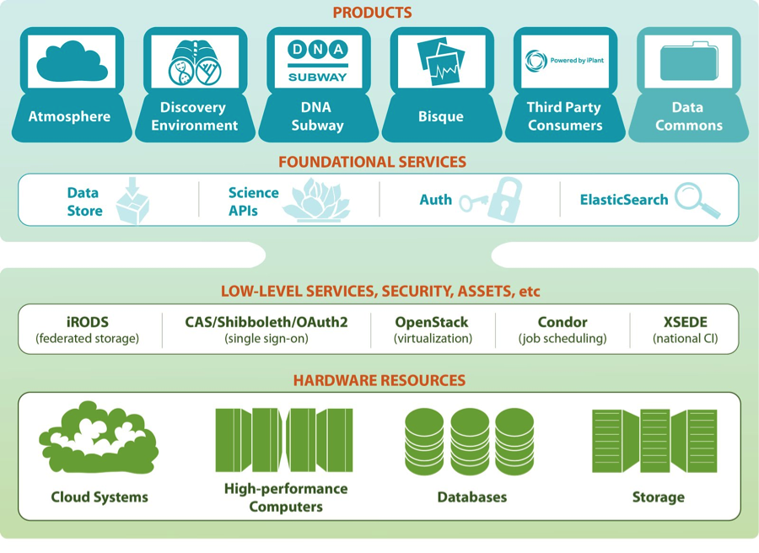
CyVerse Products
Ready to use Platforms
Extensible Services
Flexibility
Ease of Use
Established CI Components
Foundational Capabilities

Slide 9
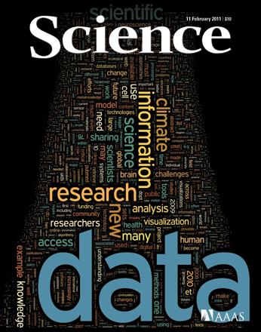
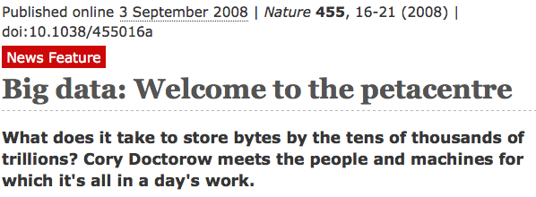
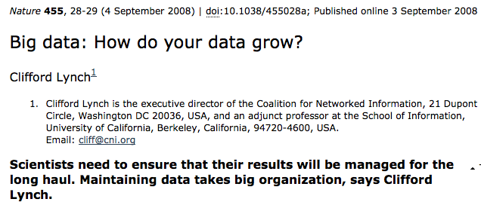
How was CyVerse built?

Slide 10
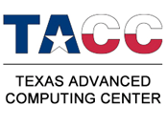
CyVerse Institutions
CyVerse is a collaborative virtual organization
CyVerse UK

Slide 11
CyVerse products
From plant science, to life science, and beyond…
Data Store
Science APIs
The resources you need to share and manage data with your lab, colleagues and community
Fully customize CyVerse resources
Discovery Environment
BisQue
Hundreds of bioinformatics apps in an easy-to-use interface
Image analysis, management, and metadata
Atmosphere
DNA Subway
Cloud computing for the life sciences
Educational workflows for Genomes, DNA Barcoding, RNA-Seq

Slide 12
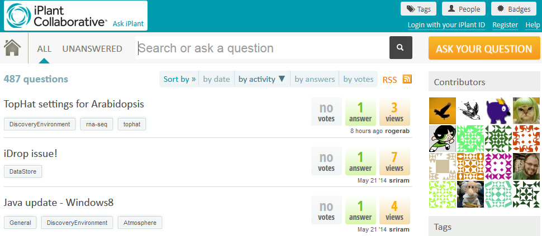
Detailed instructions with videos, manuals, documentation in
Keep asking: ask.iplantcollabortive.org

Slide 13
CyVerse Executive Team

Slide 14
Where do I sign up?
www.cyverse.org

