Slide 1
Using CyVerse Cyberinfrastructure to Enable Data Intensive Research, Collaboration, and Education
Data Store Overview

Slide 2
Download Slides and Follow Along
www.cyverse.org/tagc2016

Slide 3
Welcome to the Data Store
Manage and share your data across all CyVerse platforms

Slide 4
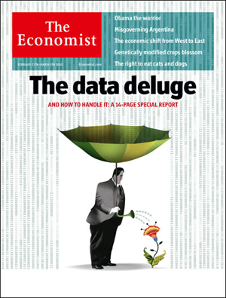
Working with Big Data
Challenges: the scope and scale of life sciences data continue to grow
Big data a term applied to data sets whose size is beyond the ability of commonly used software tools to capture, manage, and process the data within a tolerable elapsed time
Big data sizes are a constantly moving target currently ranging from a few dozen terabytes (TB) to many petabytes of data in a single data set
“‘Big Data': Big gaps of knowledge in the field of Internet". International Journal of Internet Science 7: 1–5.
Notes:
Snijders, C.; Matzat, U.; Reips, U.-D. (2012). "'Big Data': Big gaps of knowledge in the field of Internet". International Journal of Internet Science 7: 1–5.

Slide 5
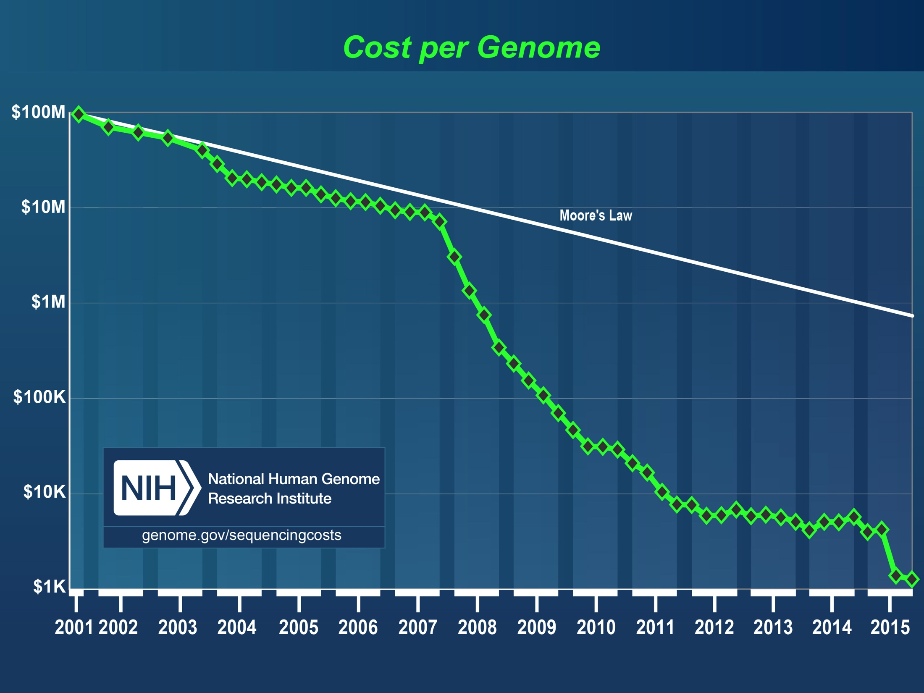
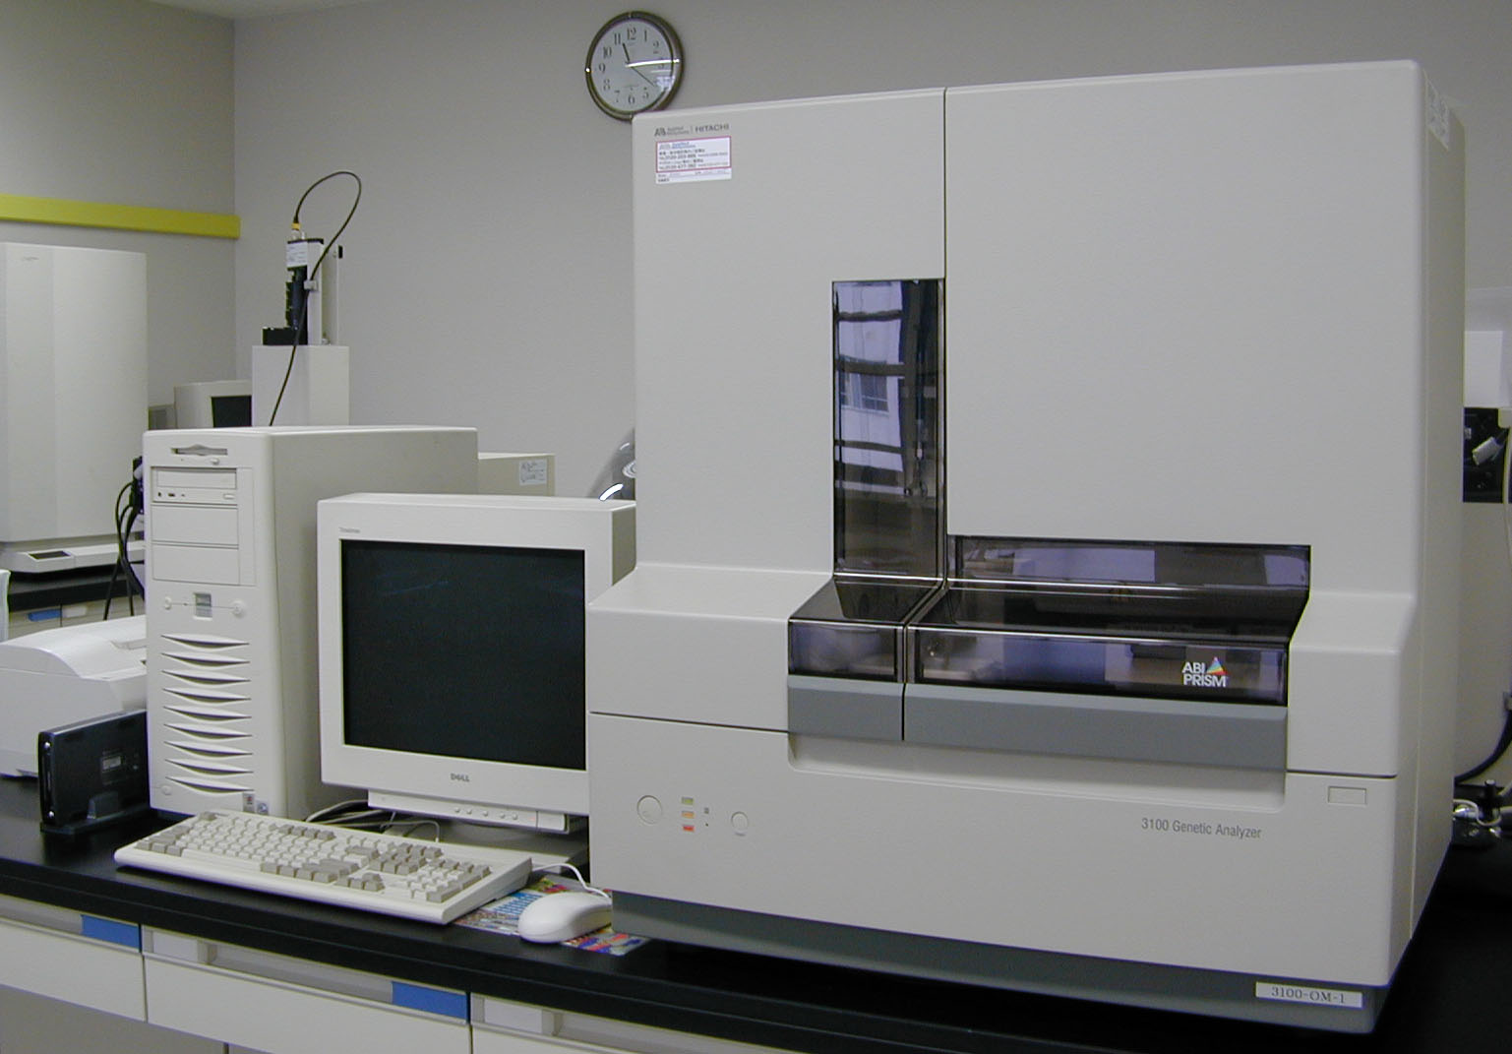
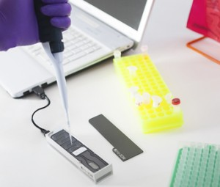
Working with Big Data
Challenges: data generation is cheaper and faster
http://www.genome.gov/sequencingcosts/

Slide 6
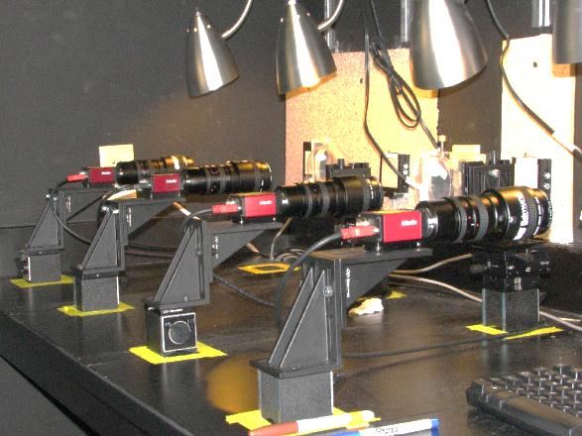
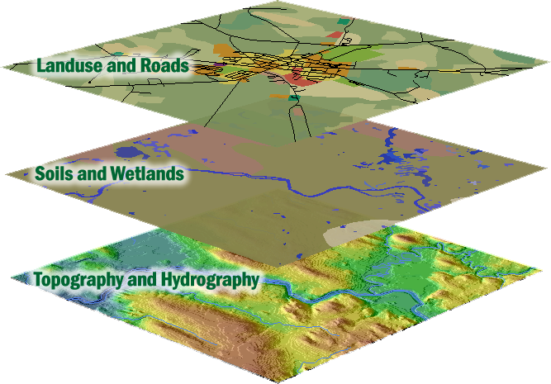
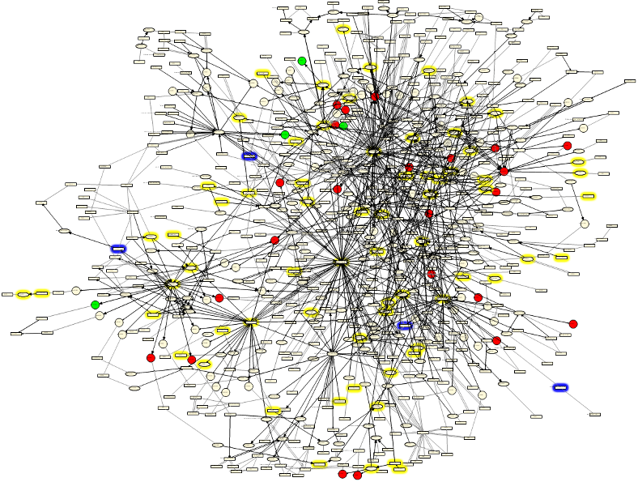
Working with Big Data
Challenge: biology encompasses more than sequence data
Advanced Imaging Geospatial Network
Biologists work with and require access to diverse data types

Slide 7
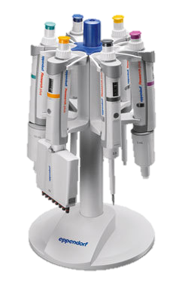
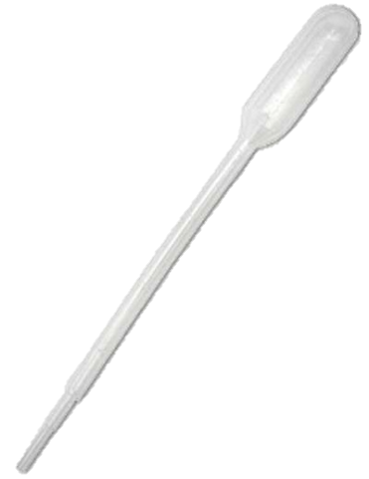
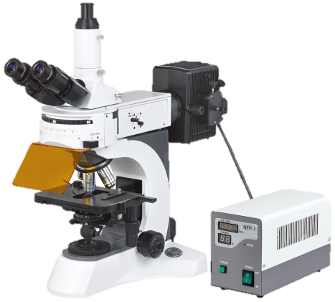
Working with Big Data
Challenges: changes in data require changes in tools
Difficult / slow transfers
Expense for storage / backup
Difficult to share and publish
Analysis
Metadata (What Is metadata?)
Changes in scale introduce quantitative and qualitative complications

Slide 8
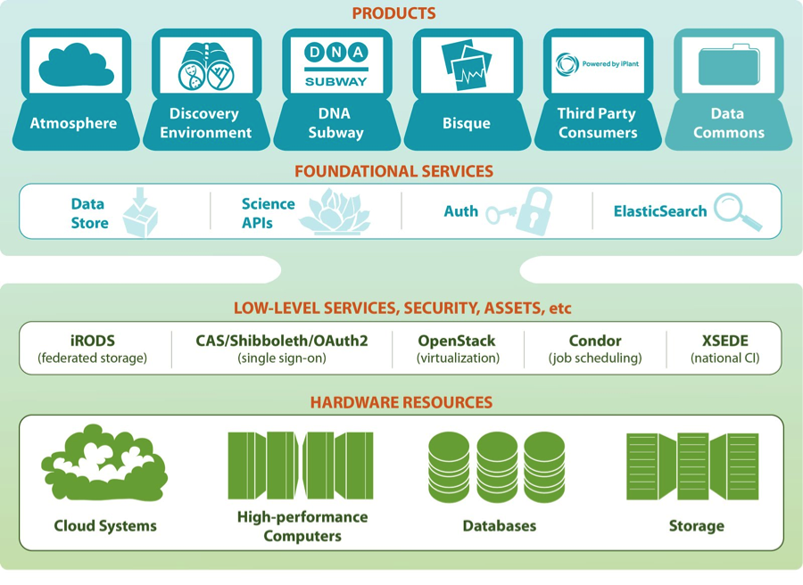
Data Store Overview
The Data Store services all CyVerse platforms
Access your data from multiple CyVerse products
Automatic backup (redundant between University of Arizona and University of Texas)
Default 100 GB allocation, > 1 TB allocations available with justification

Slide 9
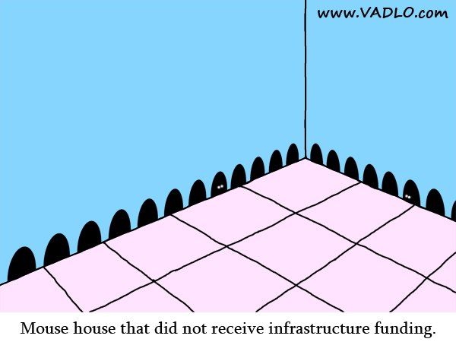
Data Store Overview
Avoid reinventing the wheel
iRODS (integrated Rule-Oriented Data System) is open source data management software
Used by research organizations and government agencies worldwide
It virtualizes data storage resources, so users can take control of their data, regardless of where and on what device the data is stored

Slide 10
Data Store Overview
Benefits
Get Science Done
Store any type of files related to your research
An evolving “Data Commons” lets you access important datasets
Metadata captures information needed for reproducibility
Automatic backup and accessibility support your data management plan
iRODS makes high-speed transfers possible (100 GB in ~30 min)
Share data instantly with collaborators within CyVerse
Reproducibility
Productivity

Slide 11
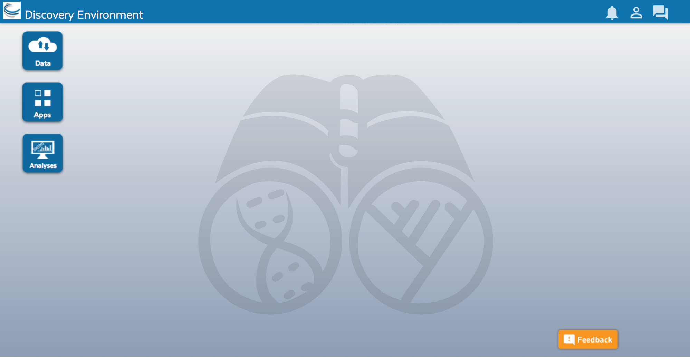
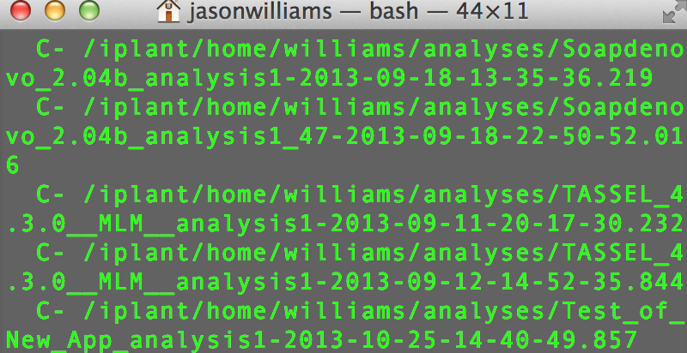
Data Store Overview
Multiple ways to access
Point-and-click
Command line
Cyberduck Discovery Environment
iCommands

Slide 12
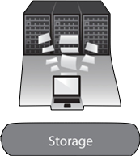
Data Store Overview
Some important things we will not “see” in the demo
Data Backups
Data Transfer
Source | Destination | Copy Method | Time (seconds)
CD | My Computer | cp | 320
Berkeley Server | My Computer | scp | 150
External Drive | My Computer | cp | 36
USB 2.0 Flash | My Computer | cp | 30
Data Store | My Computer | iget | 18
My Computer | My Computer | cp | 15
Arizona
Texas
Key component of your data management
Worry-free
Closer to optimum conditions: transfers between University of Arizona and UC Berkeley
100 GB: 26m15s, 1 GB 17.5s

Slide 13
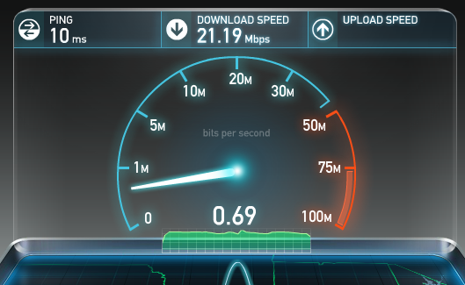
Data Store Overview
Some important things we will not “see” in the demo
http://www.speedtest.net/
Local connections and institutional policies limit data transfer
Notes:
Internet 3?

Slide 14
Data Store Overview
Transferring data using Cyberduck
Demo
www.cyverse.org/tagc2016

Slide 15
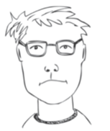
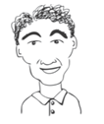
Data Store Overview
User perspectives and potential applications
Uploads all of his .fastq files along with 50GB of root growth videos
Shares all his analyses results with his thesis advisor
Created a metadata template for assembled genomes her students and collaborators will place in a shared folder
Uses public links in the supplemental materials of her publications
Developed a script to automate transfer of data to core users
Uses a shared folder to make large datasets accessible
Bench Scientist
Bioinformatician
Core Facilities
Images from personas based on: Bioinformatics Curriculum Guidelines: Toward a Definition of Core Competencies
PLOS Biology DOI: 10.1371/journal.pcbi.1003496

Slide 16
Data Store Overview
Time for Summaries and Tips

Slide 17
Tips for any transfer method
Spaces / Special Characters
Many software packages are sensitive to spaces in files names and/or the special characters below
Rename uploaded files before using them in an analysis
~ | ` | ! | @ | # | $ | % | ^ | & | * | ( | ) | + | =
{ | } | [ | ] | | | \ | : | ; | " | ' | < | > | , | ? | /

Slide 18
Tips
When sharing, use this chart to decide appropriate permissions
Permission | Read | Download | Metadata | Rename | Move | Delete
Read | x | x
Write | x | x | x
Own | x | x | x | x | x | x

Slide 19
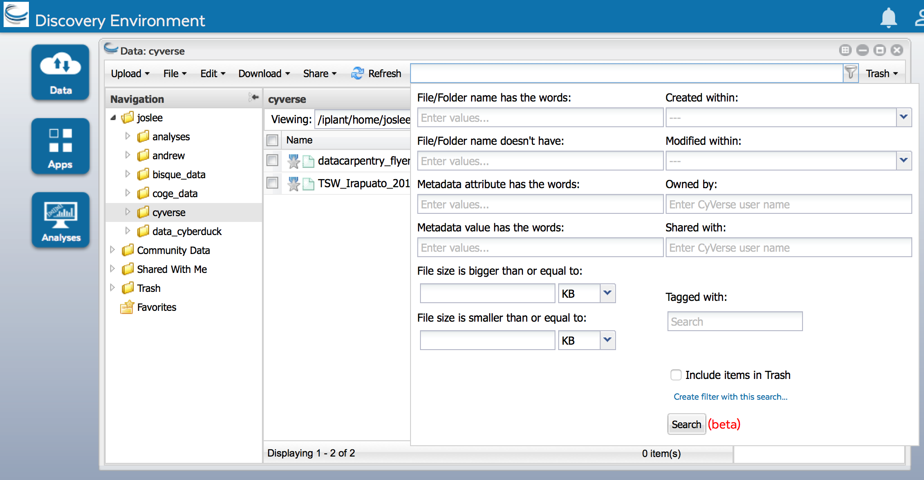
Summary: Tips for searching in the DE
Basic search bar searches all files and folders where you have permission
Advanced search allows searching based on metadata, permissions, and share status
Create auto-updated ‘smart’ folders based on searches

Slide 20
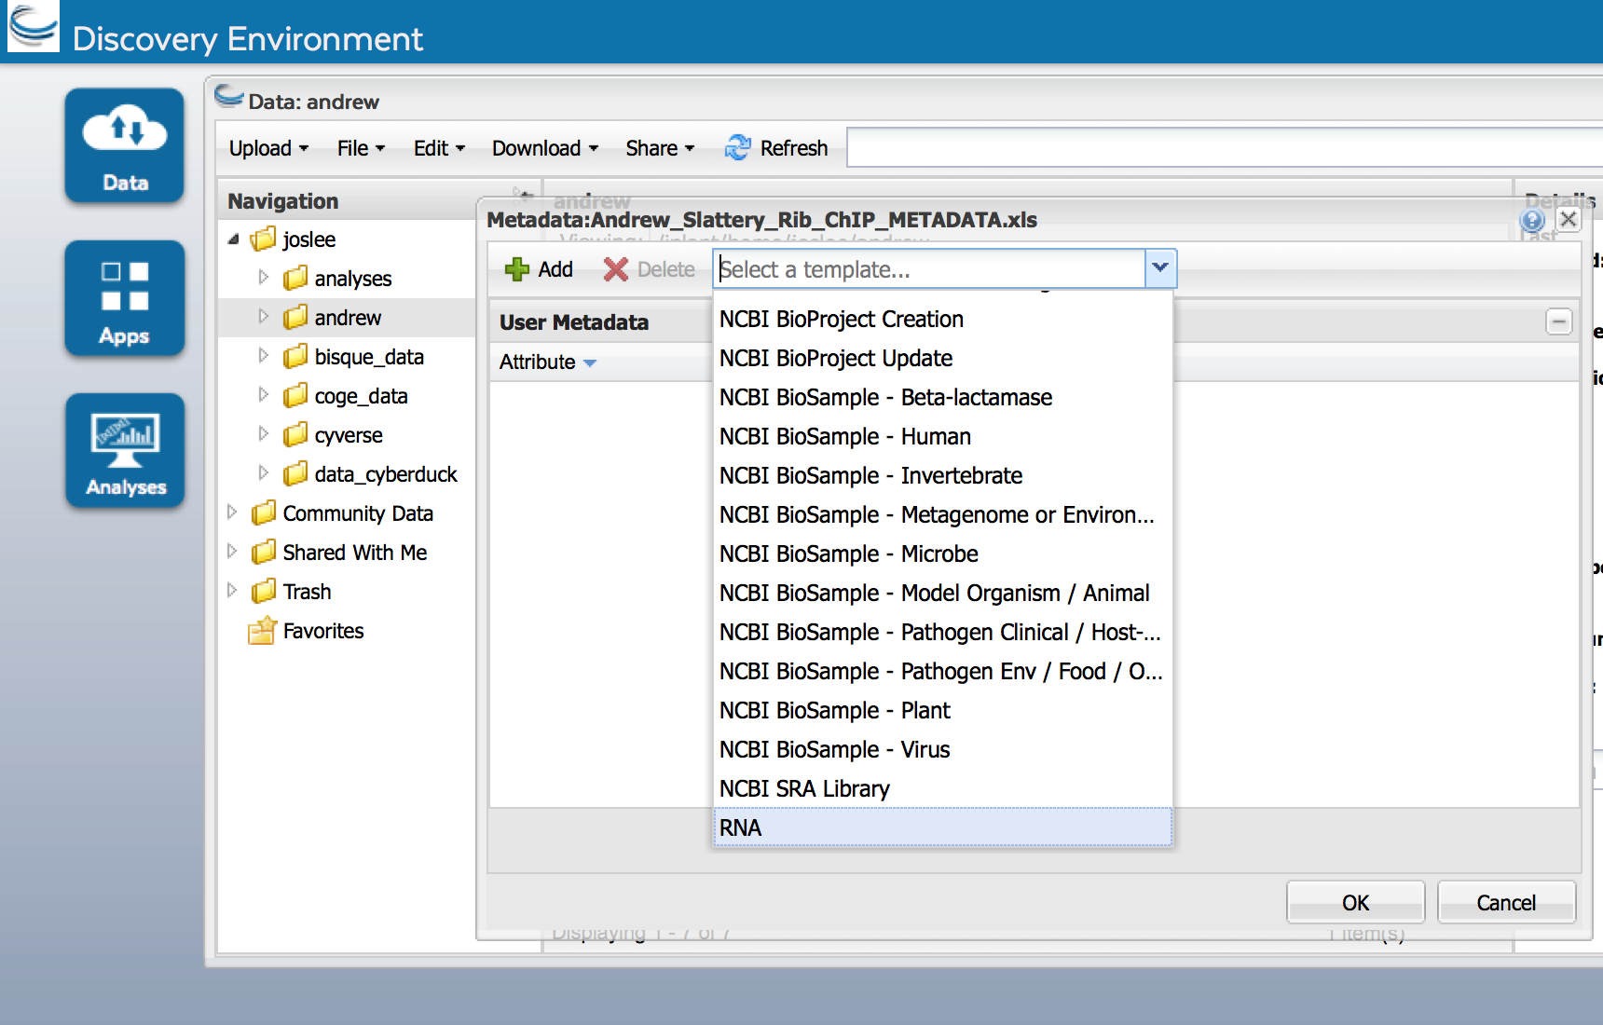
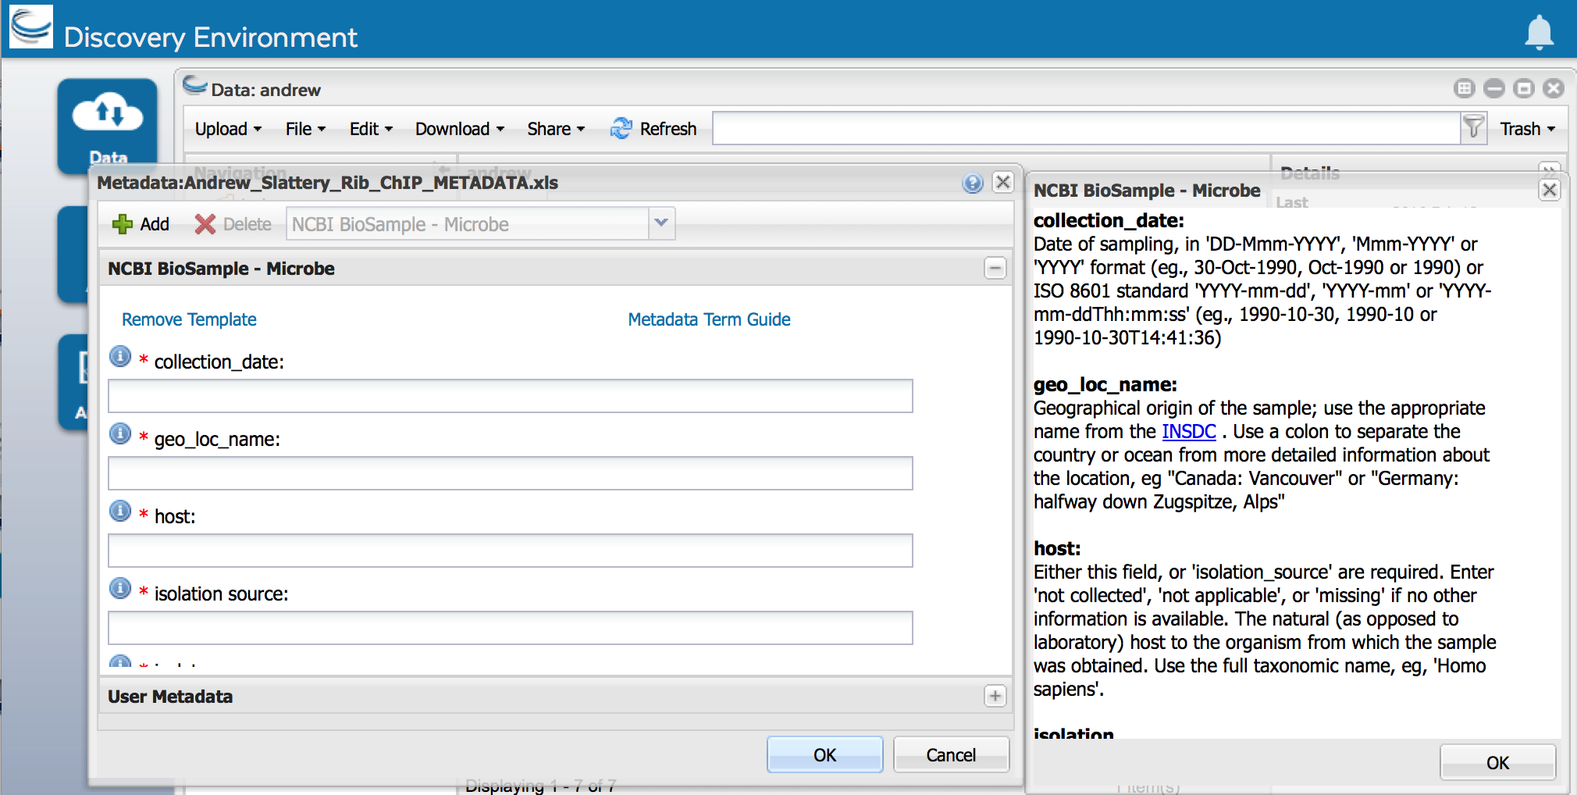
Summary: Tips for viewing and editing metadata
User metadata stored in Attribute Value Unit (AVU)
Edit → Metadata → Edit Metadata
Choose your template -> Use term guide
Add your own attributes and values / customize
Metadata not just for data management, think reproducibility!

Slide 21
Data Store Overview
User perspectives and potential applications
Uploads all of his .fastq files along with 50GB of root growth videos
Shares all his analyses results with his thesis advisor
Created a metadata template for assembled genomes her students and collaborators will place in a shared folder
Uses public links in the supplemental materials of her publications
Developed a script to automate transfer of data to core users
Uses a shared folder to make large datasets accessible
Bench Scientist
Bioinformatician
Core Facilities
Images from personas based on: Bioinformatics Curriculum Guidelines: Toward a Definition of Core Competencies
PLOS Biology DOI: 10.1371/journal.pcbi.1003496

Slide 22
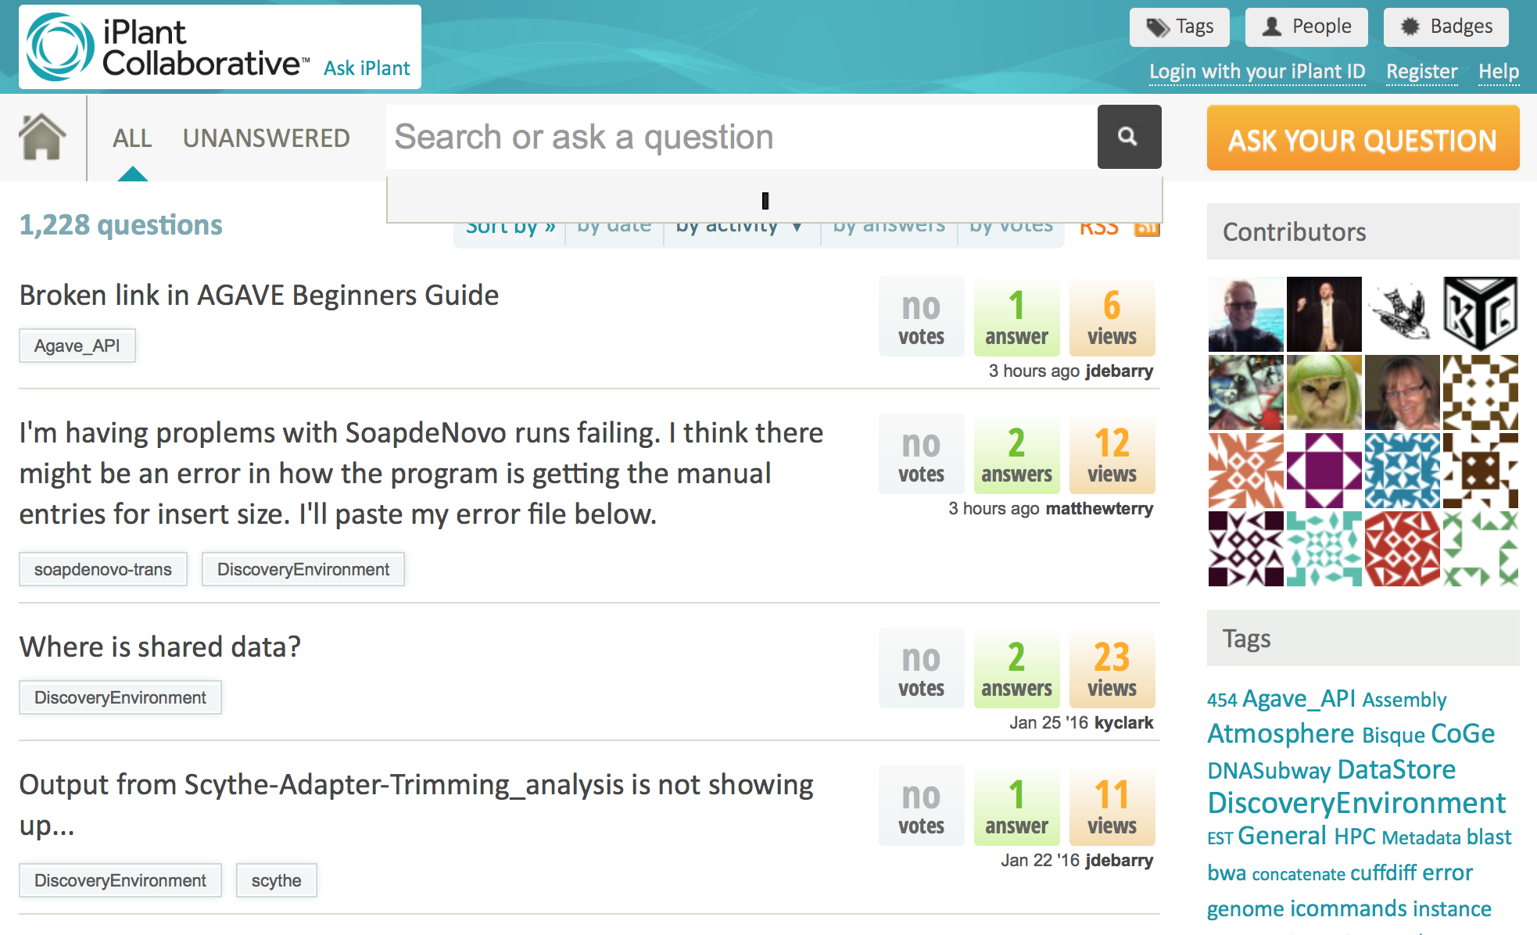
Help: ask.iplantcollaborative.org
Detailed instructions with videos, manuals, documentation in CyVerse Wiki
Search by tag

