Slide 1
Genome Annotation using MAKER
Liya Wang
MaizeCODE Annotation Workshop
Plant Biology Meeting
July 14th, 2018

Slide 2
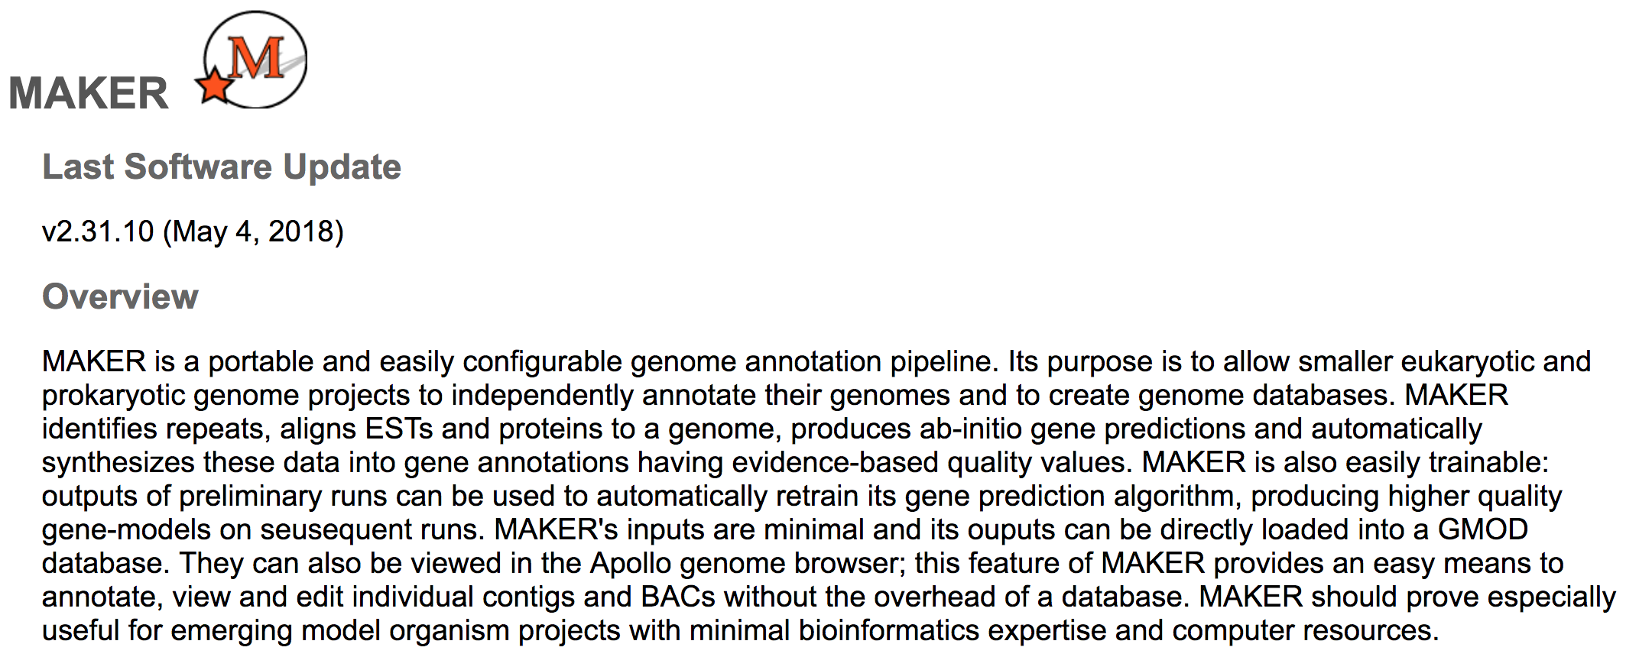
MAKER
Cantarel et al. 2008. Genome Research 18:188
Holt & Yandell. 2011. BMC Bioinformatics 12:491
Campbell, et al. 2013. Plant physiology 164(2):513-524

Slide 3
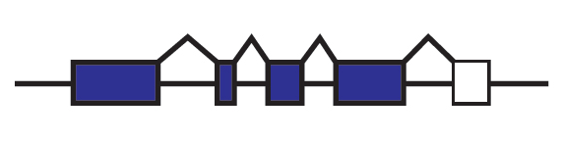
What Are Annotations?
Annotations are descriptions of features of the genome
  Structural: exons, introns, UTRs, splice forms etc.
  Coding & non-coding genes
  Expression, repeats, transposons
Annotations should include evidence trail
  Assists in quality control of genome annotations
Examples of evidence supporting a structural annotation
  Ab initio gene predictions
  ESTs
  Protein homology

Slide 4
Challenges in Plant Genome Annotation
Genomes are BIG
Highly repetitive
Many pseudo genes
Assembly contamination
Incomplete evidence
No method is 100% accurate

Slide 5
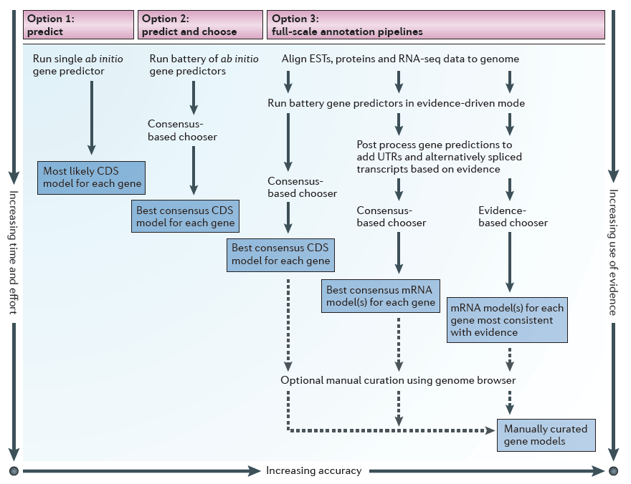
Options for Protein-coding Gene Annotation
Yandell & Ence. Nature Reviews Genetics 13, 329-342 (May 2012) | doi:10.1038/nrg3174

Slide 6
Typical Annotation Pipeline
Contamination screening
Repeat/TE masking
Ab initio prediction
Evidence alignment (cDNA, EST, RNA-seq, protein)
Evidence-driven prediction
Chooser/combiner
Evaluation/filtering
Manual curation

Slide 7
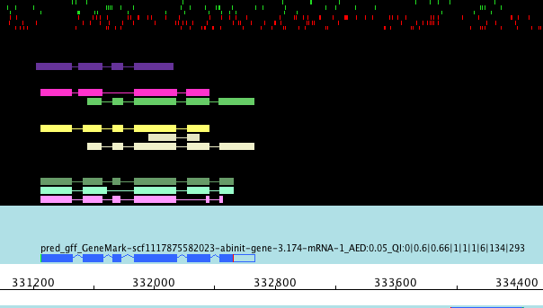
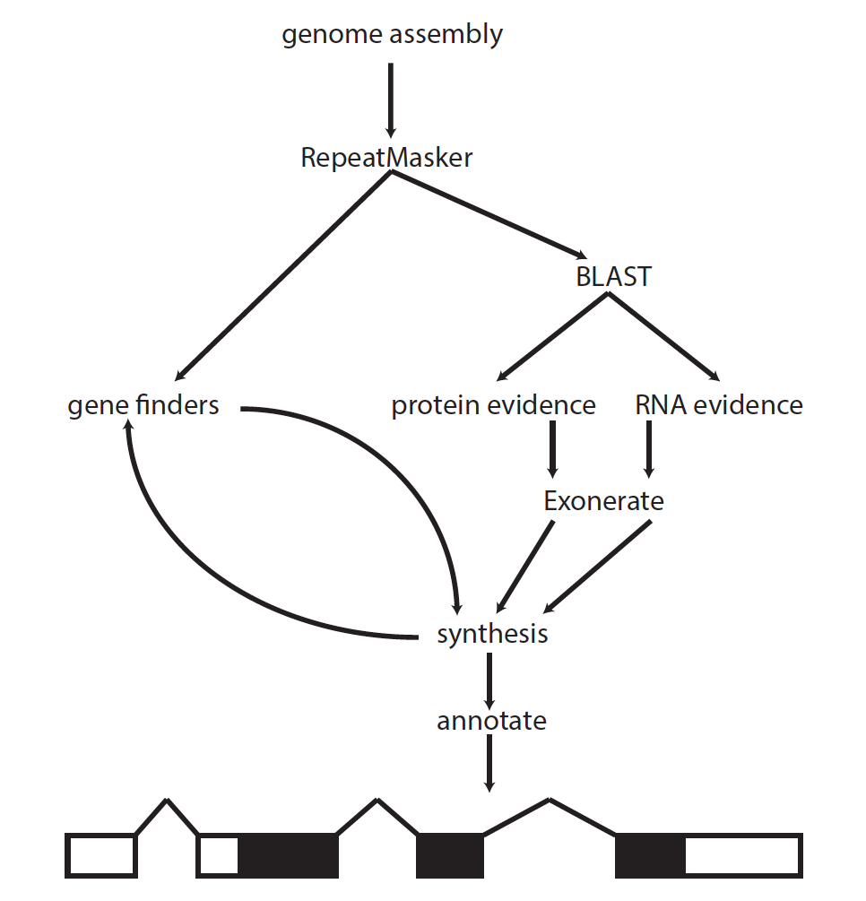
MAKER Automated Pipeline
altEST - TBLASTX
protein - BLASTX
mRNA seq - BLASTN
genome assembly

Slide 8
Annotation Edit Distance (AED)
Good Bad

Slide 9
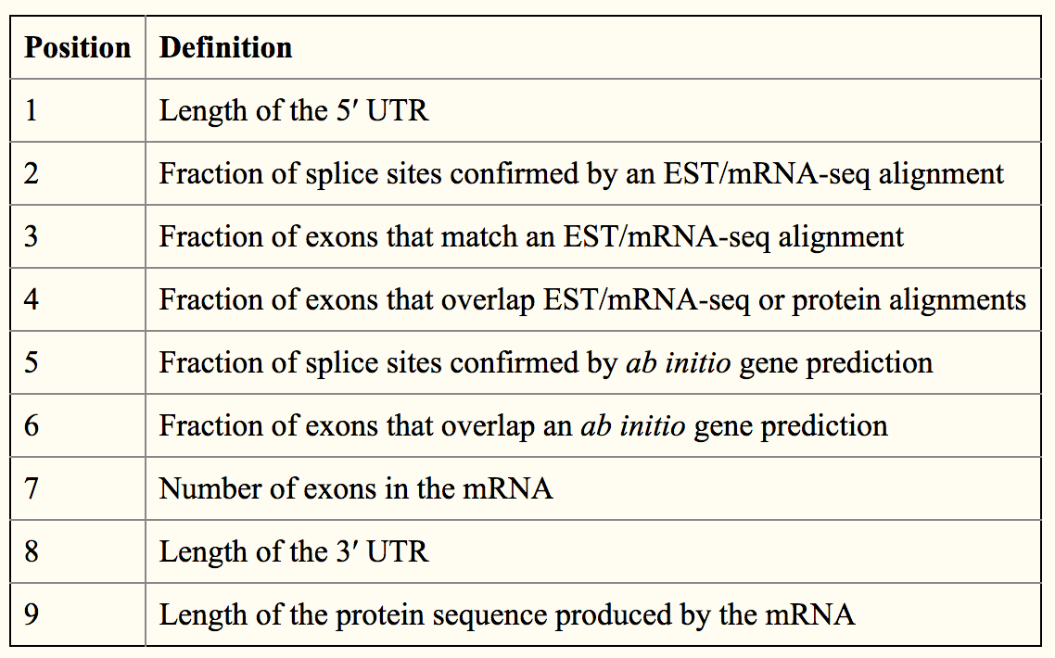
MAKER mRNA Quality index (QI)
QI:0|0.77|0.68|1|0.77|0.78|19|462|824

Slide 10
Gene Filtering
Detection of Transposon genes
  Overlap with TE annotations
  InterPro TE domains
Quality metrics
  AED scores
  Quality index
Homology based methods

Slide 11
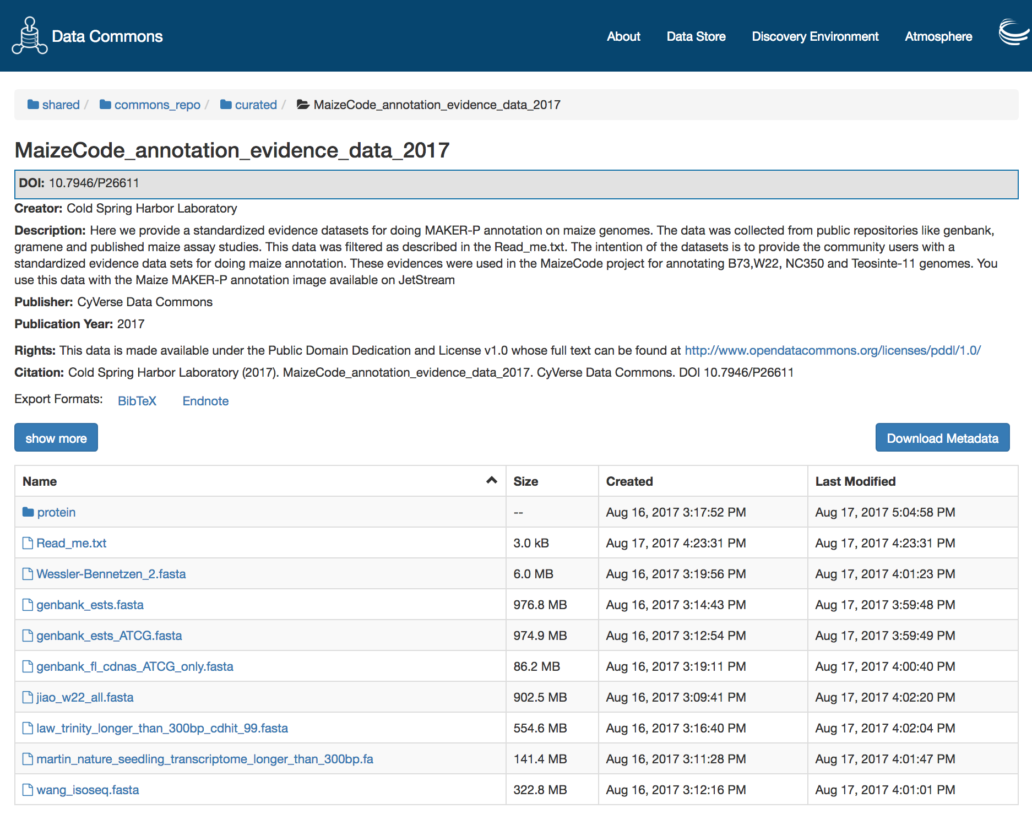
MaizeCODE Genome: NC350 Annotation
B73 annotation evidence
genbank_ESTs
genbank_FL_CDNA
isoseq_wang
repeat_library
seedling_RNA_seq_martin
trinity_law
trinity_w22_jiao
Protein
  Arabidopsis
  Brachypodium
  Rice
  Setaria
  Sorghum
Additionally: B73 v4 cDNA, NC350 RNA-seq (Trinity assembled transcripts, reference guided transcripts), B73 v4 proteins, Fgenesh prediction

Slide 12
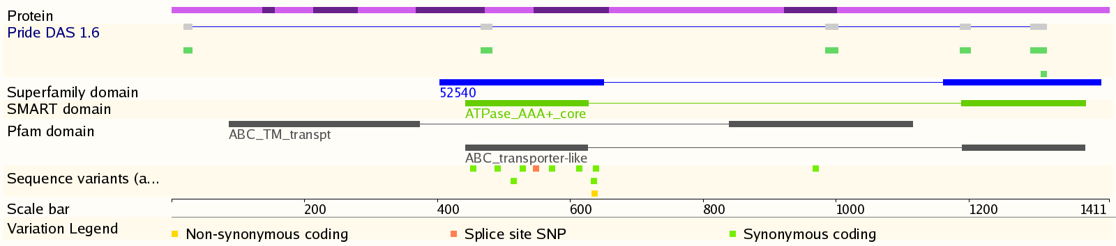
Secondary Annotation
Protein Domains
  InterPro Scan: combines many HMM databases
GO and other ontologies
Pathway mapping
  E.g. BioCyc Pathway tools

Slide 13
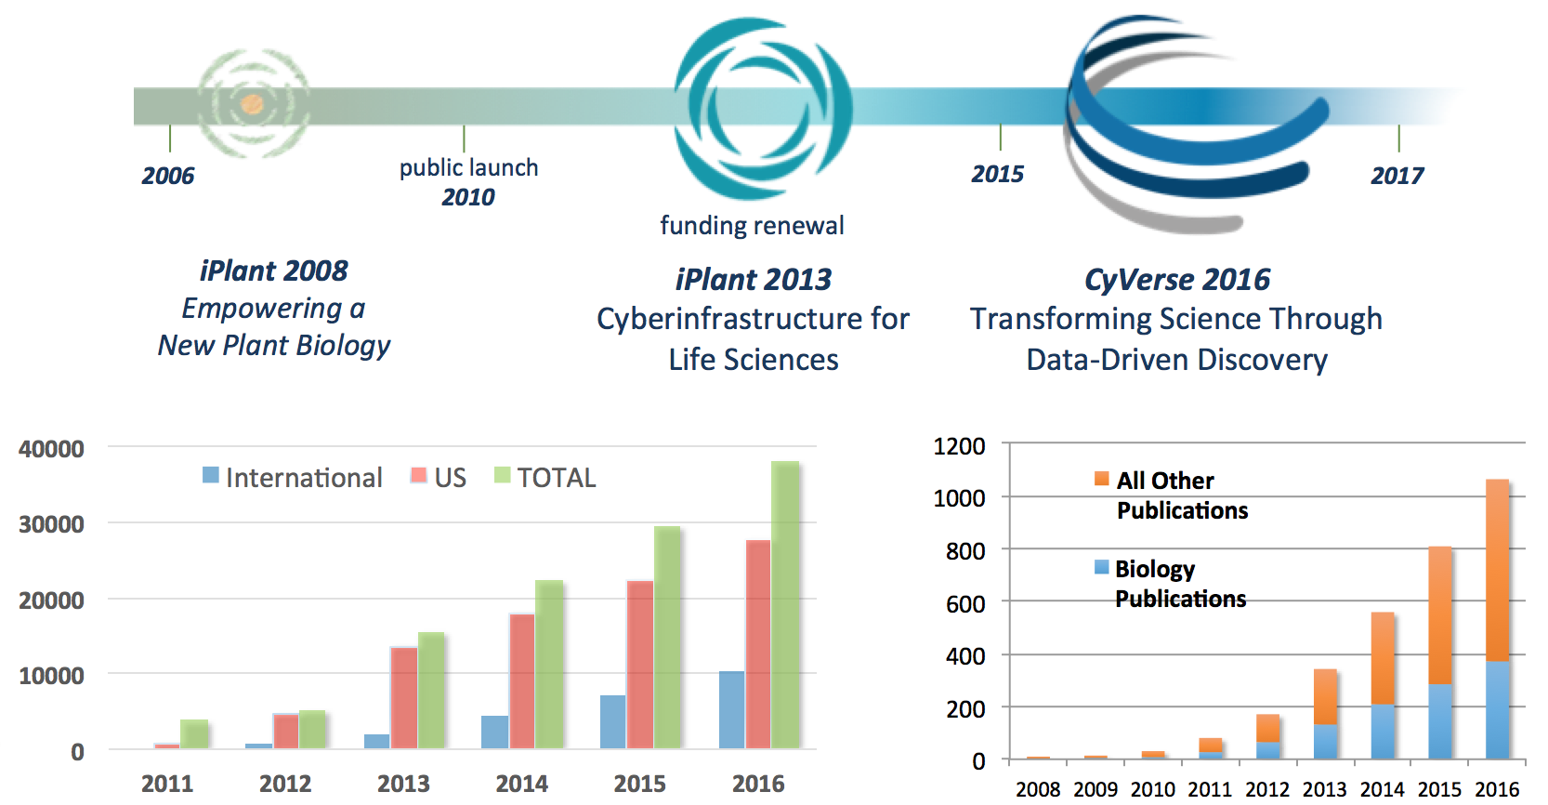
CyVerse Introdution
NSF DBI-1265383

Slide 14
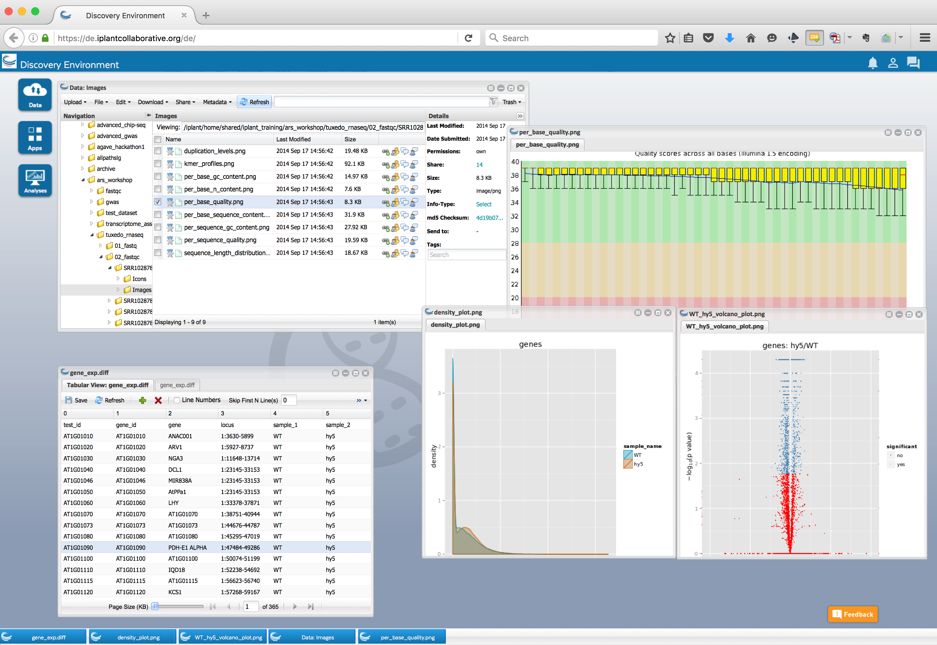
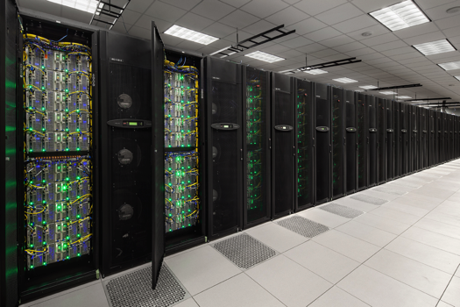
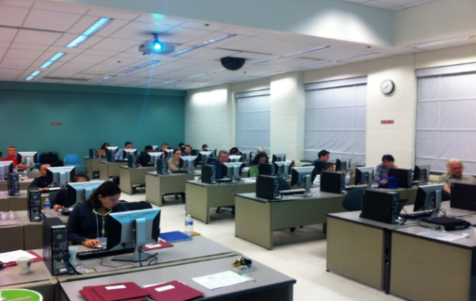
Community-focused cyber-infrastructure
Platforms, tools, datasets Storage and compute
Training and support

Slide 15
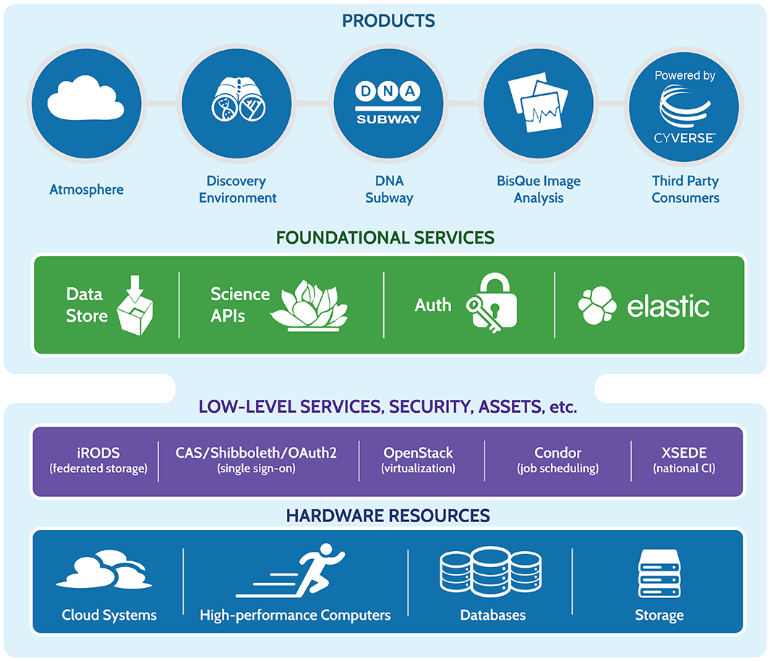
CyVerse Product Stack
Ready to use
Platforms
Extensible Services
Ease of Use
Flexibility
Established CI Components
Foundational
Capabilities

Slide 16
Data Lifecycle Support
Discovery
Upload
Data Commons Repository (DCR), Elasticsearch
Discovery Environment, iCommands, Cyberduck
Metadata
Publication
Add, delete, copy; metadata templates; bulk metadata
Analysis
Data Commons Repository (DCR), NCBI-SRA
Discovery Environment, Atmosphere, Agave API, BisQue, DNA Subway, SciApps
Sharing
Community Data folders, Data Commons, quick share links

Slide 17
Using CyVerse for Annotation
Add your data to CyVerse Data Store
  Initial 100 GB allocation – TB allocations available
  Automatic data backup
  Easy upload /download and sharing
Run annotation
  Using the Jetstream virtual image for large genome
    Command line
  Using SciApps for small genome (< 500 Mb)
    Graphic User Interface
    Automated workflow

Slide 18
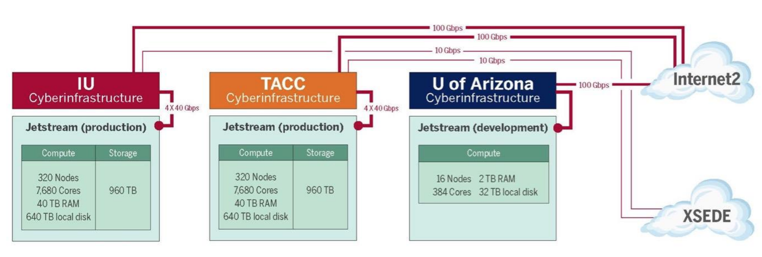
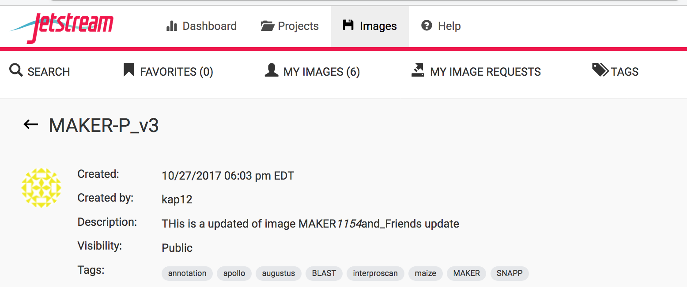
How Can I Use Jetstream?
An XSEDE User Portal (XUP) account is required. They are free! Get one at https://portal.xsede.org
Read the Allocations Overview – https://portal.xsede.org/allocations-overview
Write a successful allocation request – start with a Startup or Education request - https://portal.xsede.org/successfulrequests
https://pods.iplantcollaborative.org/wiki/display/TUT/MAKER-3.0+with+Apollo

Slide 19
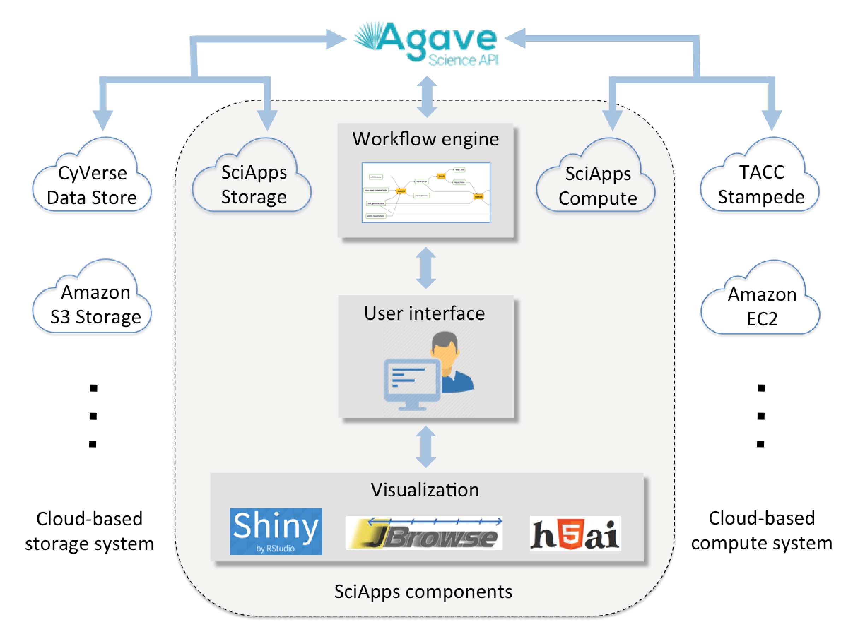
SciApps Introduction
A light-weight workflow platform that uses CyVerse Data Store for data management
Wang, et al, Bioinformatics (2018) | doi:10.1093/bioinformatics/bty439

Slide 20
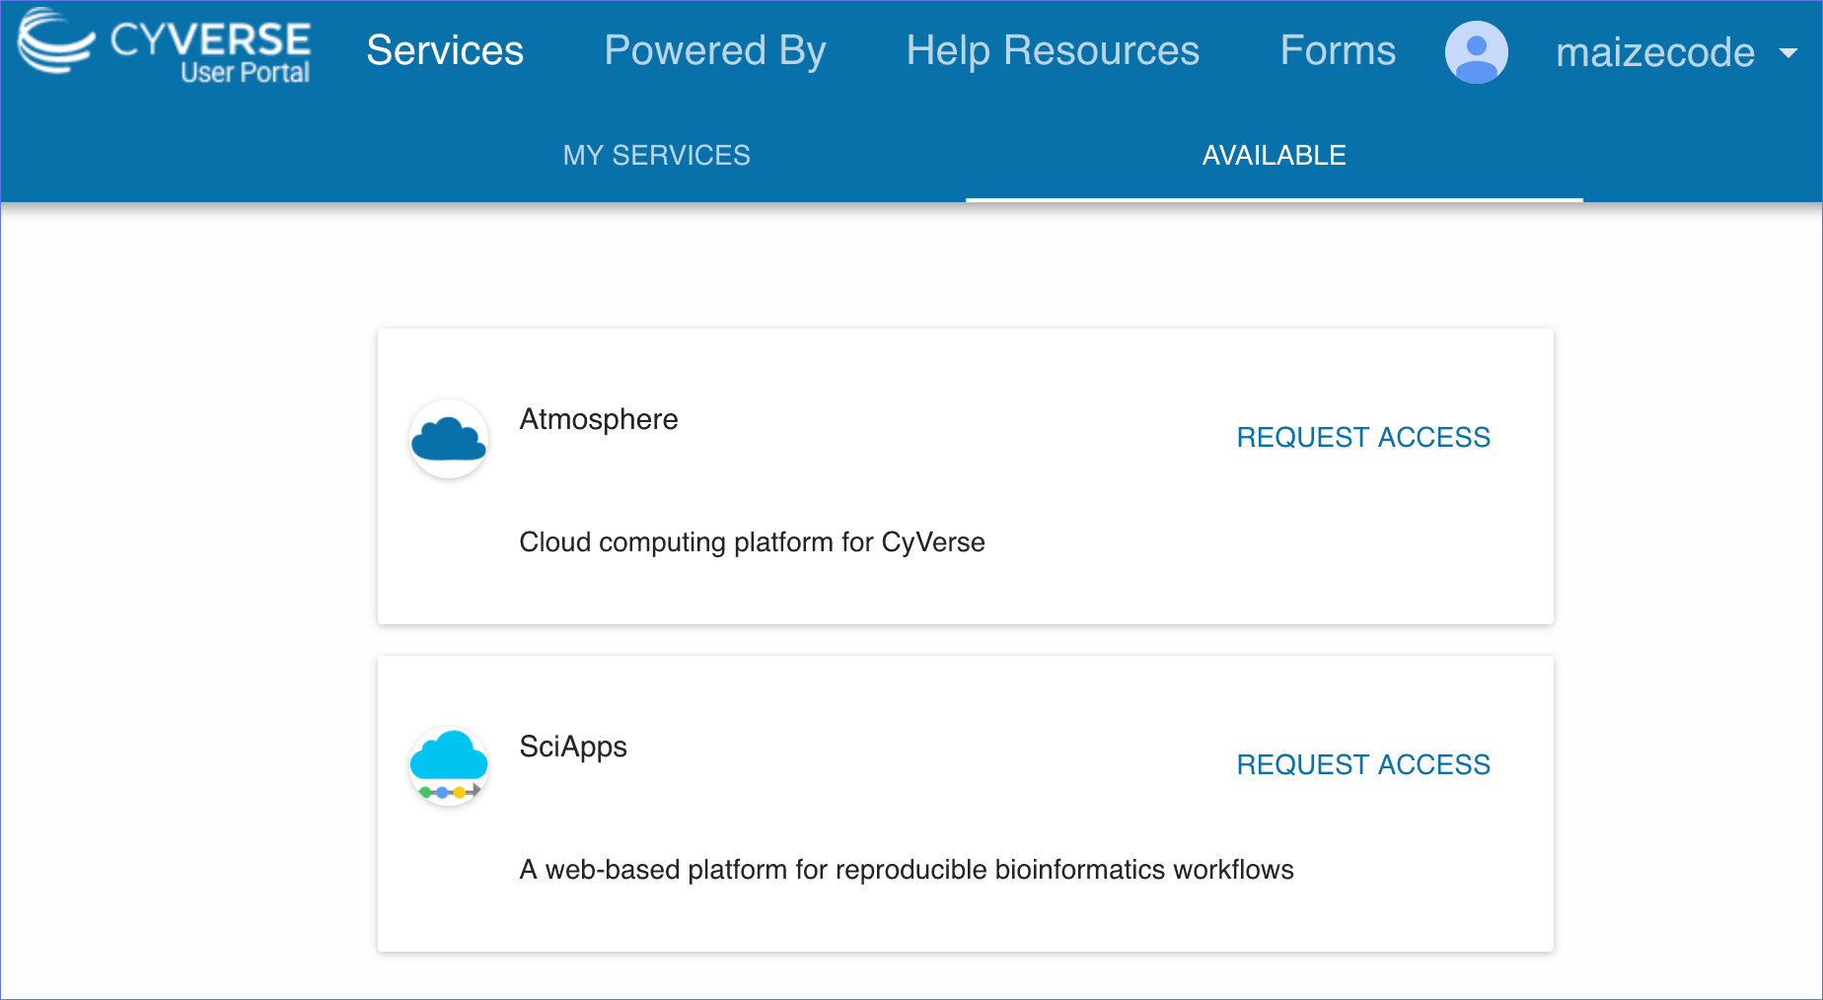
Request Access to SciApps
https://user.cyverse.org

Slide 21
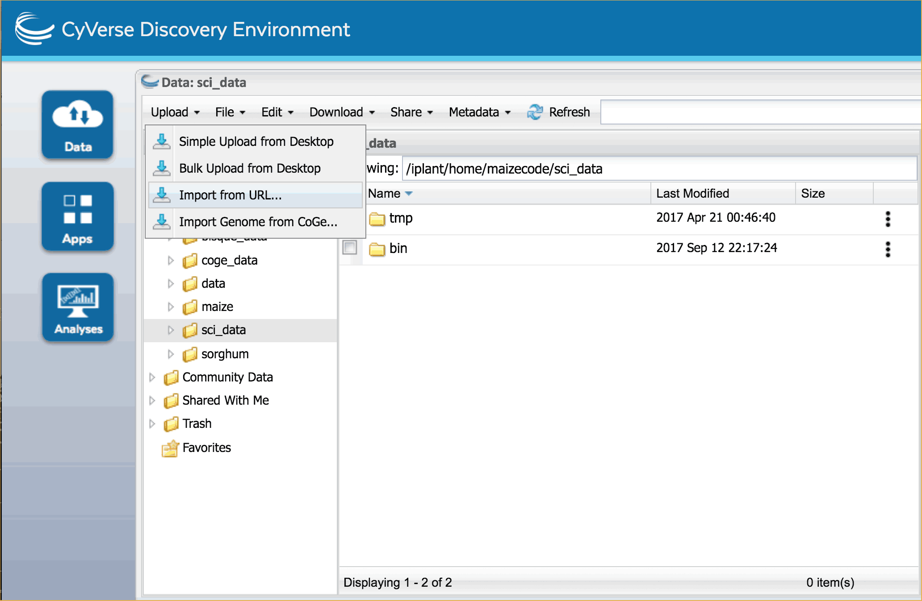

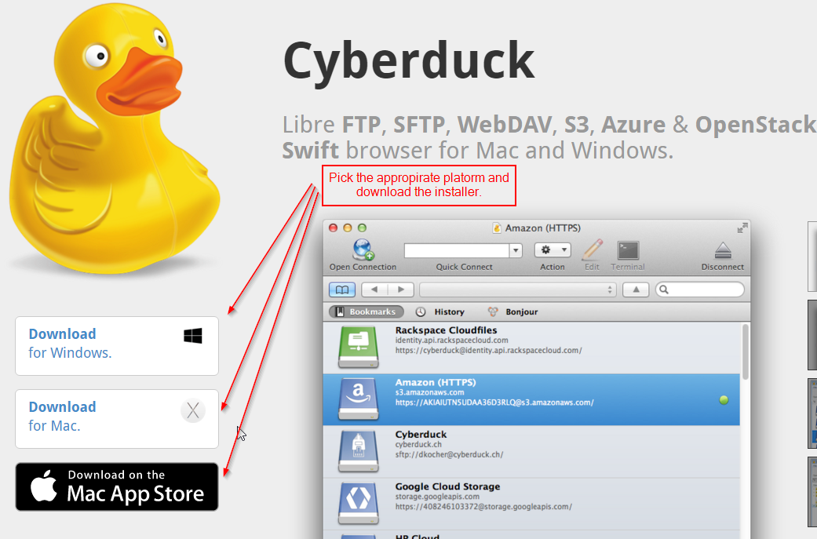
Add Data to sci_data Folder
https://de.cyverse.org (<1.9 GB)
https://pods.iplantcollaborative.org/wiki/display/DS/Using+Cyberduck+for+Uploading+and+Downloading+to+the+Data+Store

Slide 22
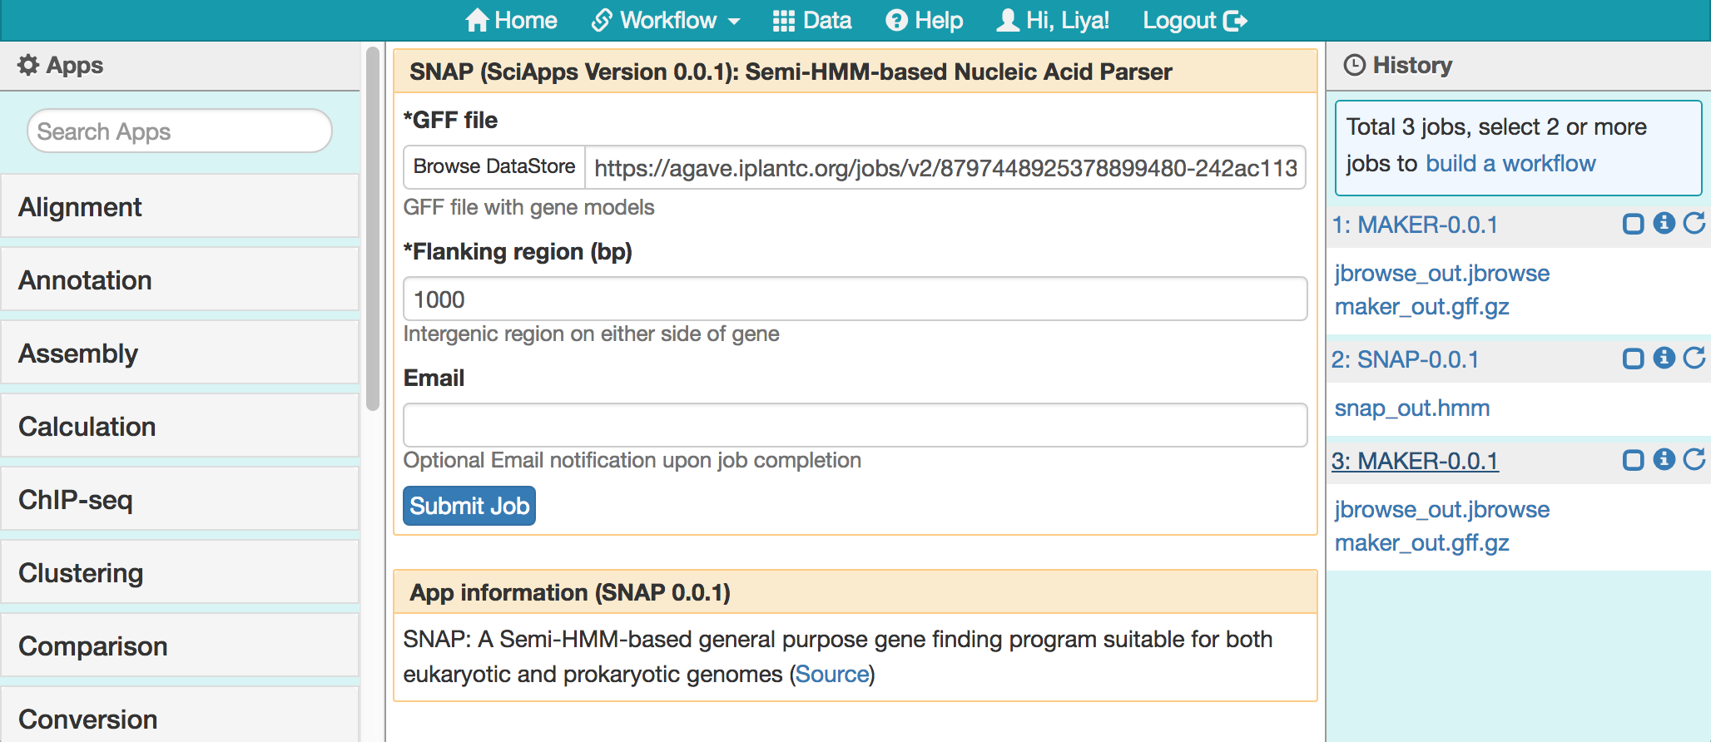
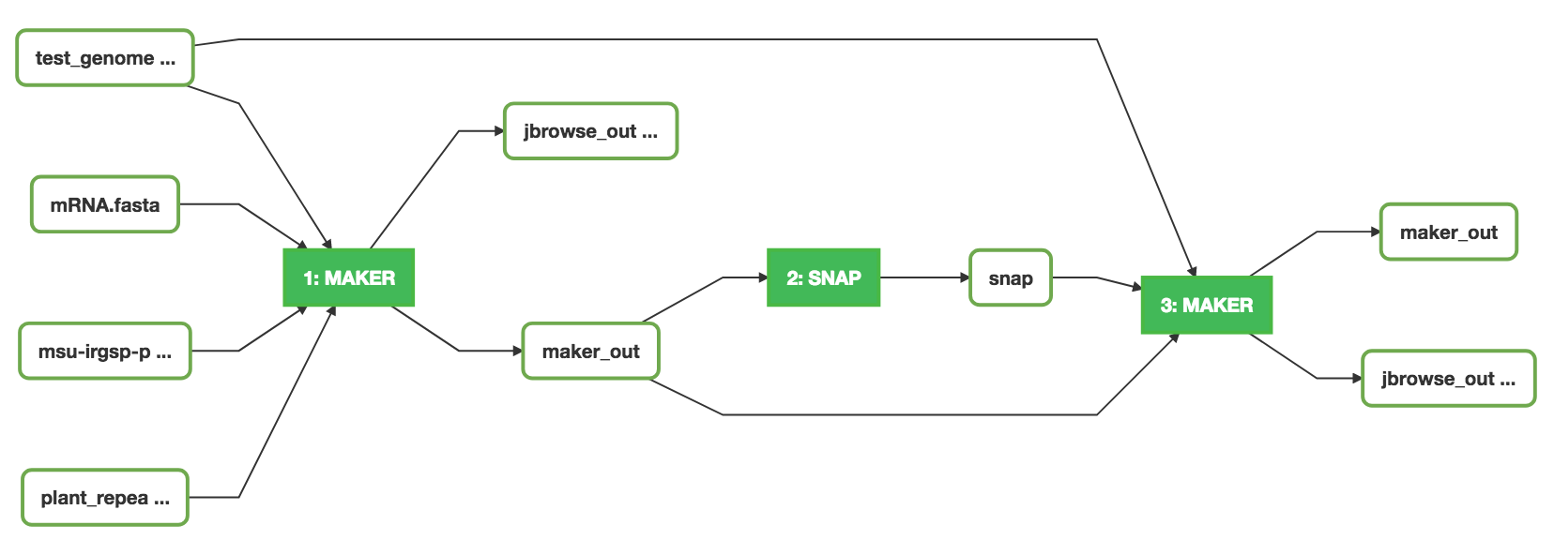
Run Analyses and Chain Them Together

Slide 23
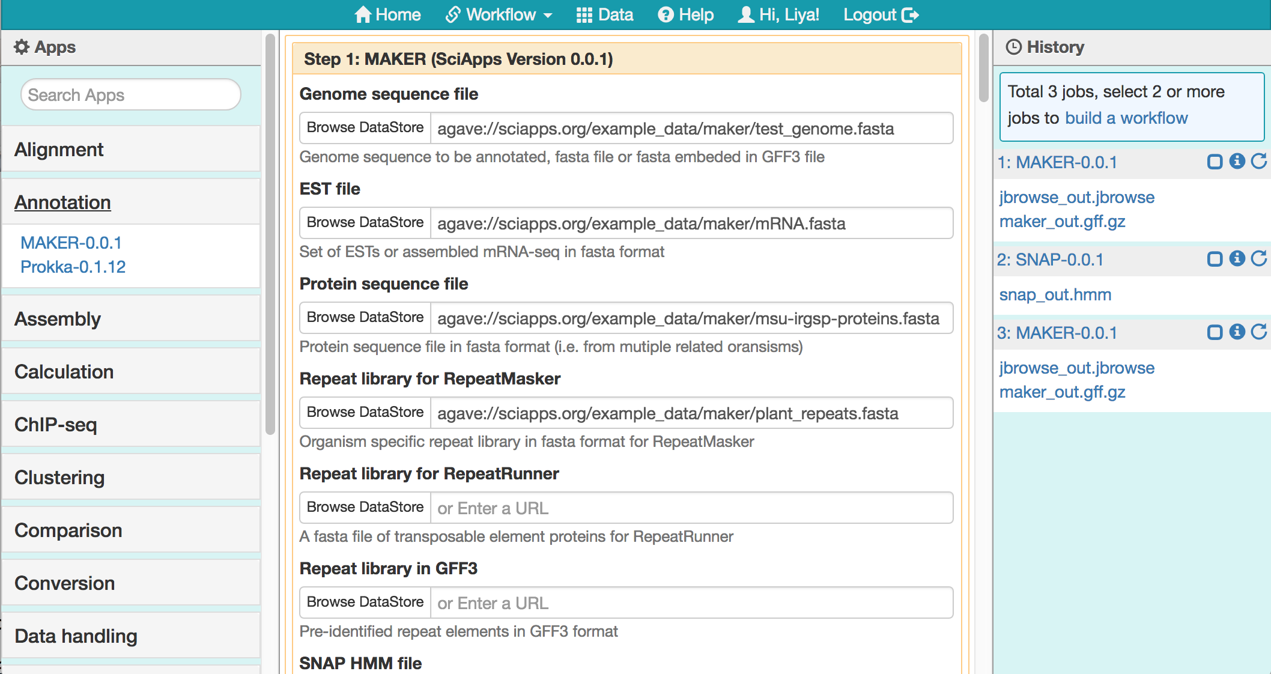
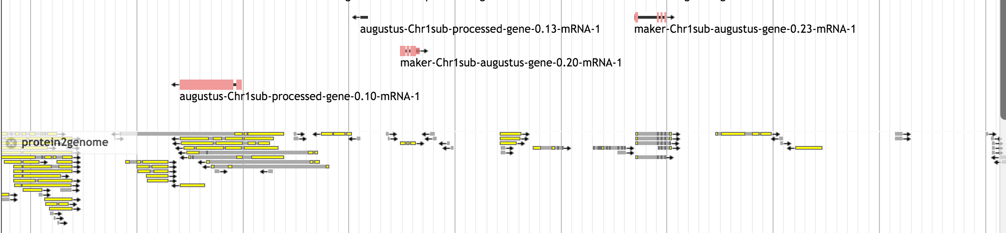
Visualize Annotation with JBrowse
HMM training
Re-annotation
Visualization
https://www.sciapps.org/
Missed genes due to lacking of HMM gene models

Slide 24
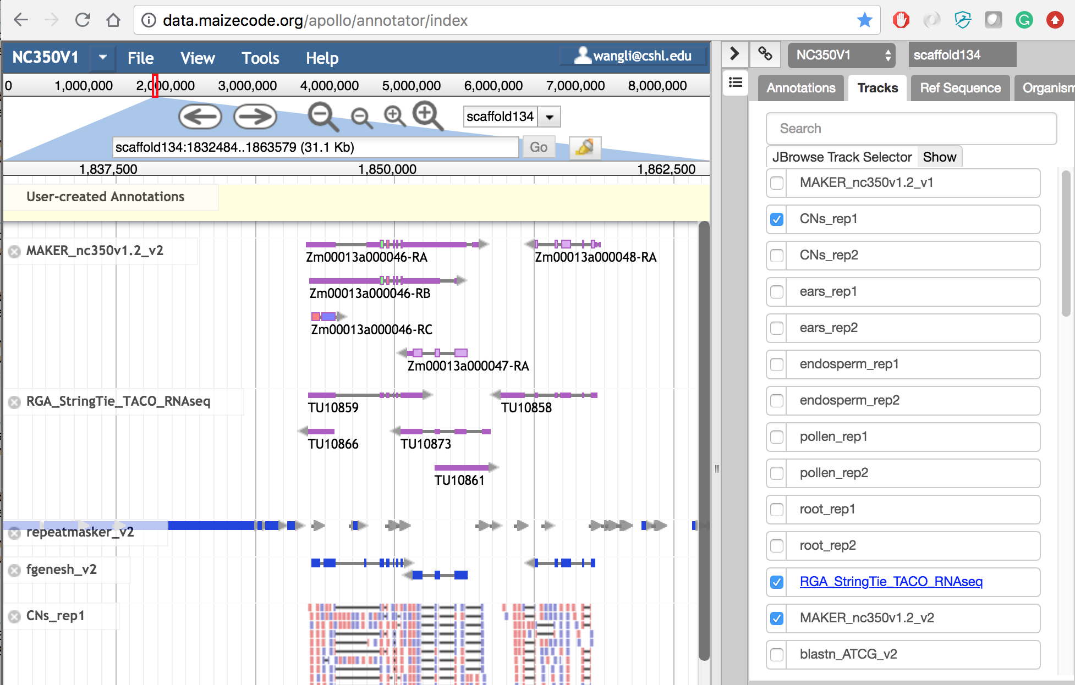
Annotation with Apollo

Slide 25
Thanks
General questions
  support@cyverse.org
Community forum
  http://ask.cyverse.org
SciApps Platform guide:
  https://cyverse-sciapps-guide.readthedocs-hosted.com

