Slide 1
The iPlant Collaborative
Community Cyberinfrastructure for Life Science
Jason Williams
Cold Spring Harbor Laboratory, iPlant

Slide 2
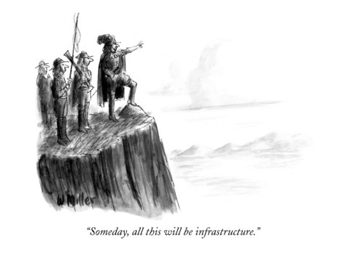
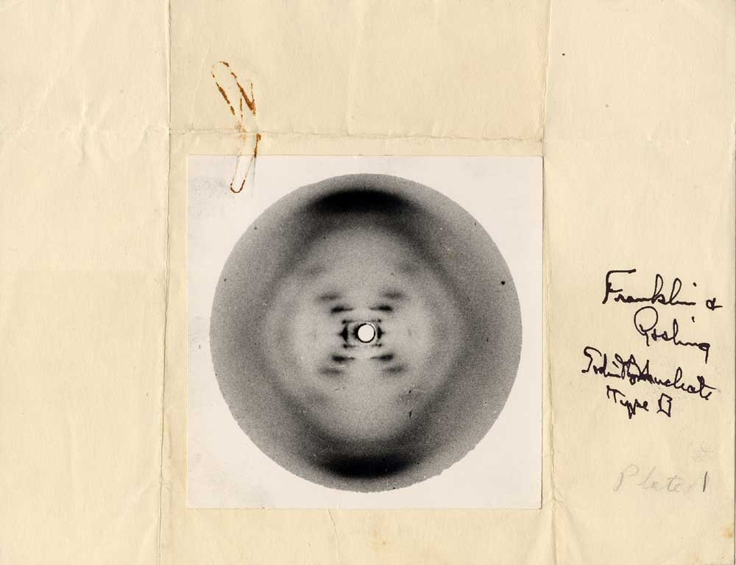
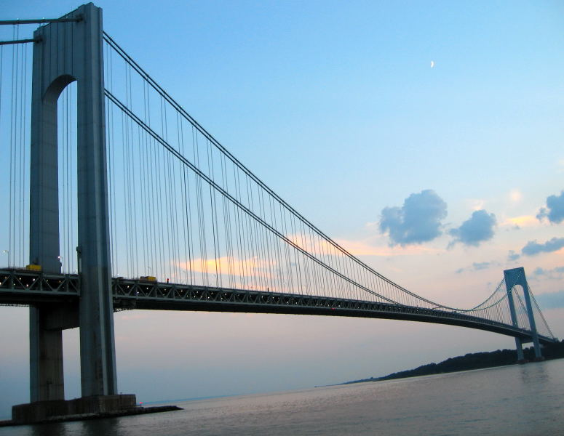
The iPlant Collaborative
Vision
How can we prepare for science we can’t anticipate?

Slide 3
The iPlant Collaborative
Vision
Enable life science researchers and educators to use and extend iPlant's foundational cyberinfrastructure to understand and ultimately predict the complexity of biological systems and their dynamic nature under various environmental conditions.

Slide 4
The iPlant Collaborative
What is Cyberinfrastructure?
Cyberinfrastructure (CI) is data storage, software, high-performance computing, and people – organized into systems that solve problems of size and scope that would not otherwise be solvable.

Slide 5
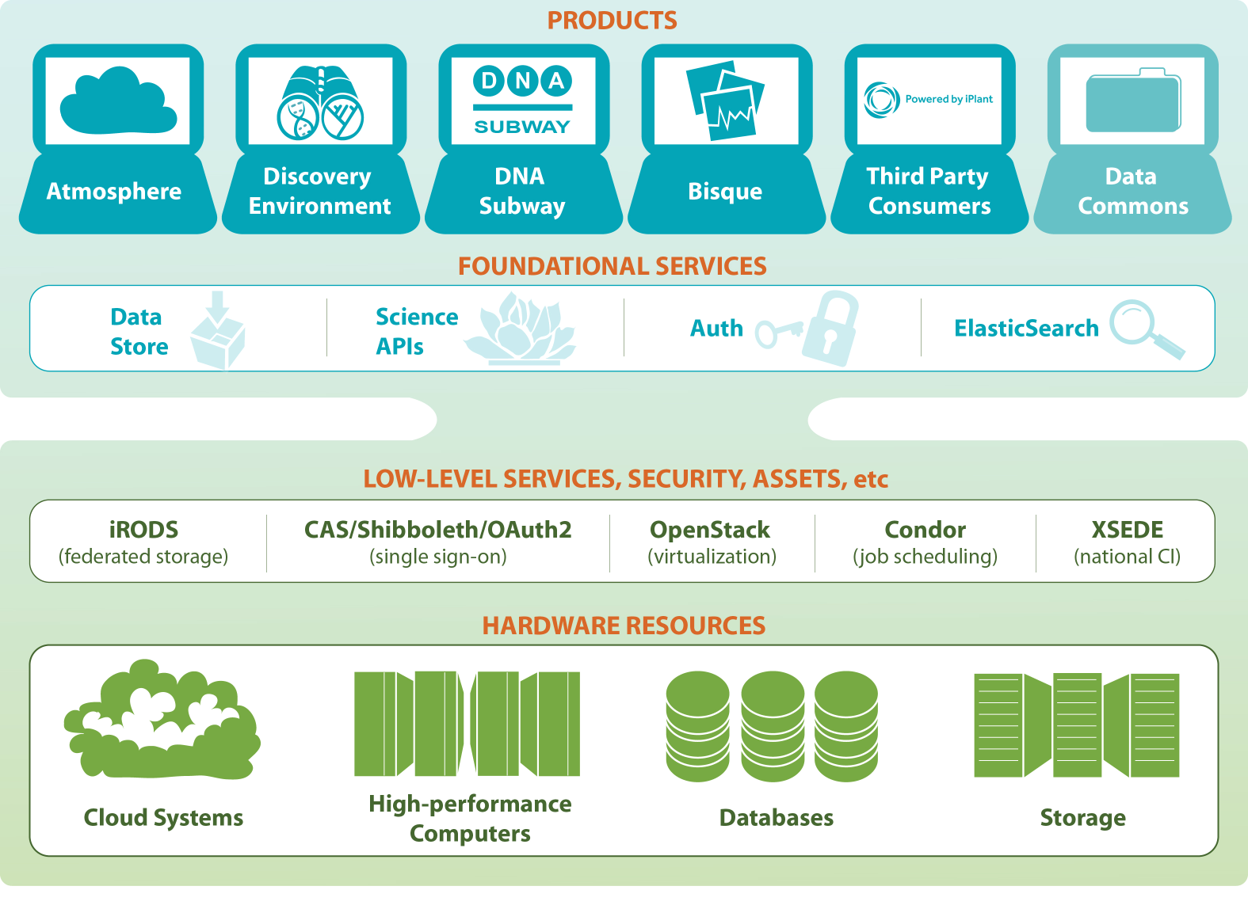
The iPlant Collaborative
What is Cyberinfrastructure?

Slide 6
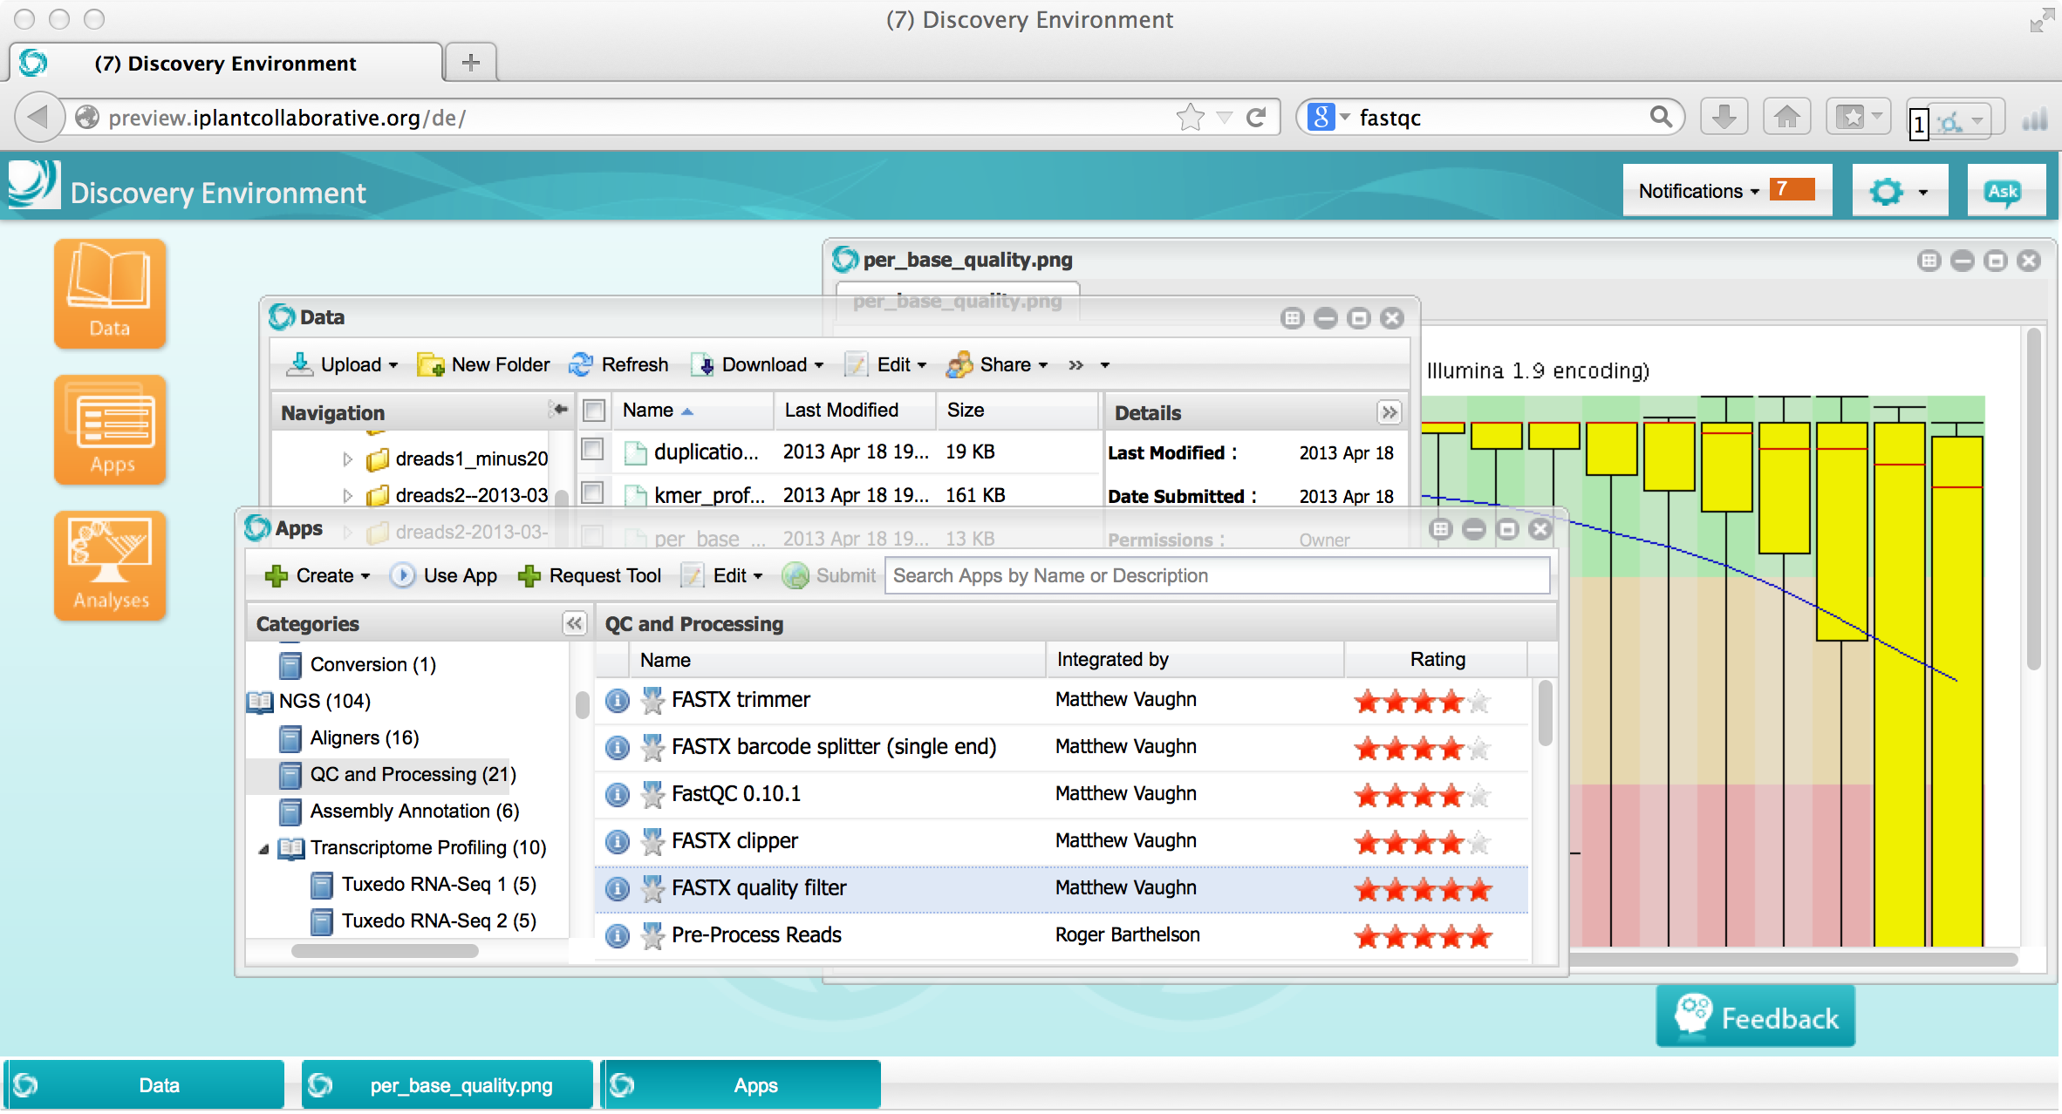
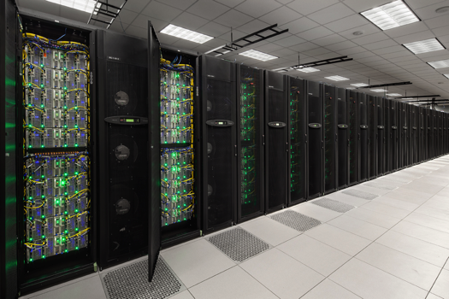
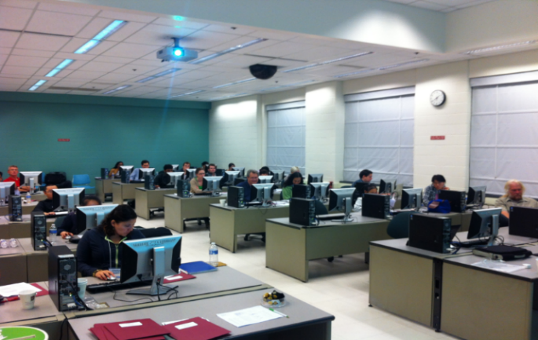
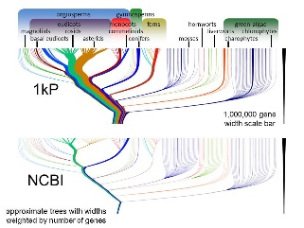
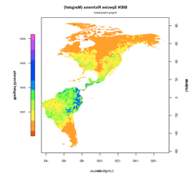
The iPlant Collaborative
What is Cyberinfrastructure?
Platforms, tools, datasets Storage and compute Training and support

Slide 7
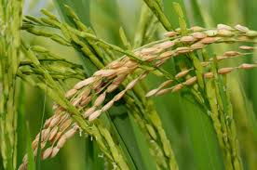
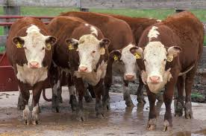
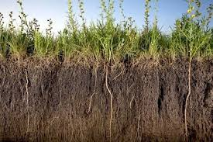
The iPlant Collaborative
What problems can iPlant Solve?
Crops and model plant systems Animal and livestock Agronomic microbes, insects…

Slide 8
The iPlant Collaborative
What problems can iPlant Solve?
iPlant is built for Data

Slide 9
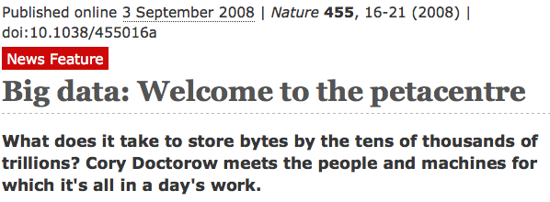
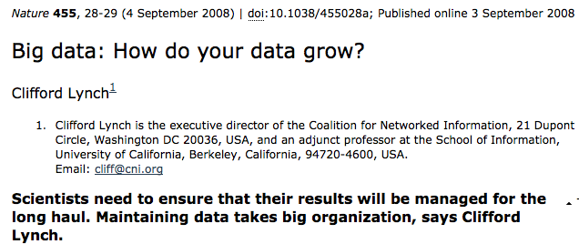
The iPlant Collaborative
How was iPlant built?

Slide 10
The iPlant Collaborative
Landscape of community identified priorities
Genomic data and analysis:
Reference guided assembly
De novo assembly
RNA-Seq (expression; gene/isoform discovery)
Variant calling
Genome/Transcriptome annotation
ChIP-Seq/Integration of epigenetic information
Multiple sequencing platforms
New and evolving technologies

Slide 11
The iPlant Collaborative
Landscape of community identified priorities
Predictive and synthetic
Pathway
Analysis
Association Studies
Evolutionary Models
Ecological Models
Knowledge gathering
Genomic
data
Environmental data
Phenotype data
Retrodictive insights
Phylogenetic Inferences

Slide 12
The iPlant Collaborative
Landscape of community identified priorities
Pathway
Analysis
Association Studies
In planning
In progress
Foundation in place
Evolutionary Models
Ecological Models
Genotypic
Environmental
Phenotypic
Annotation
Climate model products
Molecular Phenotyping
Image-based Phenotyping
Comparative Genomics
Sequencing & Assembly
Environmental datasets
Trait Data
Phylogenetic Tools for inference

Slide 13
The iPlant Collaborative
Who does iPlant collaborate with?
Arabidopsis Information Portal
iPlant collaborates to enable access to the solutions that work the best for you…

Slide 14
The iPlant Collaborative
Who makes up iPlant?
iPlant is a collaborative virtual organization

Slide 15
The iPlant Collaborative
How is iPlant funded?
Funded by NSF
First funding ($50 Million) in 2008
Renewal funding ($50.3 Million) in 2013
Scientific Advisory Board
Focus on Genotype-Phenotype science
NSF Recommended expansion of scope beyond plants

Slide 16
iPlant Data Store
The resources you need to share and manage data with your lab, colleagues and community
Initial 100 GB allocation – TB allocations available
Automatic data backup
Easy upload /download and sharing

Slide 17
Discovery Environment
Hundreds of bioinformatics Apps in an easy-to-use interface
A platform that can run almost any bioinformatics application
Seamlessly integrated with data and high performance computing
User extensible – add your own applications

Slide 18
Atmosphere
Cloud computing for the life sciences
Simple: One-click access to more than 100 virtual machine images
Flexible: Fully customize your software setup
Powerful: Integrated with iPlant computing and data resources

Slide 19
Agave API
Fully customize iPlant resources
Science-as-a-service platform
Define your own compute, and storage resources (local and iPlant)
Build your own app store of scientific codes and workflows

Slide 20
DNA Subway
Educational workflows for Genomes, DNA Barcoding, RNA-Seq
Commonly used bioinformatics tools in streamlined workflows
Teach important concepts in biology and bioinformatics
Inquiry-based experiments for novel discovery and publication of data

Slide 21
Bisque
Image analysis, management, and metadata
Secure image storage, analysis, and data management
Integrate existing applications or create new ones
Custom visualization and image handling routines and APIs

Slide 22
The iPlant Collaborative
Who makes up iPlant?
Executive Team
Steve Goff - UA
Matthew Vaughn - TACC
Nirav Merchant – UA
Eric Lyons - UA
Doreen Ware – CSHL
Postdocs:
Barbara Banbury
Christos Noutsos
Solon Pissis
Brad Ruhfel
Students:
Peter Bailey
Jeremy Beaulieu
Devi Bhattacharya
Storme Briscoe
YaDi Chen
David Choi
Barbara Dobrin
John Donoghue
Yekatarina Khartianova
Chris La Rose
Amgad Madkour
Aniruddha Marathe
Andre Mercer
Kurt Michaels
Zack Pierce
Andrew Predoehl
Sathee Ravindranath
Kyle Simek
Gregory Striemer
Jason Vandeventer
Nicholas Woodward
Kuan Yang
Staff:
Greg Abram
Sonali Aditya
Ritu Arora
Roger Barthelson
Rob Bovill
Brad Boyle
Gordon Burleigh
John Cazes
Mike Conway
Victor Cordero
Rion Dooley
Aaron Dubrow
Andy Edmonds
Dmitry Fedorov
Melyssa Fratkin
Michael Gatto
Utkarsh Gaur
Cornel Ghiban
Edwin Skidmore
Brandon Smith
Mary Margaret Sprinkle
Sriram Srinivasan
Josh Stein
Lisa Stillwell
Jonathan Strootman
Peter Van Buren
Hans VasquezGross
Rebeka Villarreal
Ramona Wallls
Liya Wang
Anton Westveld
Jason Williams
John Wregglesworth
Weijia Xu
Steve Gregory
Matthew Hanlon
Natalie Henriques
Uwe Hilgert
Nicole Hopkins
EunSook Jeong
Logan Johnson
Chris Jordan
Kathleen Kennedy
Mohammed Khalfan
David Knapp
Lars Koersterk
Sangeeta Kuchimanchi
Kristian Kvilekval
Sue Lauter
Tina Lee
Zhenyuan Lu
Eric Lyons
Aaron MarcuseKubitz
Naim Matasci
Sheldon McKay
Robert McLay
Nathan Miller
Steve Mock
Martha Narro
Shannon Oliver
Benoit Parmentier
Jmatt Peterson
Dennis Roberts
Paul Sarando
Jerry Schneider
Bruce Schumaker
Faculty Advisors & Collaborators:
Ali Akoglu
Kobus Barnard
Timothy Clausner
Brian Enquist
Damian Gessler
Ruth Grene
John Hartman
Matthew Hudson
David Lowenthal
B.S. Manjunath
David Neale
Brian O’Meara
Sudha Ram
David Salt
Mark Schildhauer
Doug Soltis
Pam Soltis
Edgar Spalding
Alexis Stamatakis
Steve Welch

