Slide 1
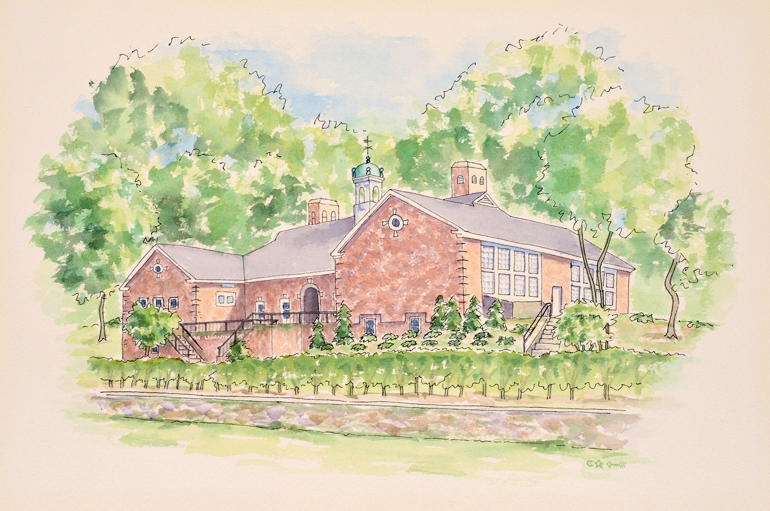
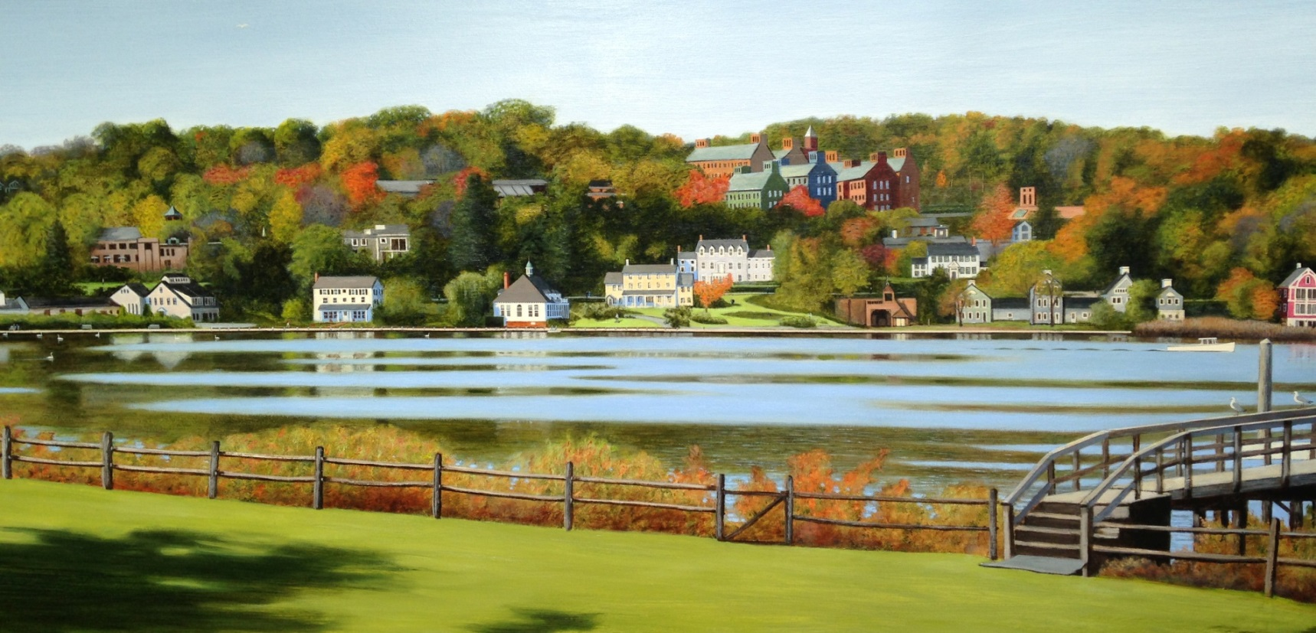
DNA Subway and Microbiomes
The CURE Challenge
Austin Community College
July 30-31, 2018
Dave Micklos
DNA Learning Center,
Cold Spring Harbor Laboratory

Slide 2
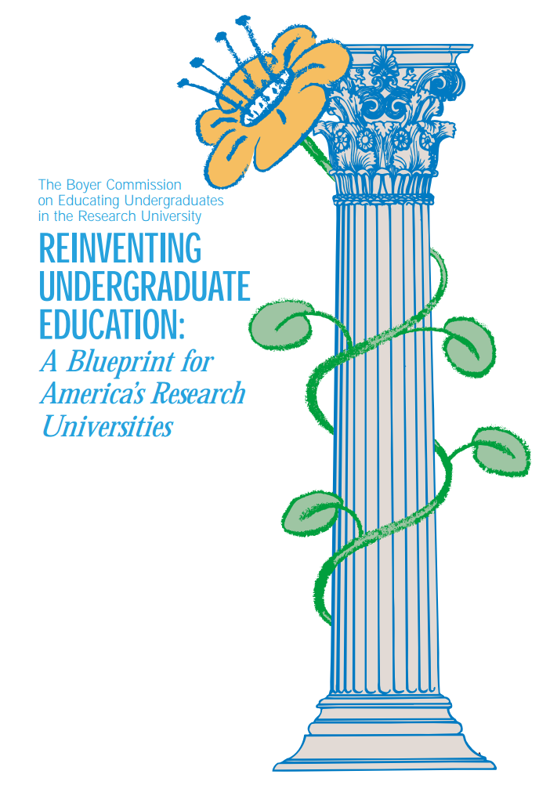
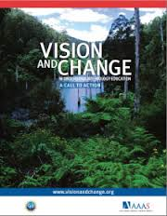
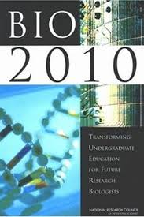
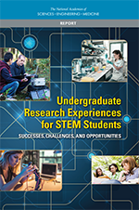
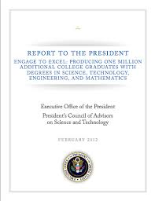
2011
2008
1998
PCAST
2012
2003
2017

Slide 3
How to reform science education?
Foster conceptual, higher level thinking, and science practice rather than memorization of terms, facts, and techniques.
Adopt inquiry and student-centered approaches that begin with students’ own questions.
Increase opportunities for interdisciplinary and collaborative work.
Research experiences engage students in science practices, iterating solutions, collaborating and discussing results.
Scale research experiences to reach students early and in the context of for-credit courses = Course-Based Undergraduate Research Experiences (CUREs).
Notes:
3

Slide 4
A National Concern: Students are leaving the sciences
Fewer than 40% of students entering college with intention of majoring in STEM complete a STEM degree; many leave after their first or second year.
^{I}
J. P. Holdren, E. Lander, (PCAST) “Engage to excel: producing one million additional college graduates with degrees in science, technology, engineering, and mathematics” (Washington, D.C., 2012), p. 103.
Notes:
For every 100 students who enter UT intending to get a science degree, on average 17 more will graduate if they participate in FRI.

Slide 5
The PCAST Challenge
Increasing retention from 40% to 50% would generate 750,000 additional STEM graduates over the next decade.
^{I}
J. P. Holdren, E. Lander, (PCAST) “Engage to excel: producing one million additional college graduates with degrees in science, technology, engineering, and mathematics” (Washington, D.C., 2012), p. 103.
Notes:
For every 100 students who enter UT intending to get a science degree, on average 17 more will graduate if they participate in FRI.

Slide 6
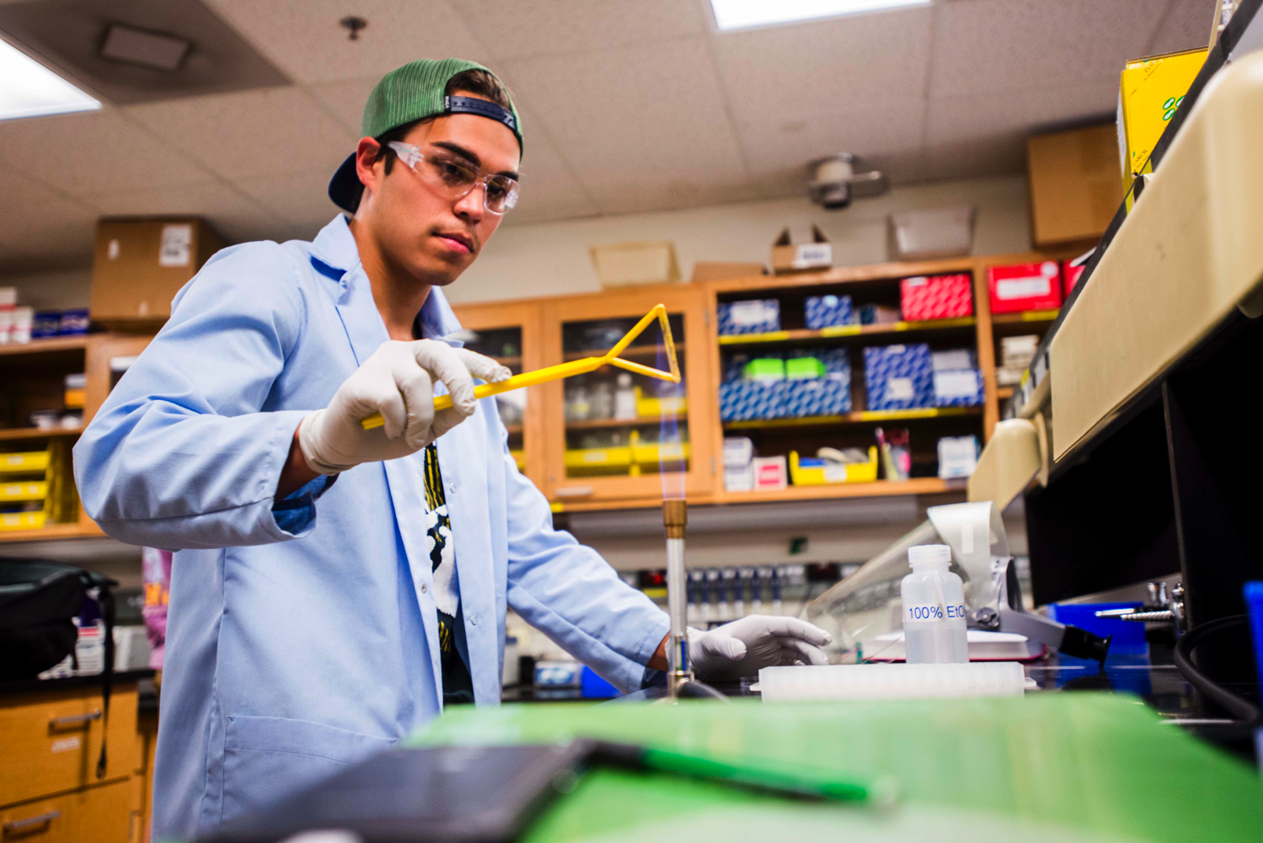
Traditionally, most undergraduate research has happened outside of the curriculum.

Slide 7
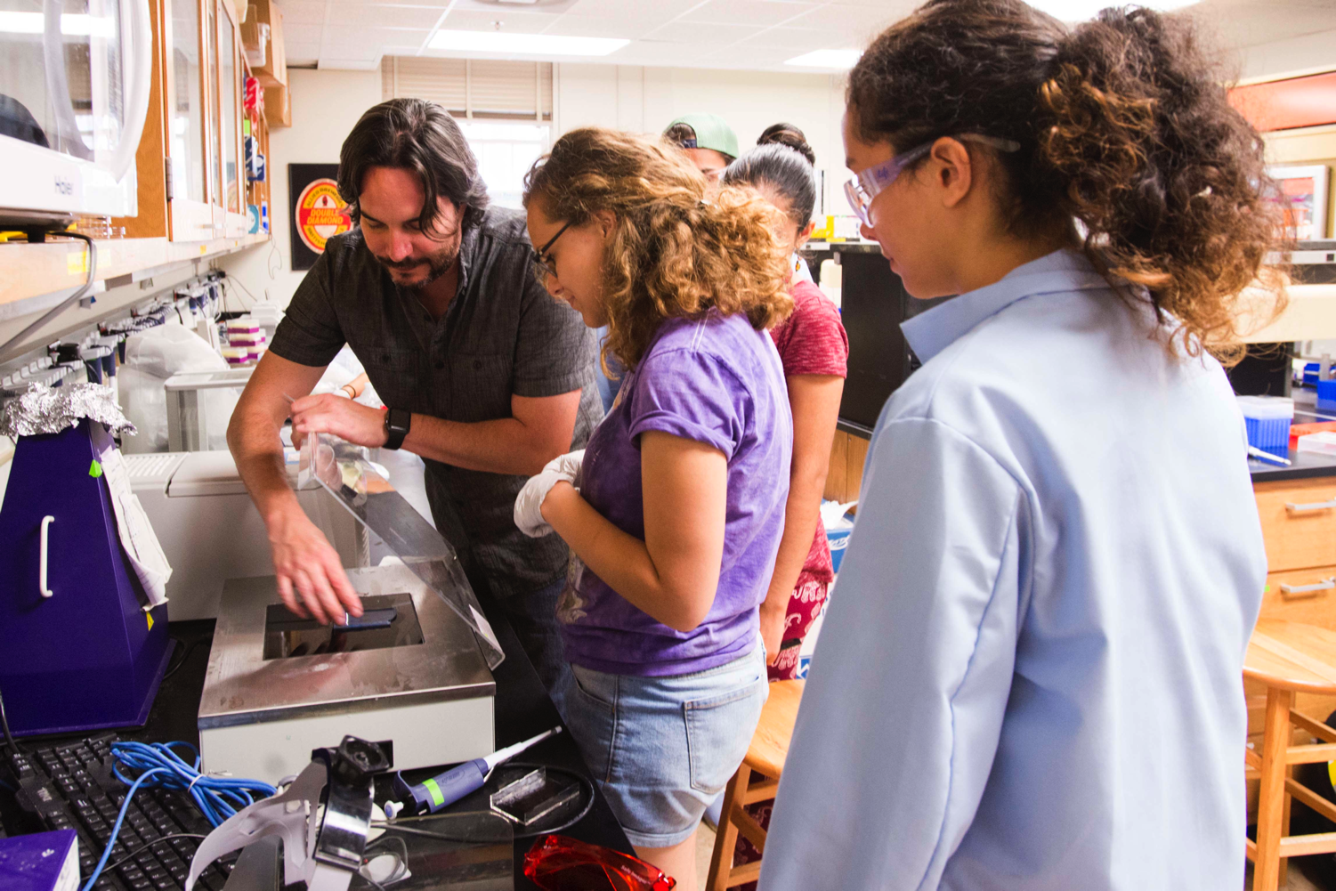
CUREs scale up research to reach many in context of for credit courses.

Slide 8
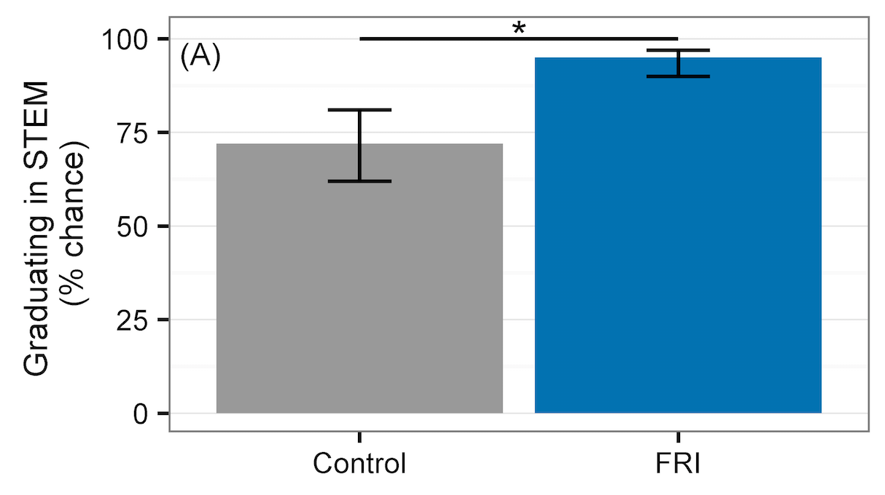
UT Austin’s Freshman Research Initiative (FRI) increases retention in STEM 23%
71%
94%
n=1,624; 812 matched pairs
* Significant difference; error bars represent 98.75% confidence intervals
NOTE: 22.1% = National Hispanic STEM 6-year graduation rate
Rodenbusch, Hernandez, Simmons, & Dolan, CBE-Life Sciences Education, June 2016
Notes:
Logistic regression
Pseudo-R2 is 0.22 for FRI + controls
Pseudo-R2 is 0.15 for controls only

Slide 9
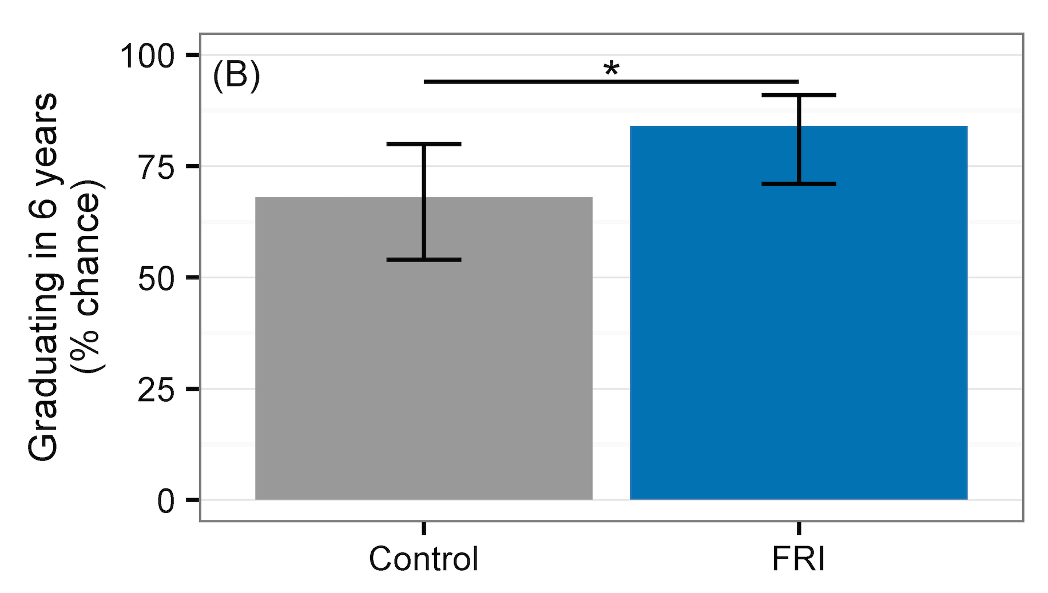
UT Austin’s Freshman Research Initiative (FRI) increases 6 year graduation 17%
66%
83%
n=990; 495 matched pairs
*These are model-based predicted outcomes for the average student
Significant difference; error bars represent 98.75% confidence intervals
NOTE: 38.6% = National STEM 6-year graduation rate
Rodenbusch, Hernandez, Simmons, & Dolan, CBE-Life Sciences Education, June 2016
Notes:
Whether or not they earned a STEM degree: FRI helps to clarify goals

Slide 10
The PCAST Challenge
Increasing retention from 40% to 50% would generate 750,000 additional STEM graduates over the next decade.
^{I}
J. P. Holdren, E. Lander, (PCAST) “Engage to excel: producing one million additional college graduates with degrees in science, technology, engineering, and mathematics” (Washington, D.C., 2012), p. 103.
Notes:
For every 100 students who enter UT intending to get a science degree, on average 17 more will graduate if they participate in FRI.

Slide 11
UT Austin’s Freshman Research Initiative (FRI) The CURE
^{I}
Rigorously implementing CUREs could increase retention from 40% to 60% generating 1,500,000 additional STEM graduates over the next decade.
Notes:
For every 100 students who enter UT intending to get a science degree, on average 17 more will graduate if they participate in FRI.

Slide 12
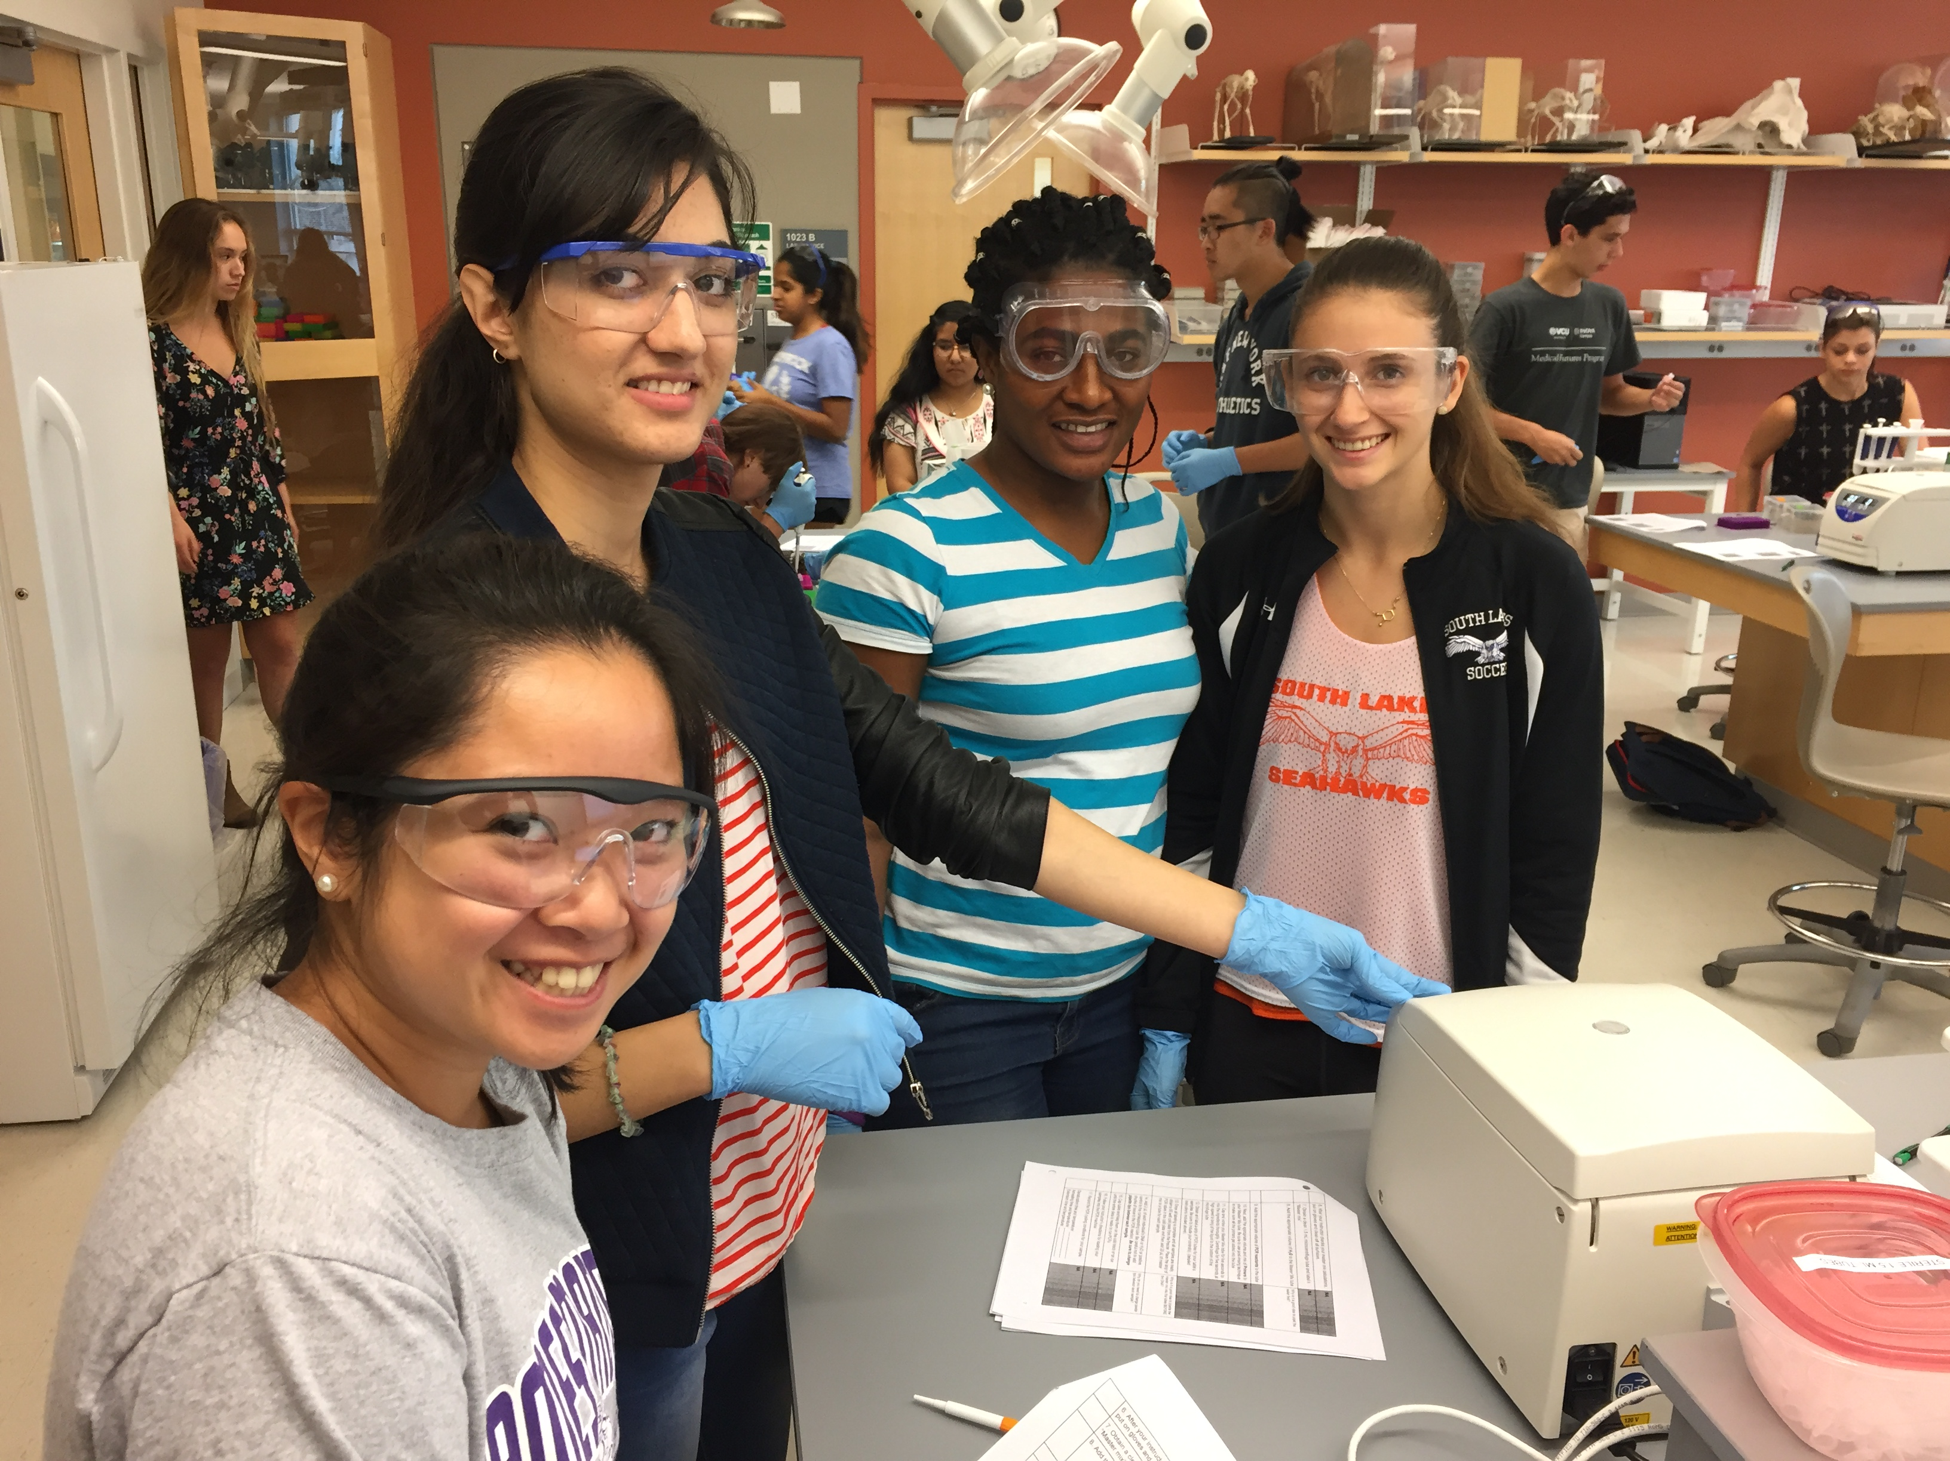
DNA Barcoding at JMU
1st semester, freshman course
500+ students/semester
Bio majors (~50%)
20+ lab sections (24 students/section)
17 instructors (mostly part-timer and masters students)

Slide 13
DNA Barcoding at JMU Meet the instructors
= full time
= part time
= masters students

Slide 14
DNA Barcoding at JMU Integrating Biology Concepts and Practice
Fundamentals
Ecology
Cell/Molec Bio.
Bioinformatics
Wk. 1-3
Process of Science
Experimental Design
Evolution and Phylogenetic Trees
Calculating Biodiversity (Transects)
Specimen Collection and photography
Record data in iNaturalist database
DNA
DNA Extraction
PCR
Gel Electrophoresis
Sanger Sequencing
“DNA subway” Blue line
Sequence Assembly
Sequence Analysis
BLAST
Phylogenetic trees
Wk. 4-5
Wk. 6-12
Wk. 12-13
Scientific Communication
Lab Notebook
Lab Report
Lab Report
Poster

Slide 15
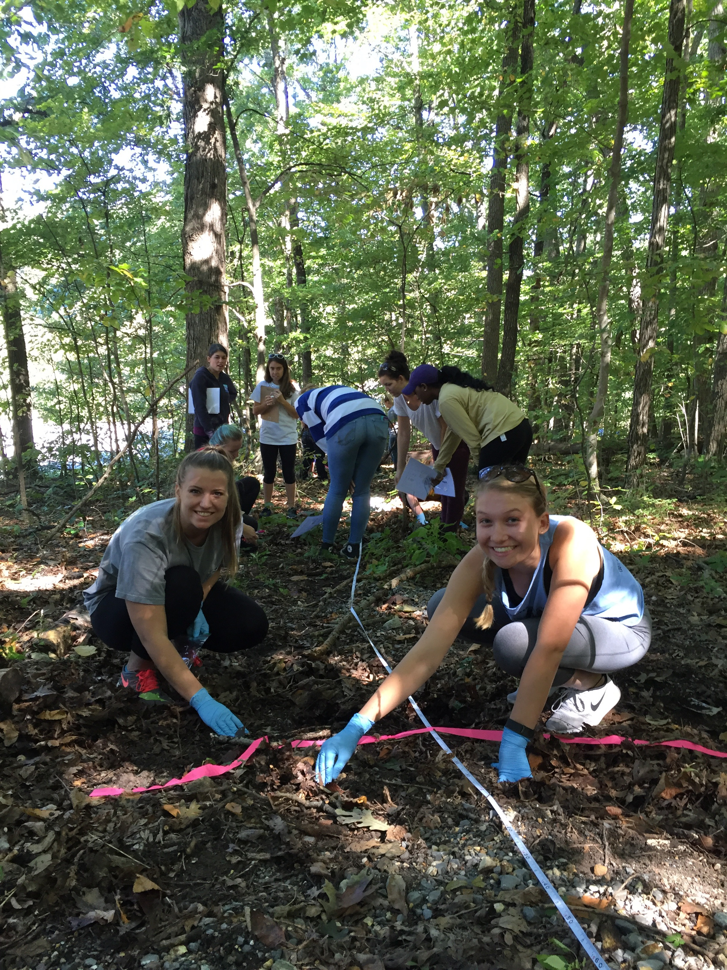
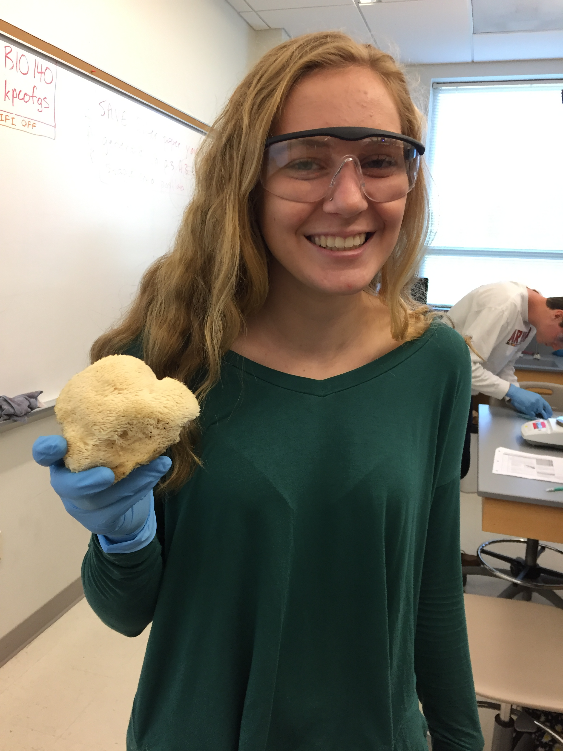
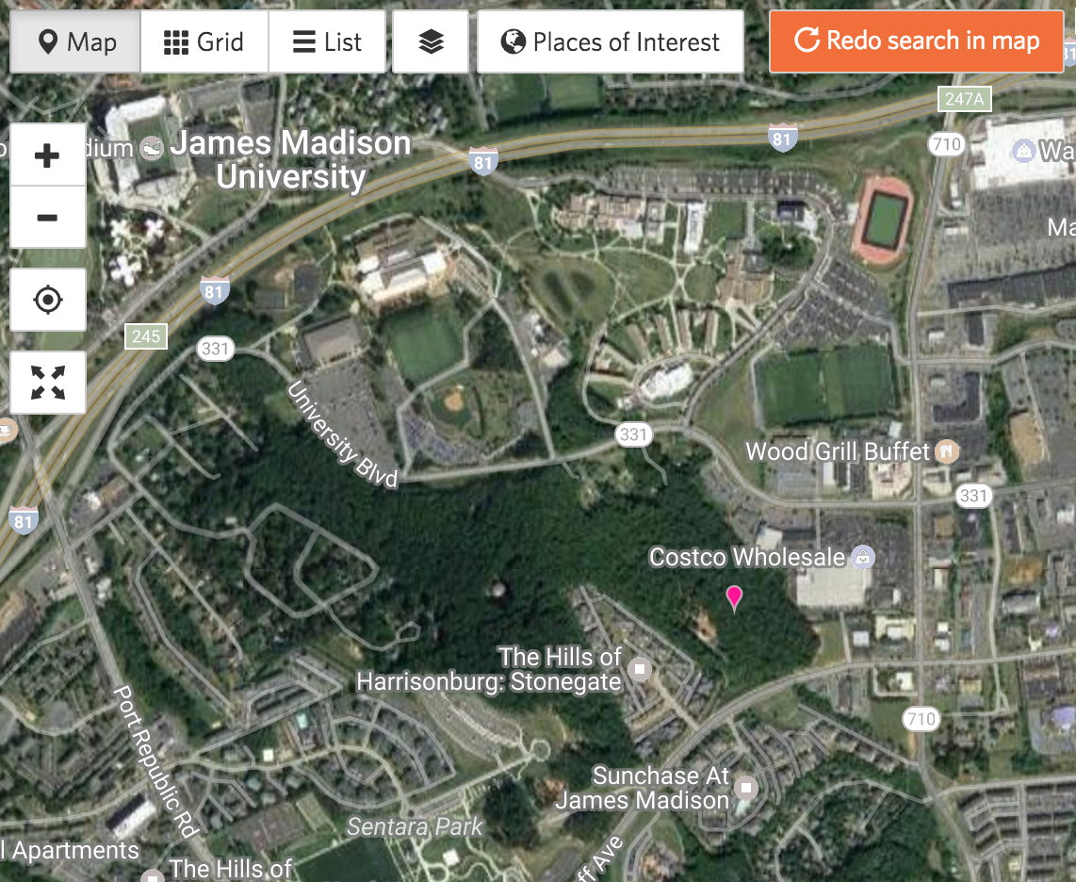
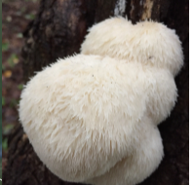
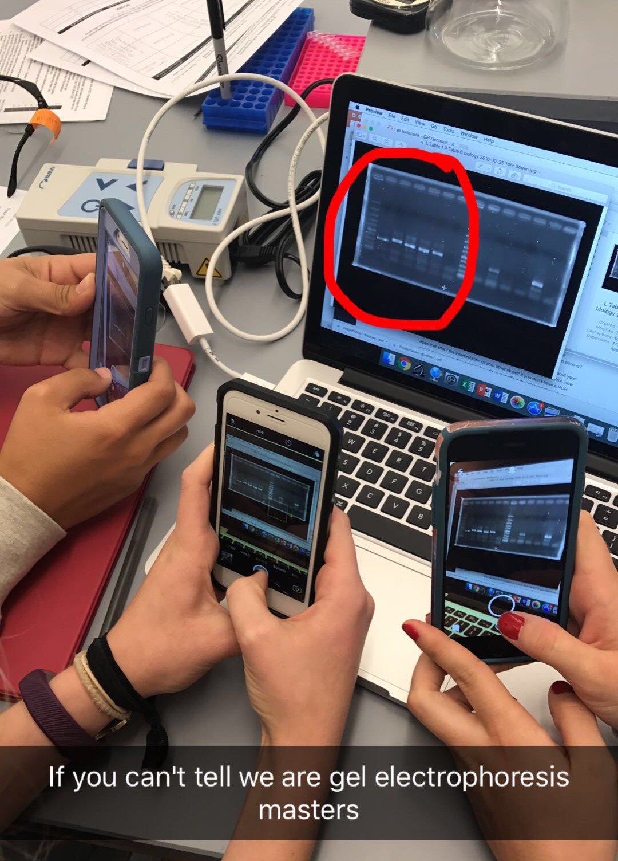
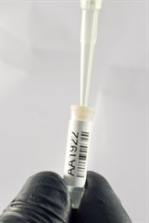
DNA Barcoding at JMU A student’s perspective
Emma collected a mushroom
Tagged in iNaturalist
ID specimen
PCR worked!
Analyzed in DNA subway
PCR product sequenced in Eurofins

Slide 16
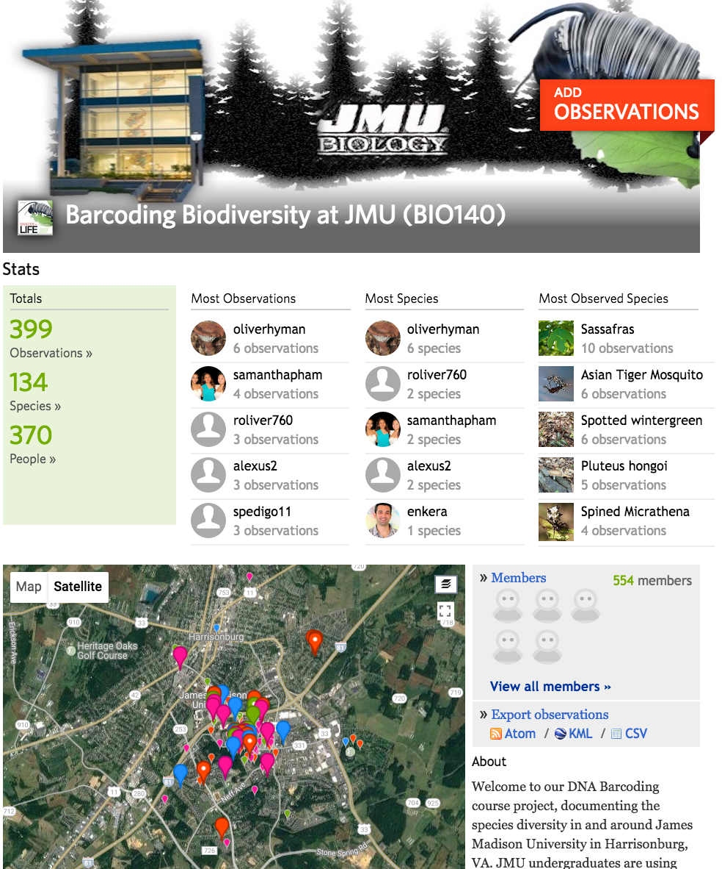

Slide 18
DNA Barcoding CUREs Moving faculty along a continuum of research experiences and increasing student exposures

Slide 19
DNA Barcoding CUREs Moving faculty along a continuum of research experiences and increasing student exposures (n=150)
67%
7%
17%
50%
7%
3%
Interested 71% 65%

Slide 20
DNA Barcoding CUREs
Moving faculty along a continuum of research experiences and increasing student exposures
Surveyed 150 college faculty who had been introduced to DNA barcoding at CyVerse and NSF workshops conducted by DNALC.
DNA Barcoding
67% had done experiments with students, about equally divided between lower and upper division courses. Reaching about 4,800 students annually.
Only 3% had implemented a CURE, but 71% were interested in starting one for underclassmen.
Metabarcoding
Only 7% had done experiments with students.
65% were interested in starting a CURE.
New NSF IUSE project will train and mentor faculty to move along this barcoding continuum

Slide 21
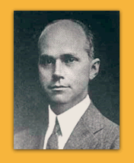
Acknowledgements
DNALC
Bruce Nash
Christine Marizzi
Sharon Pepenella
Cornel Ghiban
Jason Williams
Dave Micklos
CSHL Genome Center
Sara Goodwin
Elena Ghiban
Rockefeller University
Jesse Ausubel
Mark Stoeckle
Feinstein Institute of Northwell Health
Annette Lee
Anthony Liew
Northern Arizona University
Greg Caporaso
Richard
Lounsbery
Foundation
NSF CyVerse

