Slide 1

GBS & GWAS using the iPlant Discovery Environment
Maize Genetics Conference 3-14-2013 St. Charles, IL

Slide 2
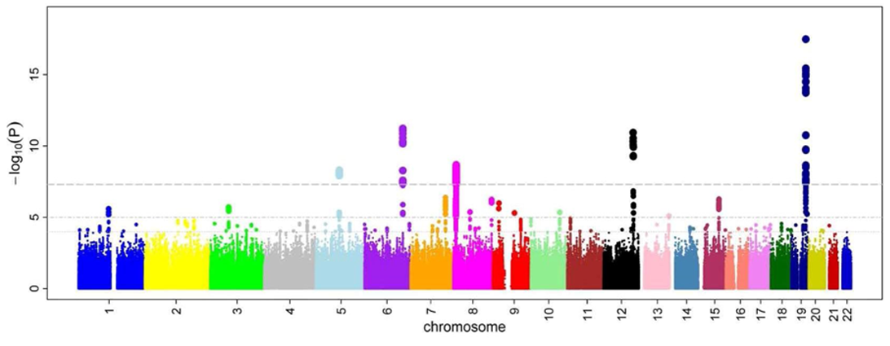
Overview: This training module is designed to demonstrate the Genotype by Sequencing Workflow and Genome Wide Association Study using a Mixed Linear Model
Questions:
How can we determine genotypes using sequencing technology?
How can we find genetic variants (e.g. SNPs) associated with a phenotype?
Notes:
http://upload.wikimedia.org/wikipedia/commons/1/12/Manhattan_Plot.png

Slide 3
Tools for Statistical Genetics in the DE
Tool | Purpose
Genotype by Sequencing Workflow | Automatic pipeline for extracting SNPs from GBS data (with genome from user or from iPlant database)
UNEAK pipeline | Automatic pipeline for extracting SNPs from GBS data without reference genomes
MLM workflow | Automatic workflow for fitting Mixed Linear Model
GLM workflow | Automatic workflow for fitting General Linear Model
QTLC workflow | Automatic workflow for composite interval mapping
QTL simulation workflow | Automatic workflow for simulating trait data with given linkage map
PLINK | PLINK implementation of various association models
Zmapqtl | Interval mapping and composite interval mapping with the options to perform a permutation test
LRmapqtl | Linear regression modeling
SRmapqtl | Stepwise regression modeling
AntEpiSeeker | Epistatic interaction modeling
Random Jungle | Random Forest implementation for GWAS
FaST-LMM | Factored Spectrally Transformed Linear Mixed Modeling
Qxpak | Versatile mixed modeling
gluH2P | Convert Hapmap format to Ped format
LD | Linkage Disequilibrium plot
Structure | Estimation of population structure
PGDSpider | Data conversion tool
GLMstrucutre | GLM with population structure as fixed effect

Slide 4
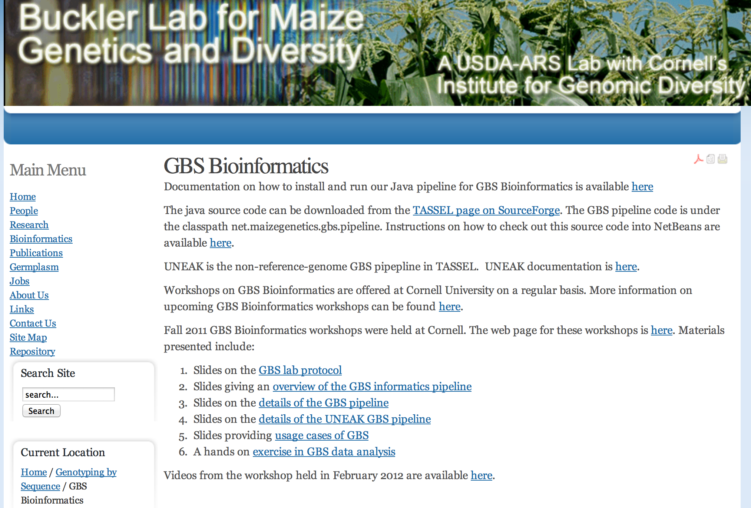
http://www.maizegenetics.net/gbs-bioinformatics
Elshire et al. PLoS One. 2011 May 4;6(5):e19379. doi: 10.1371/journal.pone.0019379

Slide 5
Genotype By Sequencing
Ed Buckler (Cornell University)
http://www.maizegenetics.net/gbs-bioinformatics
Elshire et al. PLoS One. 2011 May 4;6(5):e19379. doi: 10.1371/journal.pone.0019379

Slide 6
GBS Overview
http://cbsu.tc.cornell.edu/lab/doc/GBS_overview_20111028.pdf

Slide 7
Identification of markers with/without the reference genome
B73
SNP and small INDELs
Loss of cut site
Mo17

Slide 8
Reads -> Tags -> Aligned Tags -> SNPs/INDELs
CAGCAAAAAAAAAAAAGAGGGATGCGGCGGCTTGCGTGCATGGGACACAAGCGTGTAGACGGGC
CAGCAAAAAAAAAAAAGAGGGATGGGGCGGCTTGCGTGCATGGGACACAAGCGTGTAGACGGGC
Two ways of alignments:
Anchored to reference genome
Pair-wise alignment between tags

Slide 9
GBS Lab Protocol
From: http://cbsu.tc.cornell.edu/lab/doc/GBS_Method_Overview1.pdf

Slide 10
http://cbsu.tc.cornell.edu/lab/doc/Buckler_FilterImpTools111028.pdf

Slide 11
Input files:
Sequence (QSEQ or FASTQ)
Key file (bar-code to sample)
http://cbsu.tc.cornell.edu/lab/doc/GBS_overview_20111028.pdf

Slide 12
http://cbsu.tc.cornell.edu/lab/doc/GBS_overview_20111028.pdf

Slide 13
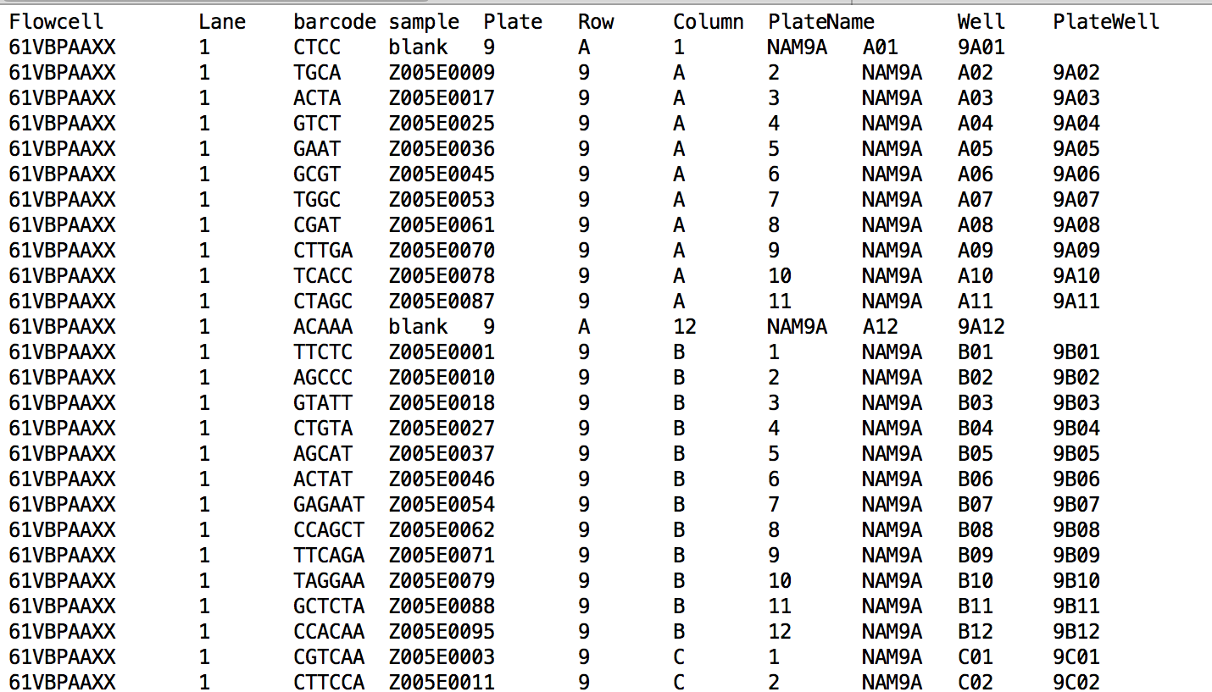
Input Key File

Slide 14
http://cbsu.tc.cornell.edu/lab/doc/Buckler_FilterImpTools111028.pdf

Slide 15
Trims and cleans reads to 64 bp tags
http://cbsu.tc.cornell.edu/lab/doc/Buckler_FilterImpTools111028.pdf

Slide 16
http://cbsu.tc.cornell.edu/lab/doc/Buckler_FilterImpTools111028.pdf

Slide 17
Locates tags on genome
http://cbsu.tc.cornell.edu/lab/doc/Buckler_FilterImpTools111028.pdf

Slide 18
http://cbsu.tc.cornell.edu/lab/doc/Buckler_FilterImpTools111028.pdf

Slide 19
Associates tags to germplasms
http://cbsu.tc.cornell.edu/lab/doc/Buckler_FilterImpTools111028.pdf

Slide 20
Saved as a binary file
http://cbsu.tc.cornell.edu/lab/doc/Buckler_FilterImpTools111028.pdf

Slide 21
http://cbsu.tc.cornell.edu/lab/doc/Buckler_FilterImpTools111028.pdf

Slide 22
http://cbsu.tc.cornell.edu/lab/doc/Buckler_FilterImpTools111028.pdf

Slide 23
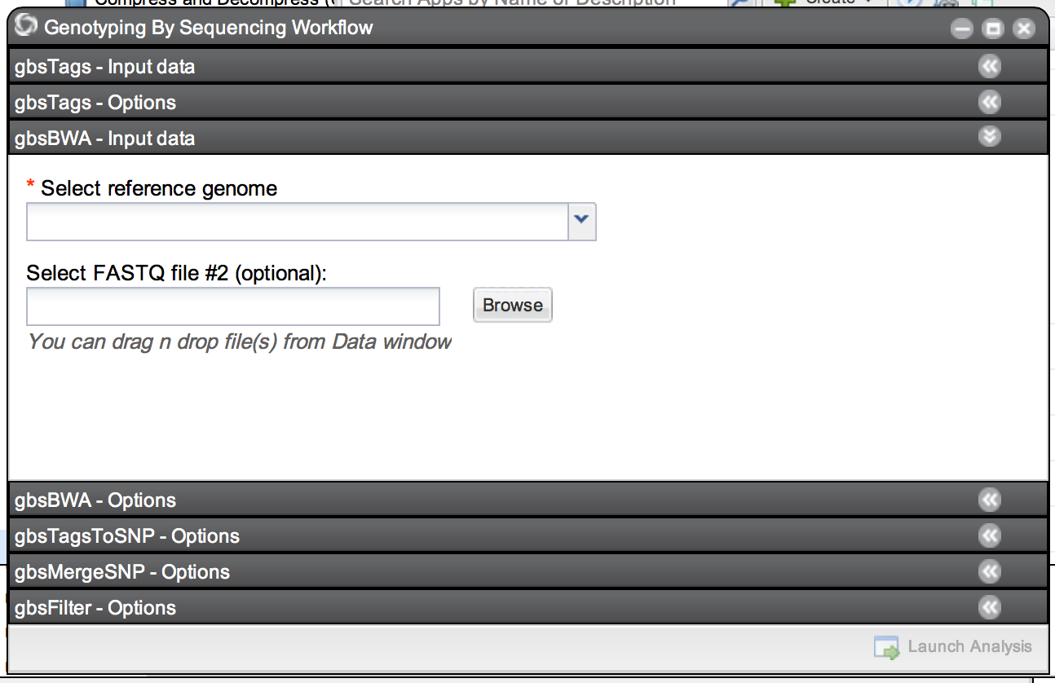
“Genotype By Sequencing Workflow” in DE
Individual steps strung together to run with a single click
Some steps merged to reduce I/O

Slide 24
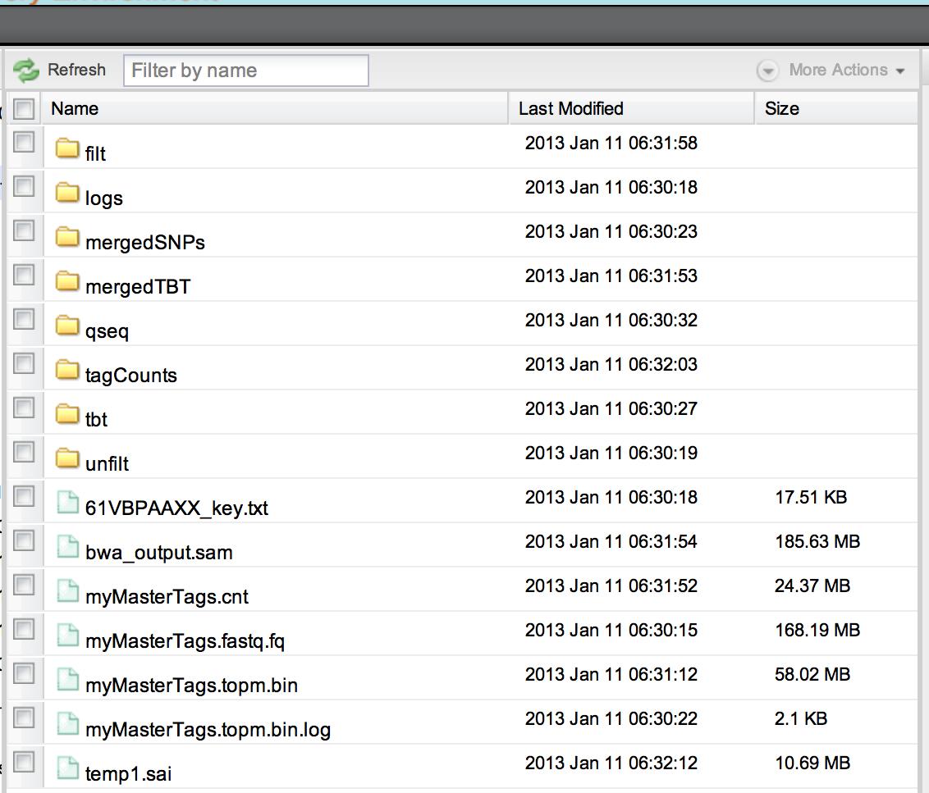
GBS Workflow Output in the DE
Final filtered hapmap files in folder “filt”

Slide 25
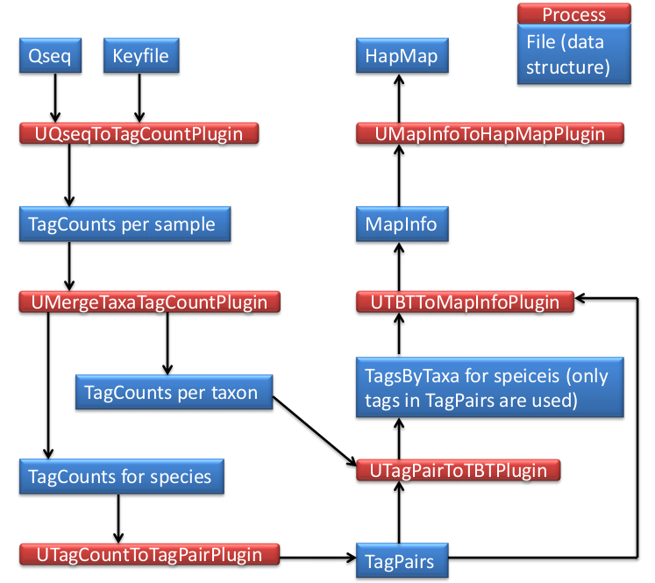
Final Notes on GBS
If you do not have a reference genome:
-- use “UNEAK” (also part of TASSEL)
http://www.maizegenetics.net/images/stories/bioinformatics/TASSEL/uneak_pipeline_documentation.pdf
If your reference genome is not support by the DE:
-- use “GBS Workflow with user genome”

Slide 26
MLM Pipeline for GWAS
Mixed Linear Model alternative to General Linear Model:
Reduces false positives by controlling for population structure
Uses compression to decrease effective sample size
P3D protocol to eliminate need to re-compute variance components
Speeds compute time up to ~7500x faster than GLM
Ed Buckler (Cornell University)
TASSEL
marker
filter
K
convert
impute
MLM
GLM
trait
impute
Zhang et al. Nature Genetics. 2010; doi:10.1038/ng.546
http://www.maizegenetics.net/statistical-genetics
http://www.maizegenetics.net/tassel/docs/Tassel_User_Guide_3.0.pdf

Slide 27
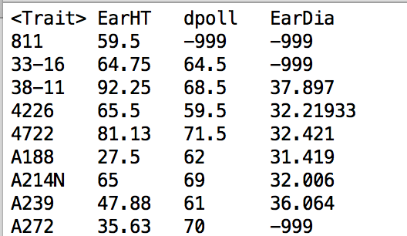
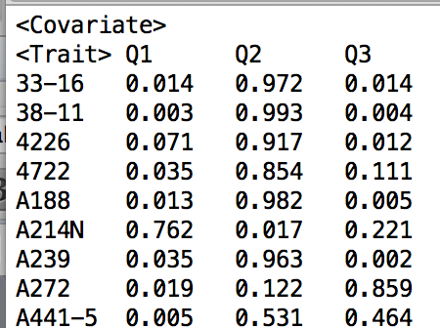
MLM Input Files
Phenotype data
traits
strain
Hapmap file
Phenotype data
Kinship matrix*
Population structure*
Population structure
3 populations sum to 1
strain
* Use “MLM Workflow” App in DE if they are not available. This app will also output the kinship matrix.

Slide 28
MLM Output
MLM1.txt
  Marker
  “df” degrees of freedom
  “F” F distribution for test of marker
  “p” p-value
  “errordf” df used for denominator of F-test
  etc.
MLM2.txt
  Estimated effect for each allele for each marker
MLM3.txt
  The compression results shows the likelihood, genetic variance, and error variance for each compression level tested during the optimization process.
See TASSEL manual for details:
http://www.maizegenetics.net/tassel/docs/Tassel_User_Guide_3.0.pdf

Slide 29
THANKS!

