Slide 1
Using Biological Cyberinfrastructure
Scaling Science and People: Applications in
Data Storage, HPC, Cloud Analysis, and Bioinformatics Training
ISMB/ECCB 2015 – Applied Knowledge Exchange Session
John Fonner (@JohnFonner) – University of Texas, Austin – TACC / iPlant
Jason Williams(@JasonWilliamsNY) – Cold Spring Harbor Laboratory / iPlant
Download Session Slides: www.iplantc.org/akeswiki1

Slide 2
Cyberinfrastructure is…
Data storage, software, high-performance computing, and people organized into systems to solve problems of size and scope not otherwise solvable.
2

Slide 3
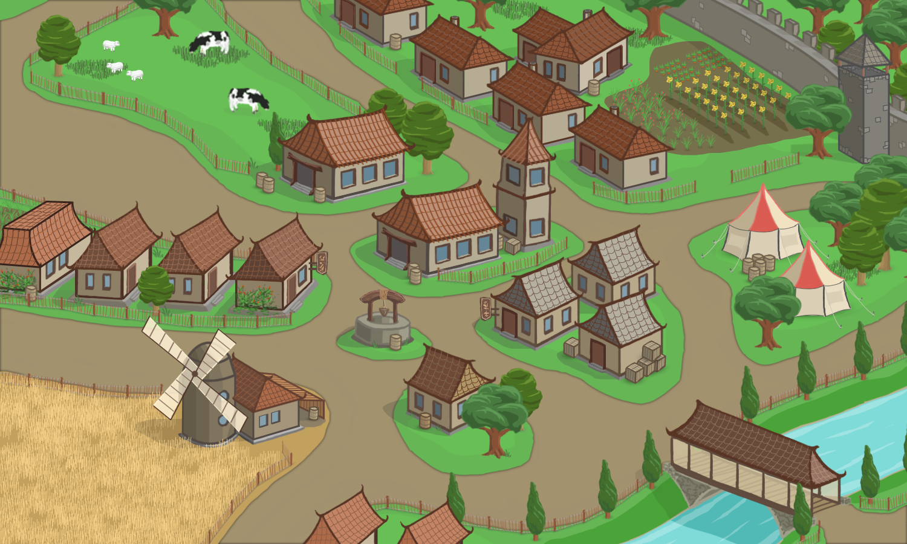
Cyberinfrastructure = Scalability
Field trials
Clinical testing
Individual Investigators
School
Conferences
Data Bases
http://best360.deviantart.com/art/My-Huge-Lego-Ship-Front-Side-1994676
HT Processing
3

Slide 4
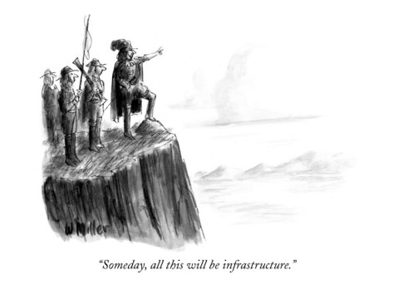
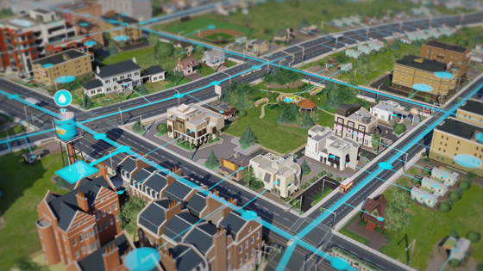
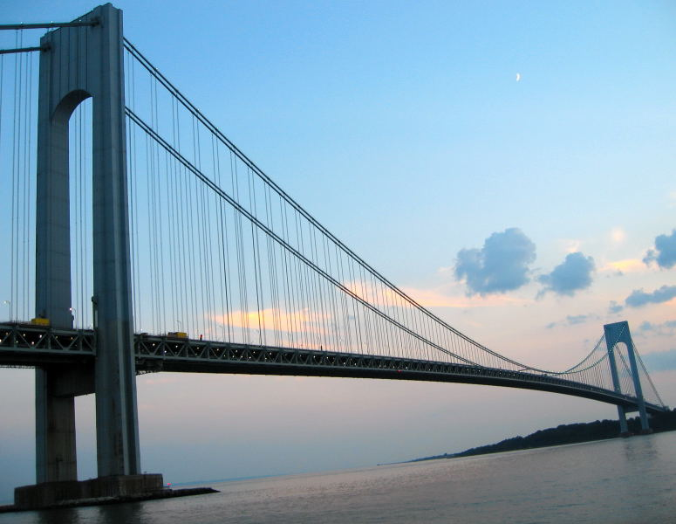
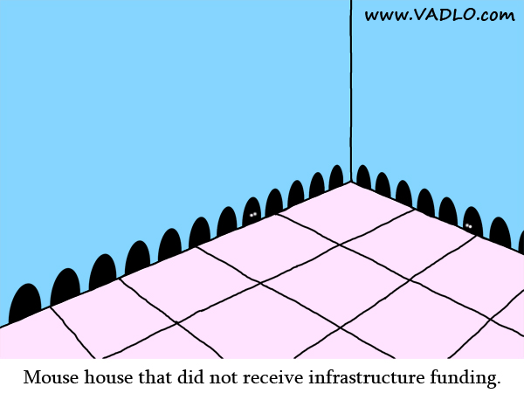
Cyberinfrastructure = Scalability
4

Slide 5
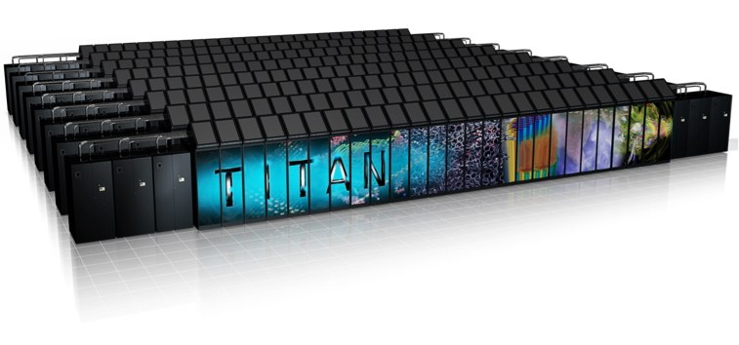
Not everything scales at the same rate…
Computing
Still advancing at Moore’s law
Moving in many different directions (goals): HPC vs. Cloud vs. PC
Only as good as the software that uses it
5

Slide 6
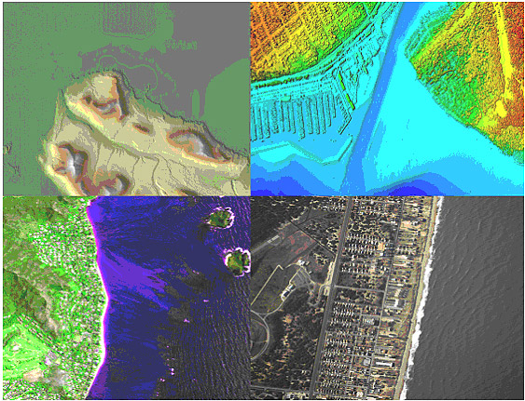
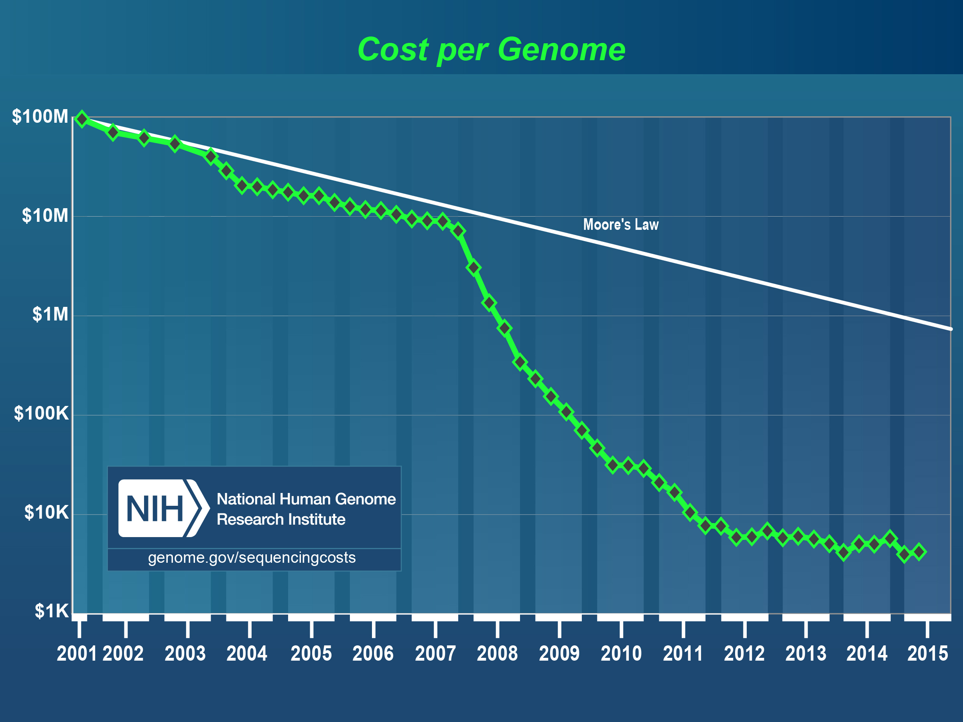
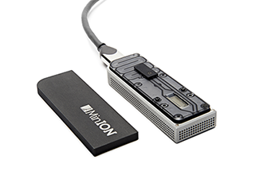
Not everything scales at the same rate…
Biological Data
Unlimited data ; knowledge advances (more) stochastically
Many endpoints but many shared goals and contexts
Lots of data types (much more than sequence data)
6

Slide 7
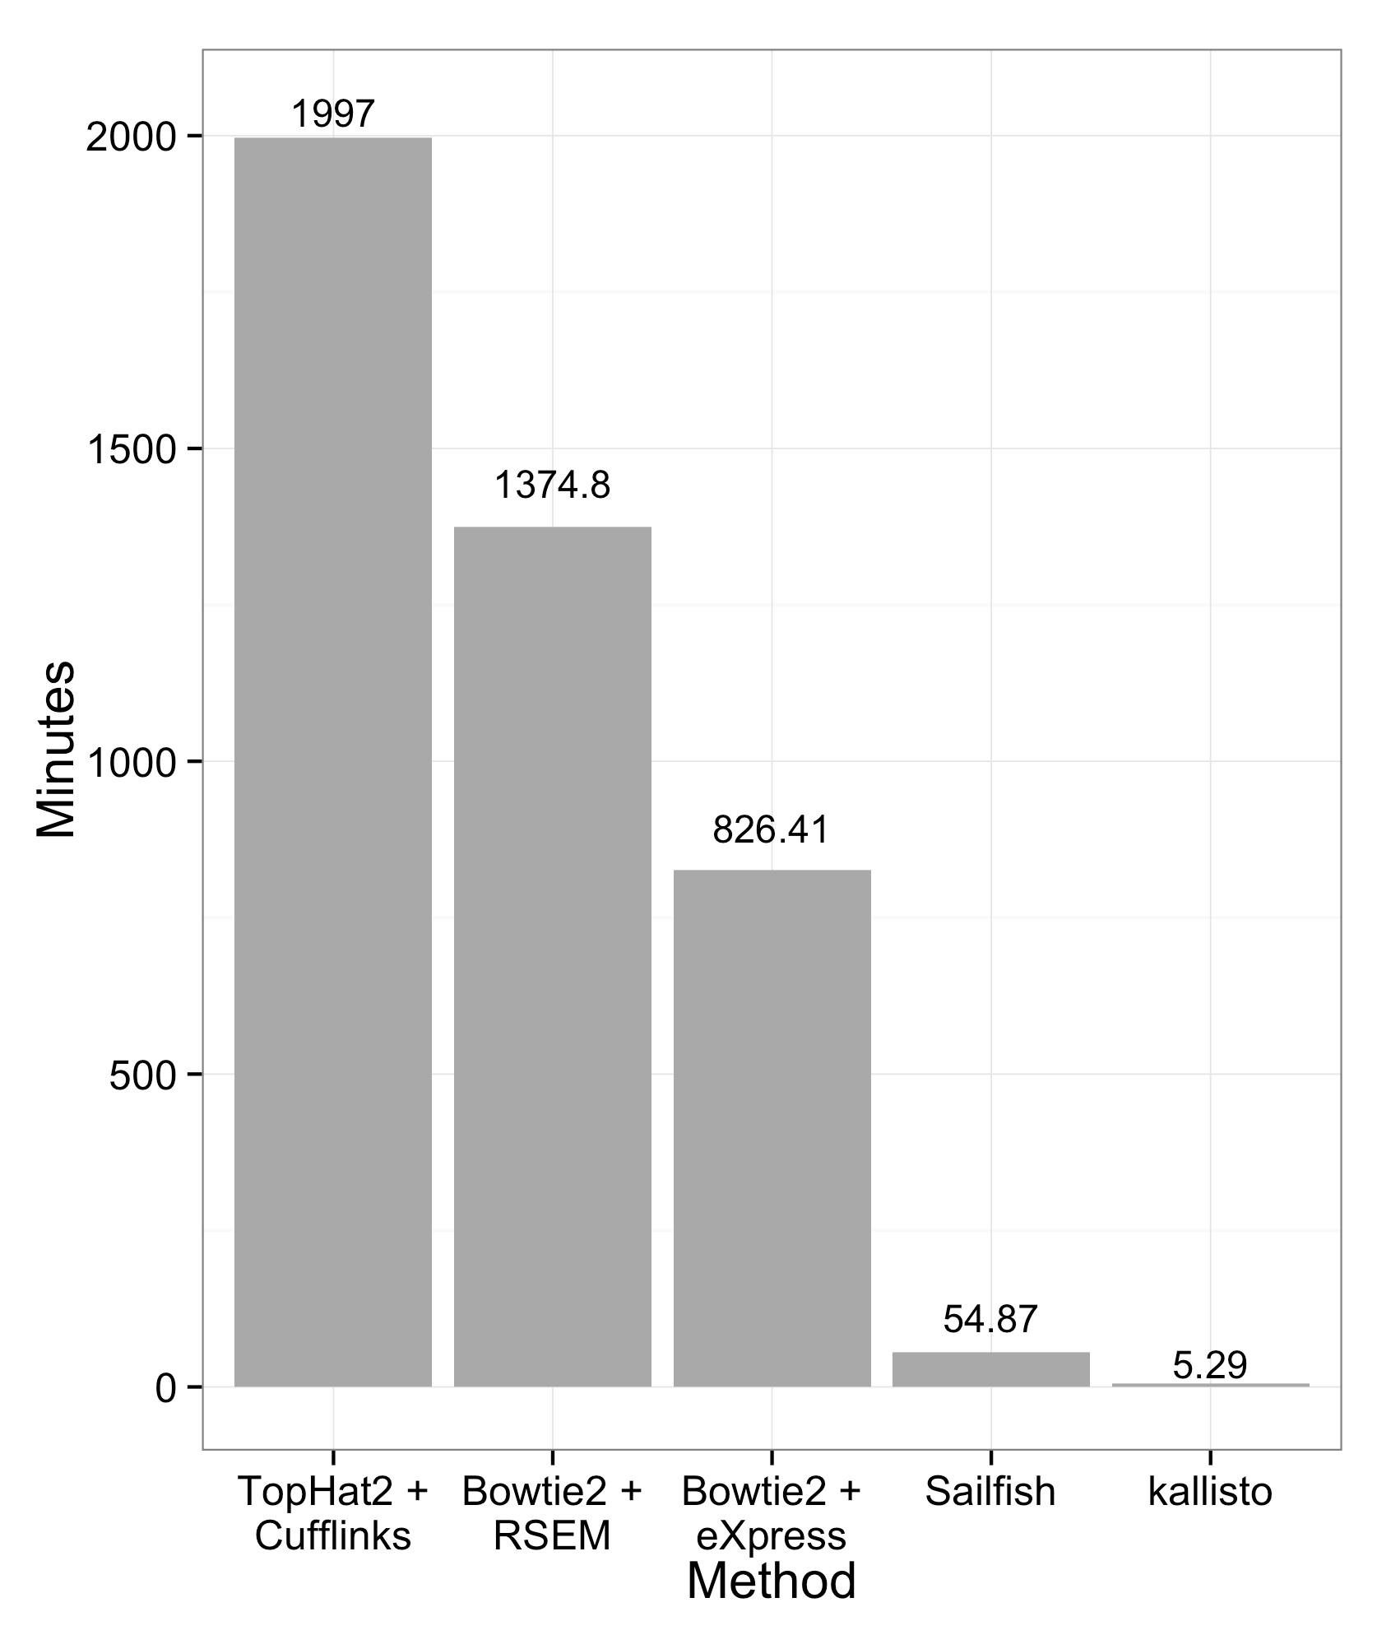
Not everything scales at the same rate…
Software
https://pachterlab.github.io/kallisto/about.html
‘The vast body of results being generated by current computational science practice suffer a large and growing credibility gap: it is impossible to verify most of the
computational results shown in conferences and papers.’’
Short lifetimes and varied lifecycles (stable, trendy, untamed)
Many tools will get better!
Positive: Lots of choices, Negative: Lots of choices
7

Slide 8
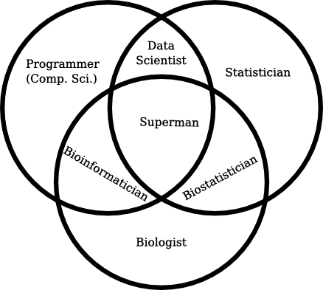
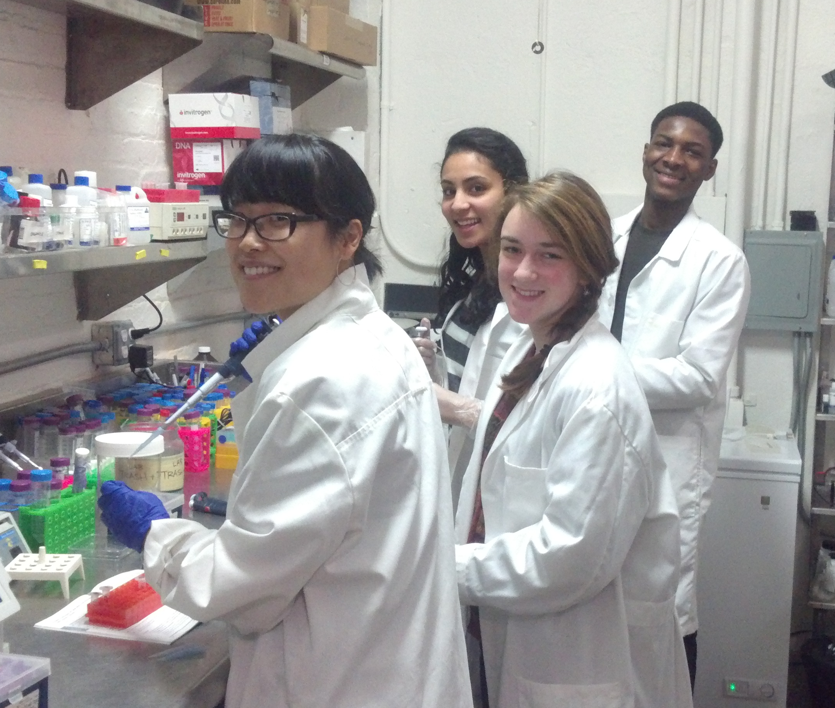
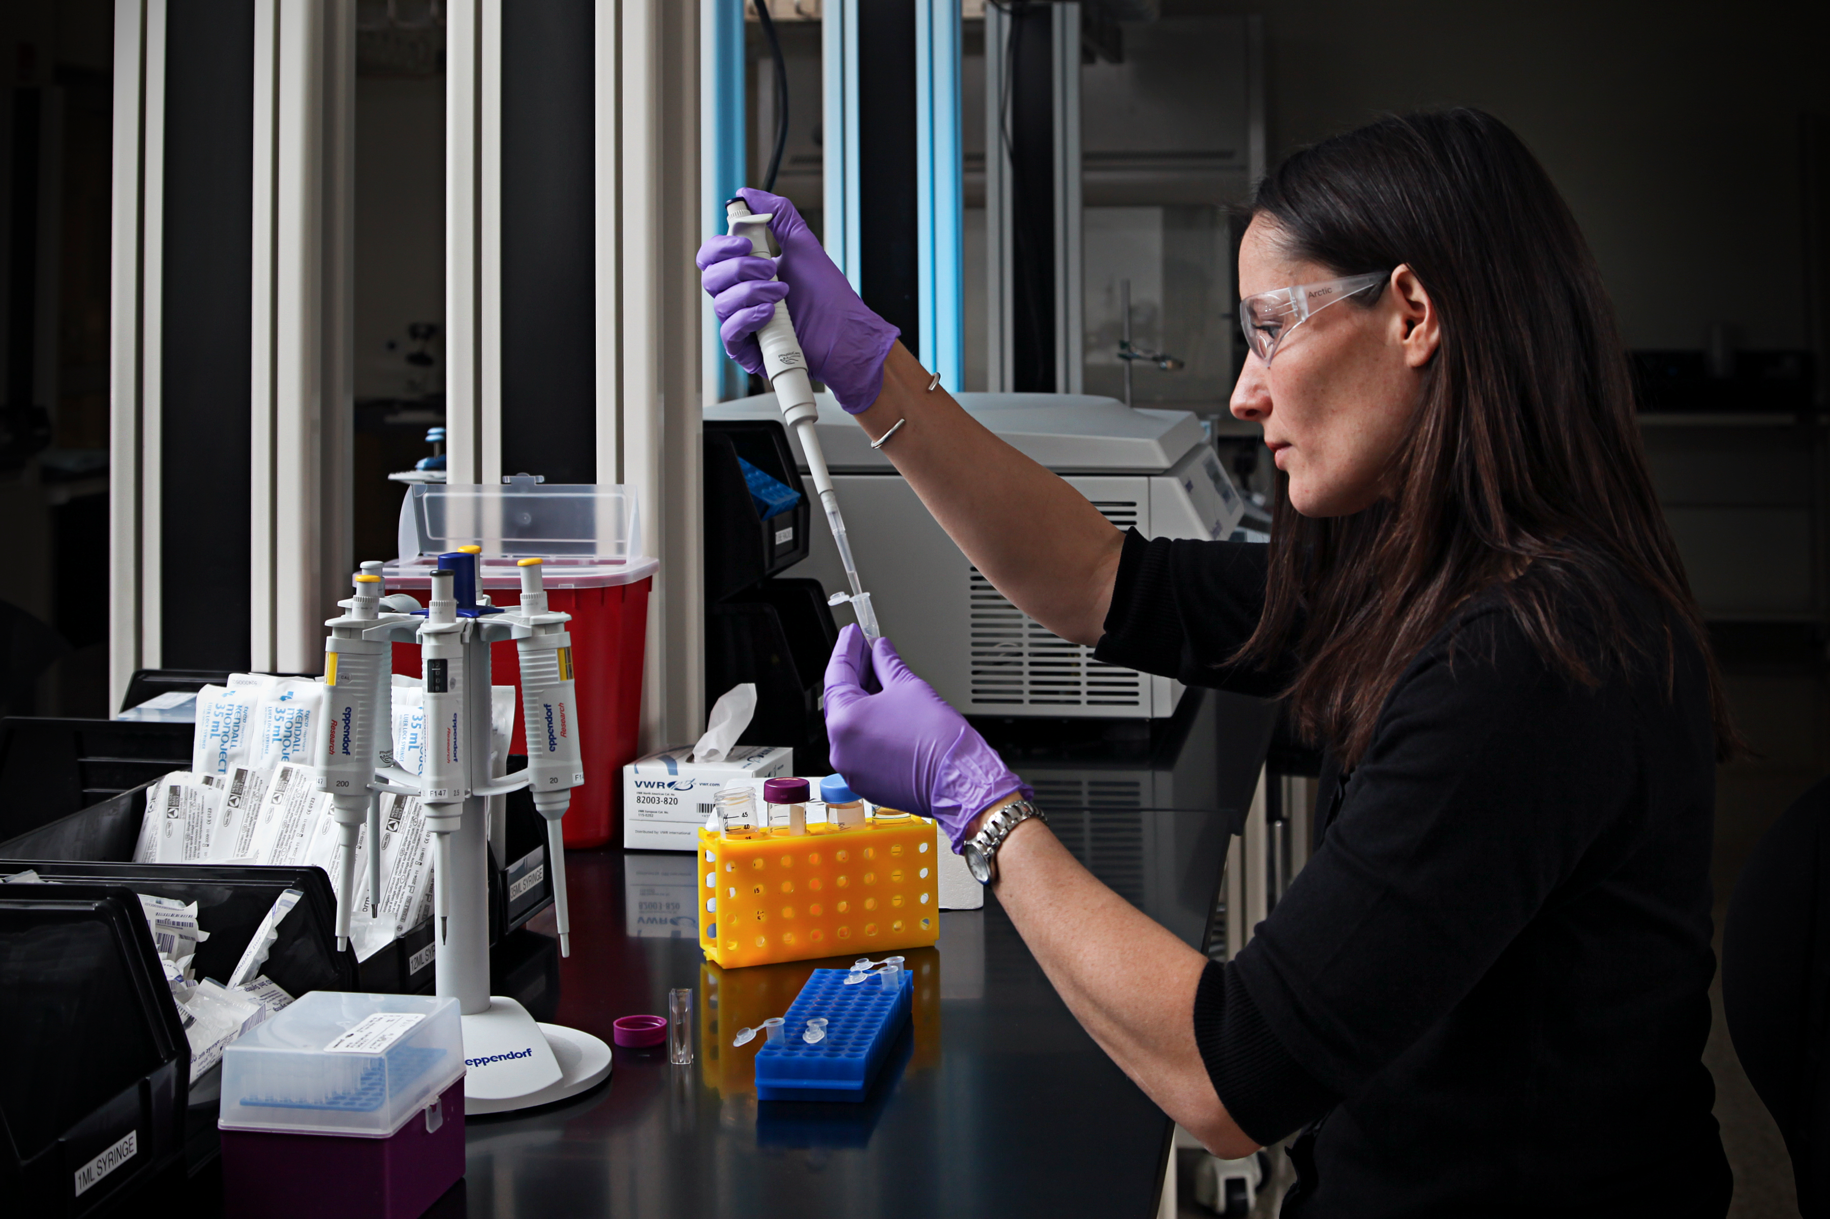
Not everything scales at the same rate…
People
http://blog.fejes.ca/?p=2418
Scale orthogonally
Maybe the worst at scaling (but also the most rewarding)
Proactively inclusion builds community and good science
8

Slide 9
21st Century Biology Requires all the Pieces
Data
Software
Computing/HPC
People
9

Slide 10
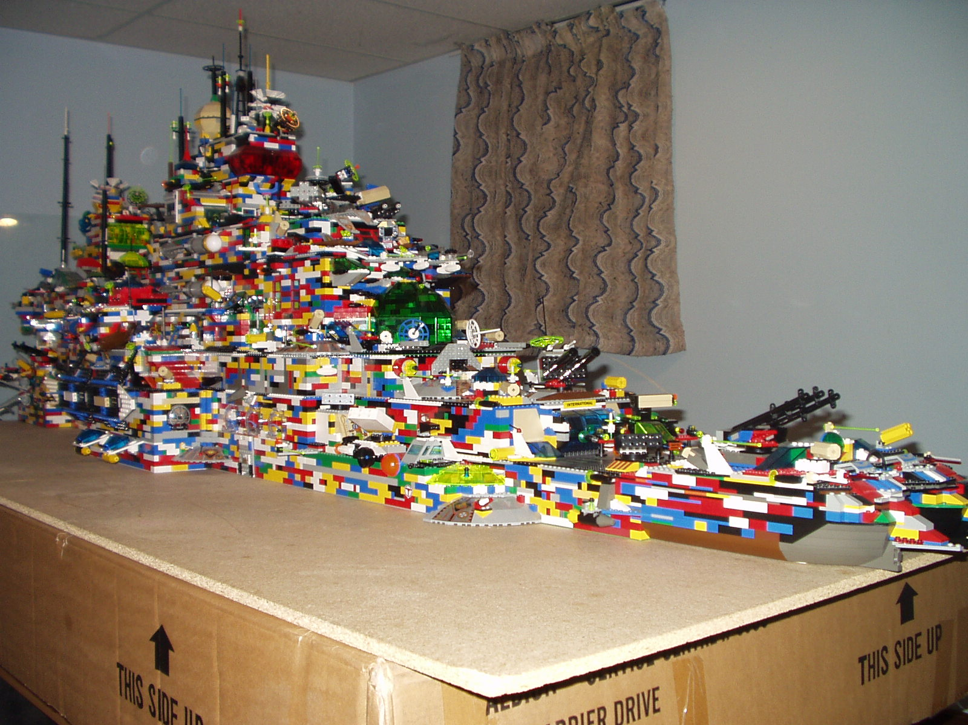
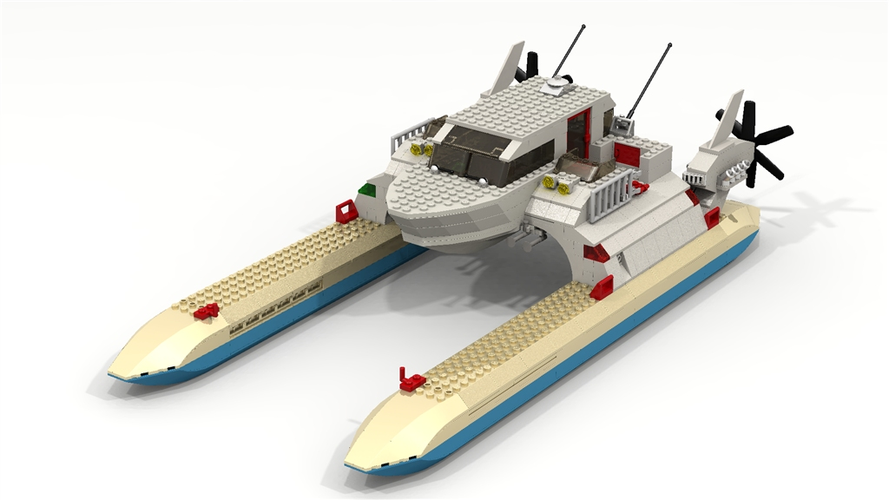
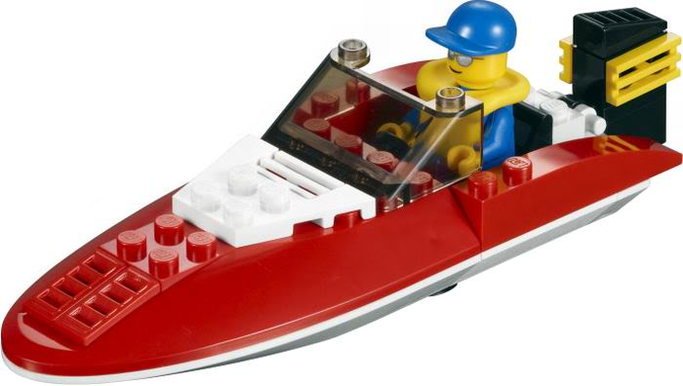
Some assembly required…
10
http://best360.deviantart.com/art/My-Huge-Lego-Ship-Front-Side-1994676

Slide 11
Session Goal
Demonstrate cyberinfrastructure as
concept / tool / technique
for answering ‘big questions’ in biology
11

Slide 12
Broad Objectives for this Session
Understand how to move and manage large datasets ( MB, GB, TB /100-1000’s files)
Create reproducible bioinformatics projects with or without the command line
Think critically about leveraging computing at multiple scales (personal, cloud, HPC)
Motivate continued learning and contribution to the bioinformatics community
12

Slide 13
iPlant Collaborative
Lessons from a purpose built biology CI…
We will be using iPlant as the example for the first national-scale biology CI; focus will be on widely applicable concepts and best practices
The iPlant Collaborative is funded by a grant from the National Science Foundation Plant Cyberinfrastructure Program (#DBI-0735191).
13

Slide 14
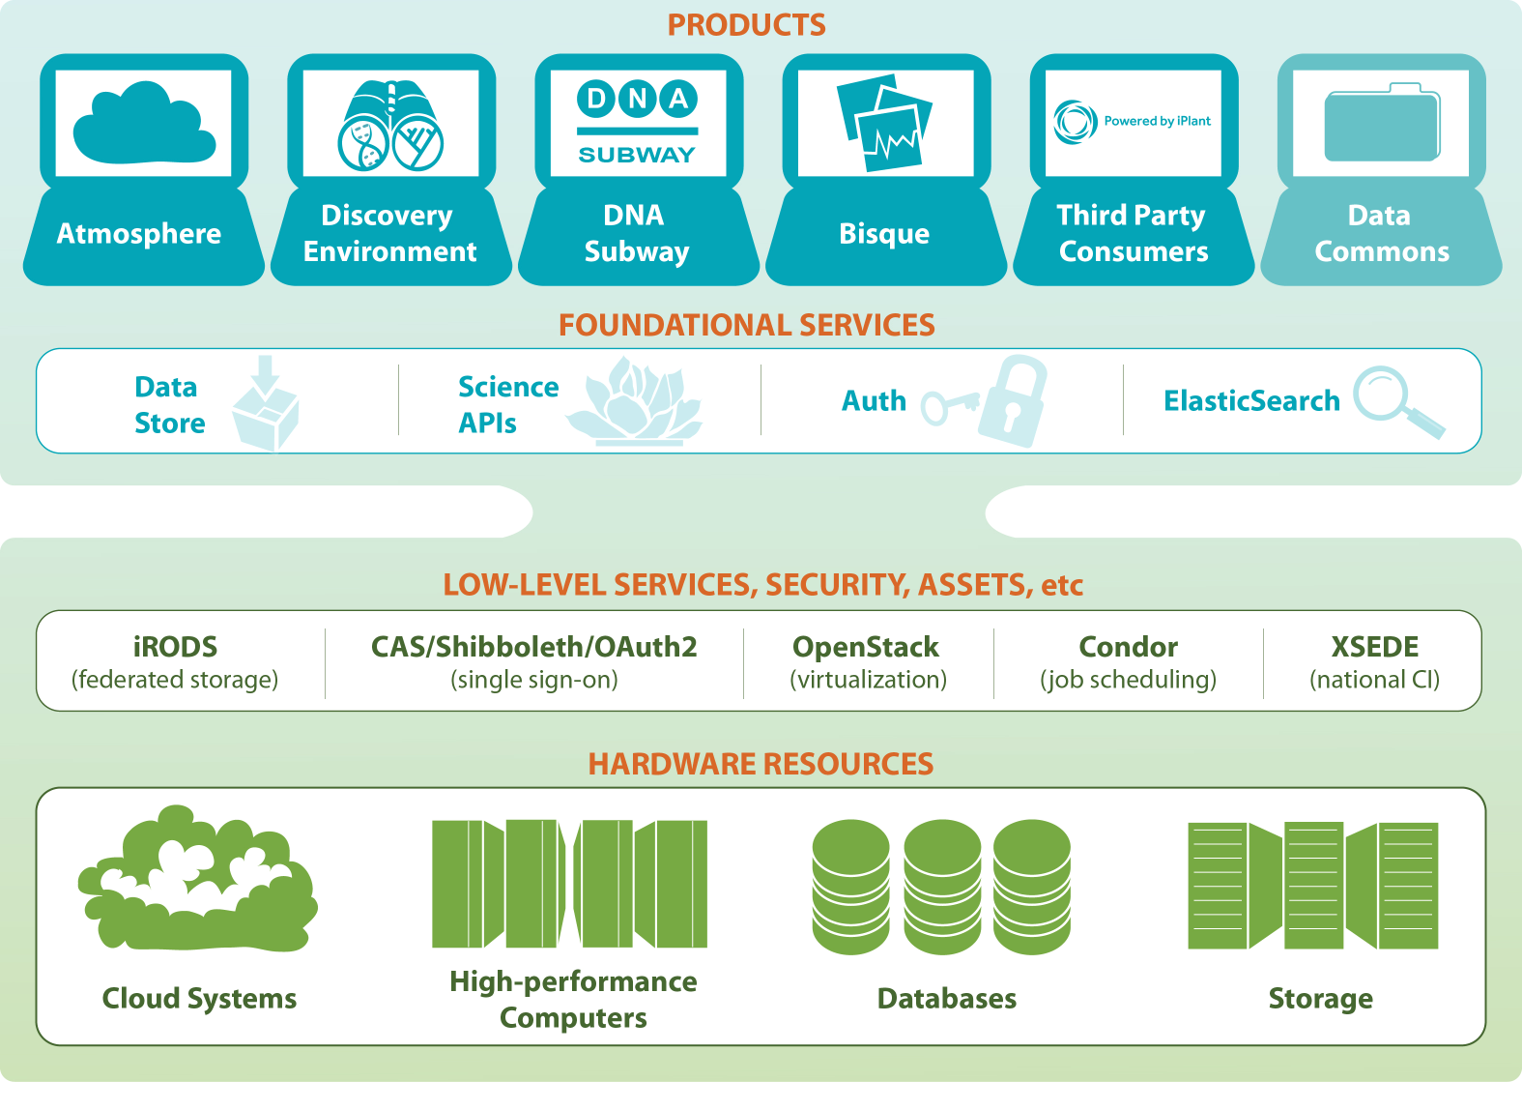
The iPlant Collaborative CI Stack
14

Slide 15
Arrival of “As a Service” models
CI is the layer that bring these things together
Flexibility
Productivity
Pain
Cyberinfrastructure
Is “Research as a Service”
SaaS: Software as a Service
(e.g. Clustering/Assembly is a service)
PaaS: Platform as a Service
IaaS plus core software capabilities on which you build SaaS
(e.g. Hadoop/MapReduce is a Platform)
IaaS: Infrastructure as a Service
(get computer time with a credit card and with a Web interface like EC2)
15
http://salsahpc.indiana.edu

Slide 16
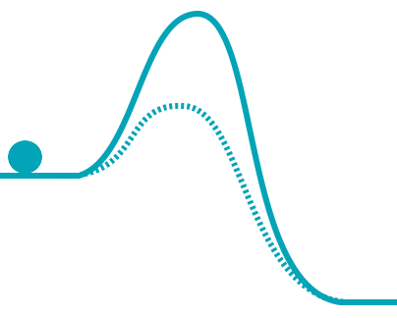
Some things to keep in mind…
While we will do as much hands-on as possible – time constraints will make this session a mix of follow along demos and practical activities. Detailed tutorials to follow up with are all online!
16

Slide 17
The limitations of any training workshop
“I had the feeling I have been exposed to many bioinformatics tools but I would be unable to use any of them on my own.”
17

Slide 18
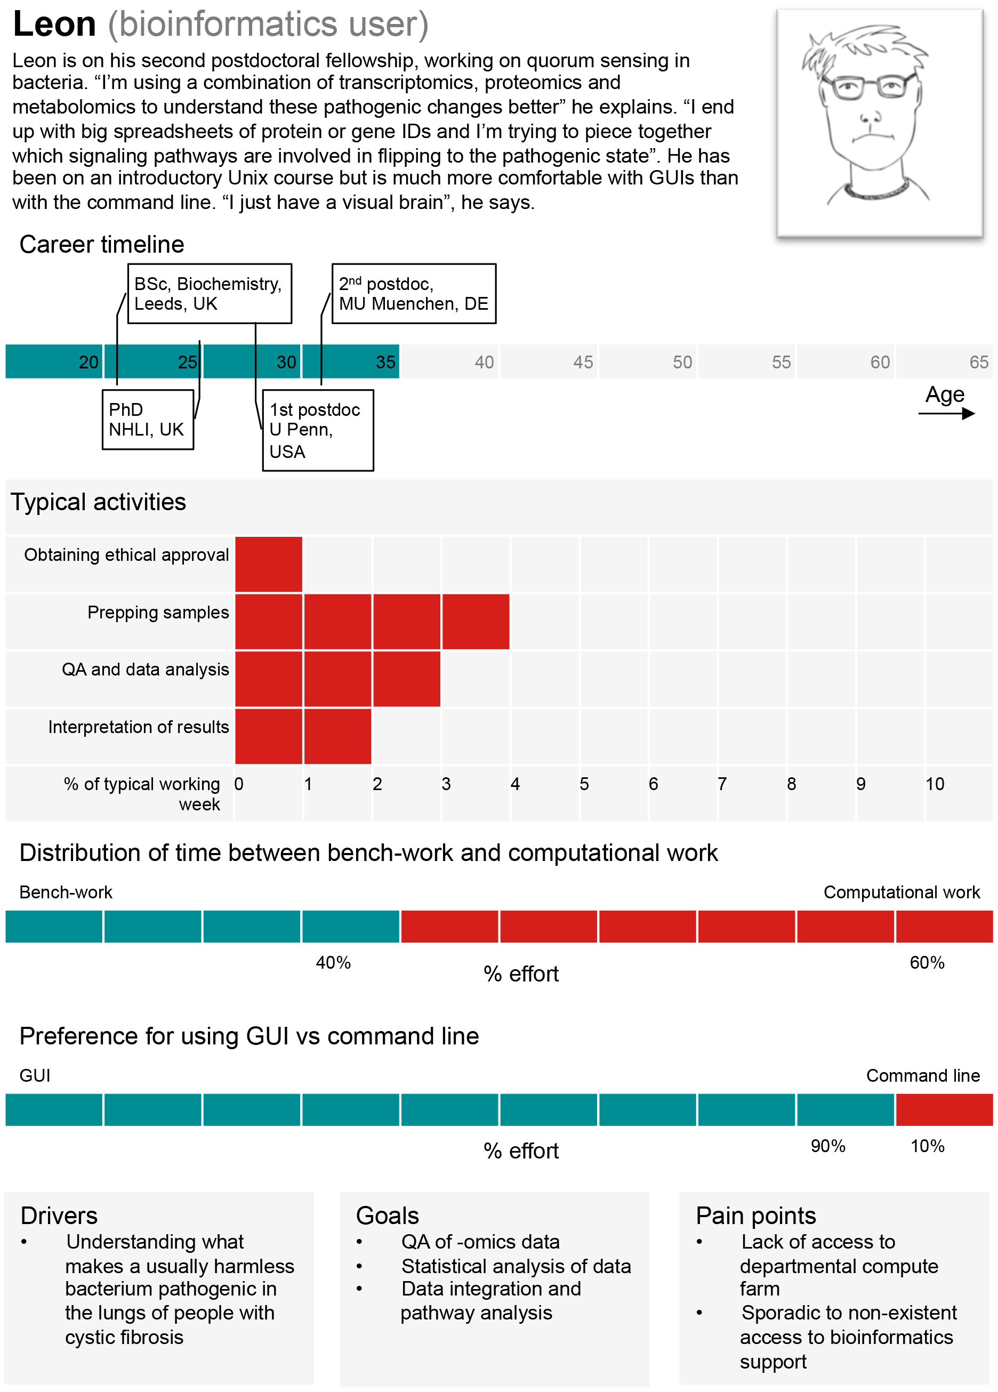
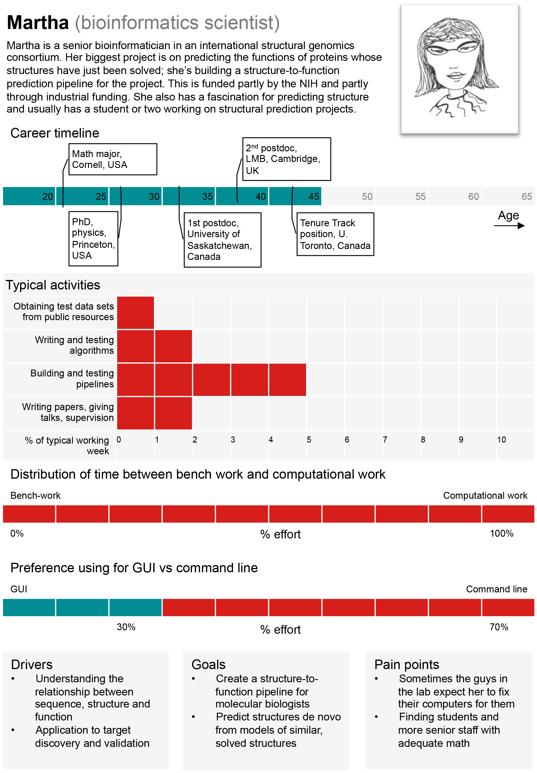
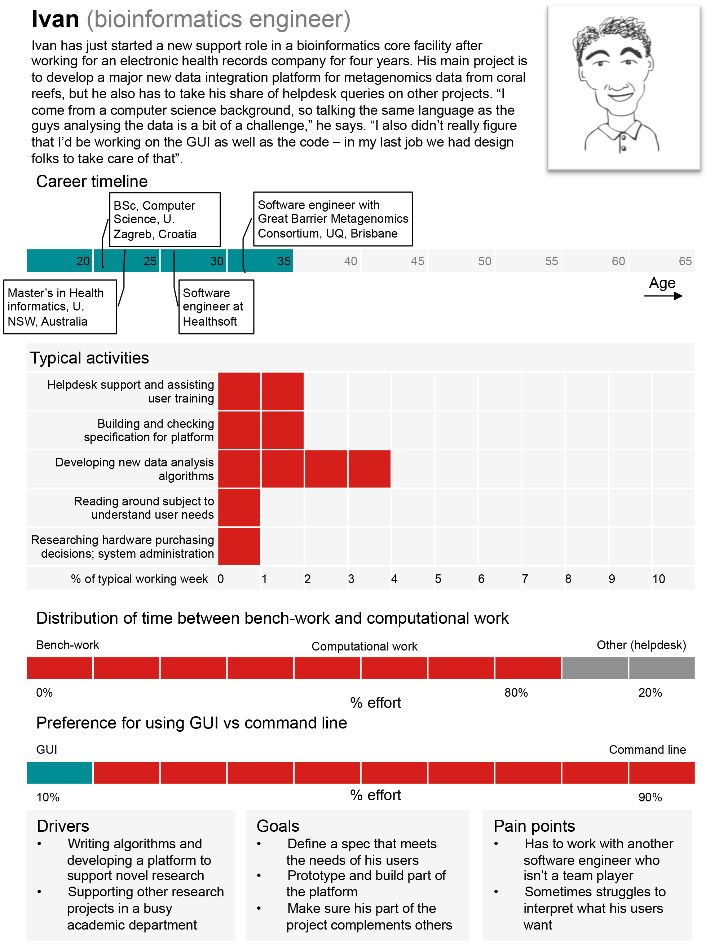
Know what type of user you are (or want to be)
18

Slide 19
Look for what’s important to you
Get Science Done
Ability to access and manage data
Software to analyze data
Computing resources
Skills and help to use software and interpret results
Ensure Reproducibility
Metadata management
Ability to share data and workflows
Open source sustainable tools
Increase Productivity
High-performance and scalable computing
Ability automate and collaborate
Funding spent on science, not software or hardware
19

Slide 20
Key take home knowledge
CI scales biological questions by linking and coordinating Data, Software, HPC, and People
Science endpoints are almost always custom (discovery) but have lots of commonalities – Shared pipes, but bring your own extension cords/faucets
People are very (most?) important – understand user needs first!
20

Slide 21
The iPlant Collaborative is funded by a grant from the National Science Foundation Plant Cyberinfrastructure Program (#DBI-0735191).
21

