Slide 1
Using Biological Cyberinfrastructure
Scaling Science and People: Applications in
Data Storage, HPC, Cloud Analysis, and Bioinformatics Training
Scaling Compute – Challenges with RNA-Seq

Slide 2
Rapid discussion questions
How many ‘Big Data’ challenges can you name for an RNA-Seq experiment?
Opinion – real bioinformatics should be done at the command line; thoughts?
How can you make RNA-Seq data valuable?
2

Slide 3
Now what?
@SRR070570.4 HWUSI-EAS455:3:1:1:1096 length=41
CAAGGCCCGGGAACGAATTCACCGCCGTATGGCTGACCGGC
+
BA?39AAA933BA05>A@A=?4,9#################
@SRR070570.12 HWUSI-EAS455:3:1:2:1592 length=41
GAGGCGTTGACGGGAAAAGGGATATTAGCTCAGCTGAATCT
+
@=:9>5+.5=?@<6>A?@6+2?:</7>,%1/=0/7/>48##
@SRR070570.13 HWUSI-EAS455:3:1:2:869 length=41
TGCCAGTAGTCATATGCTTGTCTCAAAGATTAAGCCATGCA
+
A;BAA6=A3=ABBBA84B<&78A@BA=(@B>AB2@>B@/9?
@SRR070570.32 HWUSI-EAS455:3:1:4:1075 length=41
CAGTAGTTGAGCTCCATGCGAAATAGACTAGTTGGTACCAC
+
BB9?A@>AABBBB@BCA?A8BBBAB4B@BC71=?9;B:3B?
@SRR070570.40 HWUSI-EAS455:3:1:5:238 length=41
AAAAGGGTAAAAGCTCGTTTGATTCTTATTTTCAGTACGAA
+
BBB?06-8BB@B17>9)=A91?>>8>*@<A<>>@1:B>(B@
@SRR070570.44 HWUSI-EAS455:3:1:5:1871 length=41
GTCATATGCTTGTCTCAAAGATTAAGCCATGCATGTGTAAG
+
BBBCBCCBBBBBA@BBCCB+ABBCB@B@BB@:BAA@B@BB>
@SRR070570.46 HWUSI-EAS455:3:1:5:1981 length=41
GAACAACAAAACCTATCCTTAACGGGATGGTACTCACTTTC
+
?A>-?B;BCBBB@BC@/>A<BB:?<?B?=75?:9@@@3=>:
3

Slide 4
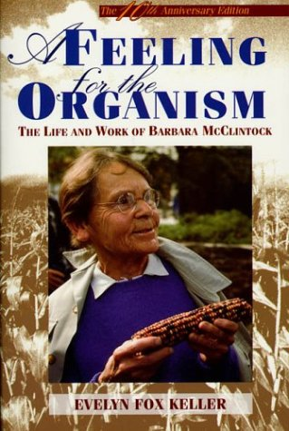
Now what?
@SRR070570.4 HWUSI-EAS455:3:1:1:1096 length=41
CAAGGCCCGGGAACGAATTCACCGCCGTATGGCTGACCGGC
+
BA?39AAA933BA05>A@A=?4,9#################
@SRR070570.12 HWUSI-EAS455:3:1:2:1592 length=41
GAGGCGTTGACGGGAAAAGGGATATTAGCTCAGCTGAATCT
+
@=:9>5+.5=?@<6>A?@6+2?:</7>,%1/=0/7/>48##
@SRR070570.13 HWUSI-EAS455:3:1:2:869 length=41
TGCCAGTAGTCATATGCTTGTCTCAAAGATTAAGCCATGCA
+
A;BAA6=A3=ABBBA84B<&78A@BA=(@B>AB2@>B@/9?
@SRR070570.32 HWUSI-EAS455:3:1:4:1075 length=41
CAGTAGTTGAGCTCCATGCGAAATAGACTAGTTGGTACCAC
+
BB9?A@>AABBBB@BCA?A8BBBAB4B@BC71=?9;B:3B?
@SRR070570.40 HWUSI-EAS455:3:1:5:238 length=41
AAAAGGGTAAAAGCTCGTTTGATTCTTATTTTCAGTACGAA
+
BBB?06-8BB@B17>9)=A91?>>8>*@<A<>>@1:B>(B@
@SRR070570.44 HWUSI-EAS455:3:1:5:1871 length=41
GTCATATGCTTGTCTCAAAGATTAAGCCATGCATGTGTAAG
+
BBBCBCCBBBBBA@BBCCB+ABBCB@B@BB@:BAA@B@BB>
@SRR070570.46 HWUSI-EAS455:3:1:5:1981 length=41
GAACAACAAAACCTATCCTTAACGGGATGGTACTCACTTTC
+
?A>-?B;BCBBB@BC@/>A<BB:?<?B?=75?:9@@@3=>:
4

Slide 5
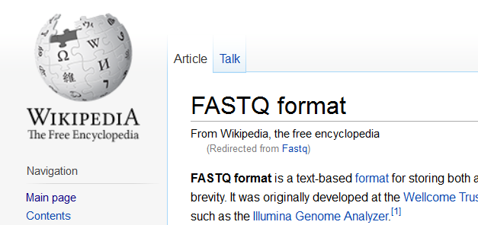
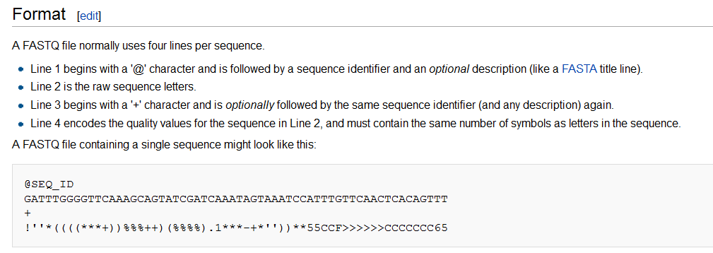
Getting a feel for the data
FASTQ format
5

Slide 6
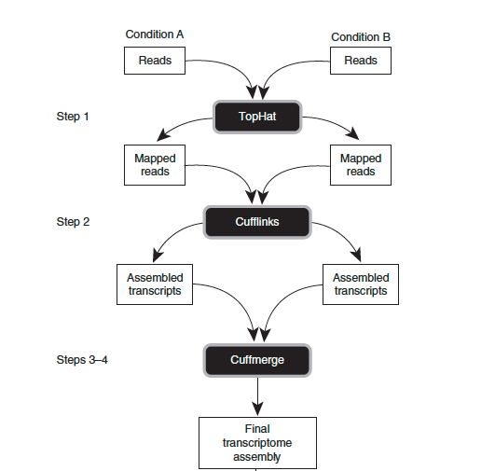
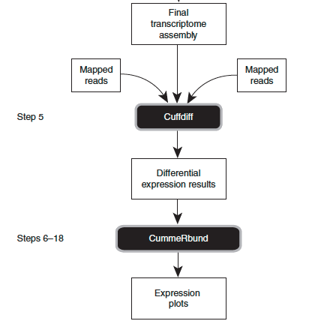
Tuxedo Workflow
*TopHat and Cufflinks require a sequenced genome
Differential expression
6

Slide 7
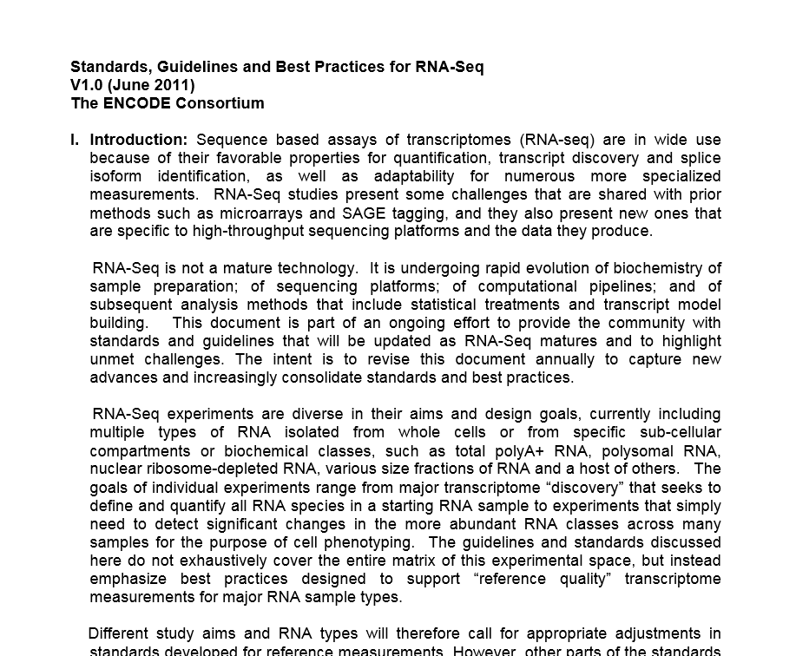
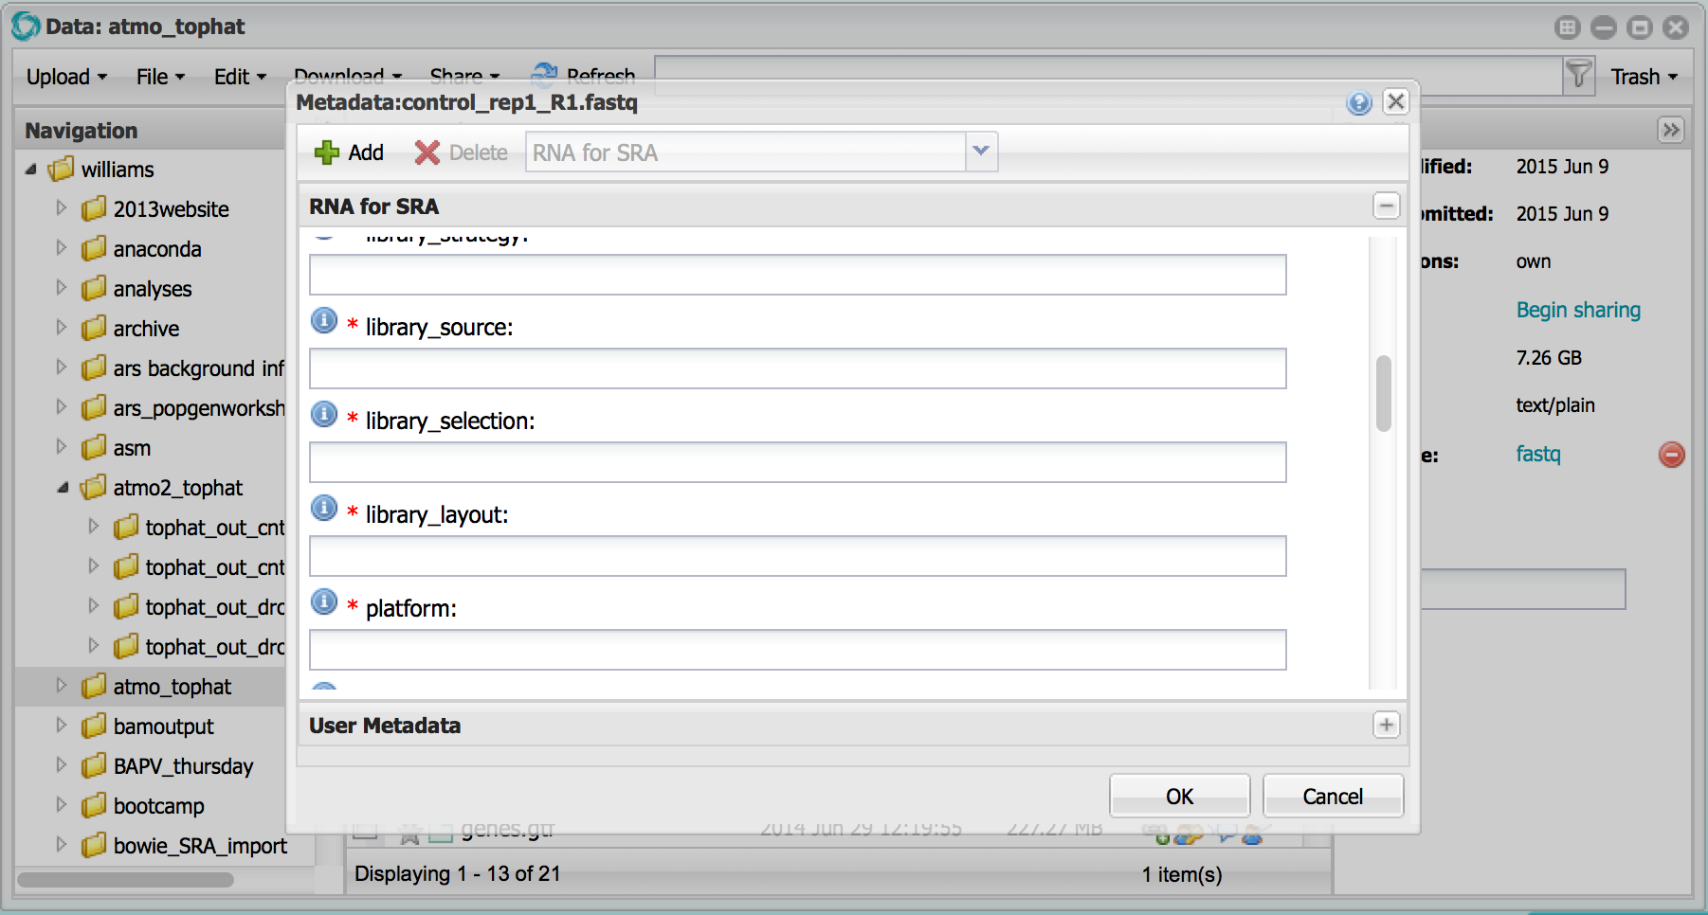
Metadata Standards
Suggestions before you sequence
7

Slide 8
Command line version
$ tophat -p 8 -G genes.gtf -o C1_R1_thout genome C1_R1_1.fq C1_R1_2.fq
$ tophat -p 8 -G genes.gtf -o C1_R2_thout genome C1_R2_1.fq C1_R2_2.fq
$ tophat -p 8 -G genes.gtf -o C1_R3_thout genome C1_R3_1.fq C1_R3_2.fq
$ tophat -p 8 -G genes.gtf -o C2_R1_thout genome C2_R1_1.fq C1_R1_2.fq
$ tophat -p 8 -G genes.gtf -o C2_R2_thout genome C2_R2_1.fq C1_R2_2.fq
$ tophat -p 8 -G genes.gtf -o C2_R3_thout genome C2_R3_1.fq C1_R3_2.fq
$ cufflinks -p 8 -o C1_R1_clout C1_R1_thout/accepted_hits.bam
$ cufflinks -p 8 -o C1_R2_clout C1_R2_thout/accepted_hits.bam
$ cufflinks -p 8 -o C1_R3_clout C1_R3_thout/accepted_hits.bam
$ cufflinks -p 8 -o C2_R1_clout C2_R1_thout/accepted_hits.bam
$ cufflinks -p 8 -o C2_R2_clout C2_R2_thout/accepted_hits.bam
$ cufflinks -p 8 -o C2_R3_clout C2_R3_thout/accepted_hits.bam
$ cuffmerge -g genes.gtf -s genome.fa -p 8 assemblies.txt
$ cuffdiff -o diff_out -b genome.fa -p 8 –L C1,C2 -u merged_asm/merged.gtf \
./C1_R1_thout/accepted_hits.bam,./C1_R2_thout/accepted_hits.bam,\
./C1_R3_thout/accepted_hits.bam \./C2_R1_thout/accepted_hits.bam,\
./C2_R3_thout/accepted_hits.bam,./C2_R2_thout/accepted_hits.bam
Your transformed RNA-Seq Data
Your RNA-Seq Data
8

Slide 9
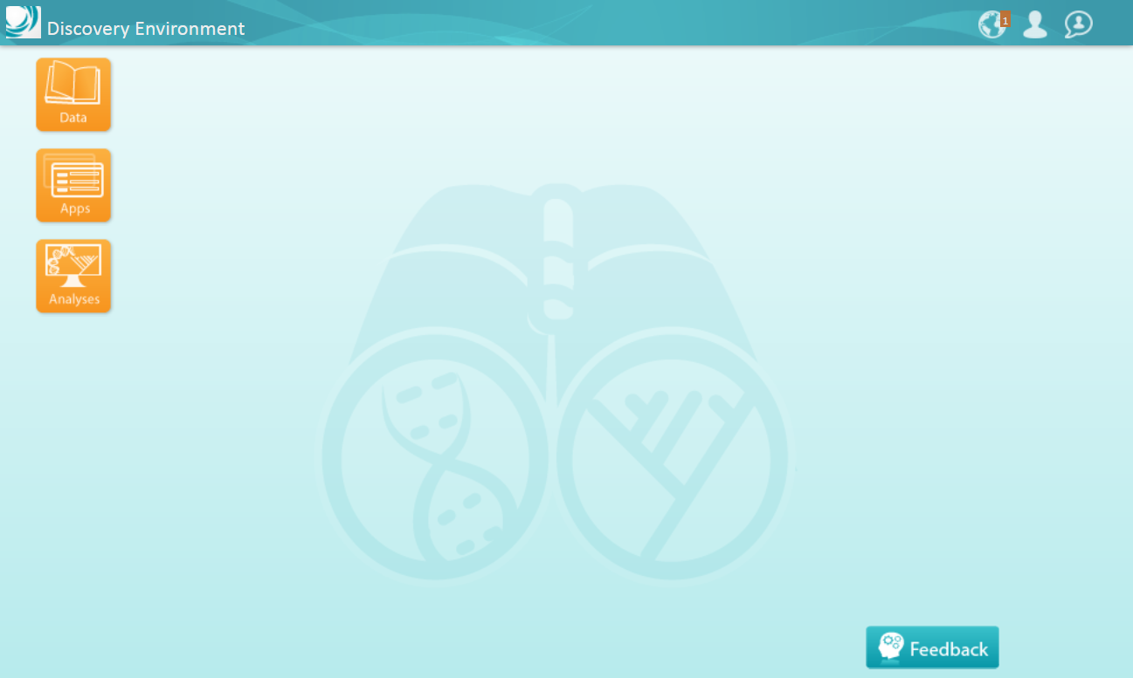
Discovery Environment – Accessible CI
9

Slide 10
Discovery Environment
Hundreds of bioinformatics Apps in an easy-to-use interface
A platform that can run almost any bioinformatics application
Seamlessly integrated with data and high performance computing
User extensible – add your own applications
10

Slide 11
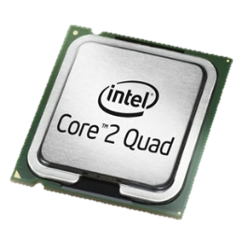
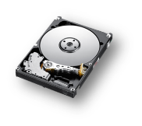
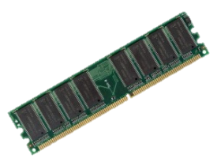
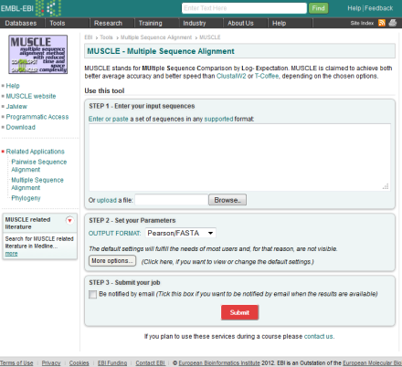
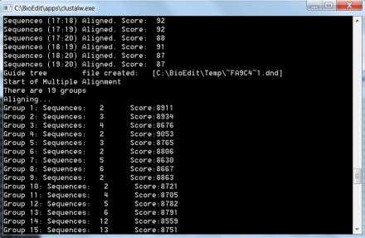
Discovery Environment Overview
Choosing your compute
Little or none
Some: dependent on funding
or institutional resources
(and how much hardware
you are comfortable sitting on)
Scalable: From a single CPU job to >500K core machine – you don’t bear the pain and cost of scaling
✓
Scalability
?
$
11
Web services Local compute Discovery Environment

Slide 12
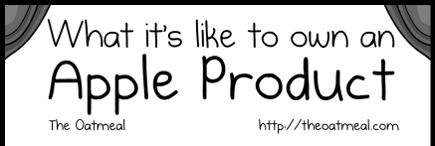
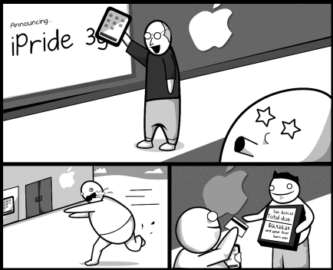
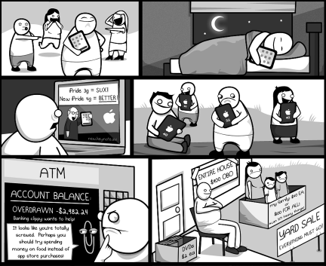
Discovery Environment Overview
The costs of keeping up with technology
Image From: http://theoatmeal.com/comics/apple
12

Slide 13
Discovery Environment Overview
Benefits
Get Science Done
Use hundreds of bioinformatics Apps without the command line
Add your own applications – an extensible, scalable platform
Create and publish Apps and workflows so anyone can use them
Analysis history and provenance – “avoid forensic bioinformatics”
High-performance computing – not dependent on your hardware
Manage a secure data repository and share data easily
Reproducibility
Productivity
13

Slide 14
Discovery Environment
Tophat (bowtie)
Cufflinks
Cuffmerge
Cuffdiff
CummeRbund
Using a GUI
Your Data
iPlant Data Store
FASTQ
Discovery Environment Atmosphere
14

Slide 15
iPlant Discovery Environment Demo
By the end of this demo you should be able to:
Understand the challenges of organize a NGS dataset (RNA-Seq)
Evaluate and understand common file types for RNA-Seq
Start analyzing your own RNA-Seq data
15

Slide 16
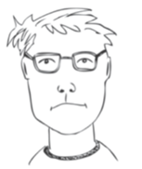
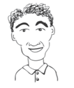
Discovery Environment Overview
User perspectives and possible applications
Does most of his data uploads/downloads/sharing here
He pushes results from his lab’s workflow into a common folder
Installed an HPC application here so that anyone can use it
Creates custom applications with default parameters exposed
Developed a workflow to QC and Filter reads for his users
Teaches about genome assembly with examples in the DE
Bench Scientist
Bioinformatician
Core Facilities
16
Images from personas based on: Bioinformatics Curriculum Guidelines: Toward a Definition of Core Competencies
PLOS Biology DOI: 10.1371/journal.pcbi.1003496

Slide 17
Key take home knowledge
To work with an NGS data set, you will need many skills (Data wrangling of genomes, knowledge of types and how to convert, etc.)
It is possible to work reproducibly without the command line, but only for so long when you want to try new and better things.
Metadata are still key (think SRA submissions). Visualizations (covered next) is also critical.
17

Slide 18
How CI Helps
Web-based GUI
Browse and examine even large (text-based) files (fastq, tab-delimited, etc.)
Analysis history, metadata, and search
User-extensibility, scalability, and access to HPC
18

Slide 19
The iPlant Collaborative is funded by a grant from the National Science Foundation Plant Cyberinfrastructure Program (#DBI-0735191).

