Slide 1
Using Biological Cyberinfrastructure
Scaling Science and People: Applications in
Data Storage, HPC, Cloud Analysis, and Bioinformatics Training
Scaling Compute – Working in the Cloud

Slide 2
Rapid discussion questions
How do you already use the cloud?
When should you be using (buying) a server and when do you think you should use a cloud resource – how do you choose?
What does ‘biology in the cloud’ mean for developers and educators?

Slide 3
What is Cloud Computing?
Yet another round of jargon

Slide 4
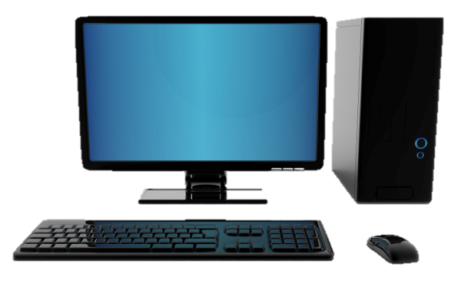
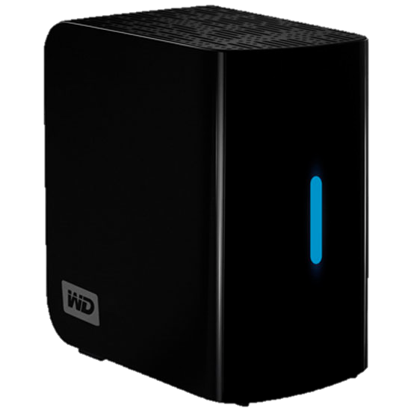
What is Cloud Computing?
Important concepts: Image
Image (file)
Complete clone (files/data)
Original system
Document(s) (file)
Copied Document(s) (file)

Slide 5
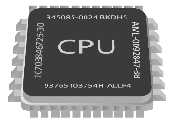
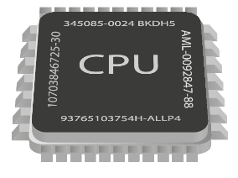
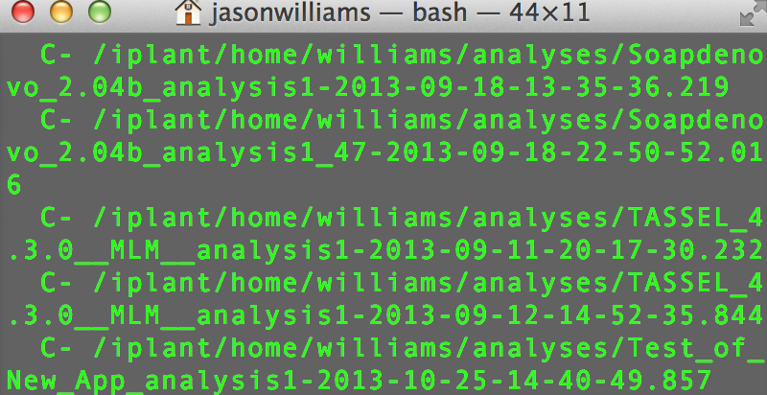
What is Cloud Computing?
Important concepts: Instance
+
(Disk + CPU + Memory) + (Image)
128.196.34.158
iPlant Cloud
Atmosphere Instance
(virtual machine)

Slide 6
What is Cloud Computing?
Yet another round of jargon

Slide 7
Atmosphere Overview
Largest, easiest to use open cloud for Life Science
Choose an existing image or customize
Instances up to 16-Core/128 GB RAM
Access via shell or VNC
Share your image with selected users, or make them public

Slide 8
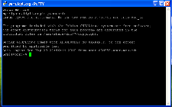
Atmosphere Overview
Connecting to your instance
Windows Mac Linux
VNC Viewer
VNC Viewer
VNC Viewer
PuTTY
Shell/terminal
Shell/terminal
VNC Viewer: www.realvnc.com/download/viewer
PuTTy: www.putty.org

Slide 9
Atmosphere Overview
Benefits
Get Science Done
Work in an on-demand Linux environment (most bioinformatics)
Collaborate with students and colleagues on the same instance
Make data, workflows, and analyses available in a public image
Access previous software version and images
Multicore high memory images to run multithreading applications
Move your analyses from your laptop to the cloud
Reproducibility
Productivity

Slide 10
Atmosphere Overview
By the end of this demo you should be able to:
Select and launch an instance
Connect your instance to the iPlant Data Store
Use an application in Atmosphere (RNA-Seq visualization)
Understand how to pause, stop, and terminate instances

Slide 11
Atmosphere Overview
Key things to remember when you try this yourself
Images do not have automatic access to your iPlant Data Store
Can iDrop to access the Data Store
Can also use iCommands
Users have monthly allocation limits
Terminate, or stop instances not in use
If a larger allocation is needed contact support
All data on terminated instances will be destroyed.
Use iDrop or iCommands to transfer data off the instance.
You may also create an EBS volume (see documentation)

Slide 12
Atmosphere Overview
User perspectives and possible applications
Learned how to use the shell and how to work with Linux
Mastered using R to develop plots for his manuscript
Launches an image and has full SUDO access to customize it
Developed a software suit with numerous R and Python library
dependencies. She updates it regularly by making a new image.
Linked several atmosphere instances with Apache Hadoop
Worked with iPlant support to import existing Amazon images
Bench Scientist
Bioinformatician
Core Facilities
Images from personas based on: Bioinformatics Curriculum Guidelines: Toward a Definition of Core Competencies
PLOS Biology DOI: 10.1371/journal.pcbi.1003496

Slide 13
Key take home knowledge
We don’t have to be afraid of the cloud… we already using it! We just need to use it wisely to manage the data and experiments we care about.
Choosing a solution always has case-by-case features, but passing up on-demand computing solutions is a great way to waste funds!
Developing datasets and software in the cloud (VMs/Docker, etc.) is gold standard reproducibility. These same traits are very helpful for classroom instruction.

Slide 14
The iPlant Collaborative is funded by a grant from the National Science Foundation Plant Cyberinfrastructure Program (#DBI-0735191).

