Slide 1
RNA-Seq visualization with CummeRbund
Atmosphere Workflow
Joslynn Lee – Data Science Educator
Cold Spring Harbor Laboratory, DNA Learning Center
jolee@cshl.edu

Slide 2
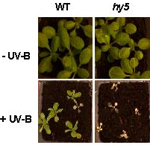
RNA-Seq Experiment Overview
In this example we will compare gene transcript abundance between wild type and mutant Arabidopisis strains.
LONG HYPOCOTYL 5 (HY5) is a basic leucine zipper transcription factor (TF)
Mutations in the HY5 gene cause a myriad of aberrant phenotypes (morphology /pigmentation) in Arabidopsis
We will use RNA-seq to compare expression levels for genes between WT and hy5- samples

Slide 3
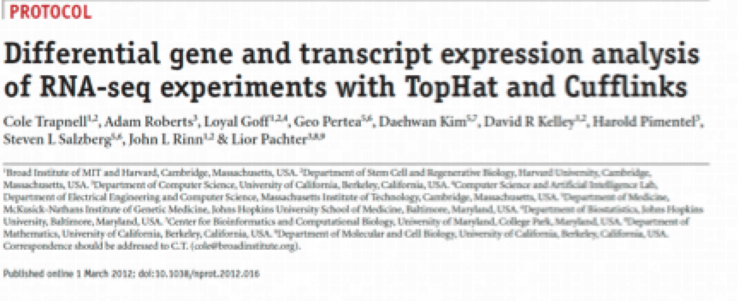
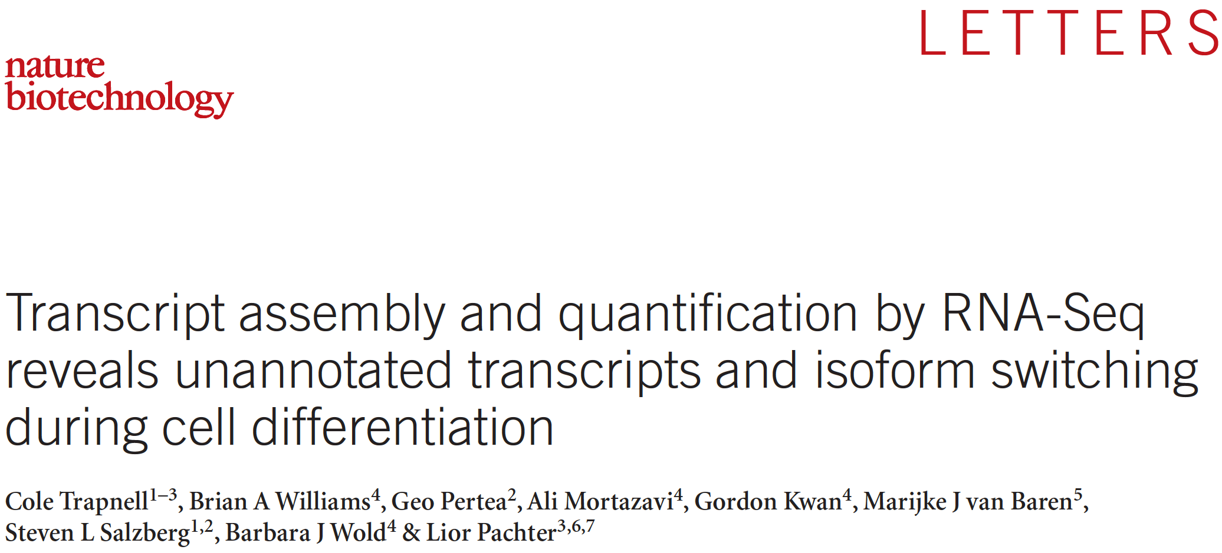
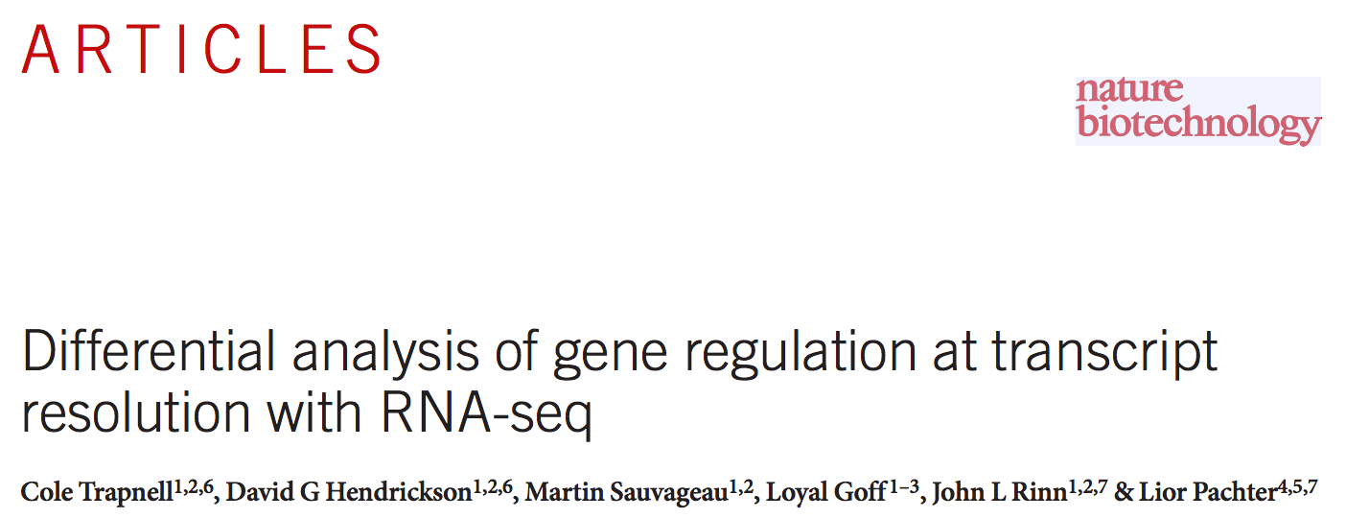
Useful resources for Tuxedo workflow
Papers with some CuffDiff results
*Graphics taken from these publications

Slide 4
Compare expression analysis using CuffDiff
One option using Tuxedo Package
Other programs:
Cuffdiff is a program that uses the Cufflinks transcript quantification engine to calculate gene and transcript expression levels in more than one condition and test them for significant differences.
The folder cuffdiff_out contains the output files from cuffdiff. Files related to differential gene expression at the gene and transcript levels:
gene_exp.diff Results (gene fragments per Kb of exon per million [FPKM] values) of differential expression testing between the two samples, WT and hy5, at the gene level.

Slide 5
Workflow of RNA-Seq in CyVerse
Using a GUI
Tophat (bowtie)
Cufflinks
Cuffmerge
Cuffdiff
CummeRbund
Your Data
CyVerse Data Store
Discovery Environment Atmosphere
FASTQ

Slide 6
Workflow of RNA-Seq in Atmosphere
CummeRbund
Any image w/R can work, and you could also search for an image with cummeRbund installed
Description:
Allows for persistent storage, access, exploration, and manipulation of Cufflinks high-throughput sequencing data. In addition, provides numerous plotting functions for commonly used visualizations.

Slide 7
cummeRbund is a visualization package
Available via Bioconductor
All of the output files are related to each other through their various tracking_ids, but parsing through individual files to query for important result information requires both a good deal of patience and a strong grasp of command-line text manipulation. Enter cummeRbund, an R solution to aggregate, organize, and help visualize this multi-layered dataset
promote rapid analysis of RNA-Seq data by aggregating, indexing, and allowing you easily visualize
create publication-ready figures of your RNA-Seq data while maintaining appropriate relationships between connected data points

Slide 8
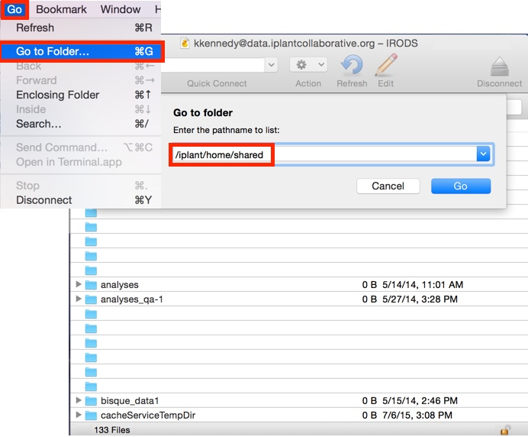
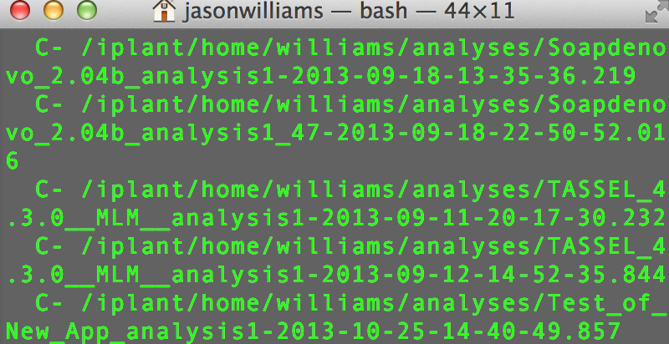
Bringing data into Atmosphere
Use iCommands or Cyberduck
Cyberduck
iCommands

Slide 9
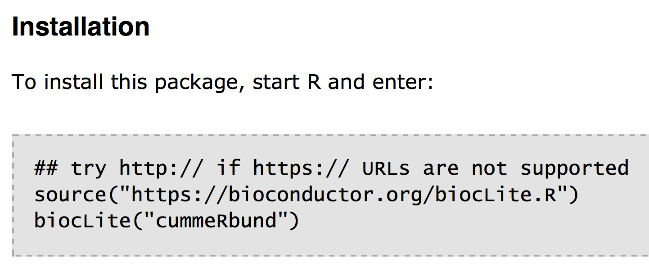
Installing CummerBund
Available via Bioconductor
Bioconductor is an open source, open development software project to provide tools for the analysis and comprehension of high-throughput genomic data.
CummeRbund is now included as part of the R/Bioconductor project. The links above point to the R packages directly, and every effort should be made to use the version provided by Bioconductor

Slide 10
Connect with VNC Viewer
Visualization for Atmosphere
Integrated Development Environment (IDE) for R
Execute R code directly from the source editor
Quickly jump to function definitions
Easily manage multiple working directories using projects

Slide 11
Output files of CuffLinks
Find in Atmosphere
1. Find output files
Desktop → test_data → iplant_cuffdiff_out

Slide 12
Output files of CuffLinks
Find in Atmosphere
1. Find output files
Desktop → test_data → iplant_cuffdiff_out
2. Install cummeRbund (once but not necessary for image)
> source("http://bioconductor.org/biocLite.R")
> biocLite("cummeRbund")
3. Load library
>library(cummeRbund)
4. Set working directory to “iplant_cuffdiff_out”
> setwd(“home/dnasubway11/Desktop/test_data/iplant_cuffdiff_out”)

Slide 13
Load cuffdiff data into the database
Import files into R Studio
CummeRbund begins by re-organizing output files of a cuffdiff analysis, and storing these data in a local SQLite database. To read your cuffdiff files:
In R studio:
> cuff <- readCufflinks(rebuild=TRUE)
> cuff
Can store values in variable (cuff) using the assignment operator <-
readCufflinks(): enables you to keep the entire dataset out of memory and significantly improve performance for large cufflinks datasets.
Variable (cuff) now contains a value

Slide 14
What do we visualize?
Global statistics and Quality Control
How good is my data?
Are my biological replicates
Creating gene sets from significantly regulated genes
Exploring the relationships between conditions

Slide 15
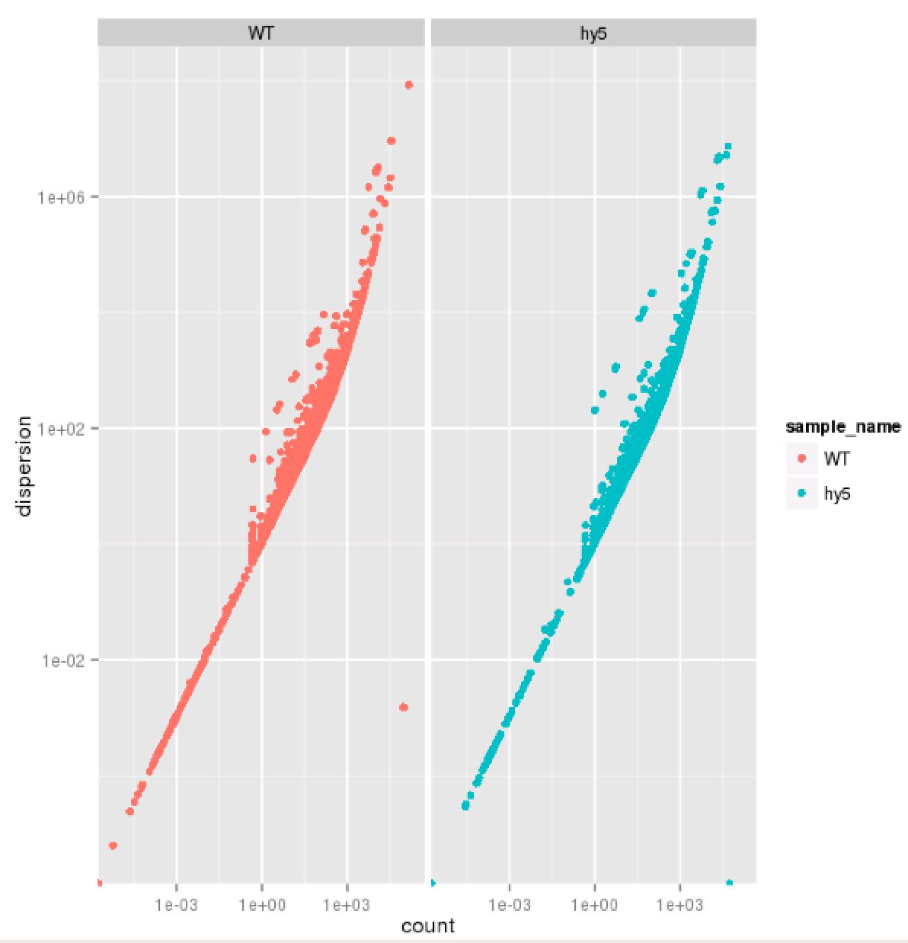
Global statistics and Quality Control
A good place to begin is to evaluate the quality of the model fitting
Overdispersion is a common problem in RNA-Seq data
As of cufflinks v2.0 mean counts, variance, and dispersion are all emitted, allowing you to visualize the estimated overdispersion for each sample as a quality control measure.
>disp<-dispersionPlot(genes(cuff))
>disp
Counts (x-axis) vs. dispersion (y-axis)
Overdispersion greater variability in a data set than would be expected based on a given model (in our case extra-Poisson variation)
If you use Poisson model, you will overestimate differential expression
“Counts” usually refers to the number of reads that align to a particular feature.
WT (left) and hy5 (right)

Slide 16
Poisson does not capture biological variability
Use dispersion
If you use Poisson model, you will overestimate differential expression
http://www.fgcz.ch/education/StatMethodsExpression/03_Count_data_analysis.pdf

Slide 17
On a break unti 1PM

Slide 18
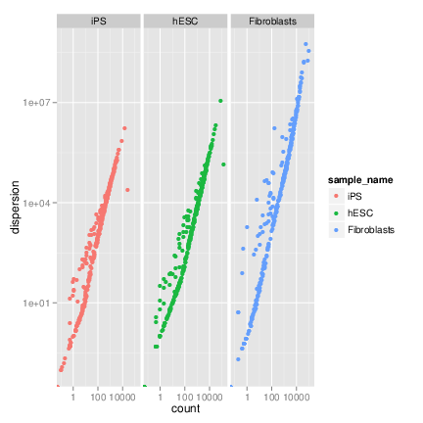
Example of overdispersed data
Use dispersion

Slide 19
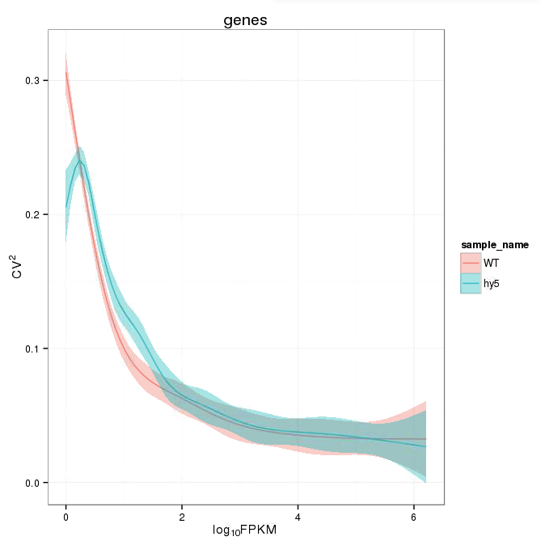
Squared Coefficient of Variation
FPKM: Fragments per kilobase of transcript per million mapped reads (For paired-end sequencing data)
The squared coefficient of variation is a normalized measure of cross-replicate variability that can be useful for evaluating the quality your RNA-seq data
>genes.scv <- fpkmSCVPlot(genes(cuff))
>genes.scv
Represents the relationship of the standard deviation to the mean
Differences in SCV can result in lower numbers of differentially expressed genes due to a higher degree of variability between replicate FPKM estimates

Slide 20
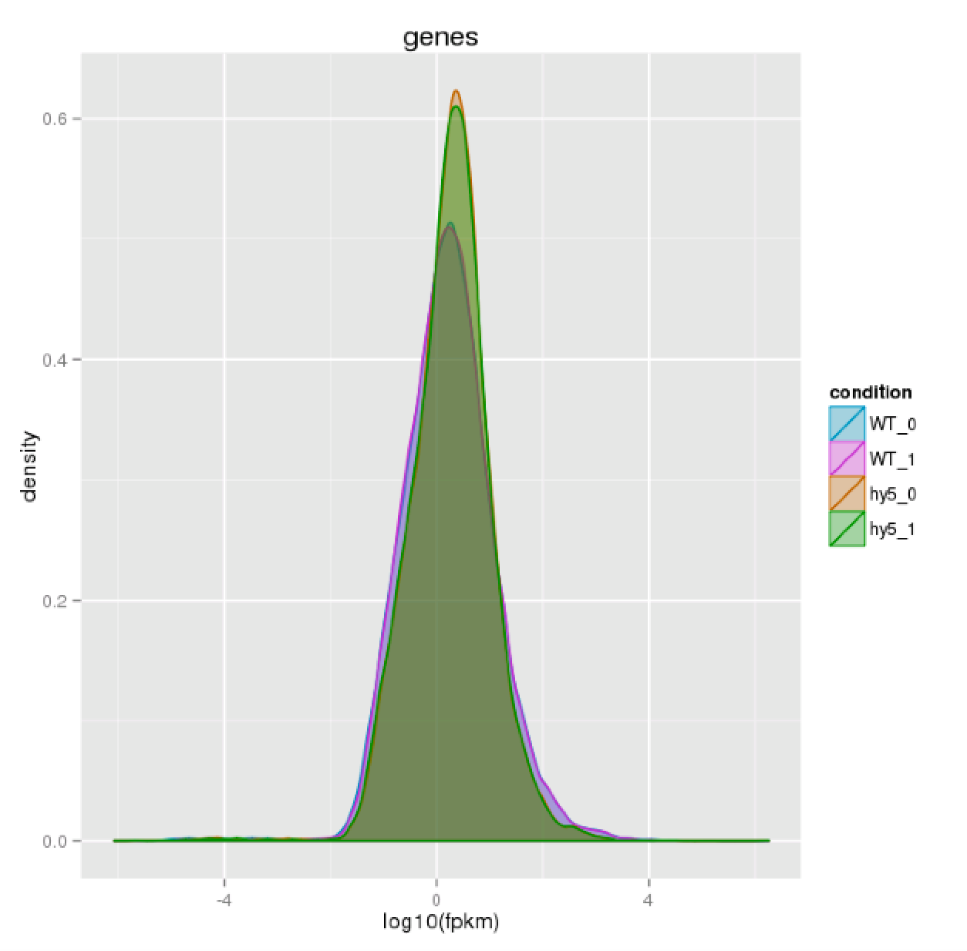
Distribution of FPKM scores
To assess the distributions of the genes in the two samples, you can use the csDensity plot.
The density plot generated by cummeRbund can be thought of as a ‘smoothed’ representation of a histogram.
>dens <- csDensity(genes(cuff))
>dens
>densRep <- csDensity(genes(cuff), replicates=T)
>densRep
Two WT and two samples

Slide 21
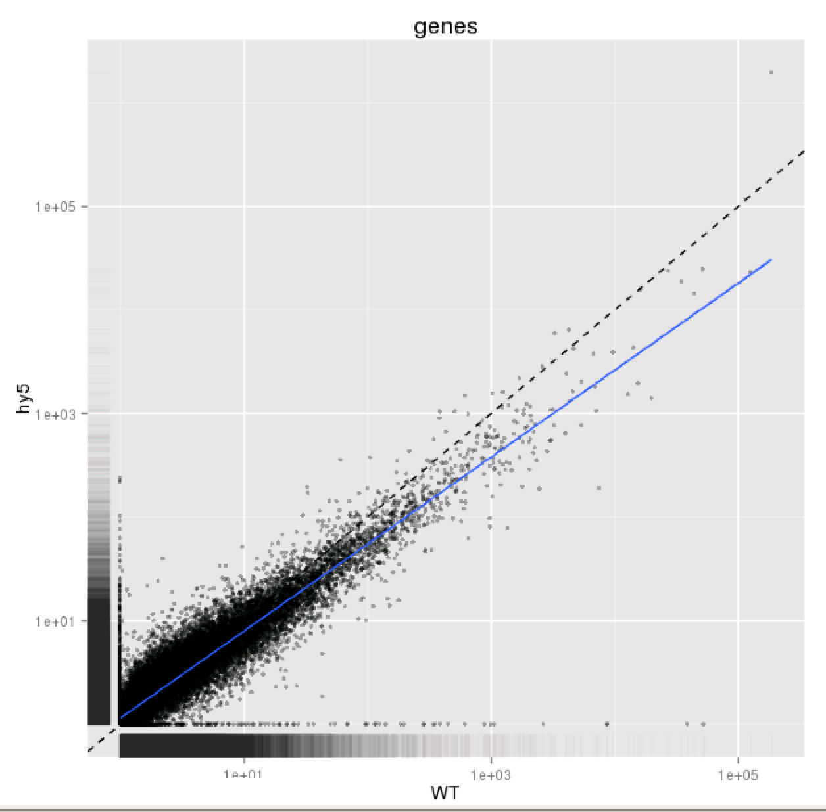
Distribution of FPKM scores
Pairwise comparisons between conditions can be made by using a scatterplot. The data is displayed as a collection of points, each having the value of one variable determining the position on the horizontal axis and the value of the other variable determining the position on the vertical axis.
> csScatter(genes(cuff), ‘WT’, ‘hy5’, smooth=T)
These plots can be useful for identifying global changes and trends in gene expression between pairs of conditions.
Scatterplot of log10(FPKM) in WT and hy5 sample is shown

Slide 22
Selecting and Filtering Gene Sets
Creating gene sets from significantly regulated genes
Determine which genes are differentially regulated. cummeRbund makes accessing the results of these significance tests simple via getSig(): Returns the identifiers of significant genes in a vector format.
>sig <-getSig(cuff, alpha=0.05, level =‘genes’)
#An alpha value by which to filter multiple-testing corrected q-values to determine significance, 0.05 is default
>length(sig)
#returns the number of genes in the sig object

Slide 23
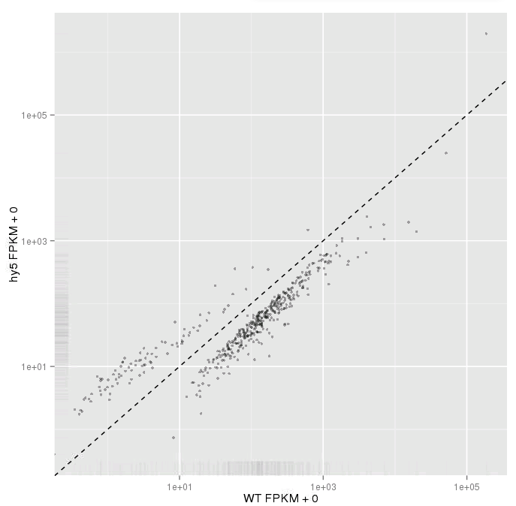
Selecting and Filtering Gene Sets
Using the ‘getGenes’ function
# Get the gene information
>sigGenes <- getGenes(cuff,sig)
Plot this in another scatter plot
>csScatter(sigGenes, ‘WT’, ‘hy5’)

Slide 24
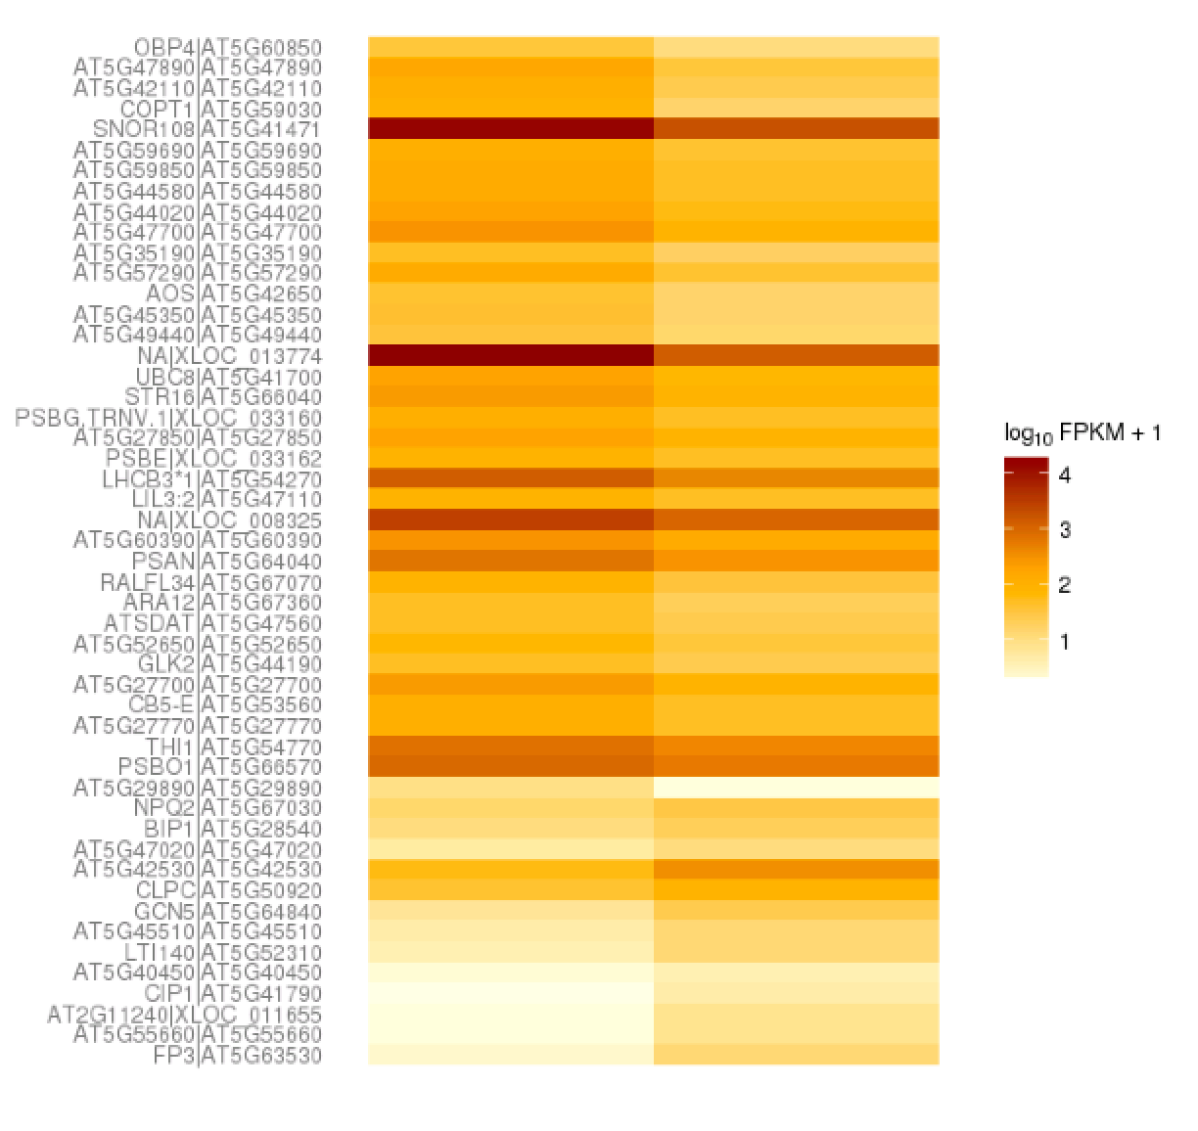
Heatmap: Similar Expression Values
There are several plotting functions available for gene-set-level visualization:
The csHeatmap() function is a plotting wrapper that takes as input either a CuffGeneSet object (essentially a collection of genes and/or features) and produces a heatmap of FPKM expression values.
>sigGenes <-getGenes(cuff,tail(sig,50))
#last 50 genes in the list we created
>csHeatmap(sigGenes,cluster=‘both’)

Slide 25
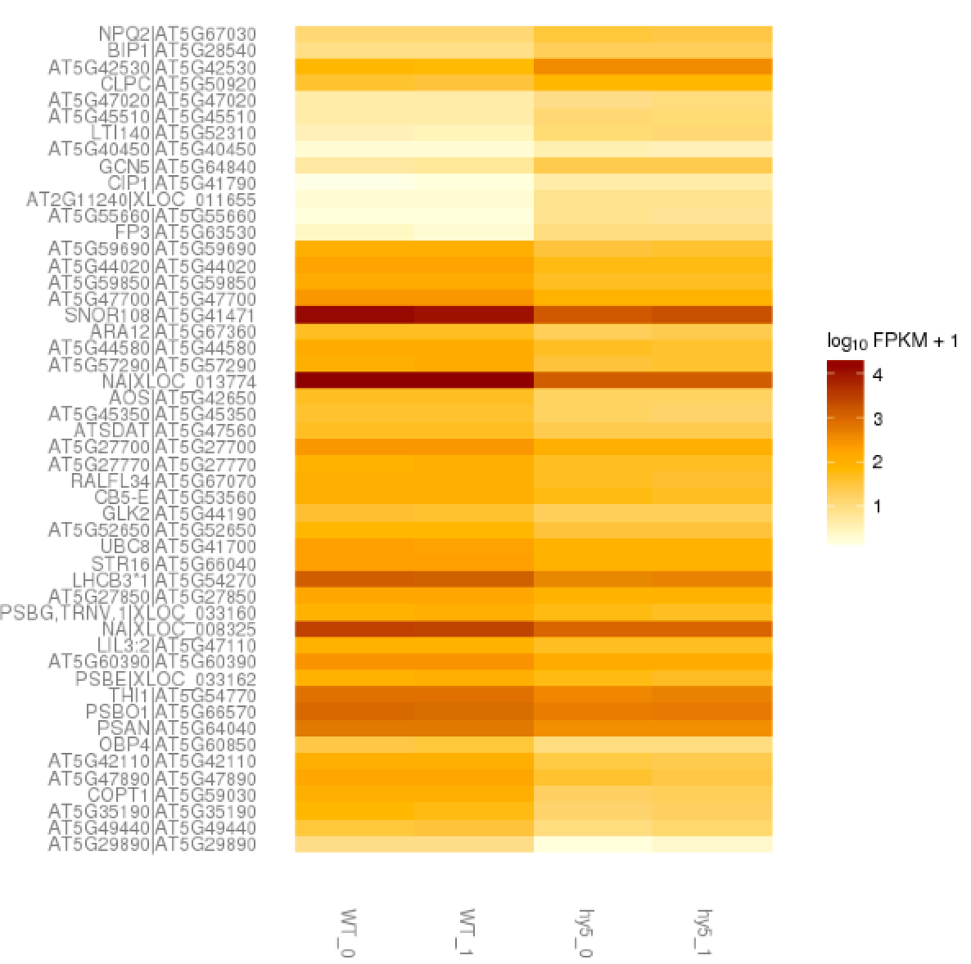
Heatmap: Similar Expression Values
>csHeatmap(sigGenes,cluster=‘both’,replicates=‘T’)

Slide 26
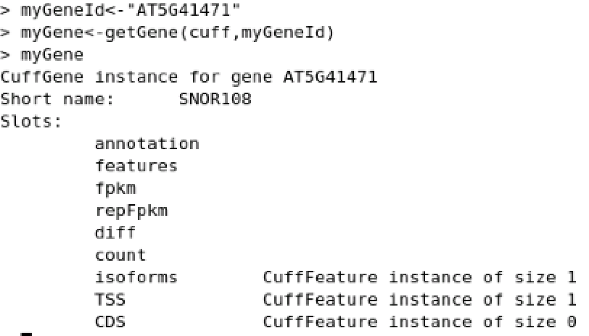
Expression Plots by Genes
> myGeneId<-”AT5G41471"
> myGene<-getGene(cuff,myGeneId)
> myGene

Slide 27
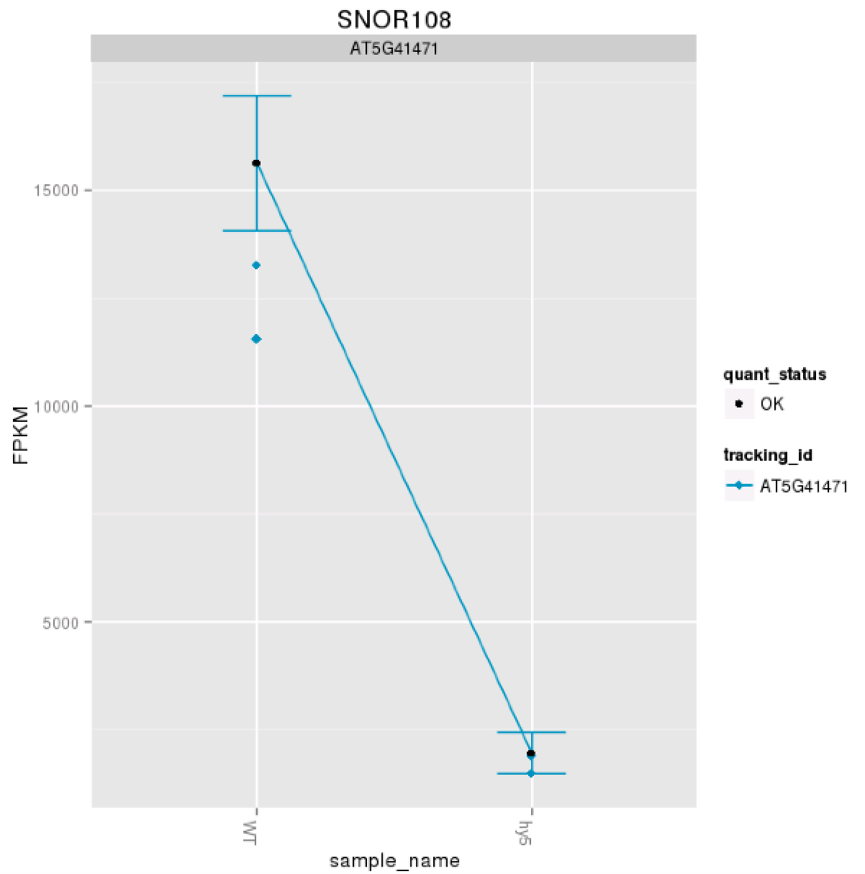
Expression Plots by Genes
> expressionPlot(myGene,replicates=‘T’)

Slide 28
Transfer data from Instance to DS via iCommands
Detailed instructions with videos, manuals, documentation in CyVerse Wiki
dnasubway11@vm65-173:~/Desktop/test_data/test1/back_to_datastore$ iput "bias_params.info"
dnasubway11@vm65-173:~/Desktop/test_data/test1/back_to_datastore$ iput -r “back_to_datastore”
-r recursive - store the whole subdirectory
-P output the progress of the upload.
-b bulk upload to reduce overhead
-T renew socket connection after 10 minutes
dnasubway11@vm65-173:~/Desktop/test_data/test1$ iget "results.txt"
Search by tag
Notes:
Go to cd .irods
ls –a
cat .irodsEnv
Get your datastore connection

Slide 29
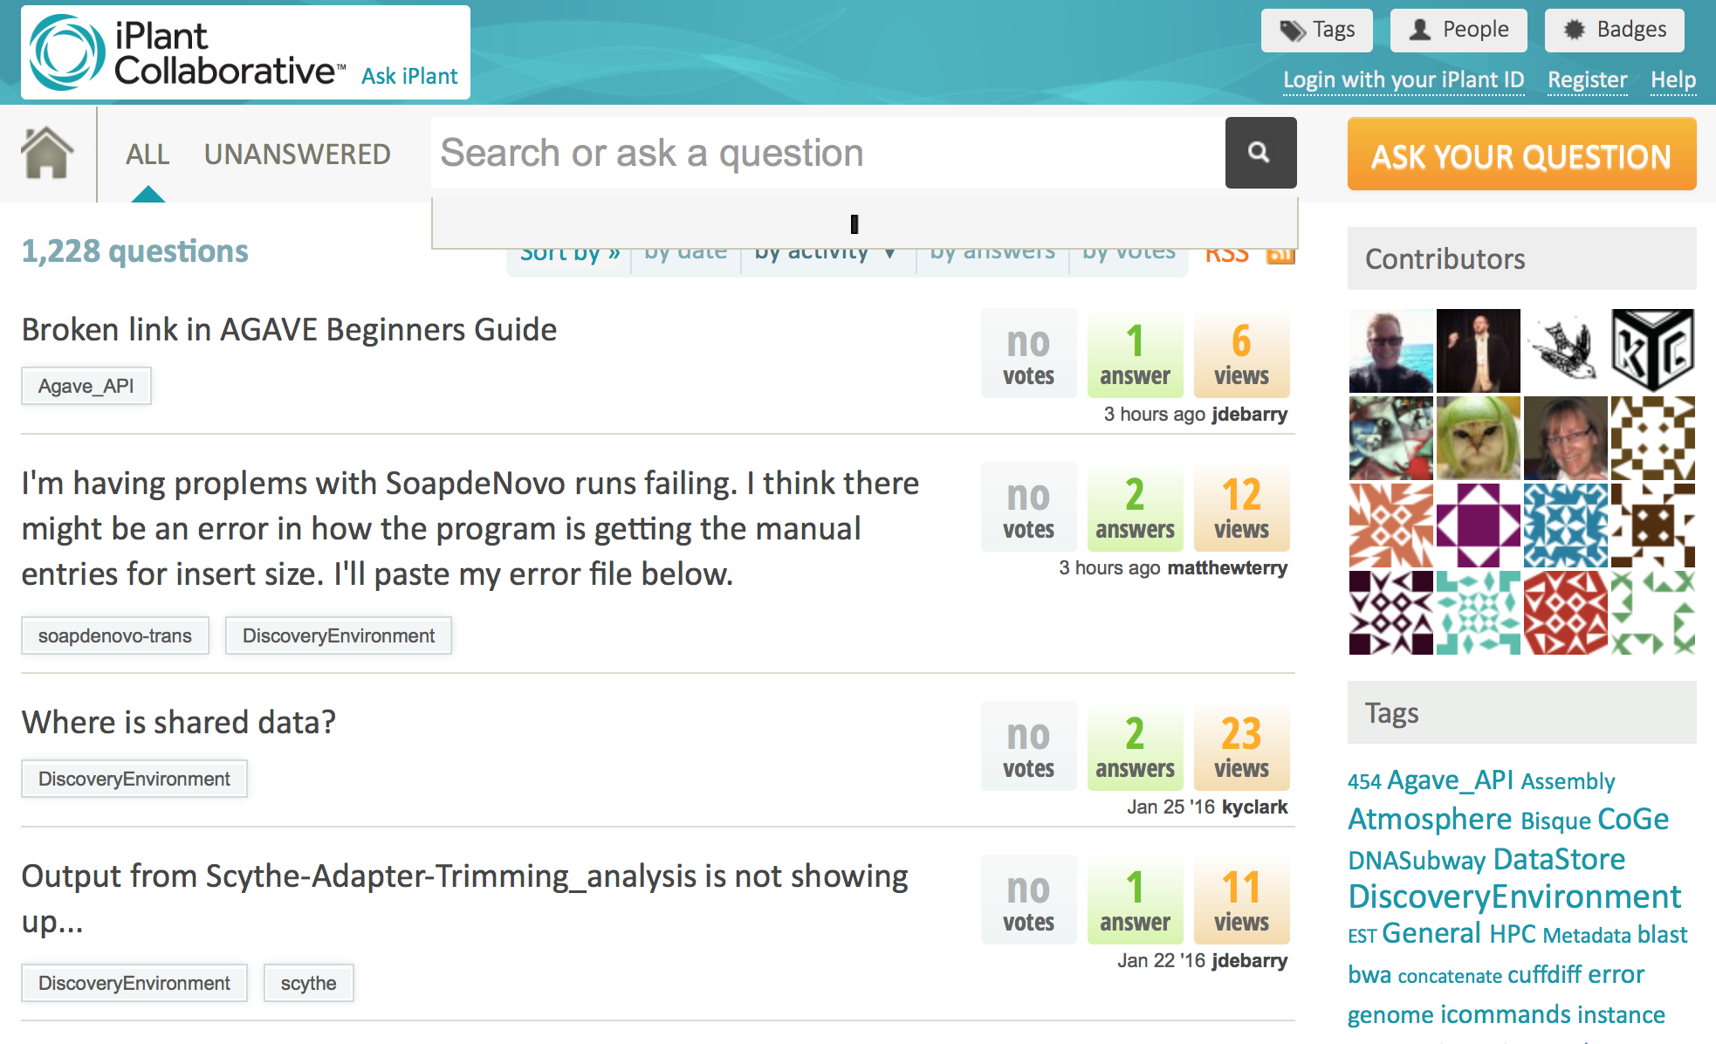
Help: ask.iplantcollaborative.org
Detailed instructions with videos, manuals, documentation in CyVerse Wiki
Search by tag

