Slide 1
Tools and Services Workshop
Data Store – Managing your ‘Big’ Data
Joslynn Lee, Ph.D. – Data Science Educator
Cold Spring Harbor Laboratory, DNA Learning Center
jolee@cshl.edu

Slide 2
Welcome to the Data Store
Manage and share your data across all CyVerse platforms

Slide 3
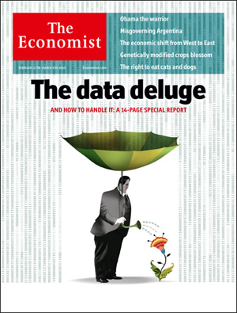
Working with ‘Big’ Data
Challenges: the scope and scale of life sciences data continue to grow
Big data a term applied to data sets whose size is beyond the ability of commonly used software tools to capture, manage, and process the data within a tolerable elapsed time
Big data sizes are a constantly moving target currently ranging from a few dozen terabytes (TB) to many petabytes of data in a single data set
“‘Big Data': Big gaps of knowledge in the field of Internet". International Journal of Internet Science 7: 1–5.

Slide 4
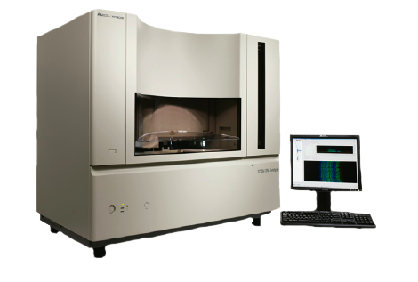
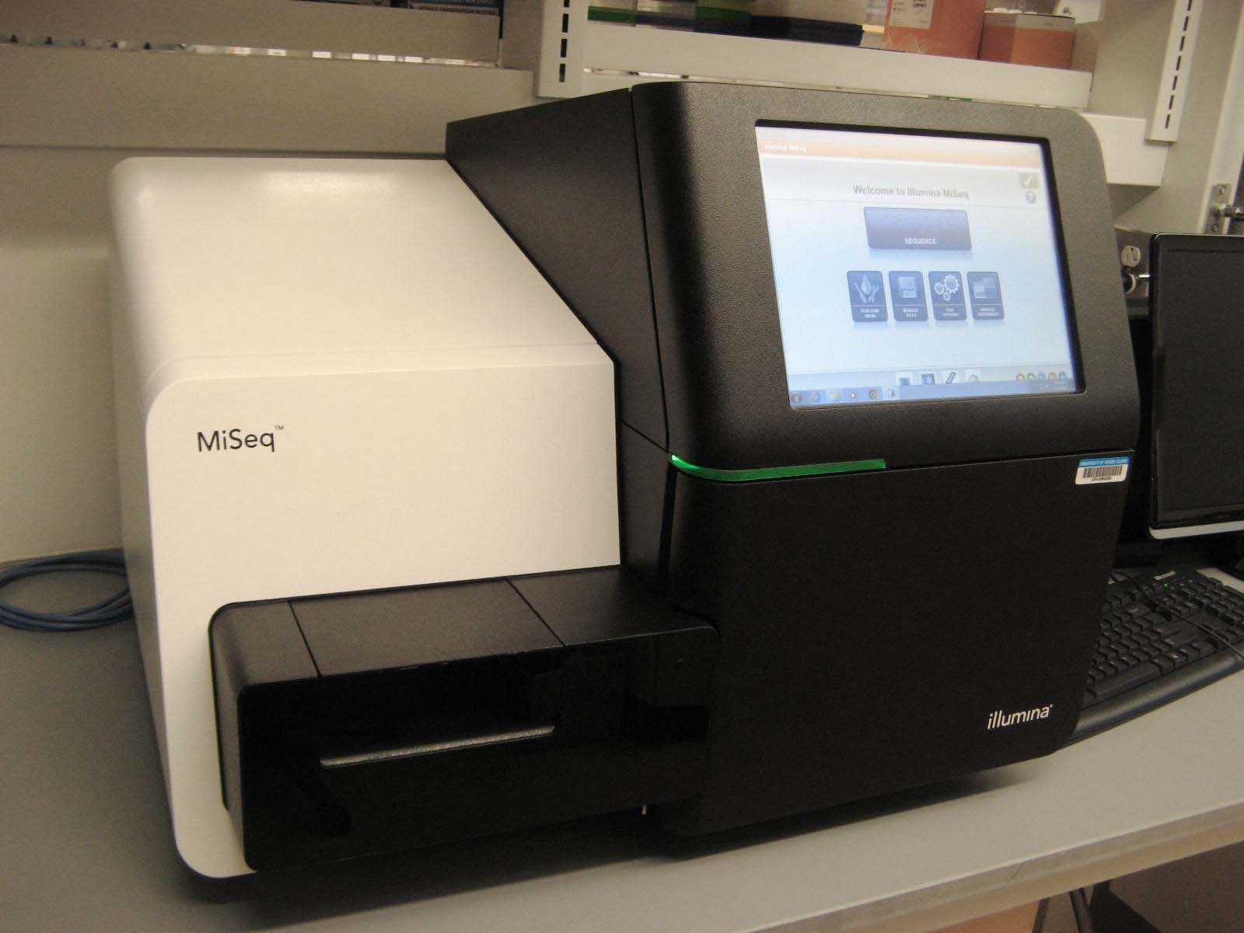
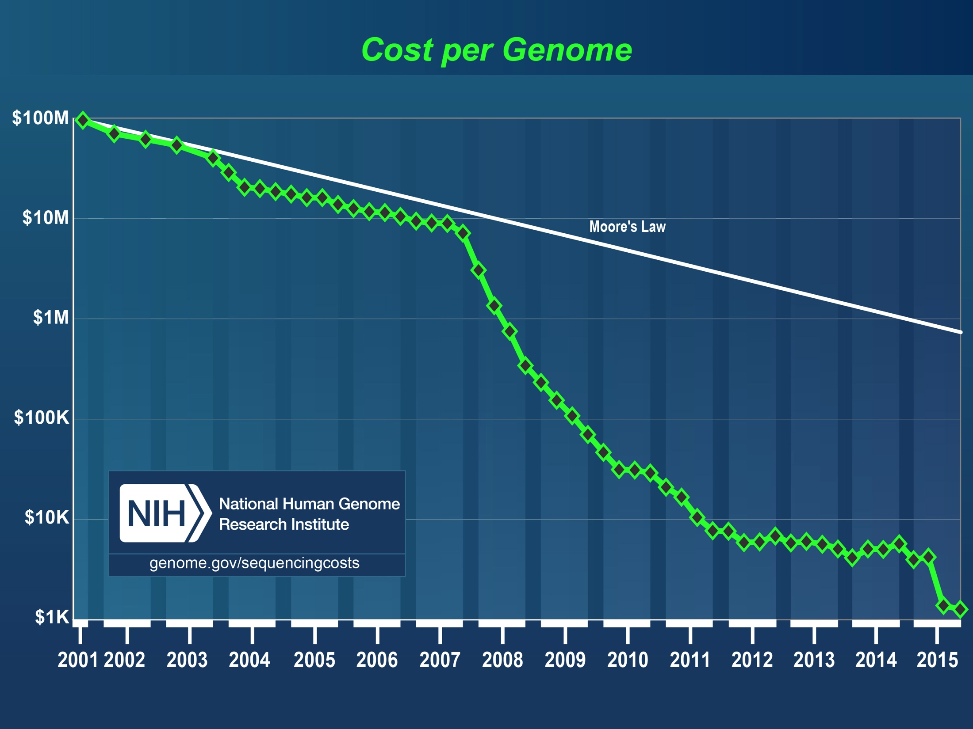
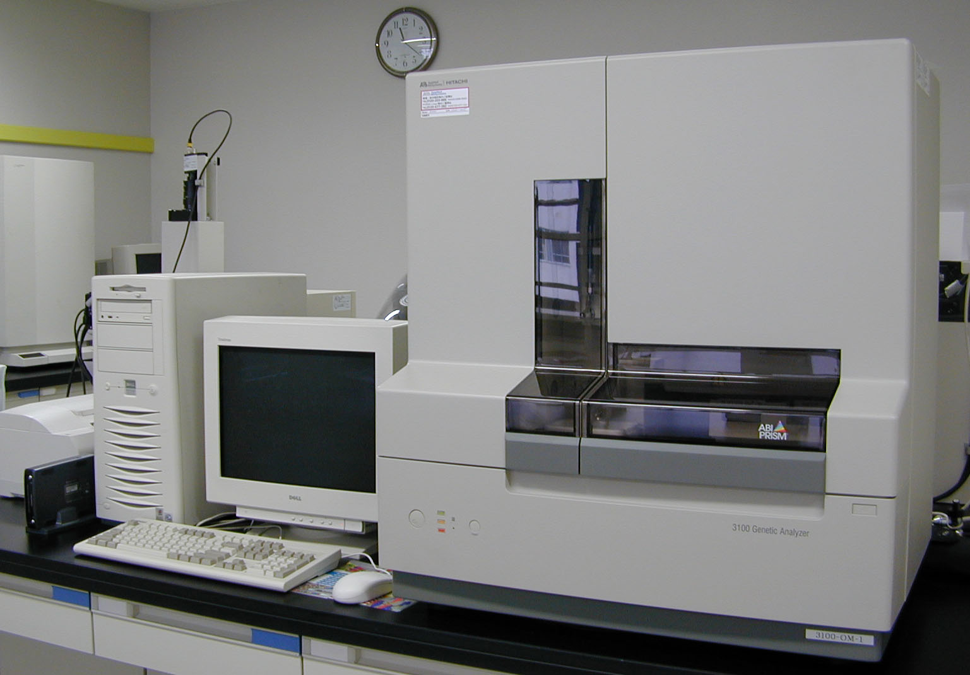
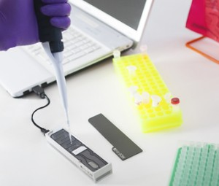
Working with ‘Big’ Data
Challenges: (sequencing example): data generation is cheaper and faster

Slide 5
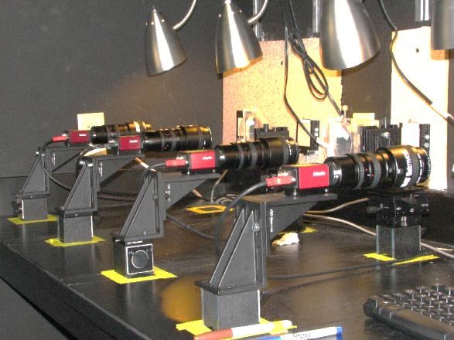
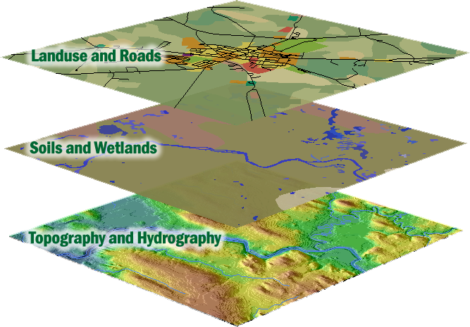
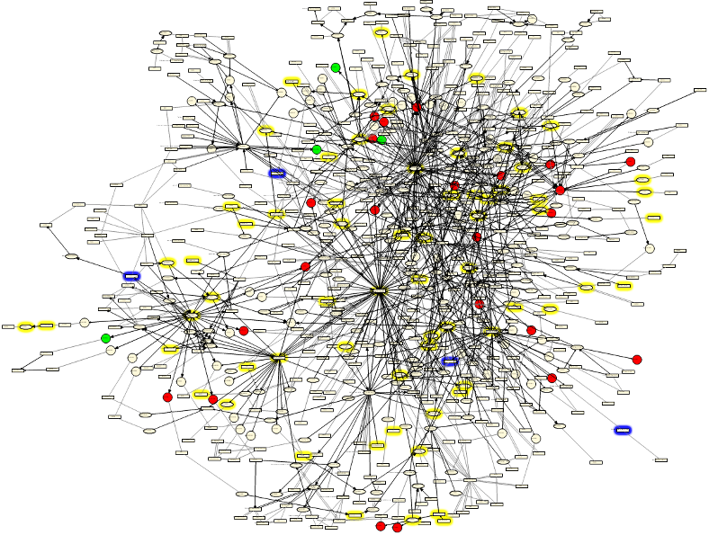
Working with ‘Big’ Data
Challenge: biology encompasses more than sequence data
Advanced Imaging Geospatial Network
Biologists work with and require access to diverse data types

Slide 6
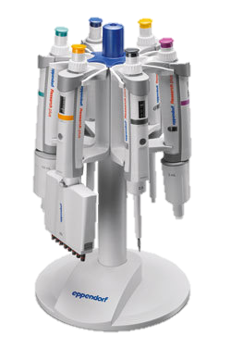
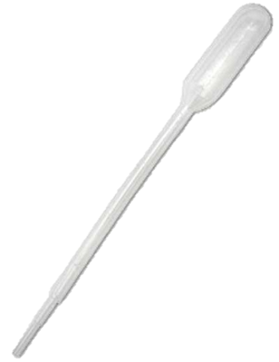
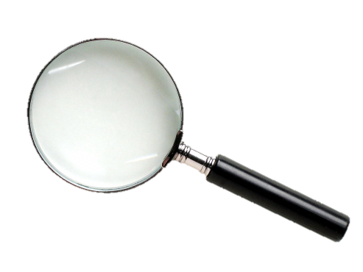
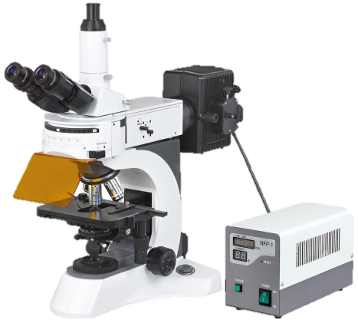
Working with ‘Big’ Data
Challenges: changes in data require changes in tools
Difficult / slow transfers
Expense for storage / backup
Difficult to share and publish
Analysis
Metadata (What Is metadata?)
Changes in scale introduce quantitative and qualitative complications

Slide 7
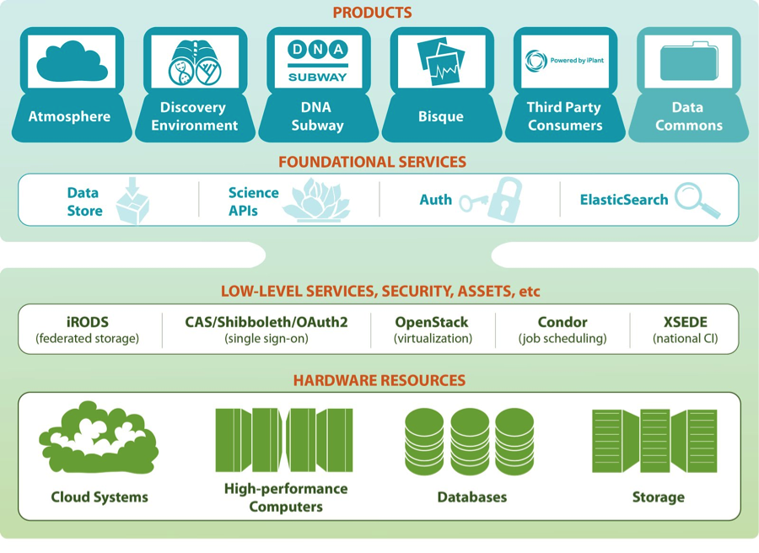
Data Store Overview
The Data Store services all CyVerse platforms
Access your data from multiple CyVerse services
Automatic backup (redundant between University of Arizona and University of Texas
Default 100 GB allocation, > 1 TB allocations available with justification

Slide 8
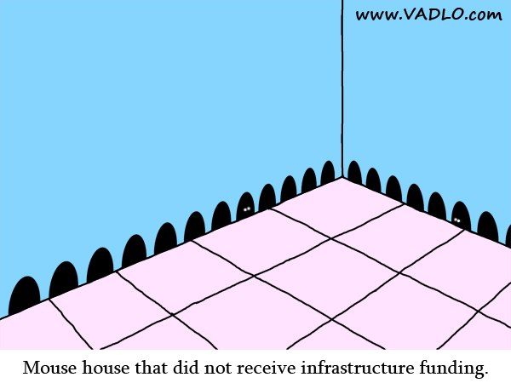
Data Store Overview
Avoid reinventing the wheel
iRODS (integrated Rule-Oriented Data System) is an established, scalable, open-source data management sytem
iRODS supports many data intensive projects
iRODS abstracts data services from data storage to facilitate executing services across heterogeneous, distributed storage systems
Critical for effective data management
Works under the hood
Folder = Collection

Slide 9
Data Store Overview
Benefits
Get Science Done
Store any type of files related to your research
allocations greater than 1 TB, please include in your request
Reproducibility
Metadata captures information needed for reproducibility
Automatic backup and accessibility support your project’s data management plan
Productivity
iRODS makes high-speed transfers possible (100 GB in ~30 min)
Share data instantly with collaborators within CyVerse

Slide 10
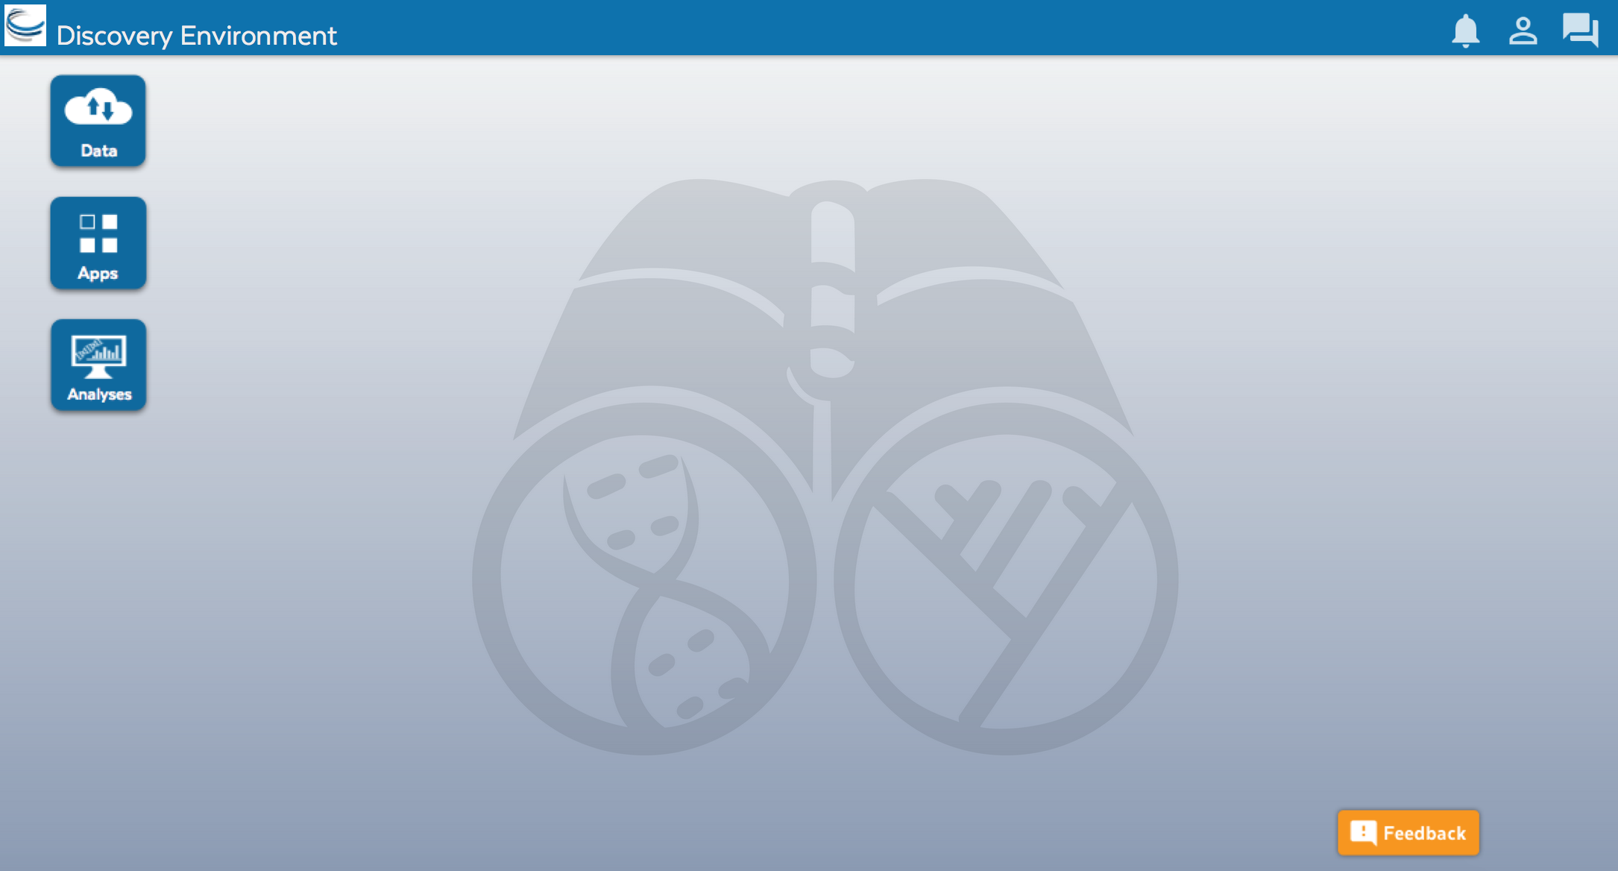
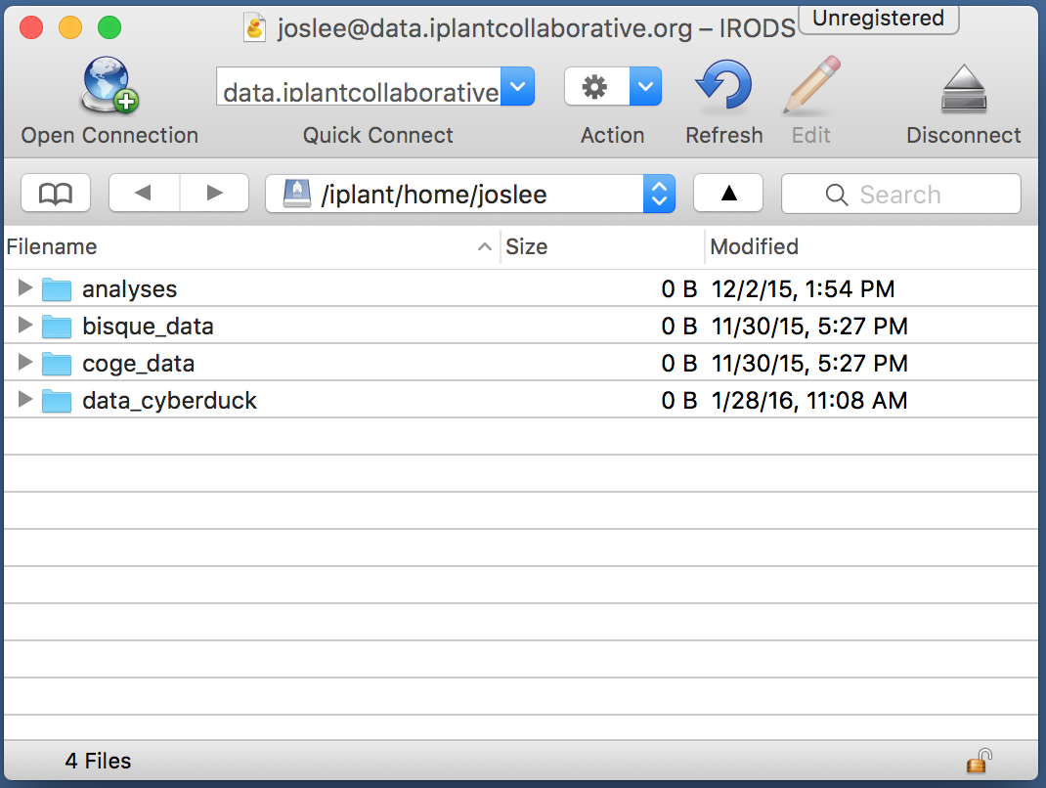
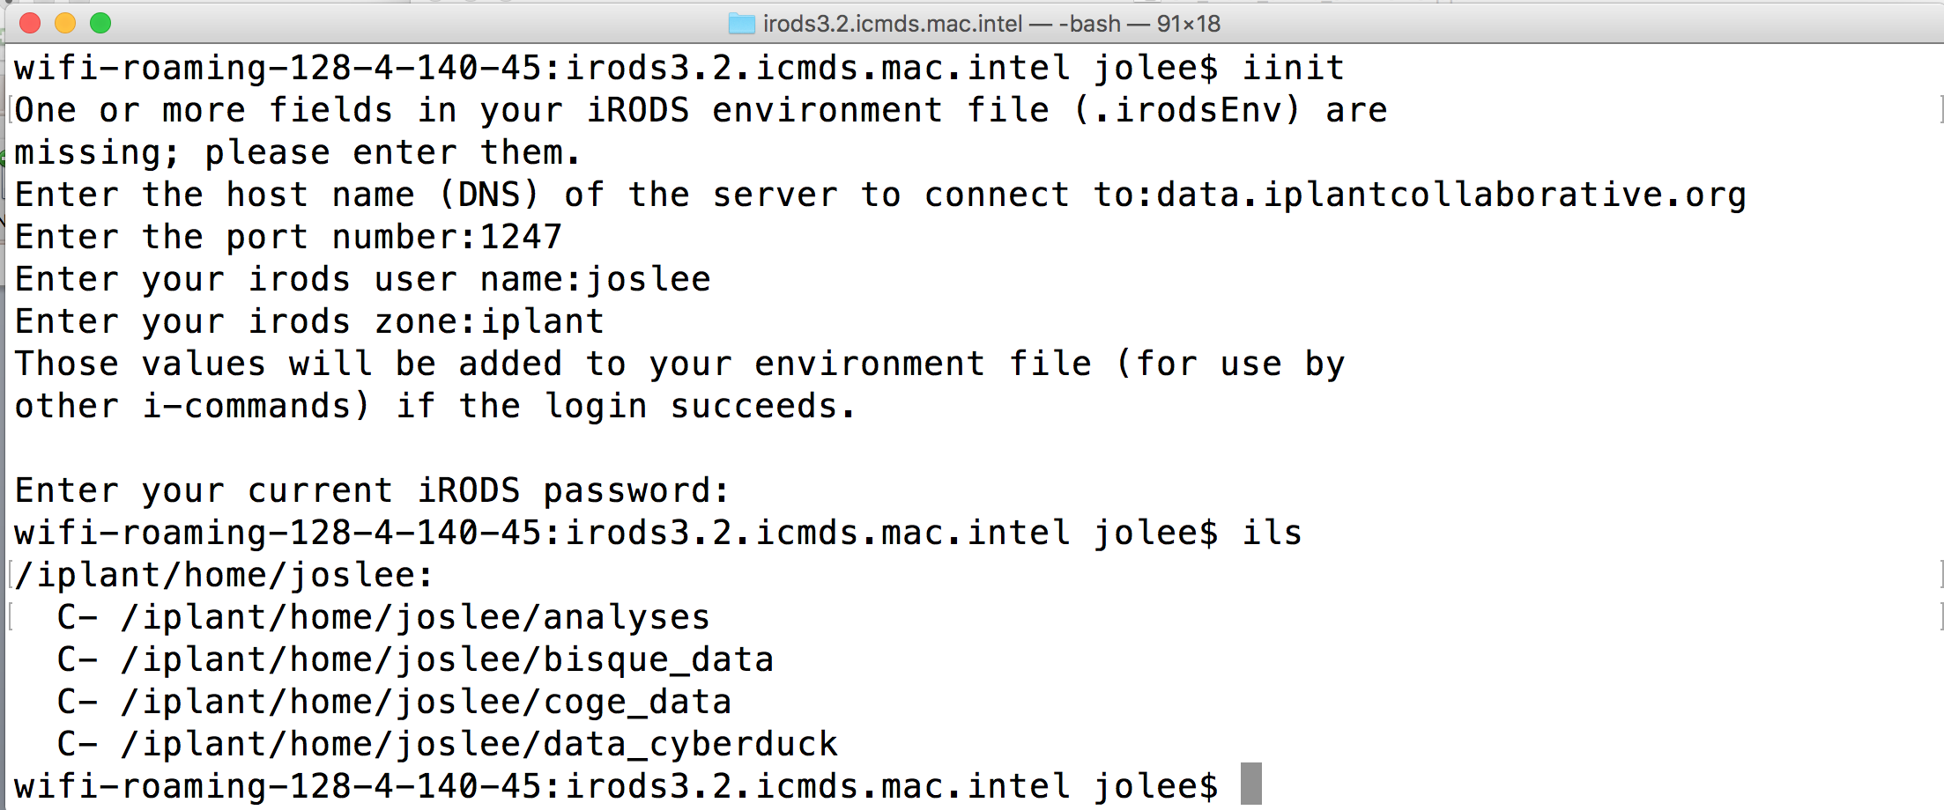
Data Store Overview
Multiple ways to access for varied skill levels
Point-and-click
Command line
Discovery Environment (DE)
Cyberduck
iCommands

Slide 11
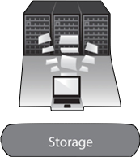
Data Store Overview
Some important things we will not “see” in the demo
Data Backups
Data Transfer
Source | Destination | Copy Method | Time (seconds)
CD | My Computer | cp | 320
Berkeley Server | My Computer | scp | 150
External Drive | My Computer | cp | 36
USB 2.0 Flash | My Computer | cp | 30
Data Store | My Computer | iget | 18
My Computer | My Computer | cp | 15
Arizona
Texas
Key component of your data management
Worry-free
Closer to optimum conditions: transfers between University of Arizona and UC Berkeley
100 GB: 26m15s, 1 GB 17.5s

Slide 12
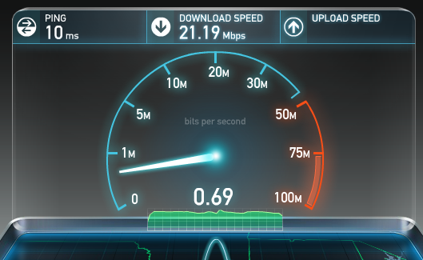
Data Store Overview
Some important things we will not “see” in the demo
http://www.speedtest.net/
Local connections and institutional policies limit data transfer

Slide 13
Hands-on Demo
Workshop packet: Data storage that supports the Life Cycle of Data
Page 7

Slide 14
Data Store Overview
Hands-on demo: Data Storage that supports the Life Cycle of Data
Transferring data with Cyberduck– page 10
Easiest way to share data with CyVerse – page 11
More Data Store exercises – page 29-30
By the end of this demo, you should be able to:
Import files from a URL (i.e. http://goo.gl/w7sIWL)
Upload / Download ‘large’ files (see Community Folder)
Share data via a public link and via the Discovery Environment (use neighbor’s CyVerse username)
View and manage file metadata

Slide 15
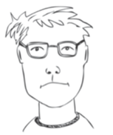
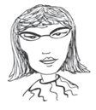
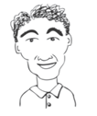
Data Store Overview
User perspectives and potential applications
Bench Scientist
Uploads all of his .fastq files along with 50GB of root growth videos
Shares all his analyses results with his thesis advisor
Bioinformatician
Created a metadata template for assembled genomes her students and collaborators will place in a shared folder
Uses public links in the supplemental materials of her publications
Core Facilities
Developed a script to automate transfer of data to core users
Uses a shared folder to make large datasets accessible
Welch et al. 2013

Slide 16
Data Store Overview
Time for Summaries and Tips

Slide 17
Summary: Tips for upload and download in the DE
‘Simple’, for small files (~5 files, < 1.8GB)
‘Bulk’, for larger files and folders (< 10GB)
Import from URL (no size limit)
Advantage
Covers most upload/download sharing needs
Point and Click
Disadvantage
Some size / speed limitations

Slide 18
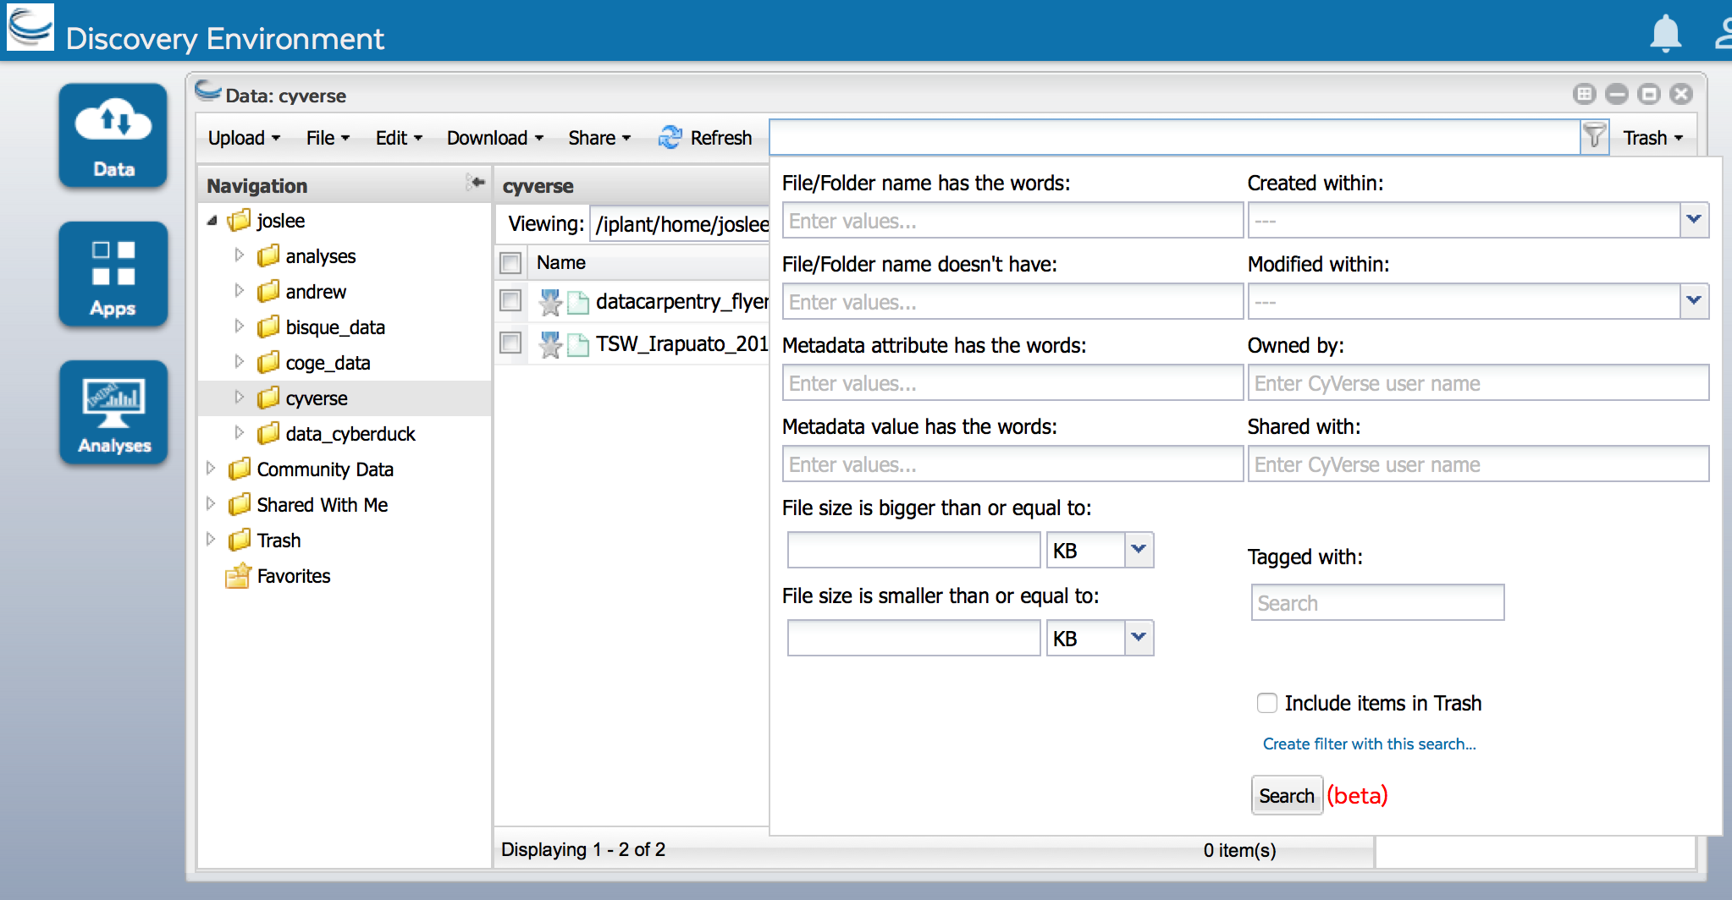
Summary: Tips for searching in the DE
Basic search bar searches all files and folders where you have permission
Advanced search allows searching based on metadata, permissions, and share status
Create auto-updated ‘smart’ folders based on searches

Slide 19
Summary: Tips for file names
Spaces / Special Characters
Many software packages are sensitive to spaces in files names and/or the special characters below
Rename uploaded files before using them in an analysis
~ | ` | ! | @ | # | $ | % | ^ | & | * | ( | ) | + | =
{ | } | [ | ] | | | \ | : | ; | " | ' | < | > | , | ? | /

Slide 20
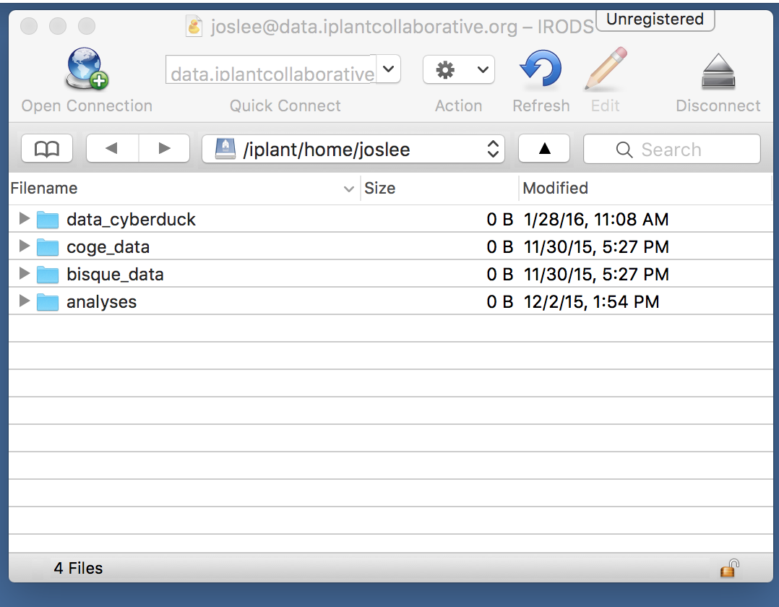
Summary: Faster transfer with Cyberduck
Free cross-platform open source file transfer program
Drag and drop files and folders
has been extensively tested with large data transfers (60-70 GB) from desktop to Data Store
access public and private data with your CyVerse account login
can access data anonymously
data that has been shared with anyone
without the need of an account

Slide 21
Summary: Sharing files in the Data Store
Two easy ways to share data from the DE
1) Discovery Environment Sharing
Share files / folders instantly
Control access permissions
Manage sharing between collaborators
2) Sharing via Public Link
No CyVerse account required
Limited to individual files
URLs are public (less secure, can revoke)

Slide 22
Summary: Tips for sharing files
When sharing, use this chart to decide appropriate permissions for CyVerse
Permission | Read | Download | Metadata | Rename | Move | Delete
Read | x | x
Write | x | x | x
Own | x | x | x | x | x | x
Scenario 1:
Lab PI with no computational biology experience
Scenario 2:
Individual who collected data
Scenario 3:
You ?

Slide 23
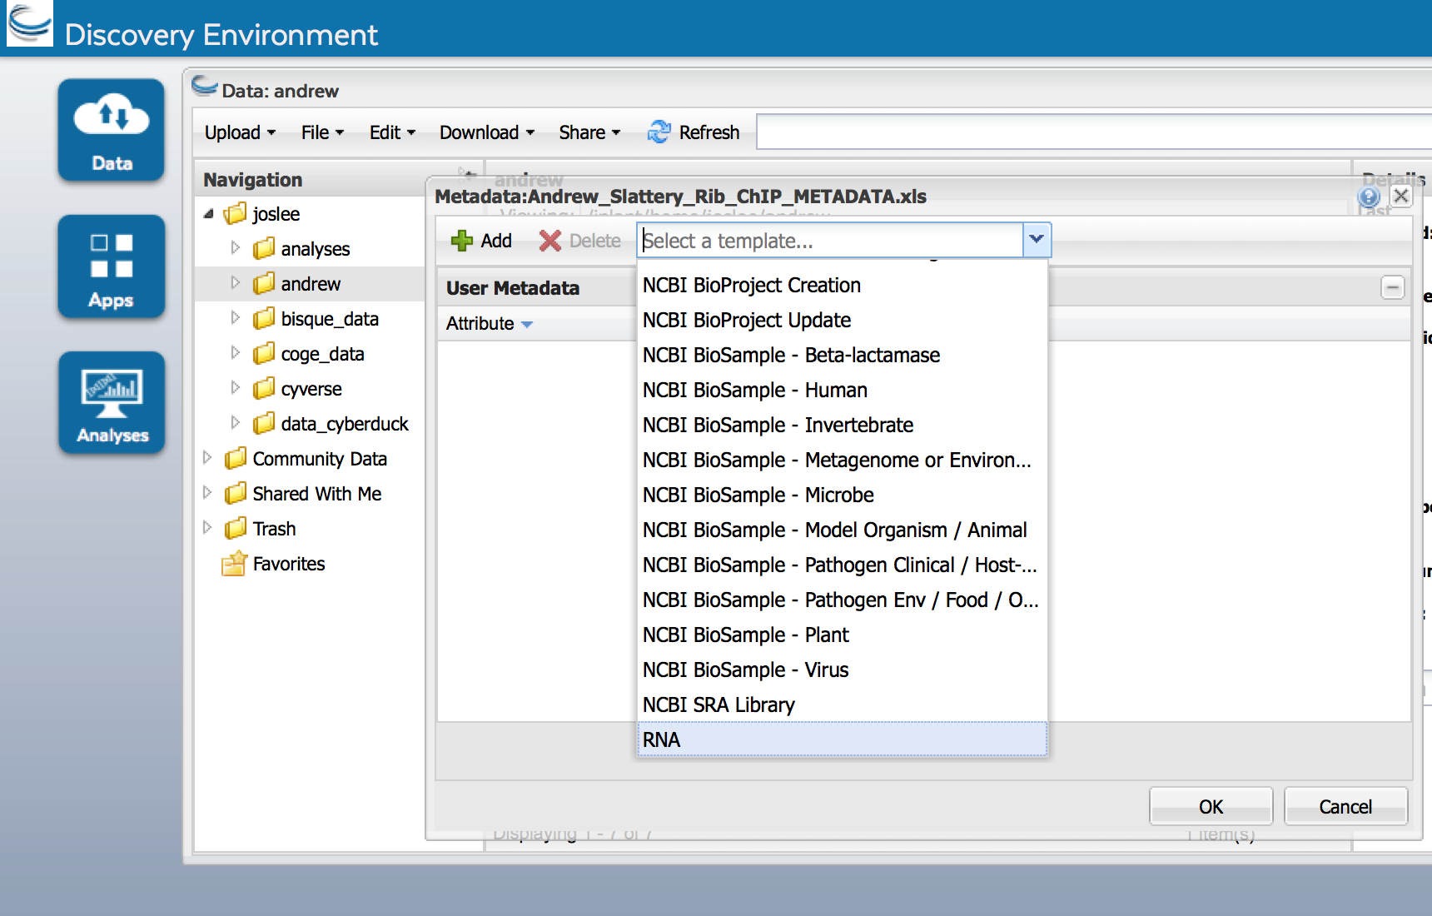
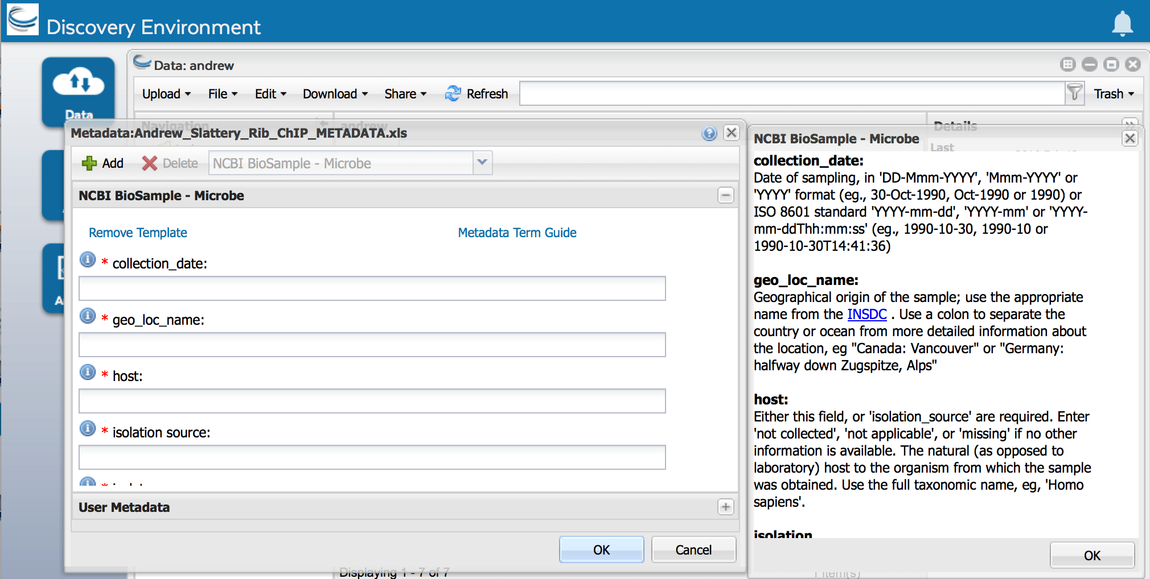
Summary: Tips for viewing and editing metadata
User metadata stored in Attribute Value Unit (AVU)
Edit → Metadata → Edit Metadata
Choose your template -> Use term guide
Add your own attributes and values / customize
Metadata not just for data management, think reproducibility!

Slide 24
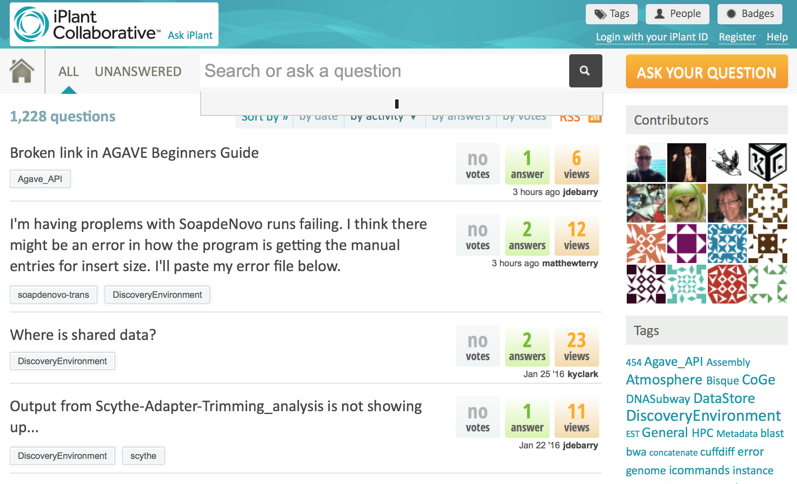
Help: ask.iplantcollaborative.org
Detailed instructions with videos, manuals, documentation in CyVerse Wiki
Search by tag

