Slide 1
iPlant Collaborative
Tools and Services Workshop
Building and Using Workflows Within the DE;
Phylogenetics

Slide 2
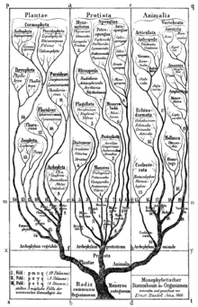
Workflows within the DE; Phylogenetics
Why is the Tree of Life Important?
“Knowledge of evolutionary relationships is fundamental to biology, yielding new insights across the plant sciences, from comparative genomics and molecular evolution, to plant development, to the study of adaptation, speciation, community assembly, and ecosystem functioning.”
Notes:
Our understanding of the phylogeny of the half million known species of green plants has expanded dramatically over the past two decades,
The task of assembling a comprehensive "tree of life" for them presents a Grand Challenge.
Also part of the grand challenge is developing the necessary infrastructre to view and use the tree of life, to put it into the hands of plant biologists

Slide 3
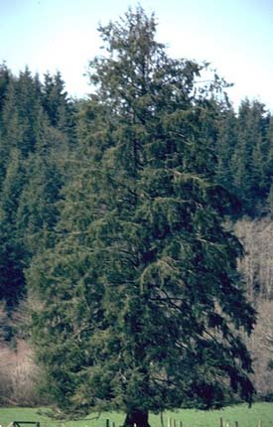
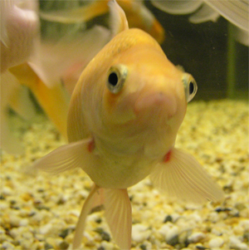
Workflows within the DE; Phylogenetics
Why is the Tree of Life Important?
We like to put things into categories!
Notes:
3

Slide 4
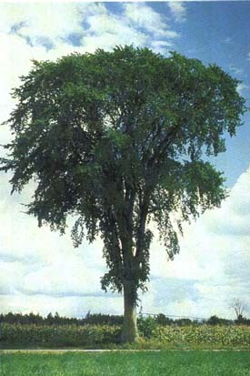
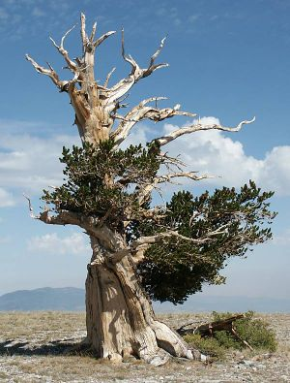
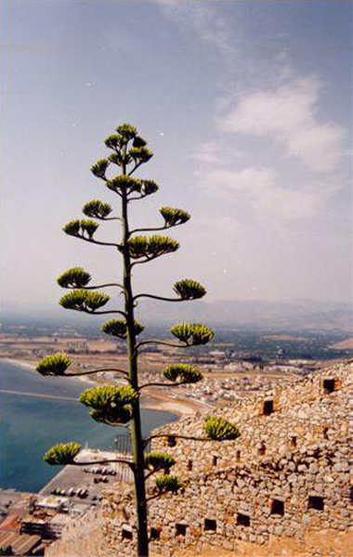
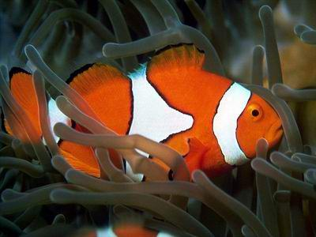
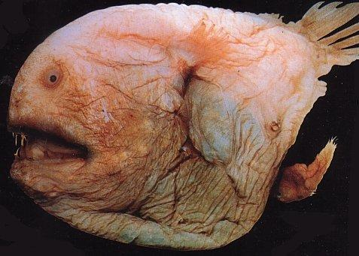
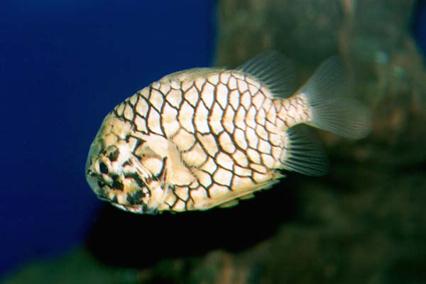
Workflows within the DE; Phylogenetics
Why is the Tree of Life Important?
Midway between the unintelligible and the commonplace, it is metaphor which produces most knowledge. —Aristotle, Rhetoric III
Notes:
4

Slide 5
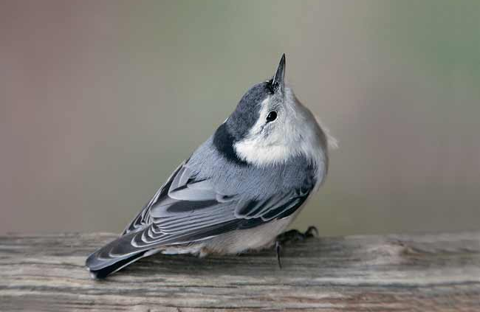
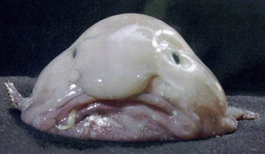
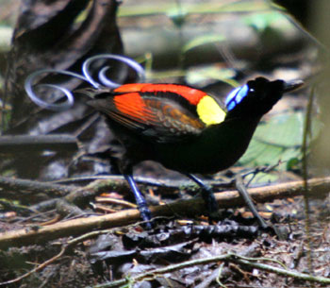
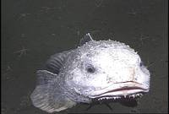
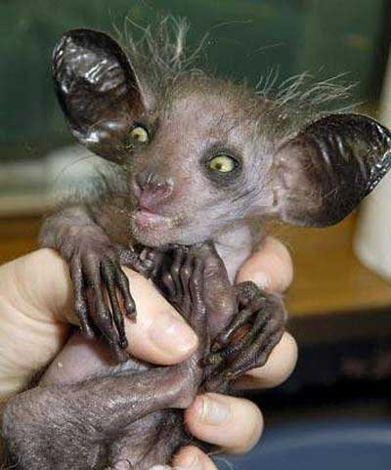
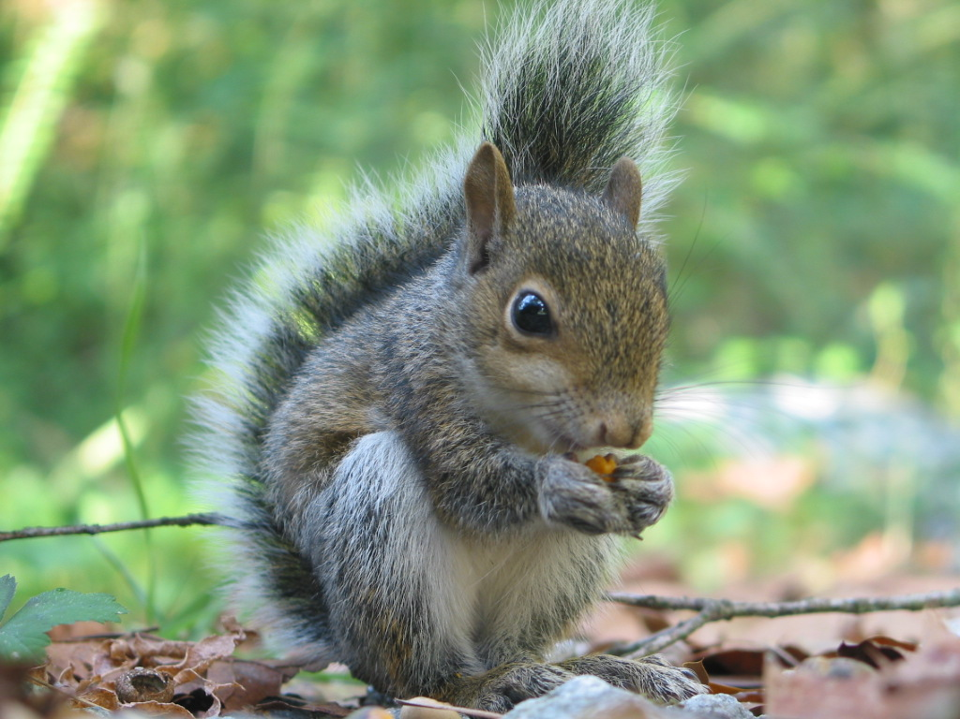
Workflows within the DE; Phylogenetics
Classifications represent inferred evolutionary relationships*
B
A
F
C
D
E
* But not always
Notes:
5
The aye aye is more closely related to the squirrel than to the nuthatch or the blobfish.
We can illustrate evolutionary relatedness by positioning these taxa in a phylogenetic tree
The more similar they are, the more likely they are closely related.

Slide 6
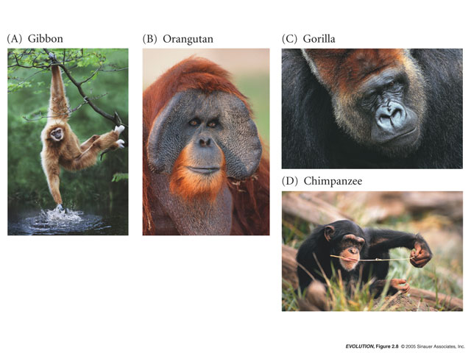
Workflows within the DE; Phylogenetics
Classifications represent inferred evolutionary relationships*
Consider primates: Do humans make up a monophyletic group?
(E) human
Notes:
6
Take a look at a real phylogenetic problem: In the early 1990’s it was largely believed that members of this primate superfamily
Could be divided up into hylobatidae, pongidae, hominidae. And this was based largely on morphological traits which strongly suggested that gorilla and orangutan and chimapnzeez looked more like one another than humans did to any of these species…does look rather different from Pongidae. In the early 1990’s, Morris goodman sequenced more than 10,000 nucleotides of a globin pseudogene and he found something rather surprising
Traditional classification has Hylobatidae, Pongidae, and Hominidae

Slide 7
Workflows within the DE; Phylogenetics
Classifications represent inferred evolutionary relationships*
Hylobatidae
Pongidae
Hominidae
(E) human
Notes:
7
Take a look at a real phylogenetic problem: In the early 1990’s it was largely believed that members of this primate superfamily
Could be divided up into hylobatidae, pongidae, hominidae. And this was based largely on morphological traits which strongly suggested that gorilla and orangutan and chimapnzeez looked more like one another than humans did to any of these species…does look rather different from Pongidae. In the early 1990’s, Morris goodman sequenced more than 10,000 nucleotides of a globin pseudogene and he found something rather surprising
Traditional classification has Hylobatidae, Pongidae, and Hominidae

Slide 8
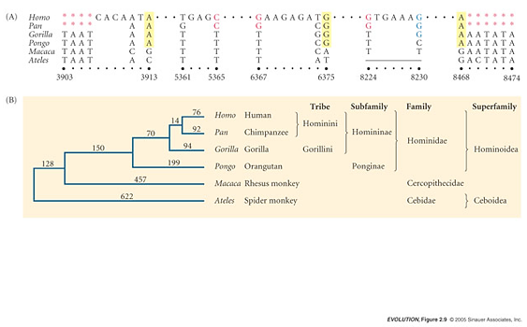
Workflows within the DE; Phylogenetics
Classifications represent inferred evolutionary relationships*
outgroup
Phylogeny based on globin pseudogene suggests that
humans and chimpanzees make up a single monophyletic group
Notes:
8
Differences in this globin pseudogene group chimp and human as sister species in a monophyletic group with respect to the other apes.

Slide 9
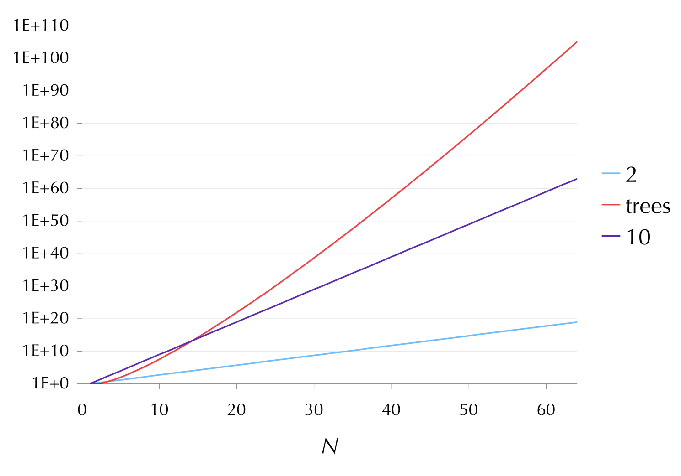
Workflows within the DE; Phylogenetics
Trees also present computational challenges
Number of atoms in the universe
Notes:
Exponential growth is fast. The number of trees grows even faster (factorially). With exponential growth, you multiply by a constant factor (i.e., 10 x 10 x 10). With trees, this factor keeps increasing 3 x 5 x 7 x 9 x 11…. At just around 50 taxa, there are more possible topologies than there are atoms in the universe. We want a tree of 500K taxa: how many possible trees are there with that many?

Slide 10
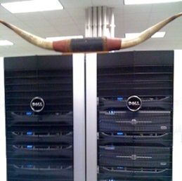
Workflows within the DE; Phylogenetics
Trees also present computational challenges
It can take weeks or months to analyze data sets with
> 100, 000 species. Example of iPlant contribution:
NINJA/WINDJAMMER (Neighbor-Joining)
-- NINJA 216K species, ~8 days
-- WINDJAMMER 216K species, ~4 hours

Slide 11
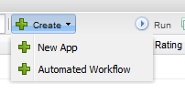
Workflows within the DE; Phylogenetics
Creating a custom workflow
The Discovery Environment allows you to chain together apps, creating custom workflows for your own use, or for publication.

Slide 12
Phylogenetic Workflow Hands-on Lab

Slide 13
Phylogenetic Workflow Lab
By the end of this module you should be able to:
Create a linear workflow of applications within the DE
Edit a workflow (order of applications/mapping of inputs
Publish a workflow in your development space
Run a workflow within the DE

Slide 14
Phylogenetic Workflow Lab
Goal: Create a multiple sequence alignment and build a phylogenetic tree using individual apps and recreate this process in an automated workflow
Task 1: Create a multiple sequence alignment using MUSCLE
Task 2: Create a phylogenetic tree using RAxML and visualize results
Task 3: Create a workflow that utilizes MUSCLE and RAxML
Task 4: Use your custom workflow to build a phylogenetic tree from unaligned sequence

Slide 15
Phylogenetic Workflow Lab
Scientific Question: How are ATP Synthase Subunit B (atpB) genes in basal groups of Magnoliophyta species related?
Obtain sequences in FASTA format
Visualize tree: (multiple methods)
Create a multiple alignment: MUSCLE
Create a phylogenetic tree: RAxML
Import sequences into DE
Automated workflow

Slide 16
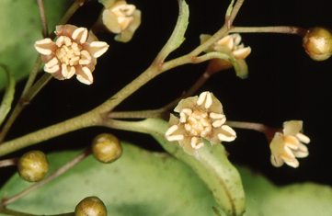
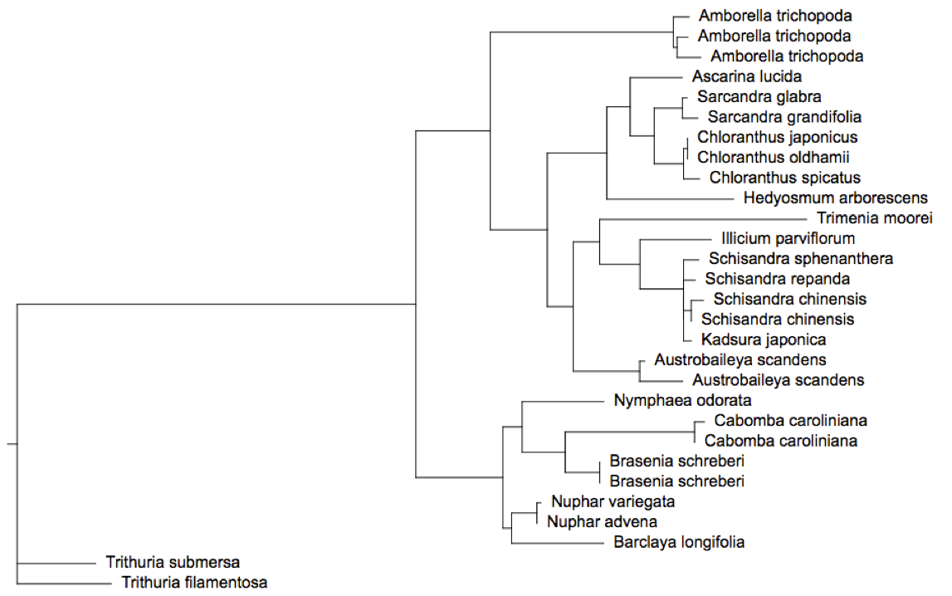
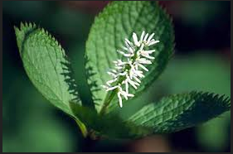
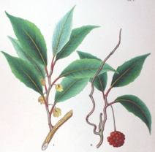
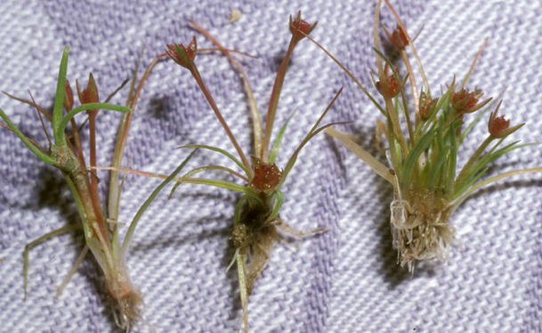
Phylogenetic Workflow Lab
ATP Synthase Subunit B gene,
Basal Magnoliophyta.
Notes:
Basal Phylogeny of Magnoliophyta (Angiosperms). Cluster 39 from the PhyloTA brpwser,
Rooting of the tree is not biologically meaningful. Together, the Nymphaeales (water lilies) and Hydatellaceae (Such a Trithuria) are thought to be sister groups th all to all other extant flowering plants except Amborella trichopoda.

Slide 17
Phylogenetic Workflow Lab
Please login to the Discovery Environment.
Follow along with the instructor
Or
Follow along with the handouts on your own

Slide 18
Phylogenetic Workflow Lab
Use workflows to simplify your life
Extend your research beyond just
next-gen sequence analysis
Chain together multiple apps and
make it easy for your collaborators
to copy your exact workflow
Future improvements will include
branching and decision points that
further extend capabilities, such
as parameter sweeps

