Slide 1

iPlant Collaborative
Bringing Together High Performance Computing and Biology

Slide 2
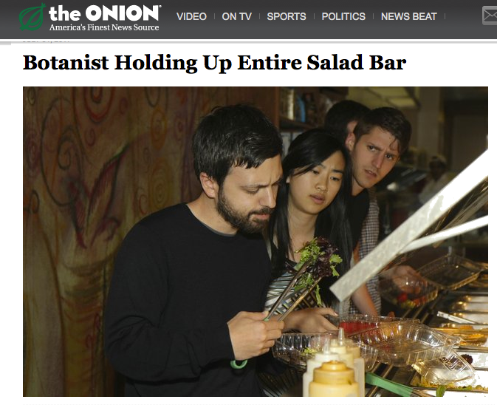

Slide 3
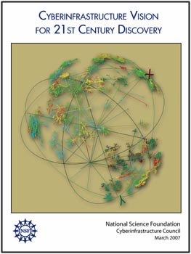
The iPlant Collaborative
Cyberinfrastructure Philosophy
We have designed iPlant to be consistent with the pillars of CIF21*
  High Performance Computing
  Data and Data Analysis
  Virtual Organization
  Learning and Workforce

Slide 4
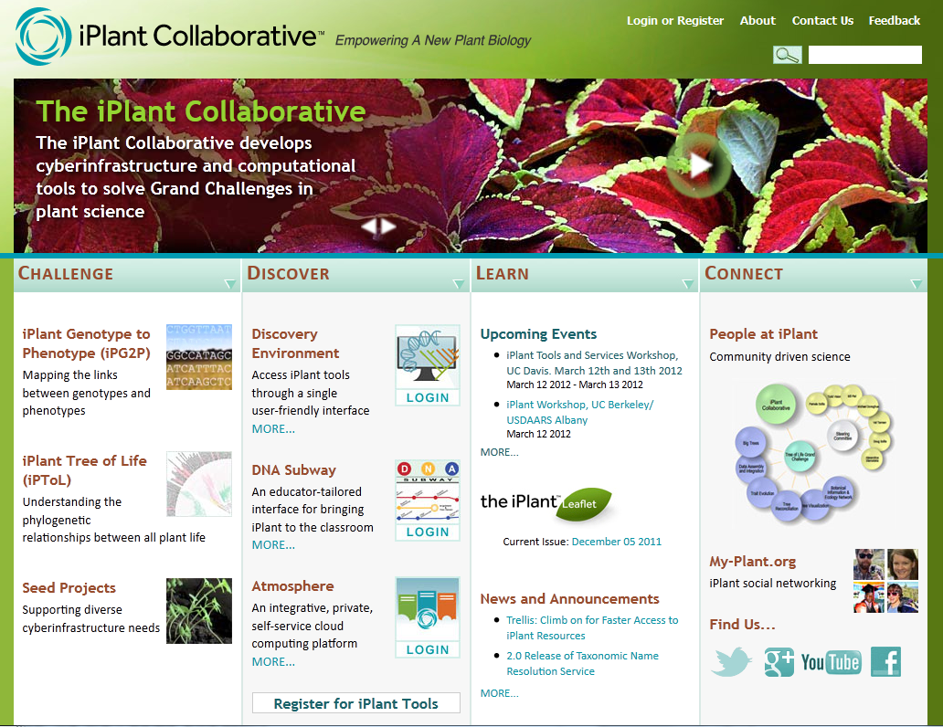
The iPlant Collaborative
Cyberinfrastructure for the Plant Sciences
Notes:
iPlant is by and for the plant science community.
We are developing a saleable extensible platform that delivers community scale solutions.

Slide 5
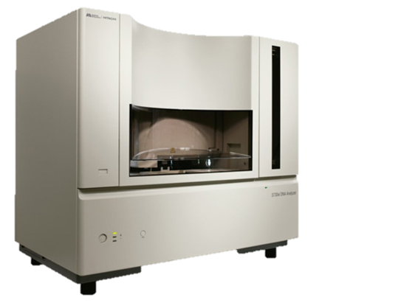
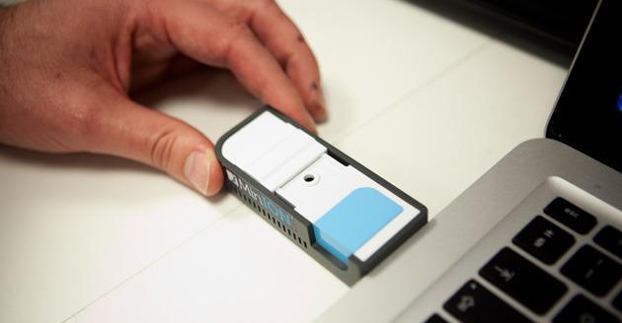
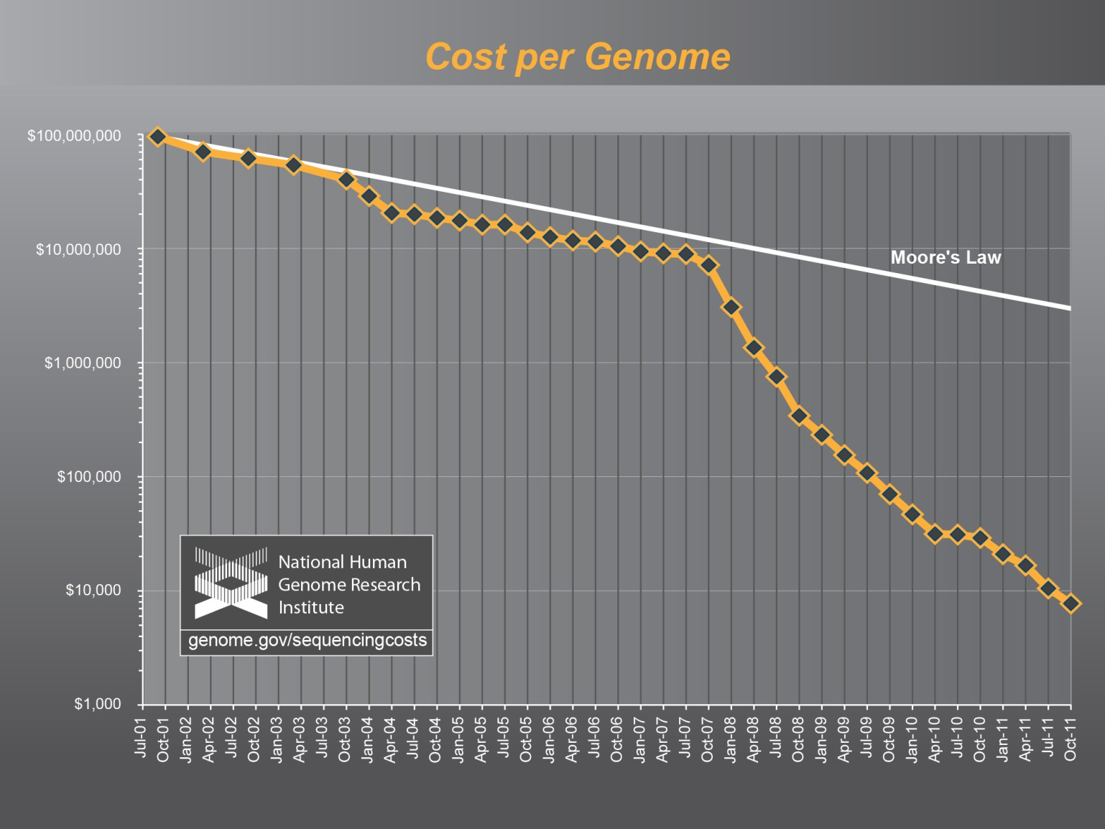
A Decade’s Progress in DNA Sequencing
2003: ABI 3730 Sequencer
2012: Oxford Nanopore MiniION
Human Genome: $2.7 Billion, 13 Years
Human Genome: $900, 6 Hours

Slide 6

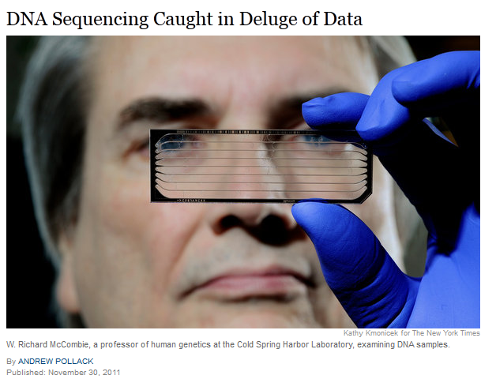
The Problem of Big Data in Biology
“BGI, based in China, is the world’s largest genomics research institute, with 167 DNA sequencers producing the equivalent of 2,000 human genomes a day.
BGI churns out so much data that it often cannot transmit its results to clients or collaborators over the Internet or other communications lines because that would take weeks. Instead, it sends computer disks containing the data, via FedEx.”

Slide 7
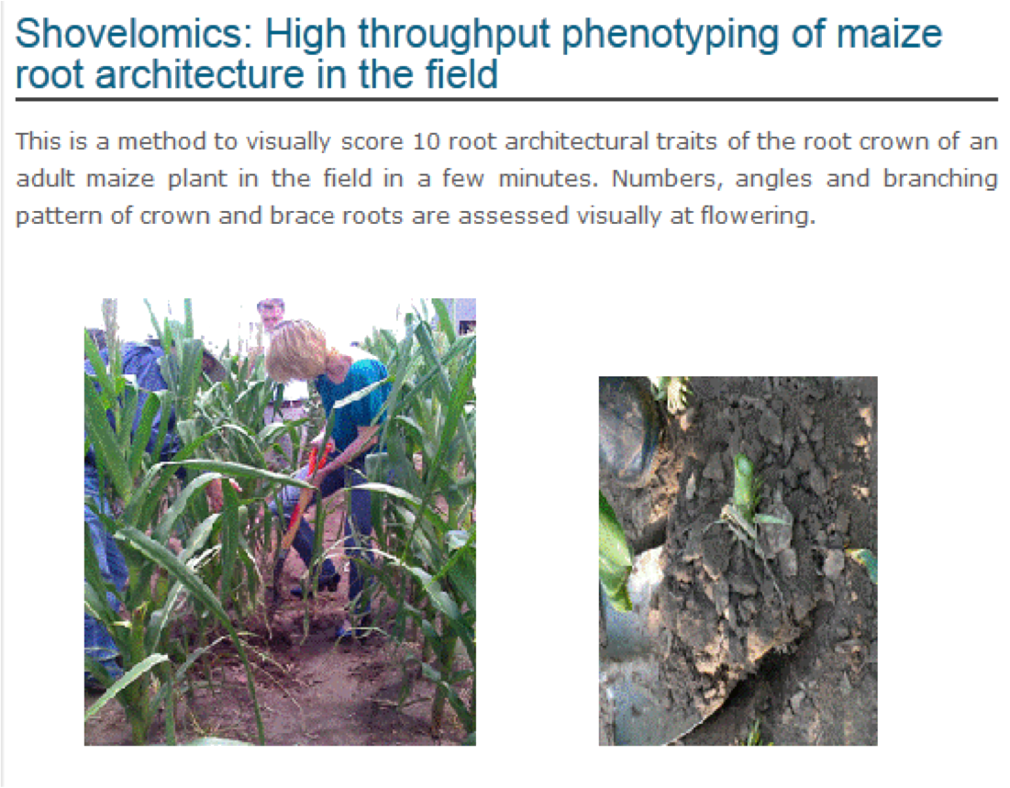
High-Throughput Phenotyping
http://roots.psu.edu/en/rootlab

Slide 8
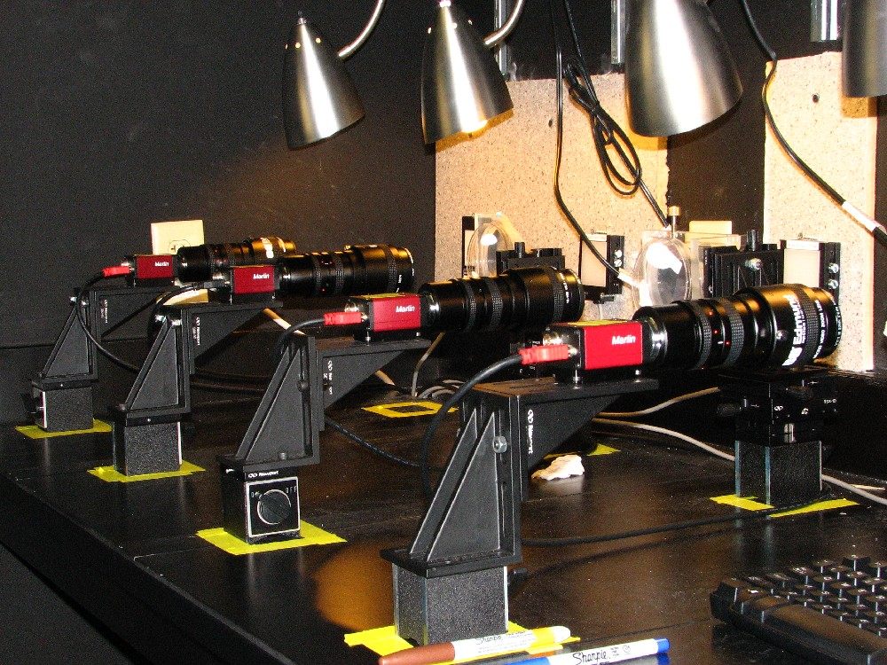
High-Throughput Phenotyping
High Throughput Phenotyping
powerful acquisition of phenotypic
data.
Phytomorph Project (Univ. Wisconsin)
$70K for 30 cameras
200 movies of root growth
4GB/day of images for processing
Notes:
Work from Nate Miller (Edgar Spalding’s Group), Univ. Wisconsin
They use iPlant’s Atmosphere is scale their data processing solution so that
Several groups can now analyze and collaborate these data-intensive projects.
“Shovelomics (Lynch lab – Penn State University)

Slide 9
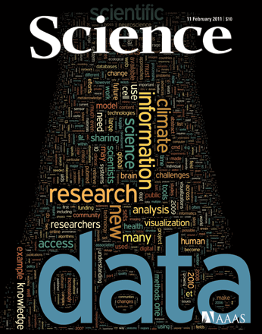
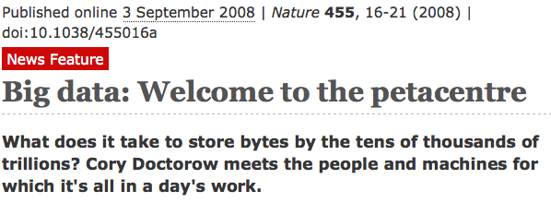
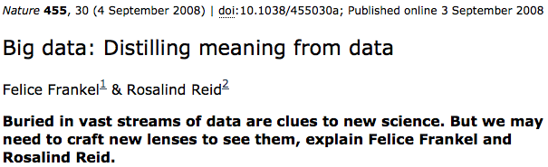
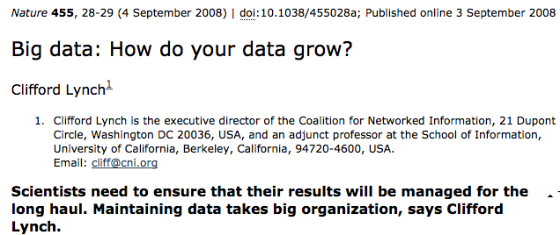
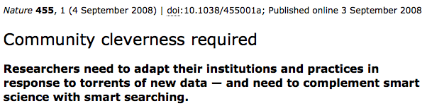
Big Data!

Slide 10
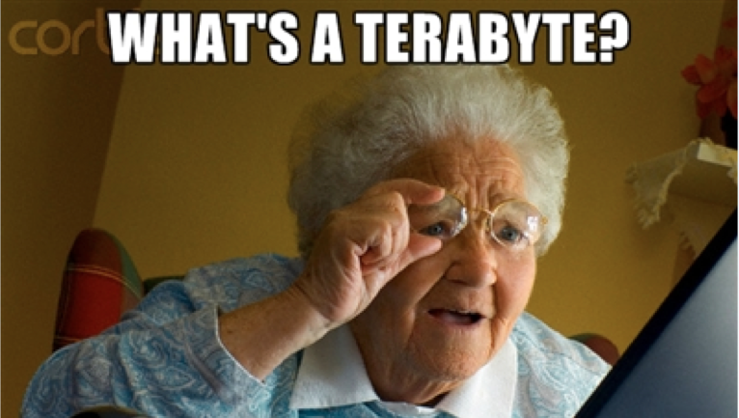
Data-intensive biology will mean getting biologists comfortable with new technology…

Slide 11
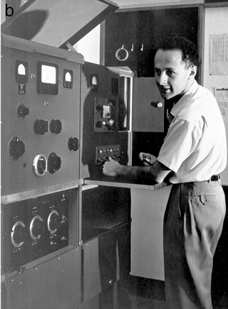
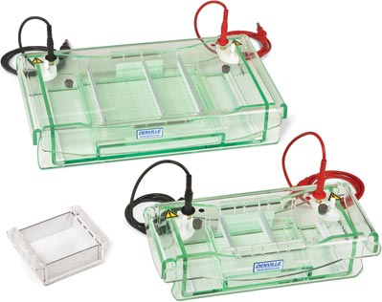
One key goal in our infrastructure, training and outreach is to minimize the emphasis on technology and return the focus to the biology.
1973
Sharp, Sambrook, Sugden
Gel Electrophoresis Chamber, $250
1958
Matt Meselson &
Ultracentrifuge, $500,000
Notes:
There was a time where a great deal of molecular biology was dependent on ultracentrifugation.
Much of the protocol was made obsolete by gel electrophoresis.
Democratizing access to and creation of knowledge accelerates progress.

Slide 12
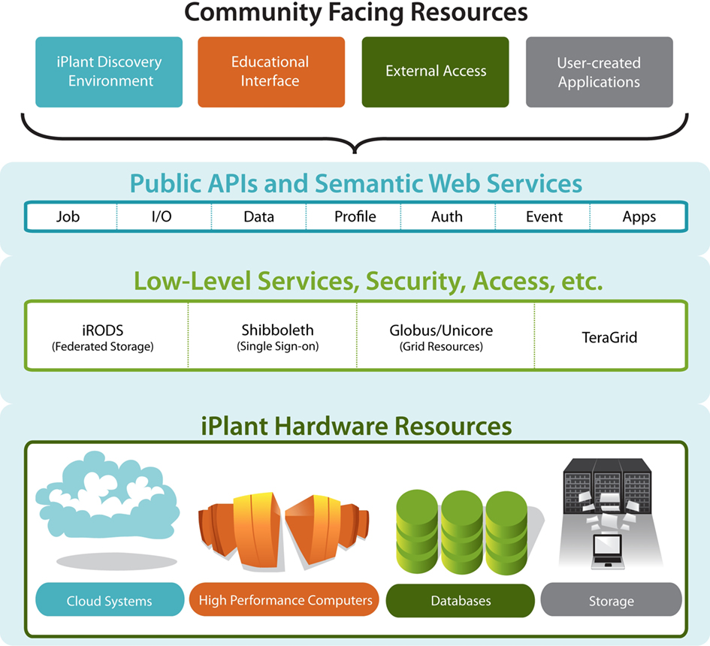

The iPlant Cyberinfrastructure
End Users
Teragrid
XSEDE
Computational
Users
Notes:
iPlant layer cake of resources and services.
Bottom->Up: Hardware->low-services/middleware->APIs

Slide 13
Ways to Access iPlant
Atmosphere: a free cloud computing platform
Data Store: secure, cloud-based data storage
Discovery Environment: a web portal to many integrated applications
DNA Subway: genome annotation, DNA bar-coding (and more) for science educators
The API: For programmers embedding iPlant infrastructure capabilities
Command line: for expert access (thru TeraGrid/XSEDE)

Slide 14
The iPlant Discovery Environment
A rich web client
  Consistent interface to bioinformatics tools
  Portal for users who won’t want to interact with lower level infrastructure
An integrated, extensible system of applications and services
  Additional intelligence above low level APIs – Provenance, Collaboration, etc.

Slide 15
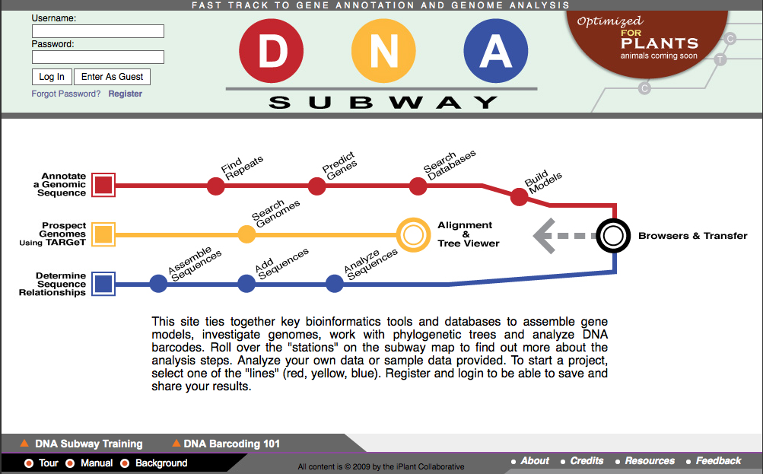
The DNA Subway

Slide 16
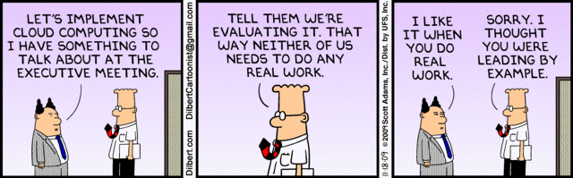
Cloud Computing
Cloud computing refers to the delivery of computing and
storage capacity as a service to a heterogeneous community
of end-recipients. – Wikipedia
http://en.wikipedia.org/wiki/Cloud_computing
Image source: http://dilbert.com/strips/comic/2009-11-18/
Notes:
There is a difference between cloud computing and cloud computing that works.

Slide 17


Project Atmosphere
Custom Cloud Computing
API-compatible implementation of Amazon EC2/S3 interfaces
Virtualize the execution environment for applications and services
Up to 12 core / 48 GB instances
Access to Cloud Storage + EBS
Run servers, CloudBurst desktop use cases. Big data and the desktop are co-local again!
>60 hosted applications in Atmosphere today, including users from USDA, Forest Service, database providers, etc.
(30 more for postdocs and grad students for training classes)

Slide 18
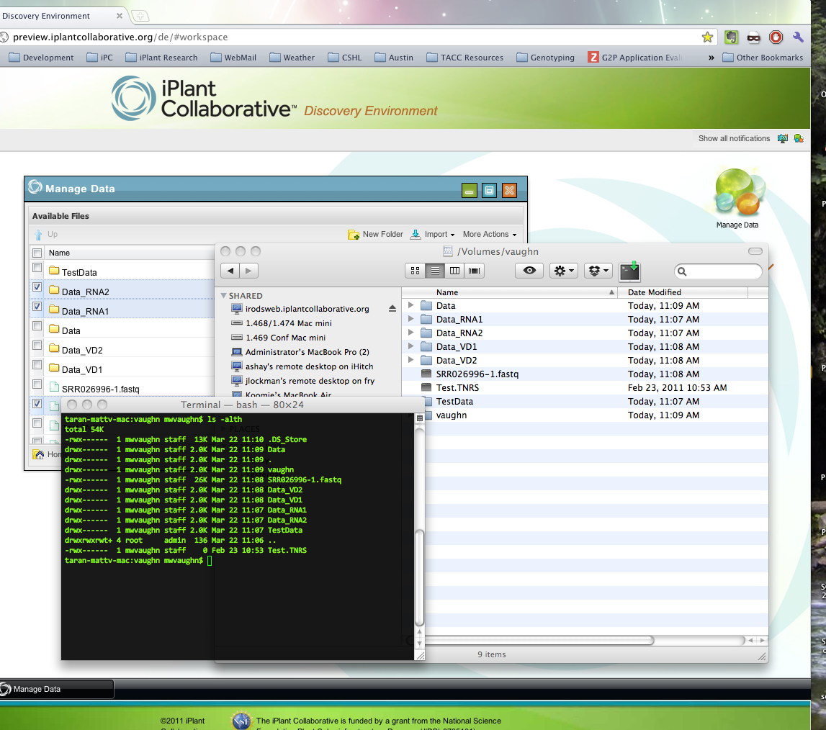
The iPlant Data Store
Fast data transfers via parallel, non-TCP file transfer
  Move large (>2 GB) files with ease
Multiple, consistent access modes
  iPlant API
  iPlant web apps
  Desktop mount (FUSE/DAV)
  Java applet (iDrop)
  Command line
Fine-grained ACL permissions
  Sharing made simple
Access and a storage allocation is automatic with your iPlant account
Notes:
~300 TB disk for now. Expanding to petascale storage ~ year’s end
Georeplicated. This is half your NSF data management plan!

Slide 19
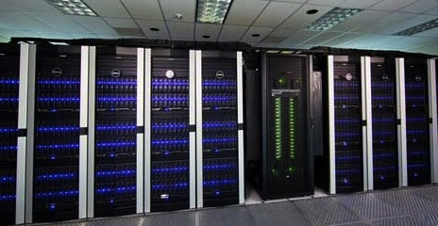
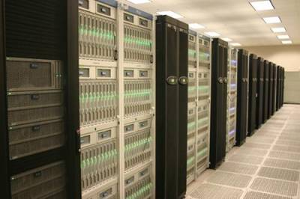
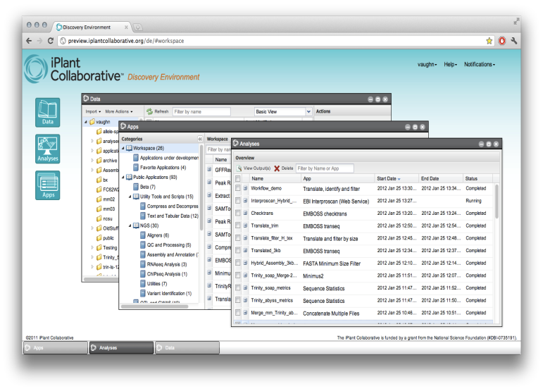
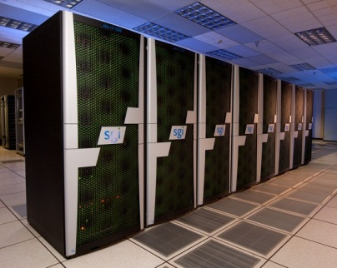
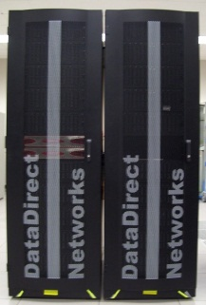
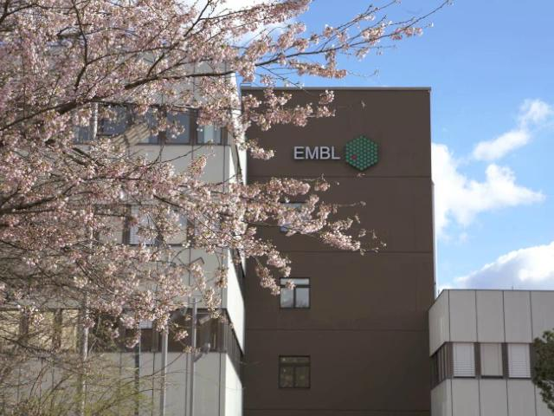
Scalable Computation for High-Throughput Inquiry
90,000 Compute Cores
Up to 1TB shared memory
Growing to ~500,000 cores by end of 2012
TACC Lonestar
TACC Ranger
PSC Blacklight
TACC Corral
EBI Web Services

Slide 20
iPlant Collaborations…
Other major projects are beginning to adopt the iPlant CI as their underlying infrastructure (some completely, some in limited ways):
  CoGe (auth service, hosting)
  BioExtract (web service platform)
  CiPRES (computation)
  Gates Integrated Breeding Platform (hosting, development)
  Galaxy (storage, for now)

Slide 21


The iPlant Collaborative
Postdocs:
Barbara Banbury
Jamie Estill
Bindu Joseph
Christos Noutsos
Brad Ruhfel
Stephen A. Smith
Chunlao Tang
Lin Wang
Liya Wang
Norman Wickett
Students:
Peter Bailey
Jeremy Beaulieu
Devi Bhattacharya
Storme Briscoe
Ya-Di Chen
John Donoghue
Steven Gregory
Yekatarina Khartianova
Monica Lent
Amgad Madkour
Aniruddha Marathe
Kurt Michaels
Dhanesh Prasad
Andrew Predoehl
Jose Salcedo
Shalini Sasidharan
Gregory Striemer
Jason Vandeventer
Kuan Yang
Executive Team:
Steve Goff
Dan Stanzione
Metadata
Data
Tools
Workflows
Viz
Faculty Advisors & Collaborators:
Ali Akoglu
Greg Andrews
Kobus Barnard
Sue Brown
Thomas Brutnell
Michael Donoghue
Casey Dunn
Brian Enquist
Damian Gessler
Ruth Grene
John Hartman
Matthew Hudson
Dan Kliebenstein
Jim Leebens-Mack
David Lowenthal
Robert Martienssen
Staff:
Greg Abram
Sonali Aditya
Roger Barthelson
Brad Boyle
Todd Bryan
Gordon Burleigh
John Cazes
Mike Conway
Karen Cranston
Rion Doodey
Andy Edmonds
Dmitry Fedorov
Michael Gatto
Utkarsh Gaur
Cornel Ghiban
Michael Gonzales
Hariolf Häfele
Matthew Hanlon
Anthony Heath
Barbara Heath
Matthew Helmke
Natalie Henriques
Uwe Hilgert
Nicole Hopkins
Eun-Sook Jeong
Logan Johnson
Chris Jordan
B.D. Kim
Kathleen Kennedy
Mohammed Khalfan
Seung-jin Kim
Lars Koersterk
Sangeeta Kuchimanchi
Kristian Kvilekval
Aruna Lakshmanan
Sue Lauter
Tina Lee
Andrew Lenards
Zhenyuan Lu
Eric Lyons
Naim Matasci
Sheldon McKay
Robert McLay
Angel Mercer
Dave Micklos
Nathan Miller
Steve Mock
Martha Narro
Praveen Nuthulapati
Shannon Oliver
Shiran Pasternak
William Peil
Titus Purdin
J.A. Raygoza Garay
Dennis Roberts
Jerry Schneider
Bruce Schumaker
Sriramu Singaram
Edwin Skidmore
Brandon Smith
Mary Margaret Sprinkle
Sriram Srinivasan
Josh Stein
Lisa Stillwell
Kris Urie
Peter Van Buren
Hans Vasquez-Gross
Matthew Vaughn
Fusheng Wei
Jason Williams
John Wregglesworth
Weijia Xu
Jill Yarmchuk
B.S. Manjunath
Nirav Merchant
David Neale
Brian O’Meara
Sudha Ram
David Salt
Mark Schildhauer
Doug Soltis
Pam Soltis
Edgar Spalding
Alexis Stamatakis
Ann Stapleton
Lincoln Stein
Val Tannen
Todd Vision
Doreen Ware
Steve Welch
Mark Westneat

