Slide 1
iPlant Collaborative
Tools and Services Workshop
Collaborating with iPlant

Slide 2
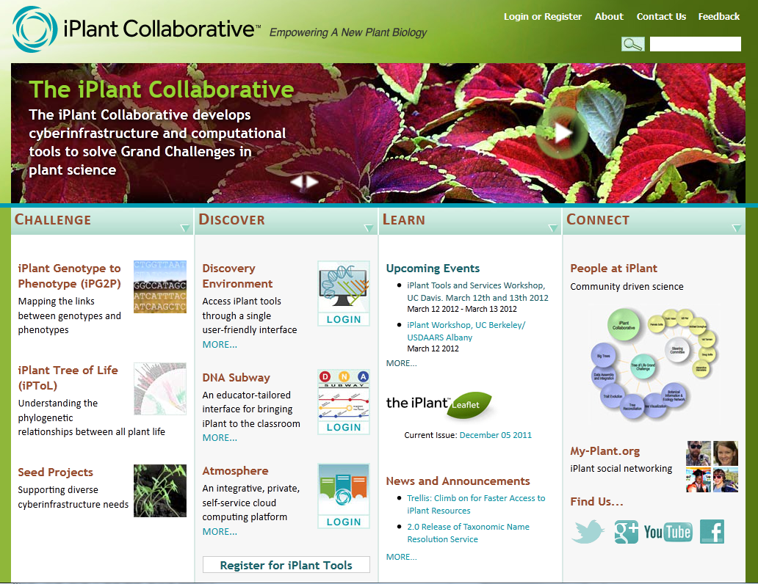
Collaborating with iPlant
iPlant is not a company!
We’re colleagues
We’re potential collaborators
Notes:
We want to emphasize that iPlant is not “selling” anything, but we are offering
Unique services and opportunities to the life-sciences that fall under the commission of the NSF cyberinfrastructure
Vision. Just like you we are interested not in CI questions in and of themselves, but with biological discovery.

Slide 3
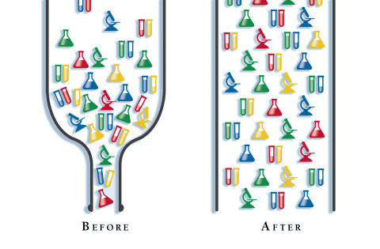
Collaborating with iPlant
Our goal is solve computational
bottlenecks that impede research.
Bottlenecks might be storage space,
but it also might be finding a way
to make tools easier to use.
Doing this properly requires
community input!
Image from: http://adammclane.com/2011/12/06/bottlenecks/

Slide 4
Collaborating with iPlant
Extensible Discovery Environment
250+ Tools in the DE
Science “App Store” now a reality
Creation of the Data Store
Creation of the Atmosphere Cloud Platform
A number of new standalone Apps (e.g. TNRS, Integrated Breeding Platform Portal)
Release of API (more than 4,000 jobs run through supercomputing API)
Launch of “Powered by iPlant” for bioinformatics portals.
Hundreds of large scale assembly jobs run for users on Lonestar, Blacklight (Actually >2M hours, 10,000 jobs for 40 labs)
75 new bio apps now supported on XSEDE supercomputers due to iPlant
Several success stories in code parallelization

Slide 5
Evolving the Discovery Environment
Summer:
More control over permissions and sharing
Better workflow support
More collaboration support
Provenance/Metadata interface exposed.
Fall:
Enhanced performance
More complex workflows
New “Data Collection” features

Slide 6
Evolving the Discovery Environment
New tools and workflows
Targeting more than 400 public tools/workflows by end of 2012
Coverage of new areas in biology
MetaGenomics, Population biology, and more…
New genomes and other datasets in public data spaces
Tighter integration with Ensembl and Genbank
Many more tools available in “scaled up” versions on supercomputing systems.

Slide 7
Coming Trends
Available biological data will continue to skyrocket.
The rise of predictive models (probably statistical models, based on massive data), perhaps synthetic models, will drive computing needs higher.
Computing is becoming much more complex: Adapt to disruptive change in software models
Late 2012 NSF systems will require *millions* of parallel, distributed memory threads to program effectively (GPUs, Intel MIC). Desktop-scale systems in 2013 will have dozens to hundreds of threads.
Scripting languages will not yield even 0.01% of available performance.
As clients get thinner, computational biology challenges will rise.
Personal computing systems focus on power and portability, meaning less compute capability (tablet, netbook, macbook air)…
Bioinformatics will need massive computation and data

Slide 8
Many Exciting Things Left to Do
More diverse interfaces
Social networks, mobile devices, push notification
Expect DE 2.0 and DE Mobile
More intelligent interfaces; more semantics, more suggestions (e.g. Watson)
Our tools will suggest to you what analysis to do, and which data to look at.
Data mining will increase in importance
More visualization
See D3.js for the future of viz at iPlant

Slide 9
iPlant Advanced Collaborative Support
Provide a computing expert for an extended period of time to rebuild a popular tool for scalability, or other key functionality
Could be scaling, infovis, or just information architecture help.
A typical engagement may run a month to 6 months.
An expert focused on making *your* particular tool or workflow run well on our systems.
Deal with the complexity of coming large scale systems (millions of threads).

Slide 10
Expansion of Powered by iPlant
Many more sites will use some aspect of iPlant resources:
Scalable storage
Scalable computing
Hosting services
Either directly or through the APIs.
Custom Discovery Environments for individual communities.
Particular species, topic or dataset.
Expand to animals

Slide 11
The iPlant Federation
Science is increasingly an international endeavor
Sharing the funding across international boundaries means sharing data, infrastructure ownership.
The CI will federate; build networks of collaborative nodes with replicated databases, unique tools and portals, independent compute resources.
One iPlant instance will talk to another one to federate queries, etc.

Slide 12
Where to go when you need help:
Wiki documentation
Support
iPlant user forums
Your Instructors
Online learning (more materials coming soon)

