Slide 1
Arun Madhavan Graduate Assistant, iPlant Collaborative
Experiences with Eucalyptus

Slide 2
What?
Elastic Utility Computing Architecture Linking
Your Programs To Useful Systems
Open source private cloud management tool
Turn your clusters/workstation farms into a cloud!
Interface-compatible with Amazon EC2 and S3

Slide 3
Players in the Cloud World
Eucalyptus community cloud
Private cloud
Open source
Eucalyptus enterprise cloud
Hybrid cloud
Ubuntu enterprise cloud
Ubuntu community cloud + paid hybrid

Slide 4
Eucalyptus: Enterprise Vs Community

Slide 5
Ubuntu Enterprise Cloud
Private cloud
Ubuntu pre-installed with Eucalyptus
Open source cloud management tools
Cloud bursting needs Landscape/similar tool
Ubuntu Public cloud (Amazon EC2)
Tools to make interaction with EC2 easier

Slide 6
Eucalyptus Architecture
Amazon EC2 Interface
Client-side API
Translator
Walrus (Storage)
Cloud Controller
Cluster Controller
Node Controller
Notes:
Challenge 1: extensibility
-- solved by using a simple, straight forward architecture and open APIs that use web services

Slide 7
Eucalyptus Components
Cloud controller
“Front-end”
Manage several clusters
Cluster controller
Manage a set of node controllers
Node controller
Single physical machine
Several virtual instances per machine

Slide 8
Accessing Eucalyptus
Basic web interface
Euca2ools, similar to EC2 tools – RESTful
Image management
VM Control
Networking and security
Block storage

Slide 9
WEB INTERFACE

Slide 10
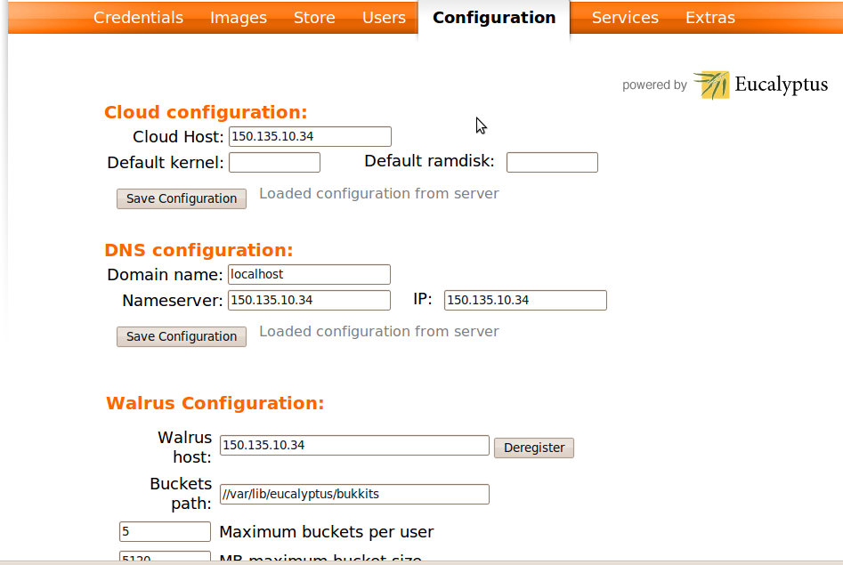
Configuration

Slide 11
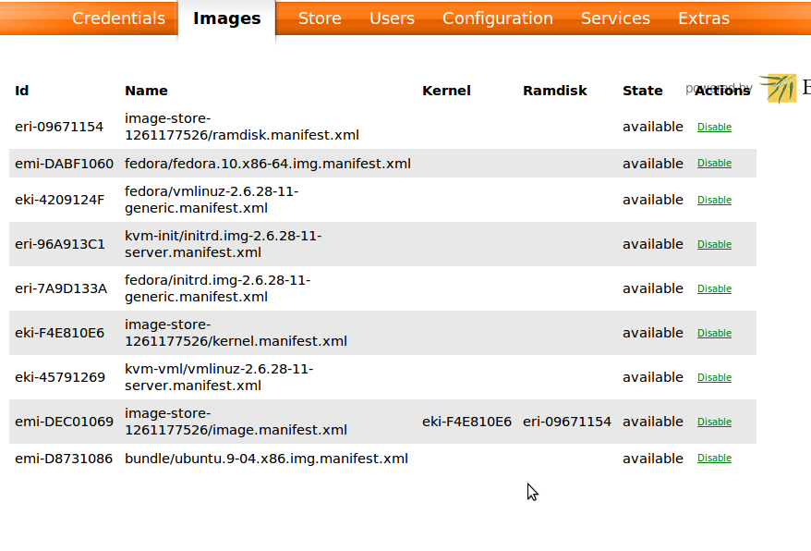
Images

Slide 12
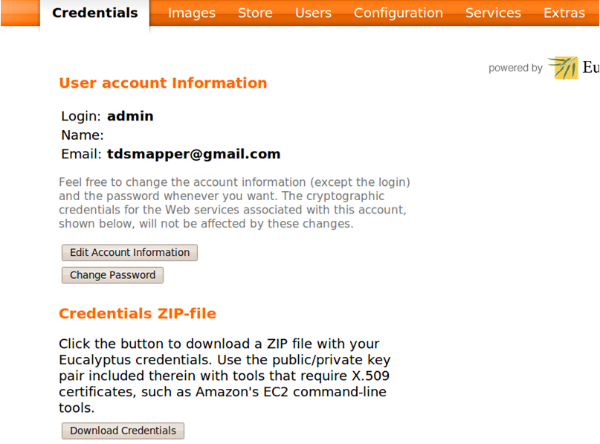
Credentials

Slide 13
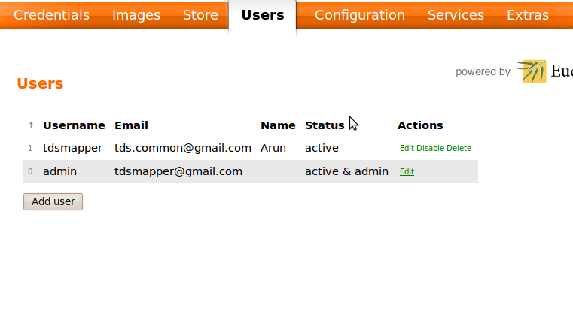
User management

Slide 14
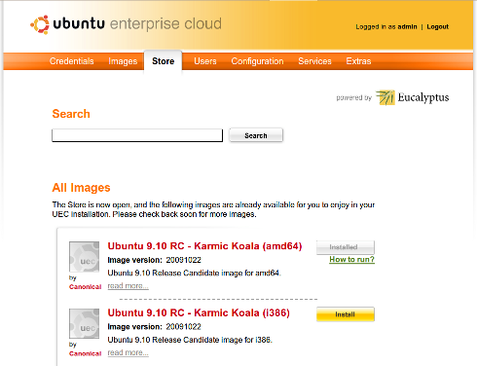
Ready Made Images

Slide 15
Euca2ools: Image Management
euca-bundle-image
euca-upload-bundle
euca-register
euca-unbundle-image
euca-delete-bundle

Slide 16
Euca2ools: VM Control
euca-describe-instances
euca-run-instances
euca-terminate instances
euca-reboot-instances

Slide 17
Euca2ools: Networking/Security
euca-allocate-address
euca-release address
euca-add-group
euca-authorize
euca-revoke

Slide 18
Euca2ools: Block storage
euca-create-volume
euca-attach-volume
euca-detach-volume
euca-create-snapshot
euca-delete-snapshot

Slide 19
DEMO

Slide 20
SETUP

Slide 21
Setting up Eucalyptus
Web interface set up
Download user credentials
Register cluster and nodes
Networking modes
Bridging
Image bundling/uploading/registration

Slide 22
Setup: Web Interface
Create user accounts
Define instance types
Make sure clusters are detected
Make sure walrus is detected
Download user credentials

Slide 23
Setup: Networking
Static
Predefined IP/MAC handed out to instances
Managed
NAT based address assignment
System
DHCP assigned addresses

Slide 24
Setup: Bridging
Node
VM 0
VNET 0
BR0
Eth0
VM 1
VNET 1
INTERNET
VM 2
VNET 2

Slide 25
Setup: Image Bundling/Uploading
Bundle – break it up into parts
Upload – Upload to Walrus in a bucket
Register – Register with Eucalyptus

Slide 26
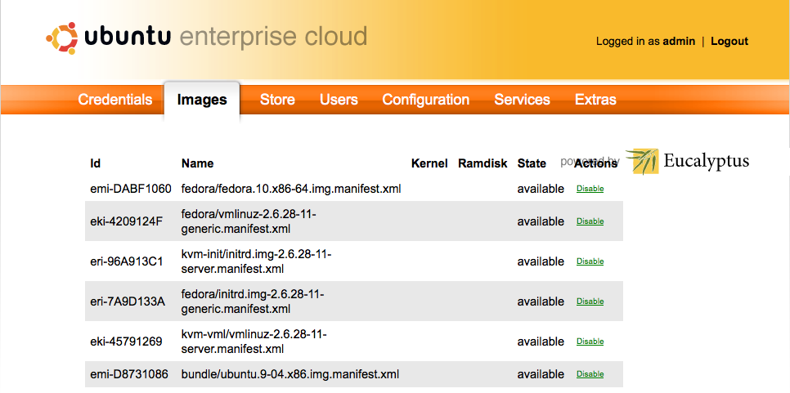
Setup: Image bundling/uploading

Slide 27
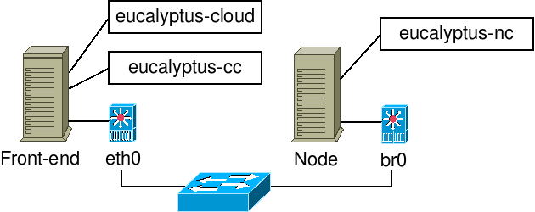
Final Setup Diagram

Slide 28
Further Topics
Creating custom images
A brief roadmap
Issues faced with Eucalyptus

Slide 29
Creating Eucalyptus Machine Images
Similar to creating Amazon Machine Images.
Create AMI Image
Download AMI bundle to local machine
Upload to Walrus
Kernel image – Hypervisor + Eucalyptus dependent
Register and instantiate

Slide 30
Brief Roadmap
Complete implementation of AWS interface (EC2/S3/EBS)
Eucalyptus core to open for community contributions
Support more hypervisors

Slide 31
Issues faced with Eucalyptus
Virtual instance connectivity
Known issue
Several workarounds on forum

Slide 32
Further work
Multiple cluster cloud
Balancing etc.
Virtual instance connectivity
Understanding storage
Images are not persistent
Attach block device to /dev/sdb

Slide 33
THANK YOU

