Slide 1
iPlant: Semantics and DataViz
DataViz working group
September 2010
Damian Gessler, Ph.D.
Semantic Web Architect
University of Arizona
dgessler (at) iplantcollaborative (dot) org

Slide 2
Data is Worthless Without Context
>$3 billion human genome at NCBI
http://www.ncbi.nlm.nih.gov/projects/genome/guide/human

Slide 3
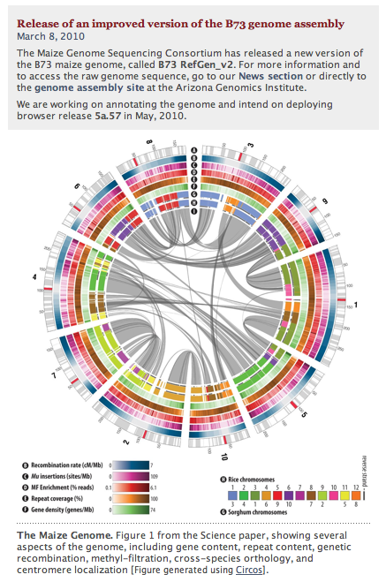
A Picture is Worth a Billion Bases
Closer to home, the maize genome was recently sequenced.
You can have it here:
www.maizesequence.org

Slide 4
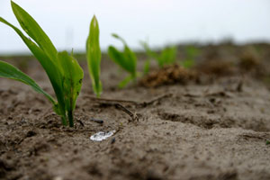
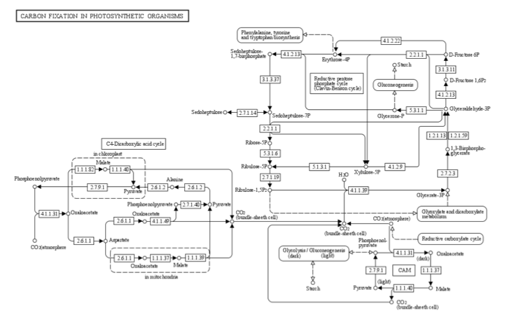
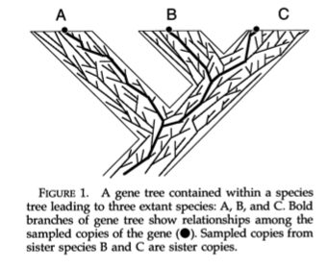
A Ubiquitous Role for Data Visualization in Discovery
http://www.kegg.jp/kegg/atlas
Maddison WP 1997 Syst. Biol. 46(3): 523-536

Slide 5
Commonalities in Data Visualization
Basic visual motifs go a long way to providing generic, powerful conceptual frameworks:
Motifs:
A line (relative order and quantitative differences)
A table (matrix; tensor)
A plot (n-dimensional functional)
A tree (hierarchical)
A network (arc-node relationships)
Geographic
Annotated images, etc.
Attributes:
Color
Size
Position
Resolution at scale
Point of view (3-dimensional rotation)
See http://flare.prefuse.org/demo
Disclaimer: Flare is ActionScript; to date, iPlant is concentrating on other technologies

Slide 6
This Should Be Easy...
... but it is not.
The promise of data visualization is exceeded perhaps only by its challenges.
There are many examples of one-off successes, but general solutions, especially in a web environment, are noticeably lacking.

Slide 7
Here’s the Rub
We have something important (data visualization),
we have a broad swath of successful examples,
we have toolboxes of technologies,
but we cannot seem to bring them all to bear to meet even some of our lowest expectations, except in special cases.
The more we delve into addressing data visualization as it pertains to a scientific cyberinfrastructure, the more difficult we realize is the problem.

Slide 8
Why is This?
It is because when we approach this from a perspective of a cyberinfrastructure we see that successful data visualization is broad-scale data integration incarnate.
And data integration is hard.

Slide 9
Data Integration is Hard
Three reasons:
Scientific: The meaning, refinement, context, and value of scientific ideas and concepts changes with discovery; it changes at a rate faster than the life cycle of many informatic infrastructures.
Technical: Much meaning and semantics is implicit, not explicit. Thus it is labor intensive to extract context and merge data and services; scaling is linear, not exponential.
Social: Value and discoveries are generated across disciplines, under different funding models, in different institutions, in different cultures, with different reward structures.

Slide 10
Inadequate Integration Thwarts Knowledge Generation
Three reasons:
Scientific: The meaning, refinement, context, and value of scientific ideas and concepts changes with discovery; it changes at a rate faster than the life cycle of many informatic infrastructures
Technical: Much meaning and semantics is implicit, not explicit. Thus it is labor intensive to extract context and merge data and services; scaling is linear, not exponential.
Social: Value and discoveries are generated across disciplines, under different funding models, in different institutions, in different cultures, with different reward structures
http://www.kegg.jp/kegg/atlas
Maddison WP 1997 Syst. Biol. 46(3): 523-536

Slide 11
A Faint Light in a Dark Fog
Basically:
data visualization = data integration + presentation
So now we understand why Flare—and so many other presentation technologies—are (generically) necessary but not sufficient:
we are missing the other harder part of the equation.
So if we solve the data integration part, we advance a solution to the entire problem.

Slide 12
So How Do We Solve the Data Integration Problem?
From the get-go, we don’t fully understand the problem.
So let’s address this.

Slide 13
RuBisCo
A “softball” problem
World’s most abundant protein
Critical for photosynthesis via its central role in carbon fixation; i.e., carbon sequestration: the light energy -> chemical energy transformation that makes virtually all life on earth possible
Relevant to everything from C3/C4 adaptation, to plant, algal, and cyanobacterial interactions with global warming; to biofuels; to feeding the planet

Slide 14
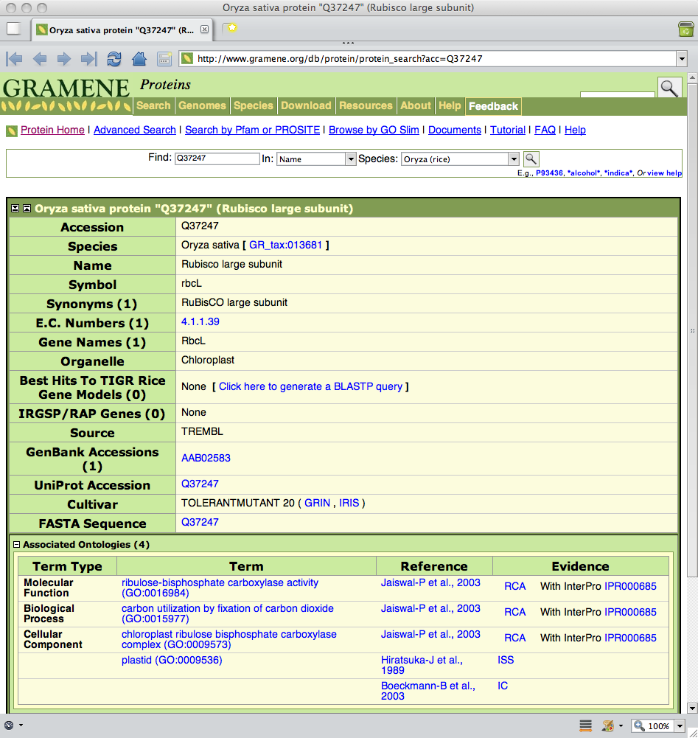
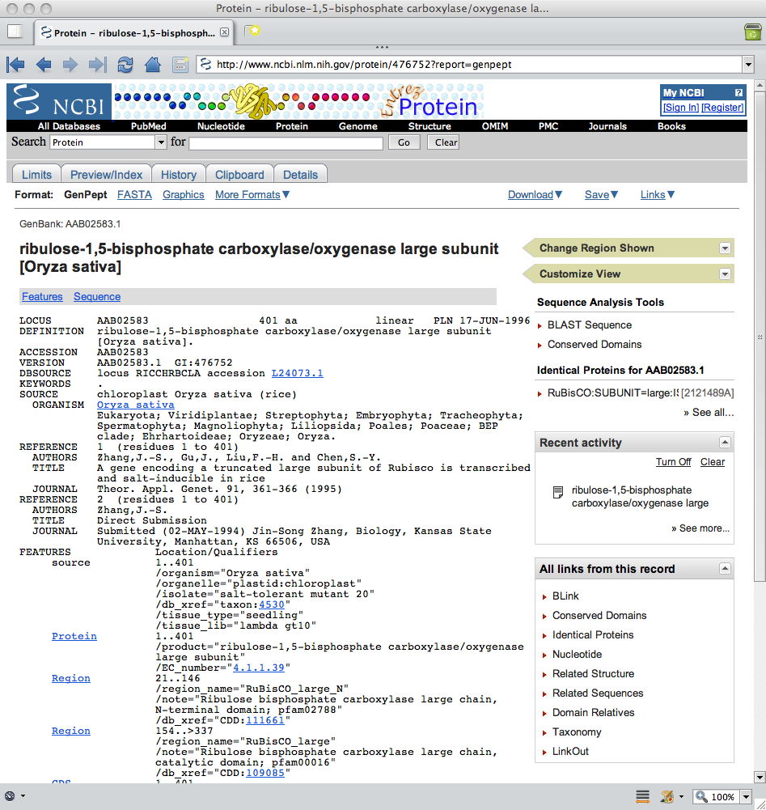
Page-Scraping RuBisCo on the Web
Page and URL scraping is:
Low-throughput
Error-prone
Does not scale
http://www.gramene.org/db/protein/protein_search?acc=Q37247
http://www.ncbi.nlm.nih.gov/protein/476752?report=genpept

Slide 15
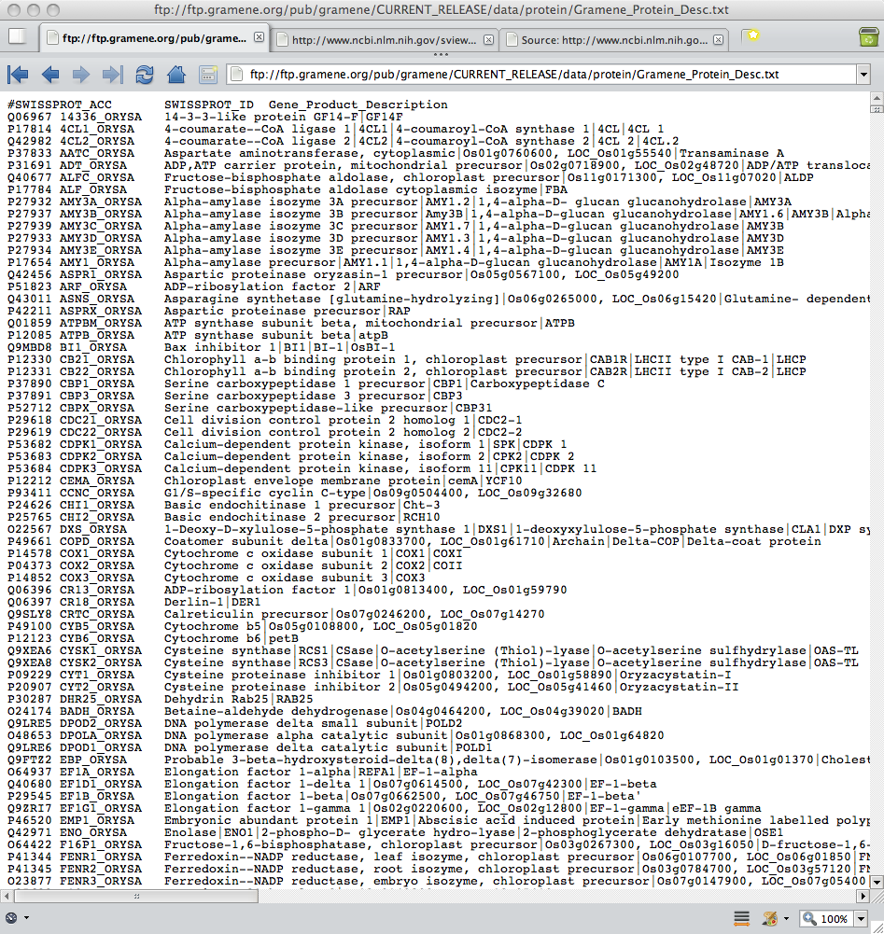
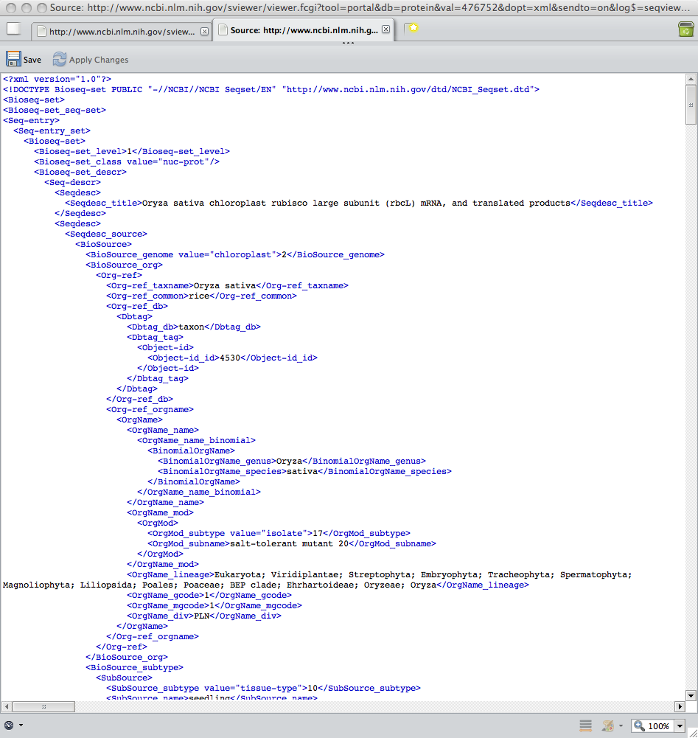
FTP Bit-Buckets are No Better
Do what?
ftp://ftp.gramene.org/pub/gramene/CURRENT_RELEASE/data/protein/Gramene_Protein_Desc.txt
http://www.ncbi.nlm.nih.gov/sviewer/viewer.fcgi?tool=
portal&db=protein&val=476752&dopt=xml&sendto=on&log$=seqview&extrafeat=984&maxplex=0

Slide 16
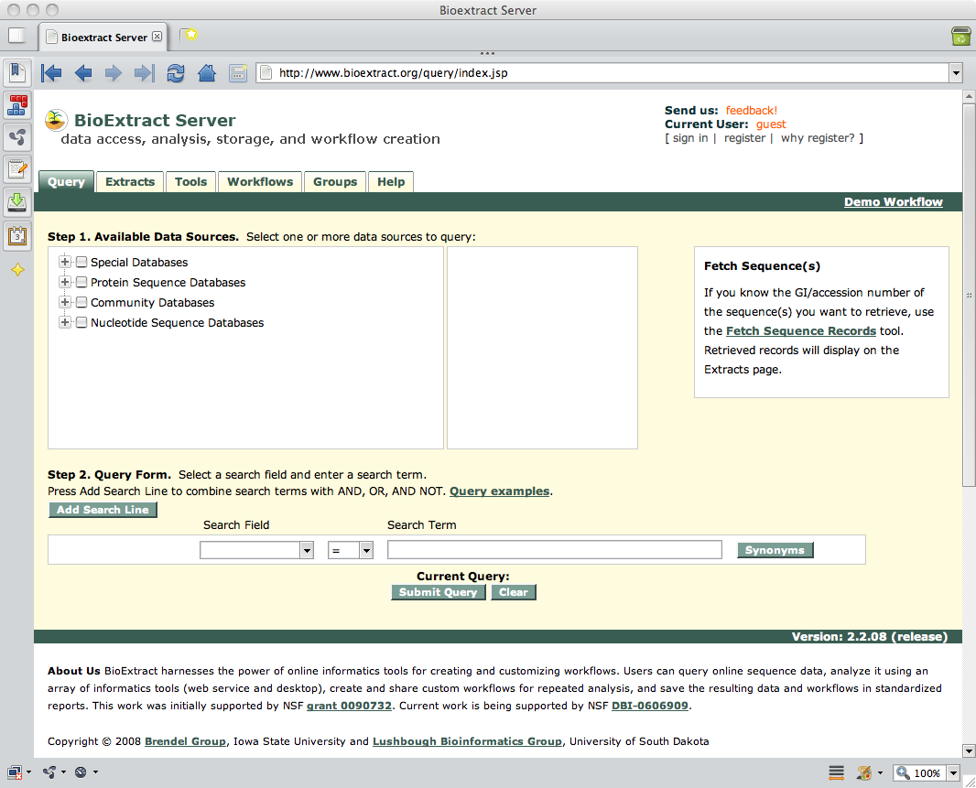
Front-Ending for the Scientist
ASP (Application Service Provider): e.g., BioExtract
http://www.bioextract.org

Slide 17
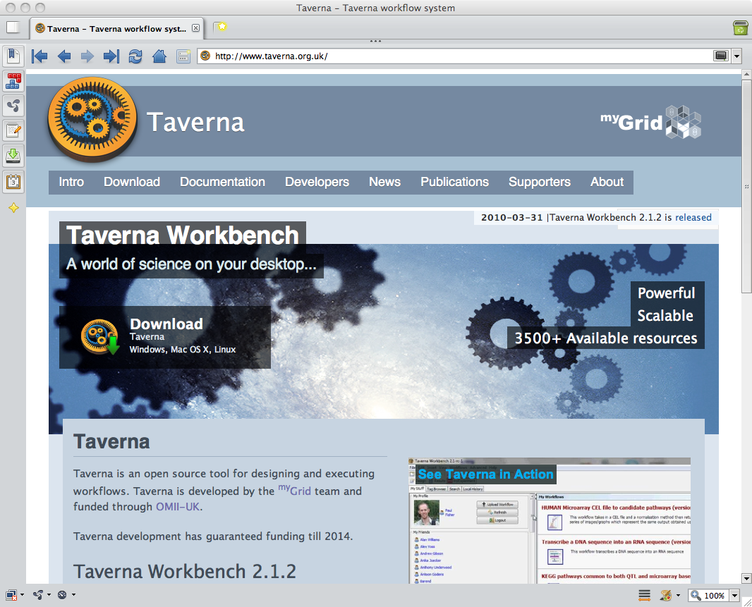
Front-Ending for the Scientist
ASP (Application Service Provider): e.g., BioExtract
Customizable workflow management: e.g., Taverna
http://www.bioextract.org
http://www.taverna.org.uk

Slide 18
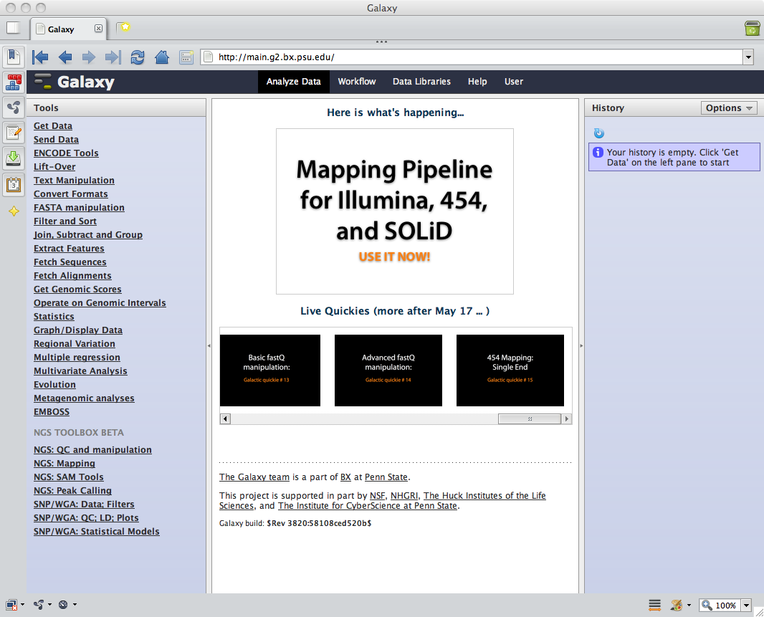
Front-Ending for the Scientist
ASP (Application Service Provider): e.g., BioExtract
Customizable workflow management: e.g., Taverna
On-site bioinformatic platforms: e.g., Galaxy
http://www.bioextract.org
http://www.taverna.org.uk
http://main.g2.bx.psu.edu

Slide 19
The Bottleneck
World Wide Web
Client
Apps
Programmatic
Access
1980's technology low-throughput, implied-semantic middle layer
Data and Services

Slide 20
RuBisCo’s Bottom Line
Bottom line: For the world’s most abundant protein—and one of the most important—there is no ready way to even aggregate (let alone integrate) known data and applicable services.
The problem for RuBisCo is indicative, not extraordinary, for data and service integration in general.
All our current solutions are low-throughput, labor-intensive, and subject to unknown false negatives.
This hindrance at the data integration level percolates up and poisons generic data visualization approaches.

Slide 21
The Semantic Web
An attempt to deal with these and other problems.
We recognize that at the core of data integration is semantics—a computable semantics—and no shenanigans with syntax and formats will ever solve the problem.
Semantics: from the Greek σημαντικός – semantikos;
the study of "meaning"

Slide 22
What Do We Mean by “Meaning?”
How could it ever be possible for computers to understand “meaning?”
Is this Artificial Intelligence (AI)?
Science Fiction?
Is it possible today?

Slide 23
How it is Done
It is possible.
It is not classical AI, nor is it science fiction.
It is based on an long-term analysis of what is and can be done with data on the web.

Slide 24
OWA: Open World Assumption
“An open world in this sense is one in which we must assume at any time that new information could come to light, and we may draw no conclusions that rely on assuming that the information available at any one point is all the information available.”
The semantic web accepts the Open World Assumption.
Allemang D, Hendler J. Semantic Web for the Working Ontologist. Elsvevier, Morgan Kaufman Burlington, MA 2008; p. 11

Slide 25
OWA: Open World Assumption
Example:
Fact: Sue’s phone number is 555-1212.
Question: Is Sue’s phone number 555-1234?
Closed world answer: No. The response you will get from a typical “closed world” database-centric approach, such as an airline reservation system.
Open world answer: I don’t know. Perhaps Sue has a home phone and a cell phone and one number is 555-1234. All I know is that Sue’s phone number is 555-1212. You have not told me what her number isn’t.
This has profound implications for logics, the web, science, and their nexus.

Slide 26
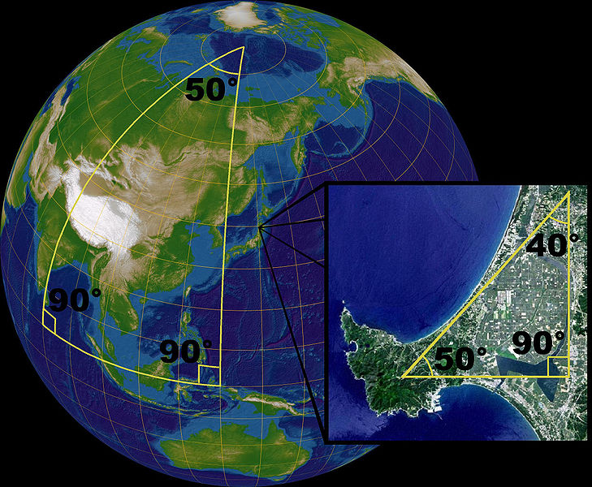
Monotonicity
Mathematics has a property called monotonicity.
Within the construct of formal mathematics, there is no statement that can ever be made (even in the future) that can “unprove” something proven today.
So if we prove that 1 + 1 = 2 (based on accepting the five Peano axioms grounding arithmetic), nothing can ever prove that wrong.
If something would “prove it wrong”, it would—it’s been proven—collapse all of arithmetic based on those axioms (i.e., anything could be “proven”; e.g., 0 > 1).
But things do change. For example Riemannian geometry (270° triangles) vs. Euclidean geometry. The way this is resolved is by changing the axiomatic grounding of the system, thus creating two systems, each internally consistent.
OWL DL (the Description Logic version of the Semantic Web’s de facto language) has this property of monotonicity.
Picture source: http://en.wikipedia.org/wiki/File:Triangles_(spherical_geometry).jpg

Slide 27
W3C OWL (Web Ontology Language)
http://www.w3.org/TR/owl2-overview

Slide 28
OWL is a Formal Logic for the Web
There are many logic systems. We concentrate on one called
First-order, description logic
First-order — We make statements and inferences about things, their relations to other things, and sets of things. We do not talk about properties of properties, or classes of classes.
Description logic — We describe things:
Individuals: “things”
Properties: relations between things
Classes: sets of things—all things that share common properties

Slide 29
Implications of OWL
Conceptually we are aligned for a paradigm shift in thinking about the data.
Cognizant of the OWA, we think in terms of reasoning over vast, semi-structured, decentralized resources (data and services).
We use a logical language such as OWL to reason over the data and draw inferences: OWL is particularly strong in classifying data based on observed properties.
OWL: Web Ontology Language

Slide 30
A Faint Light in a Dark Fog
Computers and logic make a good fit; this is promising.
So if we ground ourselves abstractly (oxymoronic¹ metaphors accepted) in a formal logic, how do we enable this on the web?
1. Or perhaps just plain moronic.

Slide 31
RDF: a Universal and Simple Model
Predicate
Subject
Object
RDF: Resource Description Framework

Slide 32
Describing Data
hasFormat
sequence
hasTaxa
FASTA
taxon
…
Note how both “data” and “metadata” are first-class citizens. Beyond the fundamental distinction between things, relationships, and groups of things (classes), our modeling does not bias on type of data over another.
This unbiased flexibility is a key to data integration.

Slide 33
RDF is the Grand Homogenizer: it Strips Context
Predicate
Subject
Object
Column
Row
Value
One BIG table
RDF: Resource Description Framework

Slide 34
RDF: Row, Column, Value
Predicate₁
Predicate_{n}
Subject₁
Object₁
Subject_{n}
Object_{n}
Predicate₂
Subject₂
Object₂
RDF enables large-scale data aggregation, even if not yet data integration.
Predicate₁
Predicate₂
Predicate_{n}
Subject₁
Subject₂
Subject_{n}
Value = Object₂
More discussion: Allemang and Hendler (2008) p. 35

Slide 35
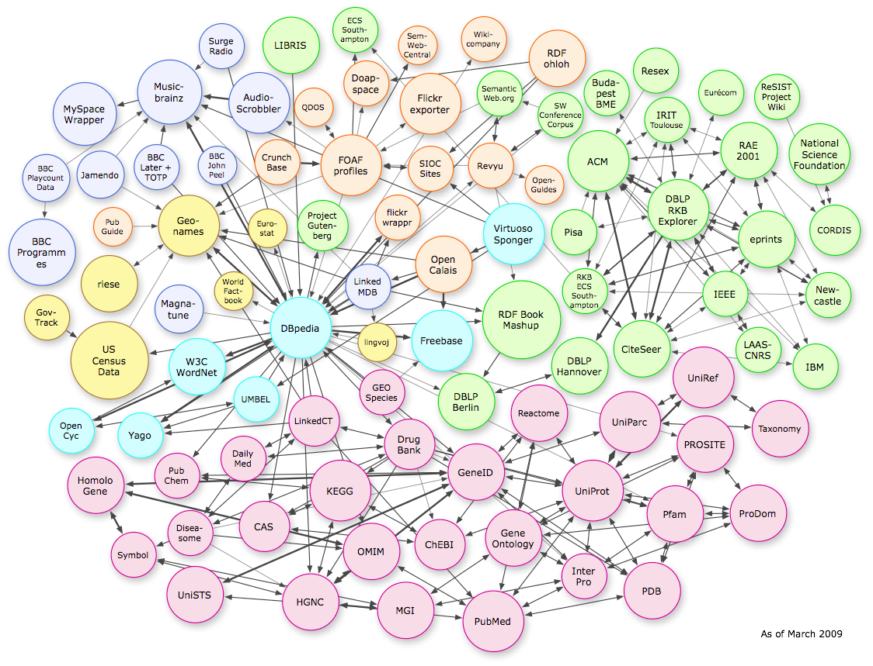
Linked Open Data: 13.1 Billion Statements and Growing
Bizer et al. Linked data–the story so far. International Journal On Semantic Web and Information Systems (2009) vol. 5 (3) pp. 1-22

Slide 36
Caveat Emptor
Remember the stock market crash of 2008?
(You know, the one that caused the deepest recession since the Great Depression?)
Remember AAA ratings on junk MBS?
It pays to look. Kick the tires.
What exactly am I getting in those 13.1 billion statements?

Slide 37
Hold that Thought
We’re going to come back to it.
But first, let’s finish with RDF, because it is truly powerful.

Slide 38
Describing Services
performsMapping
mapsTo
someResource
subject
object
This architectural feature is critical: we’re going to push the ontology
alignment problem (mapping—or transforming—data of one type into another type) onto semantically described service points.
We then automate over these ‘persisted’ human-in-the-loop points.

Slide 39
Logical Interfaces
performsMapping
mapsTo
someResource
subject
object
0
1
I’m a transcendental function
I’m periodic on 2π radians
Give me 0, I’ll give you 1

Slide 40
Logical Interfaces
performsMapping
mapsTo
cos
subject
object
foo
theta
cos
0
1
boogyBoogy
I’m a transcendental function
I’m periodic on 2π radians
Give me 0, I’ll give you 1

Slide 41
Backwards Compatibility and Robust Extensibility
performsMapping
mapsTo
cos
subject
object
theta
cos
0
-2.178184
Im(z)
Im(z)
√2i
0

Slide 42
Generality
performsMapping
mapsTo
someResource
subject
object
I compare sequences
I align reads
I display networks
I process images
I visualize your data for you
I …

Slide 43
The Technology Stack
Domain model
Higher level APIs
Programmatic control
OWL formal semantics and logic
Modeling abstraction
RDFS, XSD, basal semantics
and data types
SPARQL
RDF basal modeling layer
Triple stores, graph DBs, etc.
XML messaging layer
parsing
IRIs, URIs, HTTP
Universal namespace
and web protocols

Slide 44
Ontologies
So what about those 13.1 billion statements?
What I get is a universal data model (RDF) in a common syntax (RDF/XML), but I am missing both a shared semantic and computable logic.
I get a bunch—13.1 billion—statements of which I have virtually no chance of inferring cross-site meaning.
The “solution” is to not use arbitrary tokens for tagging, but to deploy ontologies—systems of terms and their relations—both within and between data and service offerings under an OWL DL framework.

Slide 45
iPlant Semantic Web Program
This is what we are doing in the iPlant Semantic Web Services program.
We are building a capability for high-throughput semantic description, discovery, engagement, and response handling.
This includes the capability to allow iPlant and third-parties to create extensible, transparent ontologies for their explicit use in semantic web services.

Slide 46
Data Visualization
So how does this engage with data visualization?

Slide 47
Commonalities in Data Visualization
Basic visual motifs go a long way to providing generic, powerful conceptual frameworks:
Motifs:
A line (relative order and quantitative differences)
A table (matrix; tensor)
A plot (n-dimensional functional)
A tree (hierarchical)
A network (arc-node relationships)
Geographic
Annotated images, etc.
Attributes:
Color
Size
Position
Resolution at scale
Point of view (3-dimensional rotation)
See http://flare.prefuse.org/demo
Disclaimer: Flare is ActionScript; to date, iPlant is concentrating on other technologies

Slide 48
Commonalities in Data Visualization
Basic visual motifs go a long way to providing generic, powerful conceptual frameworks:
Motifs:
A line (relative order and quantitative differences)
A table (matrix; tensor)
A plot (n-dimensional functional)
A tree (hierarchical)
A network (arc-node relationships)
Geographic
Annotated images, etc.
Attributes:
Color
Size
Position
Resolution at scale
Point of view (3-dimensional rotation)
Motif Ontology (Classes):
Linear
Relational
Functional
Hierarchical
Network
Geographic
Annotated images, etc.
Predicates (incl. inferred):
Properties
Relations
Relevance
+ Critical:
Units
Comparator services

Slide 49
Recipe
Create a visualization motif ontology
Associate data with the visualization motif ontology
Build semantically-aware visualizers and comparators
Add user customization and social networking
Join services to a semantic framework
Disclaimer: An actual project plan should not follow the recipe like a cookbook, but should include aspects of all five stages simultaneously under a carefully scoped proof-of-concept.

Slide 50
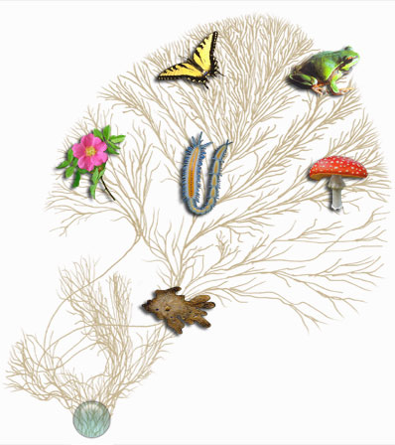
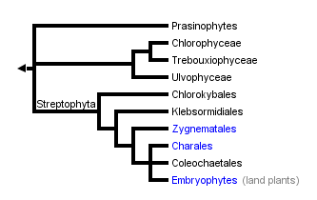
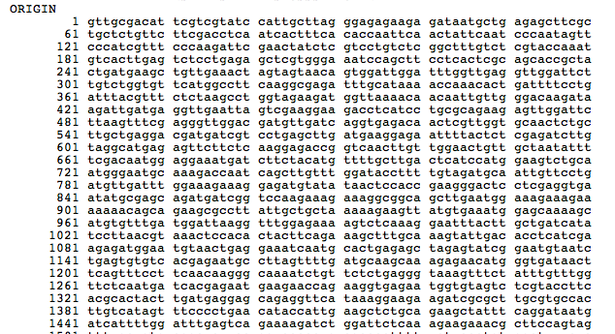
The Vision
Generic, extensible visualization as an integral component to scientific discovery
iPToL
Ultra High-Throughput Seq
(200 Gbp/run)
iPG2P

Slide 51
Semantic Web Program at iPlant
Infrastructure
Academics
Semantic web software engineering in Tucson, AZ
St. John’s College, Santa Fe, NM
Four work-study students
Grand Challenges
Research
Industry
Ultra High Throughput Sequencing
NSF
Meetings
On-site a post-doc at the expert firm Clark & Parsia in Washington, D.C.
Engage C&P for expertise
DataONE
Plant & Animal Genome 2010
June 2010 Semantic Web Workshop
Attribution: W3C Semantic Web Logo

Slide 52
Acknowledgements
Thanks to:
iPlant Collaborative
St. John’s College
NSF grants #0943879 and #EF-0735191
SSWAP Collaborators Soybase, Gramene, LIS

